Slide 1
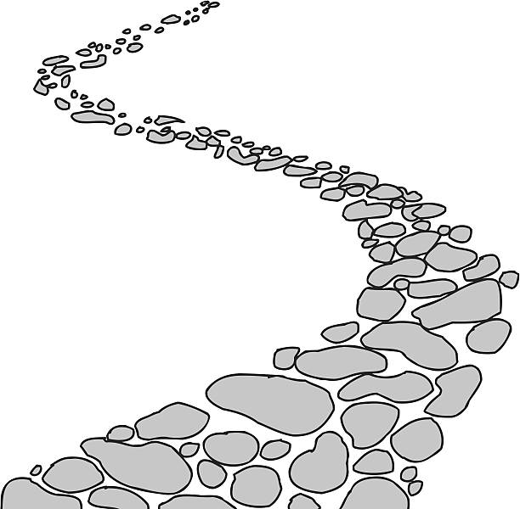
Walking the Path
~ Walking the Path of Gratitude~
Monday 22nd January 2024
Brentwood Diocese Education Service

Slide 2
Walking the path of gratitude
Thank you, God, for the life you have blessed me with.
Thank you for the opportunities that I have been given
and for the strength to make the most of them.
Thank you for your unconditional love and support,
which sees me through challenges and keeps me going.
You are an ever-present source of comfort and hope,
and I am deeply grateful for all that you do for me.
Amen
BDES

Slide 3
BDES

Slide 4
In Sunday’s Gospel Reading …
Sunday 21st January 2024 :
In the Gospel of Mark,
Jesus proclaims :
“The Kingdom of God is close at hand.”
BDES

Slide 5
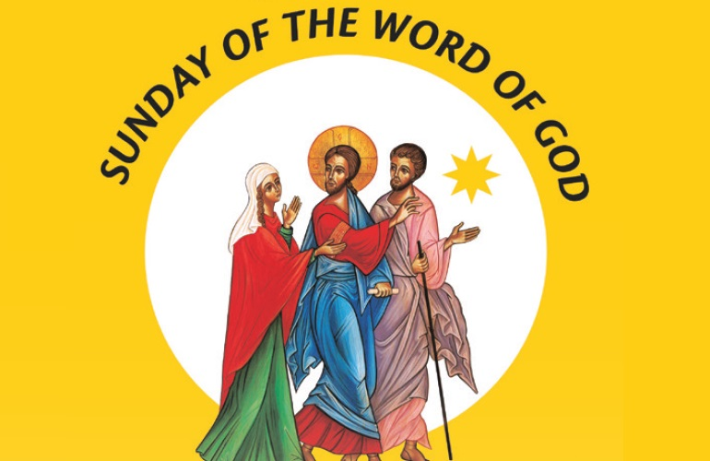
21st January
BDES

Slide 6
Reflection
BDES

Slide 7
Preparing for World Youth Day 2027
“The Gospel is for everyone.”
- Pope Francis,
World Youth Day 2023
BDES

Slide 8
SS. Timothy and Titus
26th January
Pope Benedict XVI discussed these companions of St Paul and early bishops during a general audience on 13th December 2006, noting “their readiness to take on various offices” in “far from easy” circumstances. Both saints, the Pope said, “teach us to serve the Gospel with generosity, realizing that this also entails a service to the Church herself.”
Both Timothy and Titus received letters from St Paul, included in the Bible!
BDES

Slide 9
Jerusalem: The Via Dolorosa
The Via Dolorosa or Way of Sorrows is a processional route in the Old City. It represents the path that Jesus took on the way to His crucifixion. The route leads from the site of the Antonia Fortress, where Jesus was condemned, to the Church of the Holy Sepulchre, a distance of about half a mile. Since the 18th century, Christian pilgrims follow 14 Stations of the Cross, the last five of which are inside the Church of the Holy Sepulchre, which contains the site of Calvary.
BDES

Slide 10
Walking the Path
~ Walking the Path of Gratitude~
Monday 22nd January 2024
Brentwood Diocese Education Service

