Slide 1
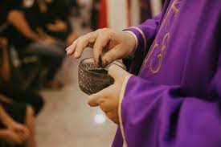
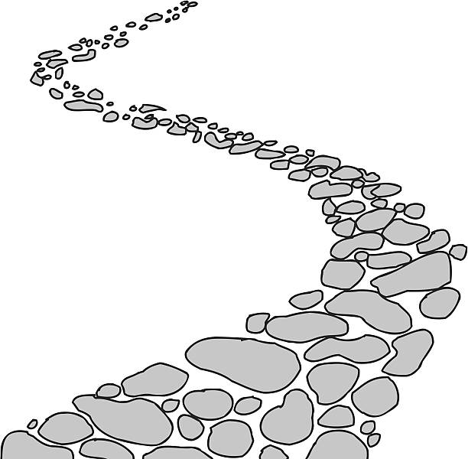
Walking the Path
~ Walking the Path of Gratitude~
Monday 12th February 2024
Brentwood Diocese Education Service

Slide 2
Walking the path of gratitude
This week sees the beginning of Lent.
Ash Wednesday begins the 40 days of Lent,
a time when we remember that
Jesus spent 40 days in the desert, fasting and resisting temptation.
The day before Ash Wednesday,
known by many as “Shrove Tuesday” or “Fat Tuesday”,
is a chance to feast and indulge –
maybe even eat a pancake or two.
We do this in preparation of our own fasting on
Ash Wednesday and throughout Lent.
BDES

Slide 3
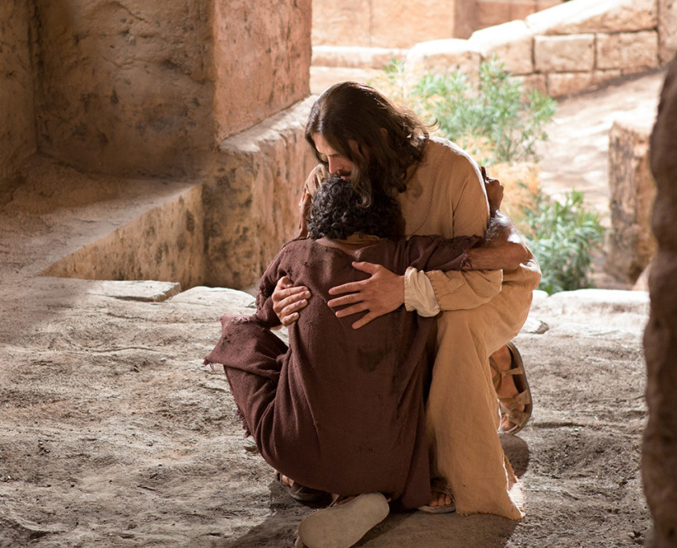
In Sunday’s Gospel Reading …
Sunday 11th February 2024
The Gospel of Mark,
Jesus heals with the words :
“Be made clean.”
BDES

Slide 4
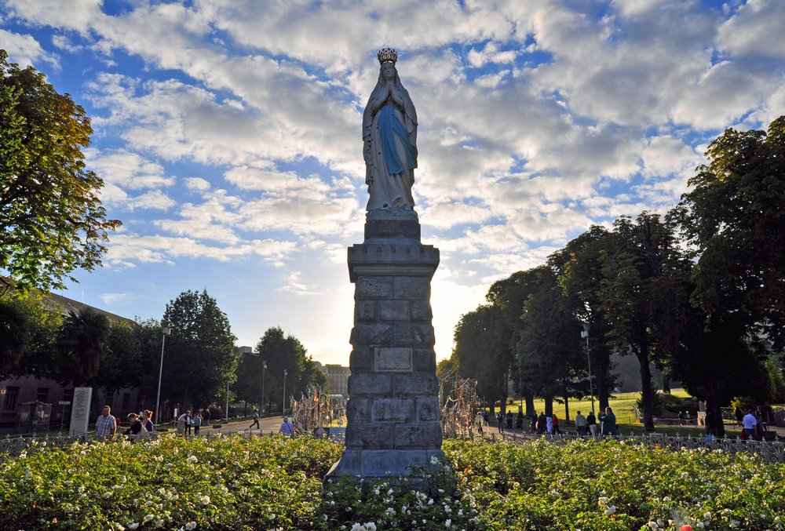
Reflection
Mother of Mercy,
Health of the Sick, Comforter of the Afflicted,
you already know my sufferings and my needs;
look on me with mercy.
At Lourdes you have given us a sign of your compassion and your love. Many sufferers have already found healing
through your intercession.
I come before you with confidence in your motherly care.
O Mary, conceived without sin,
pray for us who have recourse to you.
Amen.
BDES

Slide 5
Preparing for World Youth Day 2027
“God loves you.
Never doubt this,
whatever may happen to you in life.
At every moment,
you are infinitely loved.”
- Pope Francis,
World Youth Day, 2023
BDES

Slide 6
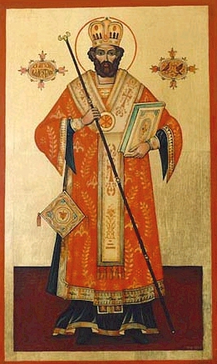
St. Valentine: 14th February
Saint Valentine, officially known as Saint Valentine of Rome, is a third-century Roman saint widely celebrated on 14th February and commonly associated with “romantic love”.
One common story about St. Valentine is that he was under house arrest with a judge named Asterius. While discussing religion with the judge, Valentine spoke of the power of the love of Jesus. As proof, Valentine restored the vision of the judge’s blind daughter.
Legend also says that Valentine refused to sacrifice to pagan gods, and sent a farewell note on the day of his execution to the girl he had healed, signed :
“Your Valentine”.
BDES

Slide 7
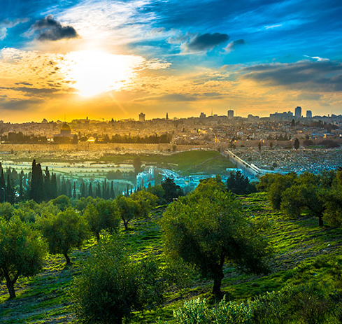
Jerusalem: The Mount of Olives
Several key events in the life of Jesus, as related in the Gospels, took place on the Mount of Olives, and in the Acts of the Apostles it is described as the place from which Jesus ascended to heaven.
Because of its association with both Jesus and Mary, the mount has been a site of Christian worship since ancient times and is today a major site of pilgrimage.
BDES

Slide 8
Walking the Path
~ Walking the Path of Gratitude~
Monday 12th February 2024
Brentwood Diocese Education Service

