Slide 1
Brentwood Diocesan Education Service
~ Prayer and Liturgy Directory ~
Maria Shepherd - Diocesan Deputy Director of Education
Grace Corry – Diocesan Primary Link Advisor
Wednesday 13th March 2024
Brentwood Diocese Education Service
“Supporting Catholic schools to provide excellent education where pupils flourish, and Christ is made known to all”

Slide 2
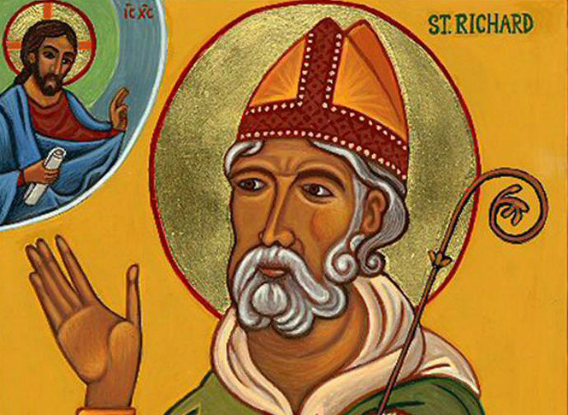
Prayer
Thanks be to thee, my Lord Jesus Christ, for all the benefits thou hast given me, for all the pains and insults thou hast borne for me. O most merciful redeemer, friend and brother, may I know thee more clearly, love thee more dearly, and follow thee more nearly, day by day. Amen.
BDES

Slide 3
BDES

Slide 4
Catholic Education : Current Context
WHERE WE ARE NOW … AND WHERE WE ARE HEADED
CSI (Catholic Schools Inspection) – launched September 2022
(in Brentwood, from January 2023)
RED (Religious Education Directory) – issued March 2023,
required implementation by September 2025 for KS3
required implementation by September 2026 for EYFS-KS2
(RECD 2012 can remain in place until 2026 for EYFS-KS2 or you implement RED)
PLD (Prayer and Liturgy Directory) – issued September 2023,
required implementation for all by September 2025
RED (Religious Education Directory) – KS4 / KS5 working party under CES
RE Adviser to be (re-)constituted in 2023-24 (especially re. Core RE)
CLMD (Catholic Life and Mission Directory) – proposed for the near future
BDES

Slide 5
Key Documents
WHERE WE ARE NOW … AND WHERE WE ARE HEADED
RECD (Religious Education Curriculum Directory) – implementation from 2012
CSI (Catholic Schools Inspection) – launched September 2022
(in Brentwood, from January 2023)
RED (Religious Education Directory) – issued March 2023,
required implementation by September 2025 for KS3
required implementation by September 2026 for EYFS-KS2
PLD (Prayer and Liturgy Directory) – issued September 2023,
required implementation by September 2025
RED (Religious Education Directory) – KS4 / KS5 working party under CES
RE Adviser to be (re-)constituted in 2023-24 (especially re. Core RE)
CLMD (Catholic Life and Mission Directory) – proposed for the near future
BDES

Slide 6
Key Documents
WHERE WE ARE NOW … AND WHERE WE ARE HEADED
RECD (Religious Education Directory) – required implementation from 2012
CSI (Catholic Schools Inspection) – launched from September 2022
(in Brentwood, from January 2023)
RED (Religious Education Directory) – launched February 2023, issued March
2023, required implementation by September 2025 for EYFS – KS3
PLD (Prayer and Liturgy Directory) – intended launch February 2023,
postponed until later in 2023, required implementation by September 2025
RED (Religious Education Directory) – KS5 working party under CES
RE Adviser to be (re-)constituted in 2023-24 (especially re. Core RE)
CLMD (Catholic Life and Mission Directory) – proposed for the near future
BDES

Slide 7
Key Documents
WHERE WE ARE NOW … AND WHERE WE ARE HEADED
RECD (Religious Education Directory) – required implementation from 2012
CSI (Catholic Schools Inspection) – launched from September 2022
(in Brentwood, from January 2023)
RED (Religious Education Directory) – launched February 2023, issued March
2023, required implementation by September 2025 for EYFS – KS3
PLD (Prayer and Liturgy Directory) – intended launch February 2023,
postponed until later in 2023, required implementation by September 2025
RED (Religious Education Directory) – KS5 working party under CES
RE Adviser to be (re-)constituted in 2023-24 (especially re. Core RE)
CLMD (Catholic Life and Mission Directory) – proposed for the near future
BDES

Slide 8
Key Documents
To follow You more nearly
The Catholic Life and Mission Directory
for Catholic Schools , Academies and Colleges in England and Wales
WHERE WE ARE NOW … AND WHERE WE ARE HEADED
RECD (Religious Education Directory) – required implementation from 2012
CSI (Catholic Schools Inspection) – launched from September 2022
(in Brentwood, from January 2023)
RED (Religious Education Directory) – launched February 2023, issued March
2023, required implementation by September 2025 for EYFS – KS3
PLD (Prayer and Liturgy Directory) – intended launch February 2023,
postponed until later in 2023, required implementation by September 2025
RED (Religious Education Directory) – KS5 working party to be re-consCES
RE Adviser to be (re-)constituted in 2023-24 (especially re. Core RE)
CLMD (Catholic Life and Mission Directory) – proposed for the near future
Catholic Life and Mission Directory
BDES

Slide 9
BDES

Slide 10
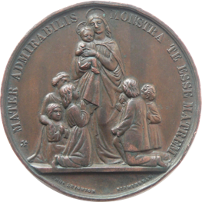
BDES

Slide 11
BDES

Slide 12
BDES

Slide 13
BDES

Slide 14
BDES

Slide 15
?
BDES

Slide 16
“I would like to help us to rekindle our wonder for the beauty of the truth of the Christian celebration, to remind us of the necessity of an authentic liturgical formation, and to recognize the importance of an art of celebrating that is at the service of the truth of the Paschal Mystery and of the participation of all of the baptized in it, each one according to his or her vocation.”
(Desiderio Desideravi, 62)
BDES

Slide 17
In these words, the Holy Father Pope Francis expresses his hopes for the faithful and reverent celebration of the liturgy throughout the Church. He invites us to be caught up in wonder and awe at the great gift which is offered by God and received by those who pray and worship through liturgy. He stresses the importance of formation for liturgical participation. He points to the vocation of all the baptised. The words of Pope Francis have a particular resonance in our Catholic schools, where our children and young people are formed in the art of prayer, learn about the mysteries of God, and grow in an understanding of their own unique call to mission. The aim of this Directory is to assist school communities in their endeavours to implement the vision of the Church for prayer and liturgy within their local setting.
- Emeritus Archbishop George Stack and Bishop Marcus Stock
BDES

Slide 18
In Catholic schools and colleges across England and Wales, teachers and other adult members of the school community have long supported the life of prayer and liturgy within their schools with imagination and dedication. We hope that this Directory will affirm what is good practice, while also setting a high bar to which all can aspire. ‘All this richness is not far from us. It is in our churches, in our Christian feasts, in the centrality of the Lord’s Day, in the power of the Sacraments we celebrate. Christian life is a continual journey of growth. We are called to let ourselves be formed in joy and in communion’ (Desiderio Desideravi, 62).
- Archbishop George Stack and Bishop Marcus Stock
BDES

Slide 19
In Catholic schools and colleges across England and Wales, teachers and other adult members of the school community have long supported the life of prayer and liturgy within their schools with imagination and dedication. We hope that this Directory will affirm what is good practice, while also setting a high bar to which all can aspire. ‘All this richness is not far from us. It is in our churches, in our Christian feasts, in the centrality of the Lord’s Day, in the power of the Sacraments we celebrate. Christian life is a continual journey of growth. We are called to let ourselves be formed in joy and in communion’ (Desiderio Desideravi, 62).
- Archbishop George Stack and Bishop Marcus Stock
BDES

Slide 20
NB Religious order schools may have additional documents that align with the charism of their order.
BDES

Slide 21
NB Religious order schools may have additional documents that align with the charism of their order.
BDES

Slide 22
NB Religious order schools may have additional documents that align with the charism of their order.
BDES

Slide 23
NB Religious order schools may have additional documents that align with the charism of their order.
BDES

Slide 24
NB Religious order schools may have additional documents that align with the charism of their order.
BDES

Slide 25
across all Catholic schools in a diocese
NB Religious order schools may have additional documents that align with the charism of their order.
BDES

Slide 26
People who support those who are responsible for prayer and liturgy
BDES

Slide 27
BDES

Slide 28
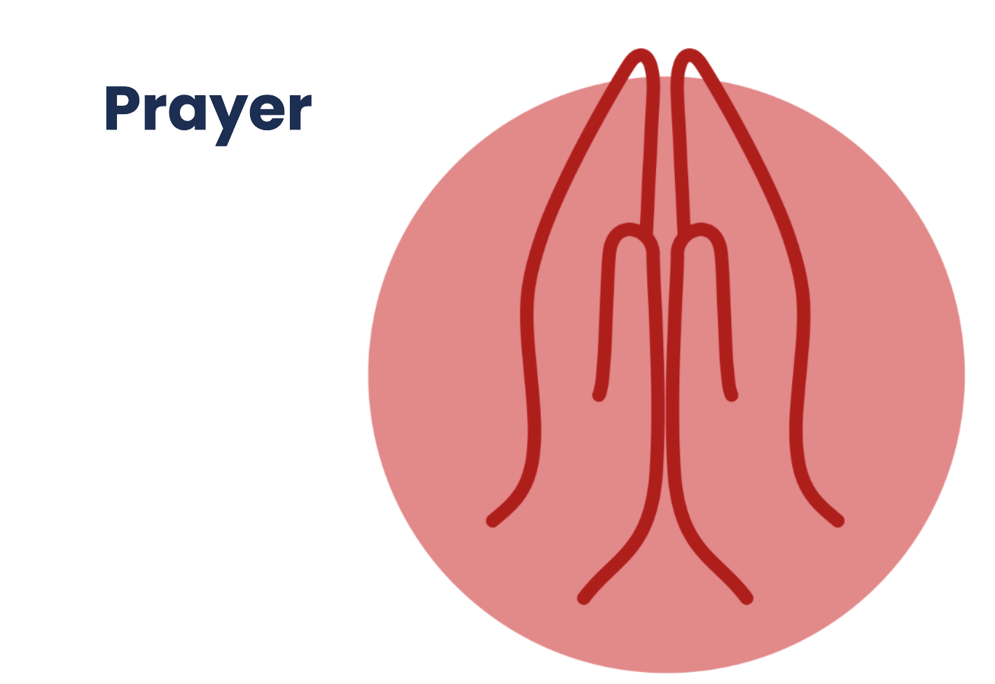
BDES

Slide 29
BDES

Slide 30
BDES

Slide 31
Liturgical Prayer
BDES

Slide 32
x
Liturgical Prayer
BDES

Slide 33
Liturgical Prayer
THE TERM
LITURGICAL PRAYER
WAS NOT APPROVED
BY THE BISHOPS
BDES

Slide 34
BDES

Slide 35
BDES

Slide 36
BDES

Slide 37
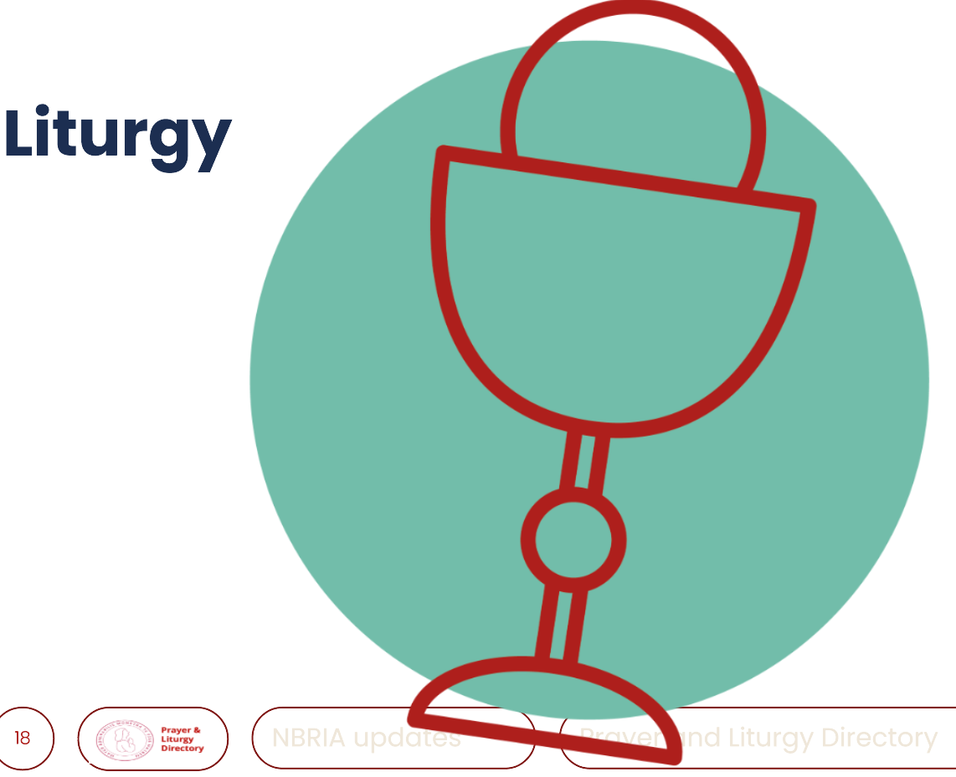
BDES

Slide 38
BDES

Slide 39
Prayer
Simple structure
One or two elements
Balance of familiarity and creativity
Celebrations of the word
Structured (often in four parts)
Elements drawn from liturgy
Place of scripture
Contrasts and creativity
Liturgy
Taken from official books
Complex structures
Many elements
BDES

Slide 40
BDES

Slide 41
BDES

Slide 42
BDES

Slide 43
BDES

Slide 44
BDES

Slide 45
Good practice in using the Directory
Various sections of the Directory can be used to provide focused guidance on particular aspects of prayer and liturgy.
For example, sections could be used:
• in developing school policies and systems
• in directly planning prayer and liturgy
• as a focus for evaluating practice
• in staff formation
• as reference points for Catholic school inspectors to support their judgements.
BDES

Slide 46
Prayer and Liturgy Directory-responsibilities
Governance
The governors, as guardians of the Catholic school’s life and mission, have a responsibility to ensure that:
• prayer and liturgy are central to the Catholic life of the school and therefore are in line with the guidance set out by the Prayer and Liturgy Directory
• there is a named person(s) who is responsible for prayer and liturgy in the school (the Prayer and Liturgy Coordinator)
• the prayer and liturgy policy is updated regularly and shared with all stakeholders
• there is a budget for prayer and liturgy that reflects its centrality to the life of a Catholic school.
BDES

Slide 47
Prayer and Liturgy Directory-responsibilities-questions to consider
As Governors are there any changes you need to make to ensure prayer and liturgy are central?
Has the Prayer and Liturgy policy been updated?
Has it been shared with all stakeholders-staff, parents, governors?
Who is the named Co-Ordinator for Prayer and Liturgy?
How much is the budget for prayer and liturgy? Is it enough?
Where in your minutes is there a record of discussion about this?
BDES

Slide 48
Prayer and Liturgy Directory-responsibilities
Headteacher
The headteacher, as the spiritual leader of the school as a Catholic community, ensures that:
• prayer and liturgy are central to the Catholic life of the school and therefore are in line with the guidance set out by the Prayer and Liturgy Directory
• they work in partnership with the leader(s) for prayer and liturgy
• those responsible for prayer and liturgy in the school have been given appropriate training and formation to ensure that all guidance is followed and adhered to
• there are suitable resources for prayer and liturgy in the school
BDES

Slide 49
Prayer and Liturgy Directory-responsibilities-questions to consider
How have you as Governors supported the Headteacher to fulfil their responsibilities?
Have you checked the responsibilities have been fulfilled?
What support do you give the Headteacher in their role as Spiritual leader of the school community?
Where is the evidence of you monitoring and evaluating this?
BDES

Slide 50
Prayer and Liturgy Directory-responsibilities
Resourcing
Prayer and liturgy are central to the school’s understanding of itself as a Catholic school, and this is reflected in the annual budget allocation and available resources, including staff time, chaplaincy provision, and dedicated spaces for prayer and liturgy.
The Catholic character of the school is reflected in religious artefacts and images on display throughout the building.
Dedicated spaces for prayer and liturgy will be furnished and maintained as such, and updated to reflect the Church’s liturgical season.
Staff training and formation costs will be funded separately to ensure that all staff are able to fulfil their responsibility to contribute to the prayer and liturgical life of the school.
BDES

Slide 51
Prayer and Liturgy Directory-responsibilities-questions to consider
How have you as Governors evaluated the impact of the resourcing/provision?
BDES

Slide 52
Prayer and Liturgy Directory-responsibilities
Training and formation
All new staff will be supported during induction and beyond, so that they fully understand the responsibility they carry within their individual role for leading prayer and liturgy in the school.
Any individual training needs will be identified and addressed through training and formation.
There will also be the opportunity for whole-staff professional development at least once a year, so that all staff understand the importance of prayer and liturgy and relevant staff are well supported to lead as required.
BDES

Slide 53
Prayer and Liturgy Directory-responsibilities-questions to consider
Do you have a record of what is done for induction of new staff in regard to prayer and liturgy?
Are you informed about/do you discuss/monitor/evaluate individual training?
Are you certain there is at least annual whole staff professional development?
BDES

Slide 54
Prayer and Liturgy Directory-responsibilities
Monitoring and evaluation
Monitoring and evaluation of the quality and impact of prayer and liturgy will take place regularly, and at least annually, and involve all key stakeholders: pupils, parents, staff, clergy, and governors.
Areas for development will be identified and issues raised will be actioned and evidenced as appropriate
BDES

Slide 55
Prayer and Liturgy Directory-responsibilities-questions to consider
How does your monitoring and evaluation feed into improvement/action plans?
BDES

Slide 56
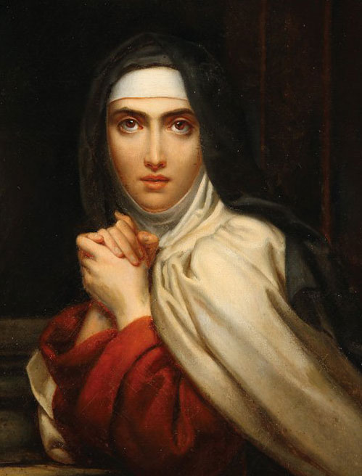
Prayer of St Teresa of Avila
Let nothing disturb you,
Let nothing frighten you,
All things are passing away: God never changes.
Patience obtains all things.
Whoever has God lacks nothing; God alone suffices.
Christ has no body now on earth but yours, no hands but yours, no feet but yours, Yours are the eyes through which to look out Christ's compassion to the world Yours are the feet with which he is to go about doing good; Yours are the hands with which he is to bless the world.”
BDES

