Slide 1

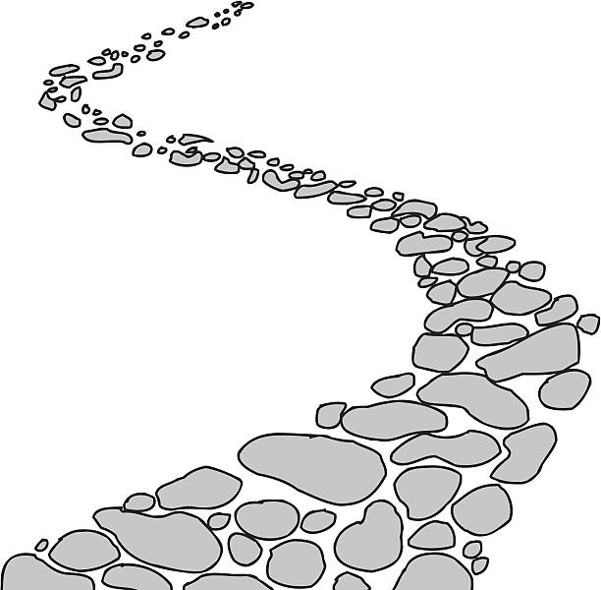

Walking the Path
~ Walking the Path of Reconciliation ~
Monday 11th March 2024
Brentwood Diocese Education Service

Slide 2

10th March 2024
BDES

Slide 3
Walking the path of reconciliation
Rejoice!
This Sunday at Mass we celebrated Laetare Sunday.
The Latin word Laetare means ‘rejoice’
and its origin is rooted in the Introit (opening chant)
for the Fourth Sunday of Lent – Laetare Jerusalem :
“Rejoice, O Jerusalem and come together all you that love her :
rejoice with joy, you that have been in sorrow.”
BE RECONCILED TO ONE ANOTHER – AND REJOICE!
BDES

Slide 4
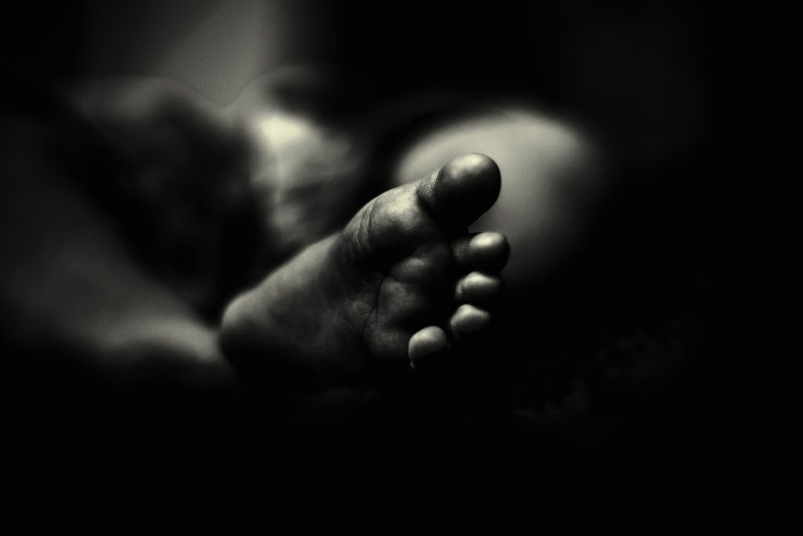
In Sunday’s Gospel Reading …
Sunday 10th March 2024 :
In the Gospel of John,
we are reminded that:
“God sent His Son.”
BDES

Slide 5

Preparing for World Youth Day 2027
“Our best dreams
are only attained
through hope, patience
and commitment.”
- Pope Francis,
Christus vivit
BDES

Slide 6
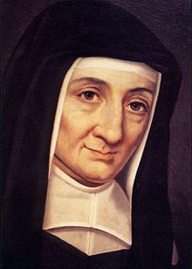
Saint Louise
de Marillac
Feast day :
15th March
Louise de Marillac (1591-1660) was a French aristocrat who received an education that prepared her for a life of comfort and security. She married in February 1613 but, sadly, her husband died in 1625. In that same year Louise met Vincent de Paul, whose collaborator she would be over the next 35 years until her death. Together, Louise and Vincent focused on those who were suffering: the sick, abandoned, illiterate, mentally ill or refugees – anyone who needed help.
She is the patron saint of social workers.
BDES

Slide 7
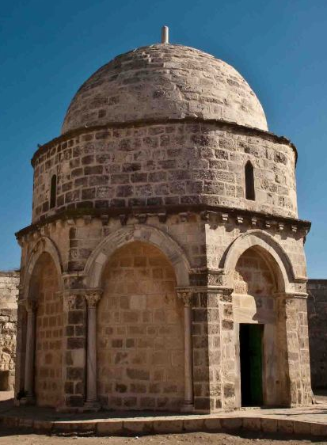
Jerusalem: Chapel of the Ascension
The Chapel of the Ascension is a chapel and shrine located on the Mount of Olives, just outside Jerusalem. Part of a larger complex consisting first of a Christian church and monastery, then a mosque, it is situated on a site traditionally believed to be the earthly spot where Jesus ascended into Heaven 40 days after His Resurrection. It houses a slab of stone believed by some to contain one of His footprints.
BDES

Slide 8
Walking the Path
~ Walking the Path of Reconciliation ~
Monday 11th March 2024
Brentwood Diocese Education Service

