Slide 1
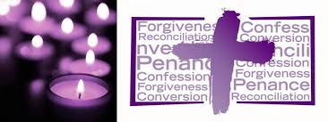
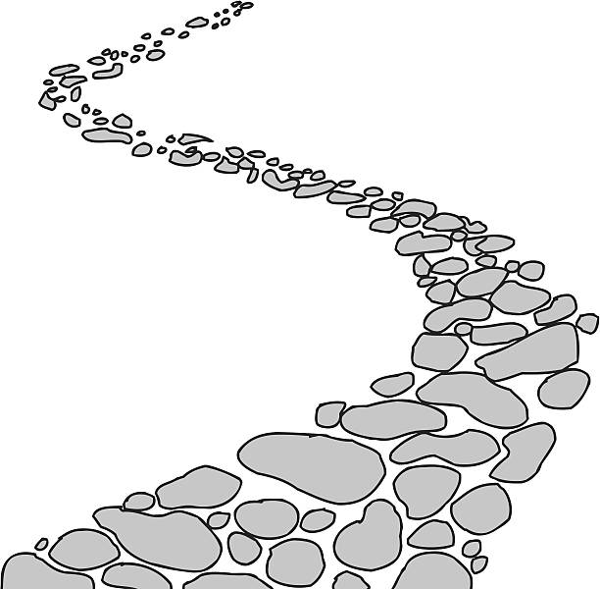
Walking the Path
~ Walking the Path of Reconciliation~
Monday 18th March 2024
Brentwood Diocese Education Service

Slide 2
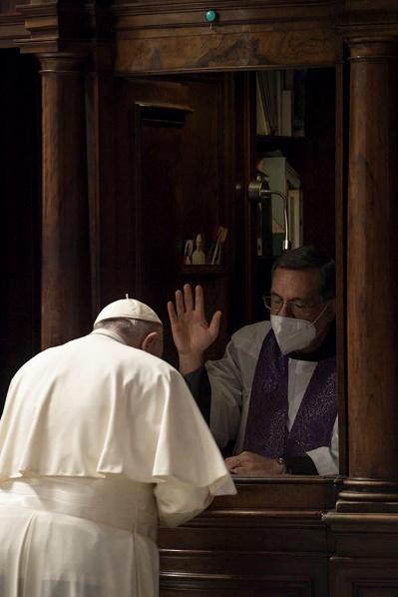
Walking the path of reconciliation
The Fifth Sunday of Lent
We are asked to pray for the penitents.
A penitent is someone who sincerely repents of wrongdoing,
resolves to make their life better,
and wants to correct anything that has offended God.
Pope Francis says :
“When I go to confession,
it is in order to be healed, to heal my soul.
To leave with greater spiritual health.
To pass from misery to mercy.”
What can you do to experience that mercy?
BDES

Slide 3
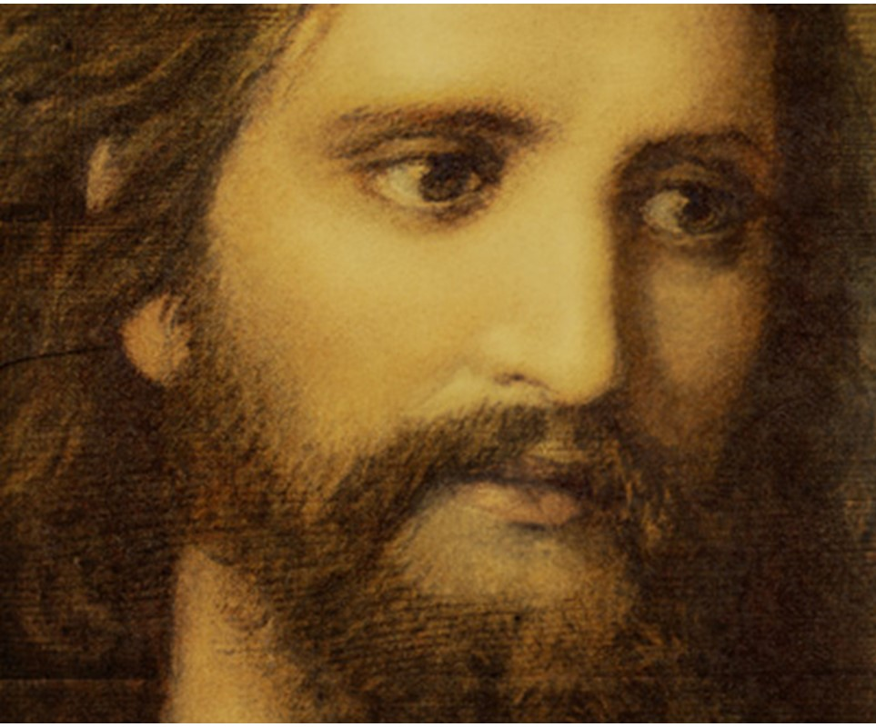
In Sunday’s Gospel Reading …
Sunday 17th March 2024 :
In the Gospel of John, some newcomers approach the disciples :
“We would like to see Jesus.”
BDES

Slide 4
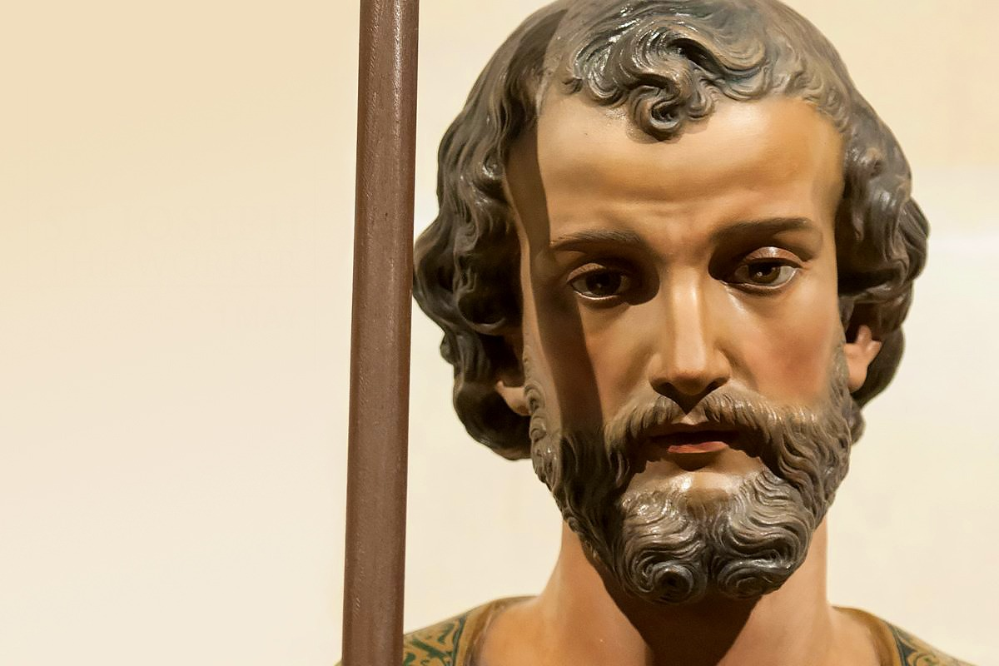
Reflection
~ 19th March is the Solemnity of St Joseph ~
Saint Joseph is the guardian and patron of the Universal Church,
as well as of numerous other causes.
“Let us allow ourselves to be “filled”
with Saint Joseph’s silence,
in a world that is often too noisy,
that encourages neither recollection nor listening
to God’s voice.”
BDES

Slide 5
Preparing for World Youth Day 2027
“Everyone is born as an original,
but many people end up dying
as photocopies.
Don’t let that happen to you!”
- Pope Francis,
Synod on Young People, 2018
BDES

Slide 6
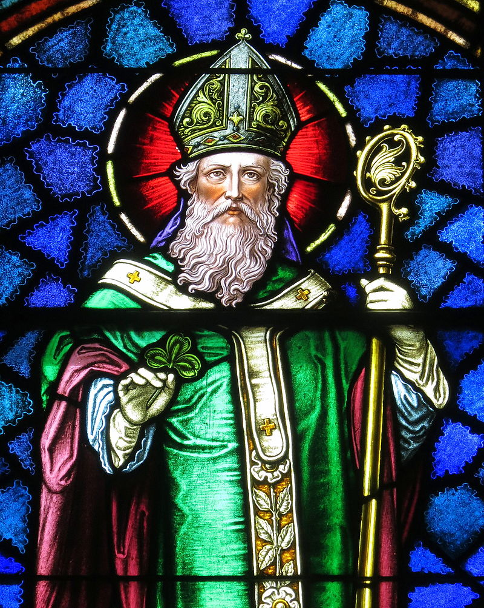
~ St Patrick’s Day : 17th March ~
Christ beside me, Christ before me, Christ behind me, King of my heart; Christ within me, Christ below me, Christ above me, never to part.
Christ on my right hand, Christ on my left hand, Christ all around me, shield in the strife; Christ in my sleeping, Christ in my sitting, Christ in my rising, light of my life.
- from St Patrick’s Breastplate
BDES

Slide 7
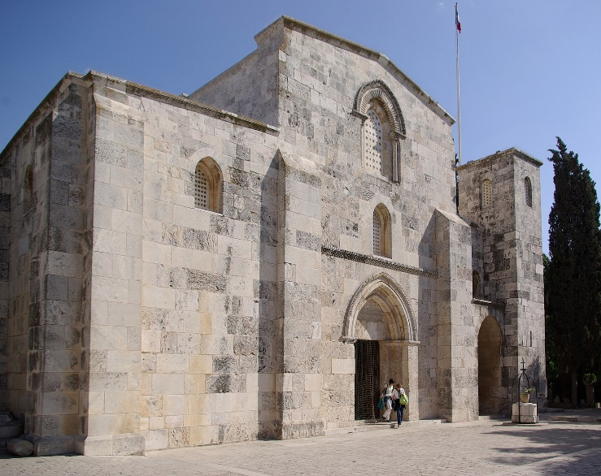
Jerusalem: Church of St Anne
The Church of Saint Anne is a French Roman Catholic church located in the Muslim Quarter of the Old City of Jerusalem, near the start of the Via Dolorosa, next to the Lion’s Gate.
The current Church of St Anne was built sometime between 1131 and 1138, during the reign of Queen Melisende.
It was built near the remains of the Byzantine basilica, over the site of a grotto believed by the Crusaders to be the childhood home of the Virgin
Mary, mother of Jesus. It is dedicated to Anne and Joachim, the parents of Mary.
BDES

Slide 8
Walking the Path
~ Walking the Path of Reconciliation~
Monday 18th March 2024
Brentwood Diocese Education Service

