Slide 1
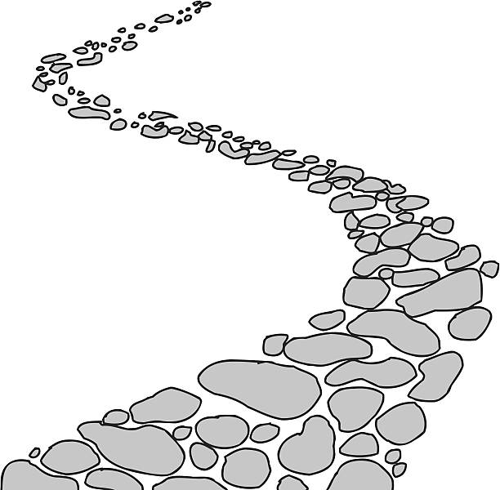
Walking the Path
~ Walking the Path of Reconciliation ~
Monday 25th March 2024
Brentwood Diocese Education Service

Slide 2
24th March 2024
BDES

Slide 3
Walking the path of reconciliation
BDES

Slide 4
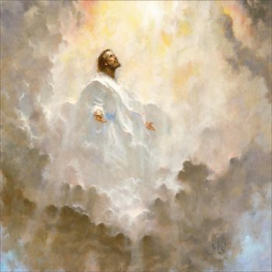
In Sunday’s Gospel Reading …
Sunday 24th March 2024 :
In the Passion narrative in St Mark’s Gospel,
Jesus tells his accusers :
“You will see the Son of Man seated at the right hand of the Power and coming on the clouds of heaven.”
BDES

Slide 5
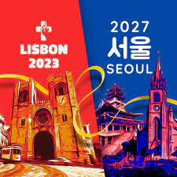
Preparing for World Youth Day 2027
“However far you may wander, he is always there, the Risen One. He calls you and he waits for you to return to him and start over again.”
- Pope Francis,
Urbi et Orbi, 2019
BDES

Slide 6
Chrism Mass : Wednesday 27th March 2024
“The fire of Easter can warm our hearts in a cold-hearted world.”
- from Bishop Alan’s Easter message on BBC Radio Essex 2018
Chrism Mass 2023, Brentwood Cathedral
BDES

Slide 7
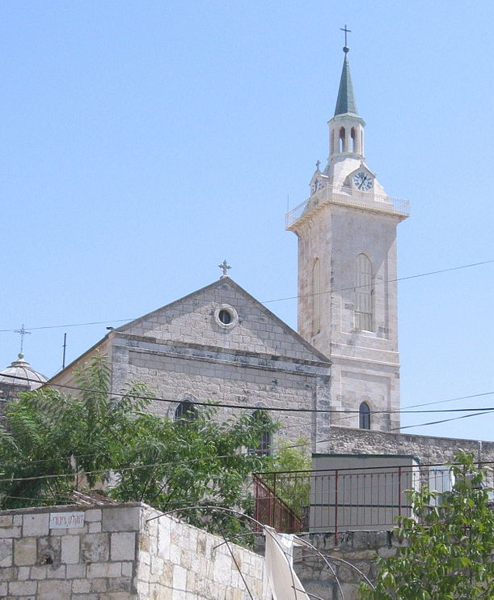
Jerusalem: Church of St John the Baptist
The birthplace of Saint John the Baptist is located in the town of Ein Karem close to Jerusalem. The church honours John’s birth from aged parents: the priest Zechariah and his wife Elisabeth, a cousin of Mary, the mother of Jesus.
The 1941-42 archaeological digs west of the main buildings uncovered a rock-cut chamber containing ceramics datable to the first century BC to 70 AD, a period that includes the lifetimes of Zechariah, Elizabeth and John.
BDES

Slide 8
Walking the Path
~ Walking the Path of Reconciliation ~
Monday 25th March 2024
Brentwood Diocese Education Service

