Slide 1
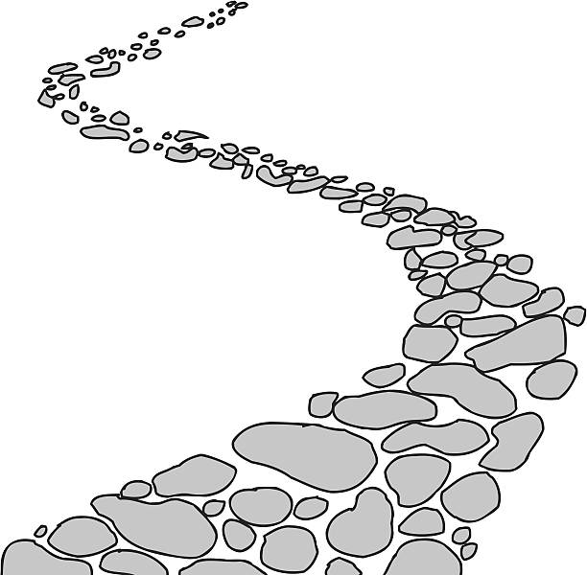
Walking the Path
~ Walking the Path of Joy ~
Monday 15th April 2024
Brentwood Diocese Education Service

Slide 2
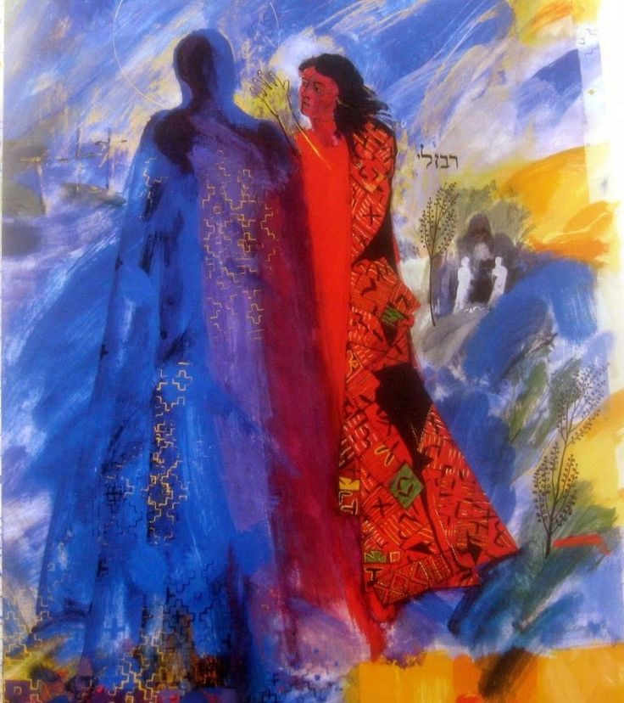
Walking the path of joy
In the accounts of the Resurrection, Mary Magdalene is transformed from sorrow to joy in the light of the Risen Lord.
She is sent forth by Jesus to proclaim a message of hope to the disciples, reminding us that we are also called to share the Good News of the Resurrection through the witness of our lives.
We are walking the path of joy.
____________________________
J.O.Y. ~ Loving Jesus, Loving Others, Loving Yourself..
BDES

Slide 3
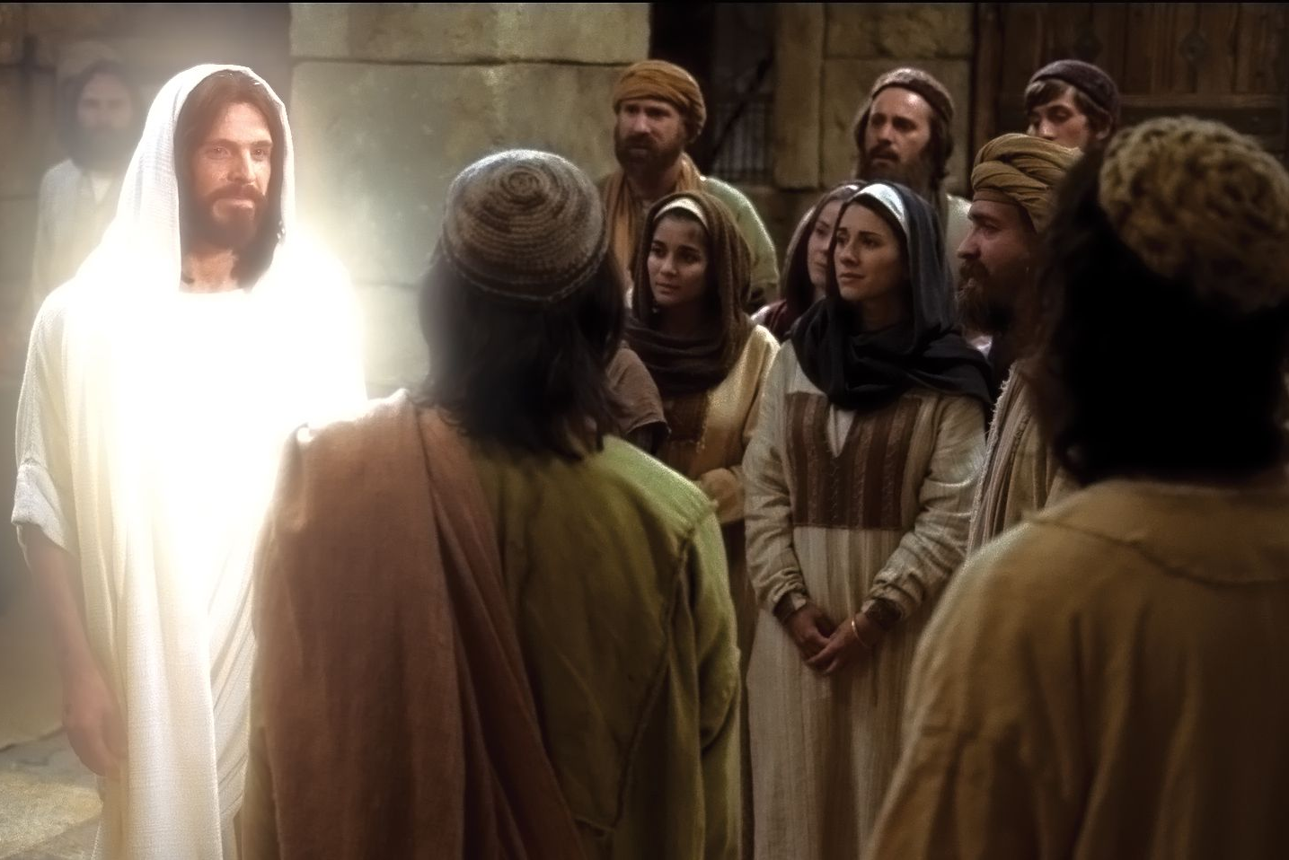
In Sunday’s Gospel Reading …
Third Sunday of Easter
14th April 2024
In the Gospel of Luke,
the Risen Lord greets His friends :
“Peace be with you.”
BDES

Slide 4
Reflection : Feed the Hungry
Lord, we pray :
let us help to give the hungry
their daily bread today;
to help provide the food they need to thrive and grow.
Pour out Your grace and love
on hungry families,
especially parents straining to feed their children despite dwindling resources.
BDES

Slide 5
Preparing for World Youth Day 2027
“I would like to say
to everyone,
with heartfelt joy,
Happy Easter to all!”
- Pope Francis,
Easter, 2023
BDES

Slide 6
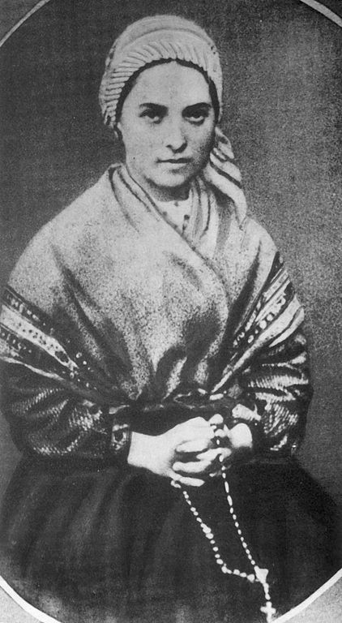
Saint Bernadette
Feast day :
16th April
Bernadette Soubirous was only 14 years old when she experienced the famous apparitions of Our Lady, the Immaculate Conception, at the grotto of Massabielle outside her home town of Lourdes between February and June of 1858. Her visions were declared as authentic by the Church in 1862 and Bernadette was canonised a saint in 1933. Lourdes has a population of only 15,000 but 5 million pilgrims visit annually.
BDES

Slide 7
The Sign of the Cross
In the name of the Father
and of the Son
and of the Holy Spirit.
Amen.
BDES

Slide 8
Walking the Path
~ Walking the Path of Joy ~
Monday 15th April 2024
Brentwood Diocese Education Service

