Slide 1
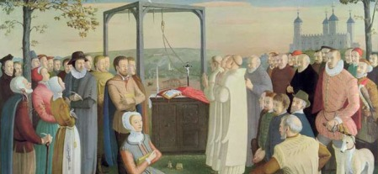
MARTYRS OF ENGLAND AND WALES

Slide 2
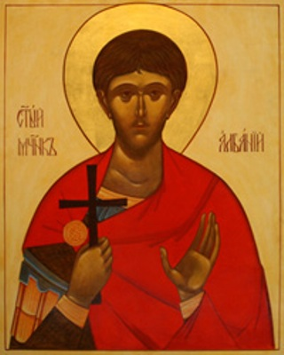
MARTYRS OF ENGLAND AND WALES
Alban was a citizen of Verulamium – an important Roman city close to present-day St Albans. He took in a Christian priest, Amphibalus, fleeing the Roman persecution of Christians. The prayer and life of the priest so impressed Alban that he accepted the Christian faith.
When the Roman authorities discovered Amphibalus, Alban exchanged clothes with him and he escaped. Alban was brought before a judge, declared his Christian faith and though tortured, refused to sacrifice to the Roman gods. As a result he was sentenced to death, the first English martyr.
St Alban of Verulamium
BDES
BDES

Slide 3
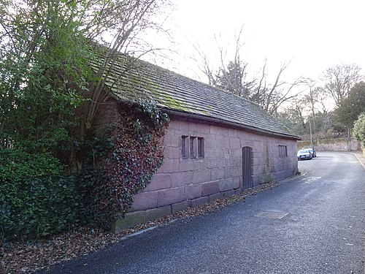
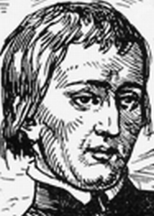
Martyrs of England and Wales : John Almond
John Almond was born 1577 in Allerton, Liverpool, and spent his childhood there and at Much Woolton, Lancashire (now Woolton, Liverpool) until at the age of eight. It is reputed that he was a student in the old school building which can be found in School Lane, Woolton, before he was taken to Ireland.
He went to the English College in Rome, at the age of twenty, where he was ordained as a priest, returning to England as a missionary in 1602.
He was arrested in 1608, and then again in 1612. In November 1612, seven priests escaped from prison.
Before his death, he prayed, distributed alms to the poor, and gave his final oration, concluding with these words: "To use this life well is the pathway through death to everlasting life". During his final speech on the scaffold he condemned regicide (killing a king), discussed the nature of grace and true repentance, and said that he conceded as much authority to King James as to any Christian prince.
John Almond was hanged, drawn, and quartered on 5 December 1612 at Tyburn, London.
BDES

Slide 4
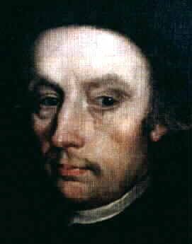
MARTYRS OF ENGLAND AND WALES
He was baptized Bryan Arrowsmith but took the confirmation name Edmund for a beloved uncle who trained English priests in Rome. His family were constantly harassed for their Catholicism and as a child saw his parents carried off to Lancaster jail by the authorities. At the age of 20 he went abroad to Douai to study for the priesthood. He was arrested, but freed under amnesty.
Edmund joined the Society of Jesus (the Jesuits) and ministered to the Catholics of Lancashire. He was arrested again 4 years later, was sentenced to death and executed at Lancaster. He was beatified in 1929 and canonized in 1970.
St Edmund Arrowsmith (1585 – 1628)
BDES
BDES

Slide 5
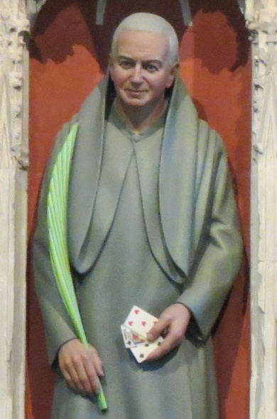
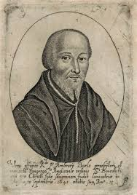
Martyrs of England and Wales : Ambrose Barlow and St Alban Roe
St Ambrose Barlow became a Benedictine monk in the year 1616. On 25 April 1641, he was arrested just after Easter Mass, and was later charged with the ‘crime’ of being a Catholic priest. He was hung, drawn and quartered on 10 September 1641 in Lancaster.
St Alban Roe (1642) was also a Benedictine who was martyred for being a priest. He was executed at Tyburn in London in 1642.
This was a period of great upheaval in England with the English Civil War beginning in 1642.
BDES

Slide 6
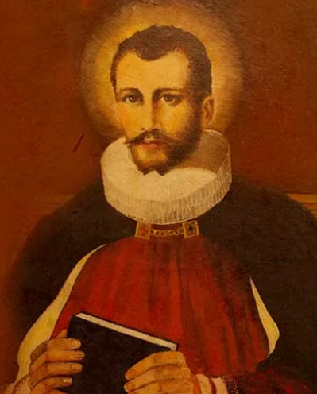
Martyrs of England and Wales : St Edmund Campion
Edmund Campion (1540- 1581) was such an accomplished scholar that he was made a fellow of St John’s College, Oxford, at the age of only 17. His Catholic faith led him to walk barefoot to Rome, where he joined the Society of Jesus.
He returned to England as a priest where he ministered to Catholics secretly until he was betrayed. He was imprisoned in the Tower of London, and sentenced to death. He was martyred at Tyburn on 1st December 1581 and canonised by Pope Paul VI in 1970.
In 1962 The Campion School in Hornchurch was founded in his honour and memory by the Society of Jesus.
BDES

Slide 7
MARTYRS OF ENGLAND AND WALES
Margaret Clitherow (1556 – 25 March 1586) suffered persecution as a Catholic during the reign of Elizabeth I; her third child, William, was born in prison where she was incarcerated for failing to attend Anglican church services. She provided safe accommodation for Catholic priests but when her son Henry went abroad to study for the priesthood, her house was searched and a priest hole was found. She was executed for refusing to plead in court.
St Margaret Clitherow
BDES

Slide 8
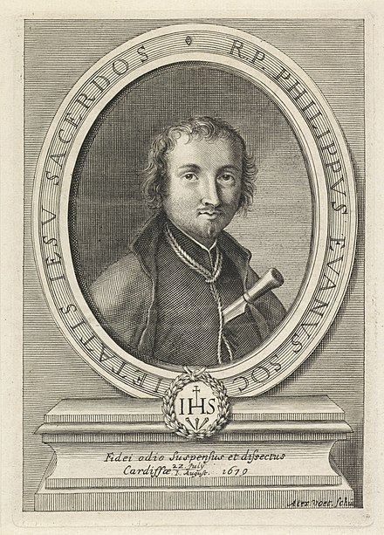
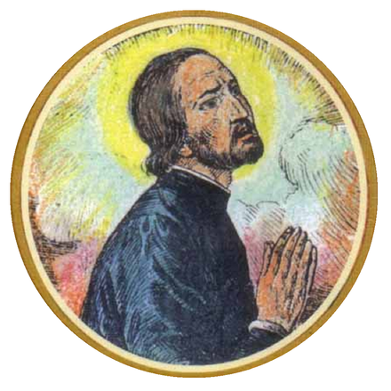
Martyrs of England and Wales : St Philip Evans and St John Lloyd
Philip Evans was born in Monmouth in 1645, and educated at Jesuit College of St. Omer. He joined the Society of Jesus in 1665, and was ordained at Liège (now in Belgium) and sent to South Wales as a missionary in 1675. He worked in Wales for four years, and despite the official anti-Catholic policy no action was taken against him. When the Titus Oates' scare swept the country both Lloyd and Evans were caught up in the aftermath.In November 1678 John Arnold, a justice of the peace and hunter of priests, offered a reward of £200 (equivalent to £30,000 in 2021) for his arrest. Despite the dangers Evans steadfastly refused to leave his flock. He was arrested at the home of Christopher Turberville at Sker, Glamorgan, on 4 December 1678. Ironically the posse which arrested him is said to have been led by Turberville's brother, the notorious priest hunter Edward Turberville.
John Lloyd, was a secular priest (a priest not associated with any religious order), he was a Breconshire man. He was educated in Ghent (now in Belgium), and from 1649 at the English College, Valladolid, Spain. He took the 'missionary oath' on 16 October 1649 to participate in the English Mission. Sent to Wales in 1654 to minister to covert Catholics, he lived his vocation while constantly on the run for 24 years. He was arrested at Turberville's house, on 20 November 1678, and imprisoned in Cardiff Gaol. There he was joined by the Jesuit, Philip Evans. These events xx events took place during the reign of Charles II.
The executions of the two priests took place on 22nd July 1679.
BDES

Slide 9
MARTYRS OF ENGLAND AND WALES
Thomas Garnet (1575 – 1608) was a Jesuit priest martyred during the reign of James I and VI. He left England to study for the priesthood in Valladolid, returned on a mission and was arrested as part of the fallout of the Gunpowder Plot. He was imprisoned, tortured and deported, but returned to continue to serve as a priest. He was captured again and executed at Tyburn, aged 32.
St Thomas Garnet
BDES

Slide 10
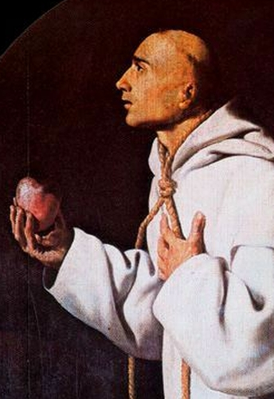
MARTYRS OF ENGLAND AND WALES
John was a Catholic priest of the Carthusian Order, and was the first Catholic martyr to die as a result of refusing to agree to take the oath of the Act of Supremacy of Henry VIII. He was also the first martyr of his order.
On the morning of the execution, from his prison cell in the Tower of London, Thomas More saw John Houghton and his two fellow Carthusian priors being dragged to Tyburn and exclaimed to his daughter: “Look, Meg! These blessed Fathers be now as cheerfully going to their deaths as bridegrooms to their marriage!” Prior John was the first to be executed.
St John Houghton (1486 – 1535)
BDES
BDES

Slide 11
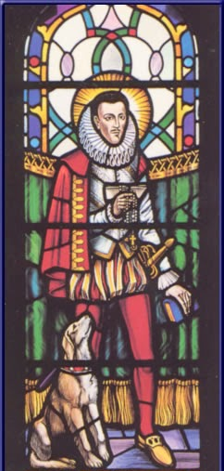
MARTYRS OF ENGLAND AND WALES
Philip was the earl of Arundel and Surrey and, although from a Catholic family, was largely indifferent to religion until his personal conversion, after which he became an enthusiastic Catholic in the midst of Elizabethan England. Arrested by authorities, he was placed in the Tower of London in 1585 and condemned to death in 1589. Although the sentence was never carried out, Philip suffered 10 years’ imprisonment in the Tower until he died of dysentery at the age of thirty eight. Beatified in 1929, he was included among the English martyrs canonized in 1970 by Pope Paul VI.
St Philip Howard (1557 – 1595)
BDES

Slide 12
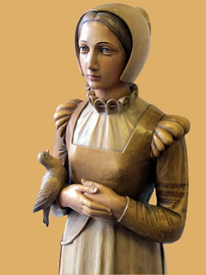
Martyrs of England and Wales : St Ann Line
St Anne Line, one of the 40 Martyrs of England and Wales, was canonised in 1970.
She was born, grew up and married in Essex. She became a Catholic some time in the 1580s despite it being illegal. She looked after a house of refuge for Catholic priests who had to hide from the authorities at the time. In 1601 she was arrested on 2nd February after allowing a number of Catholics to hear Mass. She was tried and executed in the same month. She refused to repent for hiding a priest and xxxxxxxsaid she wished it had been a thousand more.
The feast of St Anne Line is celebrated
in the first week of February.
BDES

Slide 13
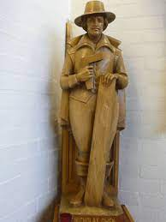
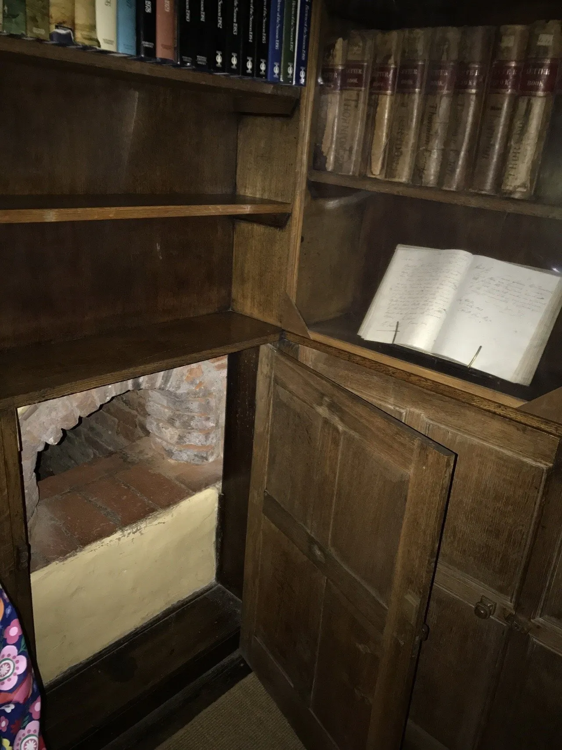
Martyrs of England and Wales : Nicholas Owen
Nicholas Owen was a carpenter by day who built the priests holes or hiding places for priests in English Catholic houses including at Ingatestone Hall in Essex.
Owen had been a servant to St Edmund Campion and then he entered the service of another Jesuit Fr. Henry Garnett. He became member of the Society of Jesus (Jesuits) and was a lay brother.
He was arrested in 1594, tortured and then released because his gaolers did not think he was important. Following this it is likely he masterminded the escape of Fr John Gerard from the Tower of London.
He was finally arrested in 1606 attempting to prevent the capture of Fr. Garnet and died as a result of torture.
BDES

Slide 14
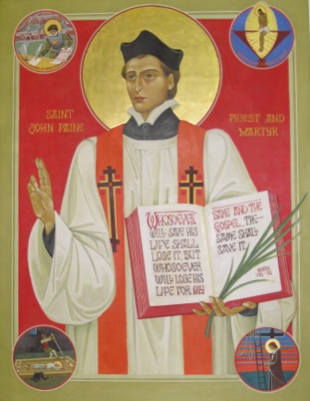
MARTYRS OF ENGLAND AND WALES
John Payne was born in Peterborough in 1532 and was ordained a priest in Douai in 1576; he returned to Elizabethan England as a missionary for the faith, basing himself in Ingatestone. He was eventually betrayed in 1581 and taken to the Tower of London where he was tortured. Finally, he was taken to Chelmsford jail to be tried at the Assizes there in 1582.
Father Payne was executed at Chelmsford on Monday 2nd April 1582. He prayed on his knees for half an hour and kissed the scaffold. He was made a saint along with the other Martyrs of England by Pope Paul VI on 25th October 1970.
Feast of St John Payne : 6th May
BDES
BDES

Slide 15
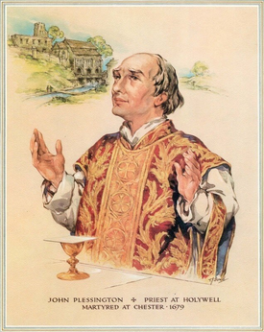
MARTYRS OF ENGLAND AND WALES
John was born into a Catholic family in Lancashire and went abroad to Spain and France to train as a priest. He then returned to England to minister to secret Catholics at Holywell and in Cheshire. For 16 years he lived undercover, under the name John Scarisbrick. In 1679 he was arrested during the Popish Plot scare caused by the infamous Titus Oates, sentenced to death for being a Catholic priest, and executed at Chester.
He was beatified by Pope Pius XI in 1929 and canonised as one of the Forty Martyrs of England and Wales by Pope Paul VI on 25th October 1970.
St John Plessington (1637 – 1679)
BDES

Slide 16
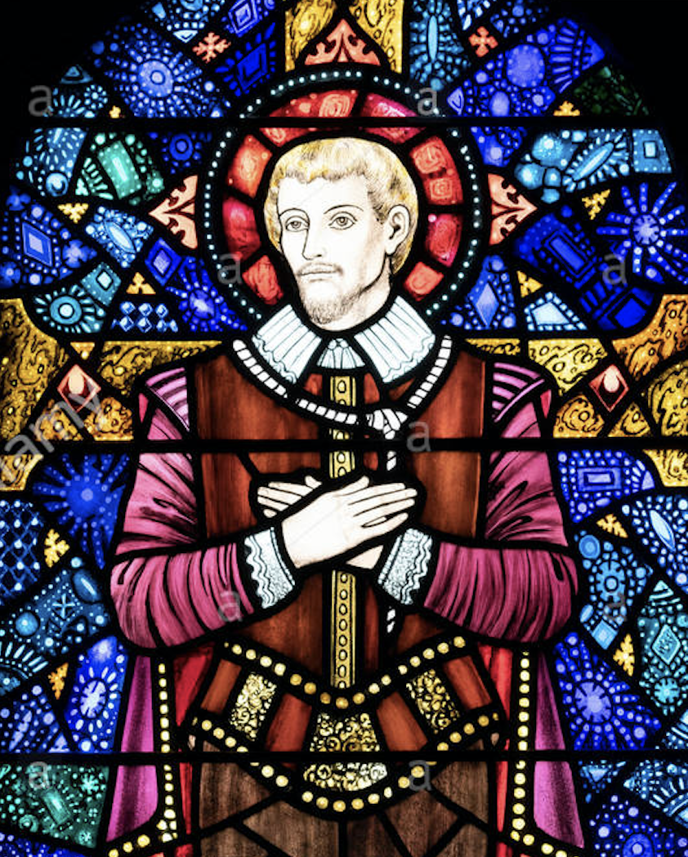
Martyrs of England and Wales : St John Rigby
St John Rigby (ca. 1570 – 21 June 1600) was a layman who was executed during the reign of Elizabeth I.
He worked as a steward for the Huddlestone family and was questioned about his beliefs. He admitted he was a Catholic and was sent to Newgate prison. Twice he was given the chance to recant, but twice refused. He told the judge that his sentence for treason “is the thing which I desire”.
As the sentence was carried out he gave the executioner who helped him up to the cart a piece of gold, saying,
“Take this in token that I freely forgive thee and others that have been accessory to my death.”
St John Rigby Catholic College in Wigan, xxxxxxxxx Greater Manchester, is named in his memory.
BDES

Slide 17
Martyrs of England and Wales : St John Rochester
A saint and martyr from our diocese.
John was the third son of John Rochester, of Terling, Essex, and Grisold Writtle, daughter of Walter Writtle, of Bobbingworth.
He joined the Carthusians, was a choir monk of the Charterhouse in London, and strenuously opposed the new doctrine of the royal supremacy under Henry VIII. Dom John Rochester and Dom James Walworth were taken to the Charterhouse of St. Michael in Hull, Yorkshire.
The government had succeeded in putting down a rising in Lincolnshire, when on 13 October 1536, the far more serious Pilgrimage of Grace broke out, mustering possibly 40,000 people. The government was desperate to stamp out any centres of resistance. Since one of the flashpoints had been the northern city of York, it was necessary for the government to mount a lesson in the city.
The two London monks were brought from Hull to York and brought before the Lord President of the North, the Duke of Norfolk, on trumped up xxxxxxxx treason charges where they were condemned to death and died on xxxxxxxxxxxxxxx 11th May 1537.
BDES

Slide 18
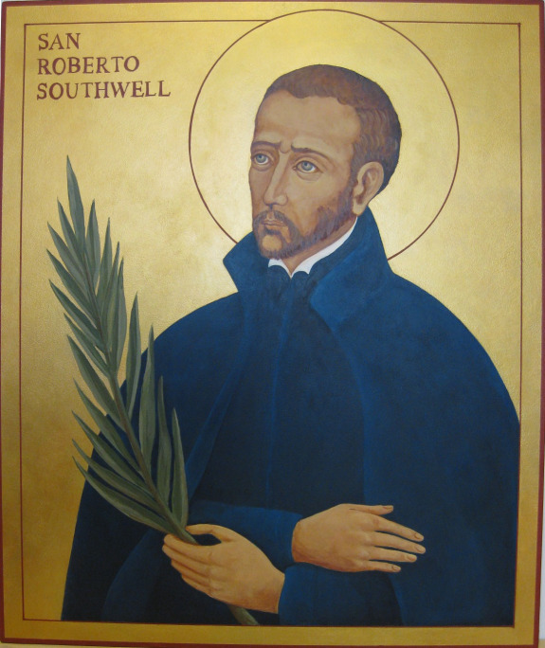
MARTYRS OF ENGLAND AND WALES
Robert Southwell was Jesuit priest, a poet, a writer of hymns, and a secret Catholic missionary in Elizabethan England.
At the age of 15, he went abroad to Douai to study, and eventually completed his studies and was ordained a priest in 1584, the year in which an act was passed in Parliament forbidding any English Catholic priests to remain in the country for more than forty days. But in 1586 Robert travelled to England to minster to Catholic families; after six years he was arrested, tortured, sentenced to death and executed at Tyburn on 25th February 1595. He was canonised in 1970.
St Robert Southwell (1561 – 1595)
BDES

Slide 19
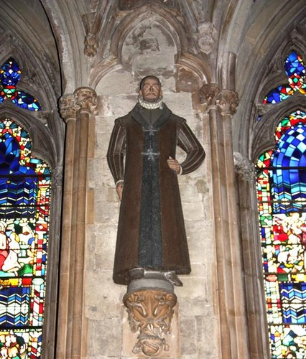
Martyrs of England and Wales : Swithun Wells
Swithun Wells (c. 1536 – 10 December 1591) was executed during the reign of Elizabeth I.
He was born in Hampshire and named after the local saint, Swithun. He was a country gentleman and one time schoolmaster whose family sheltered hunted priests. He was well-educated, a poet, musician, and sportsman. Among his travels, he had been to Rome, and had a working knowledge of Italian. He was a supporter of the Catholic priests and often arranged passage from one safe house to another. He bought his house in Gray's Inn Lane in London in 1585 and was known to welcome recusants.
He was arrested and released a number of times but in 1591 a Mass was being said in his house when the authorities broke in. He was not there but was arrested later. He was executed outside his house in Gray’s Inn Lane. There is a primary school and parish in Hampshire named after him.
BDES

