Slide 1

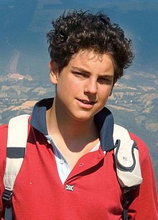
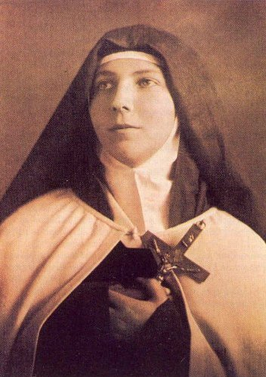
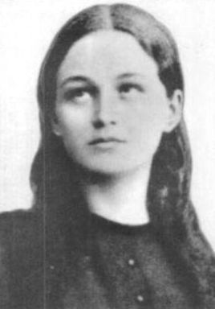
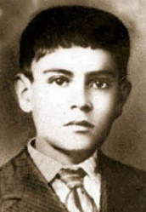
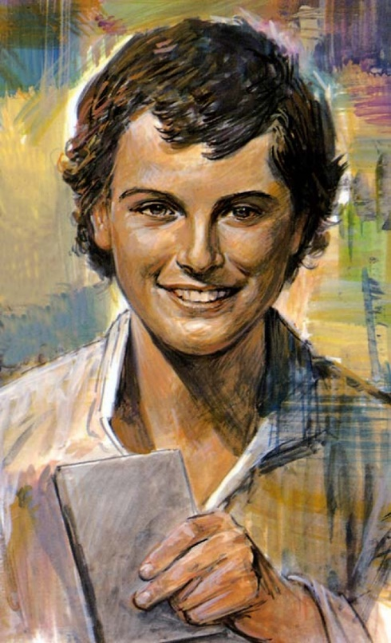
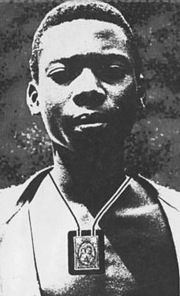
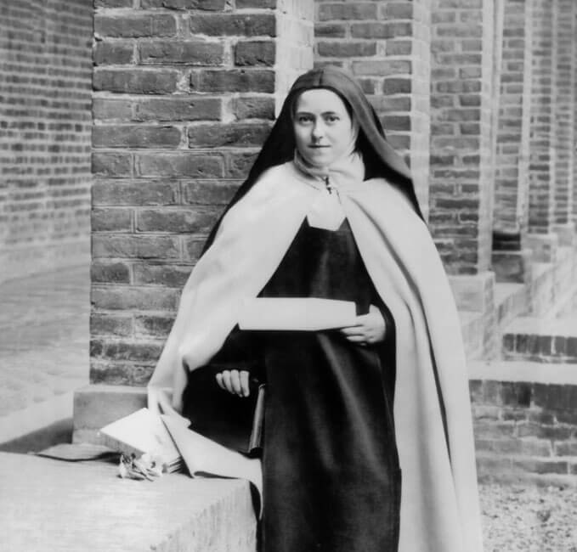
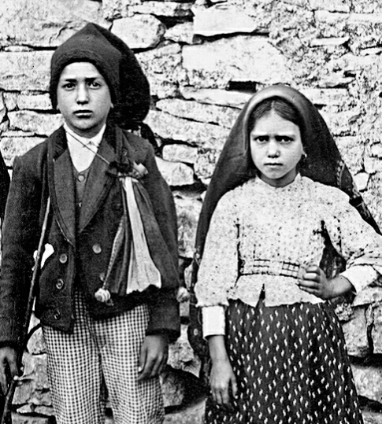
Young Saints
Brentwood Diocese Education Service

Slide 2
Young Saints # 1 : Saint Teresa of the Andes
St Teresa of the Andes died of leukaemia in 1920, aged only 19.
She was born in 1900 in Chile, as Juana Enriqueta Josephina de Los Sagrados Corazones Fernández Solar.
She was a spirited young person and often argued with her siblings. Once, when her sister Rebeca slapped her, Juana stopped herself from retaliating and kissed her on the cheek.
She was an enthusiastic swimmer and enjoyed playing the piano.
While still quite young, she read the autobiography of St Thérèse of Lisieux and was deeply affected by the example of the saint.
She became a novice of the Order of Discalced Carmelites at the age of 18. She spent time writing letters to others, encouraging them and sharing thoughts on her spiritual life.
Dying in the Spanish flu pandemic, she was allowed to take her final vows early.
BDES

Slide 3
Young Saints # 2 : Blessed Carlo Acutis
Carlo Acutis died of leukaemia in 2006, aged only 15.
He was born in 1991 in England of Italian parents and moved to Italy when he was small.
At home he would spend time with friends whose parents were going through a divorce and in school he stood up for people who were being bullied. He volunteered to work with the homeless but was also an amateur computer programmer who enjoyed films and playing on his PlayStation.
He spent time documenting Eucharistic miracles from around the world on his website.
Following a miracle attributed to him he was beatified in 2020 by Pope Francis.
BDES

Slide 4
Young Saints # 3 : Blessed Isidore Bakanja
Isidore was born in 1887 at Bokandela in what was then the Congo Free State. He became a Christian at the age of 18 and wore the scapular of Our Lady of Mount Carmel as we can see in the picture. He was told to stop spreading the Gospel by his plantation supervisor and to stop wearing the scapular. When he refused, he was repeatedly beaten and chained. As he lay dying as a result of his ill treatment, he told the plantations inspector who had rescued him : “tell them that I am dying because I am a Christian.” Missionaries in the area visited Isidore and urged him to forgive the supervisor. He assured them that he already had, declaring “When I am in heaven, I shall pray for him very much.” He was beatified on 24th April 1994 by Pope John Paul II and his feast day is 15th August.
BDES

Slide 5
Young Saints # 4 : Saint Clelia Barbieri
Clelia Barbieri died at the age of 23 in 1870.
She is seen as the youngest founder of a religious order in the history of the Catholic Church.
She was born in poverty in Bologna in Italy, where she made her First Communion at the age of eleven.
When she was fourteen she became an assistant teacher and the parish priest entrusted her with the teaching and guidance of girls in doctrine.
She then founded the religious order of the Little Sisters of the Mother of Sorrows, who looked after the poor and sick.
She died of tuberculosis and after her death her voice continued to be heard.
She was made a Saint by Pope John Paul II in 1989 and the Sisters of her order continue to work in areas like Tanzania and India today.
BDES

Slide 6

Young Saints # 5 : Saint Dominic Savio
Dominic was born in 1842 and was a student of St John Bosco. He began his studies to be a priest very early but died at the age of only 14 in 1857. St John Bosco wrote a biography of his pupil, who was a pious young man and devoted to the Catholic faith. When he was canonised a saint by Pope Pius XII in 1954, it was on account of his personal holiness and “heroic virtue”. At the time, he was the youngest non-martyr to be made a saint.
He suffered his illness patiently and was an inspiration to others. He said : “Let me do what I can this year; if I am here next year, I'll let you know what my plans are.”
Pope Pius XI described him as “small in size, but a towering giant in spirit.”
BDES

Slide 7

Young Saints #6 : Saint Jose Sanchez del Rio
Jose Sanchez del Rio died at the age of 15 in 1928.
He was a Mexican Cristero who was put to death because he refused to give up the Catholic faith.
He fought against the government, who wanted to destroy the Catholic church and was captured.
He was tortured and his parents who had tried to get him released had to watch him die.
He refused to give up his faith shouting “Viva Christo Rei!” (“Long live Christ the King!”) and as a result, following his martyrdom, the cause for his sainthood began in 1996.
He was made a saint in 2016 when Pope Francis canonised him on 16th October.
He has a seminary named after him in Minnesota in the USA.
BDES

Slide 8
Young Saints # 7 : SS Francisco and Jacinta Marto
Francisco de Jesus Marto (1908 – 1919) and Jacinta de Jesus Marto (1910 –1920) were a brother and sister from a small village near Fátima in Portugal. With their cousin Lucia they witnessed three apparitions of the Angel of Peace in 1916 and a number of apparitions of the Blessed Virgin Mary in 1917. As a result of this, Our Lady is also known as Our Lady of Fátima, which is now a major pilgrimage destination.
The two children were canonised by Pope Francis in 2017, on the 100th anniversary of the first apparition of Our Lady. They are among the youngest Catholic saints, with Jacinta being the youngest saint who did xxxxxxxx not die a martyr’s death.
BDES

Slide 9
Young Saints # 8 : Saint Therese of Lisieux
Saint Therese of Lisieux is know as the Little Flower of Jesus.
She was described by Pope Pius X as the greatest saint of modern times.
She died at the age of 24 of tuberculosis having become a nun at the age of 15. Both her parents were made saints by Pope Francis in 2015 and all 4 of her sisters became nuns
She was a member of the order of discalced Carmelites, which was an enclosed order devoted to prayer. She felt great peace in the convent.
She had a talent for explaining doctrine to others who were not as well educated as she was and was a very good teacher using ideas from the modern world to help her in this.
She described the path to heaven as the ‘little way’ imploring Jesus to be the ‘lift by which I may be raised up to God.’
Her image is available because of the photographs her sister took both before she joined and whilst she was in the convent.
BDES

