Slide 1
Walking the Path
~ Walking the Path of Joy~
Monday 22nd April 2024
Brentwood Diocese Education Service

Slide 2
Walking the path of joy
“The human heart desires joy.
We all desire joy, every family, every people
aspires to happiness.
But what is the joy that the Christian is called to live
out and bear witness to?
It is the joy that comes from the closeness of God,
from his presence in our life.”
____________________________
J.O.Y. ~ Loving Jesus, Loving Others, Loving Yourself.
BDES

Slide 3
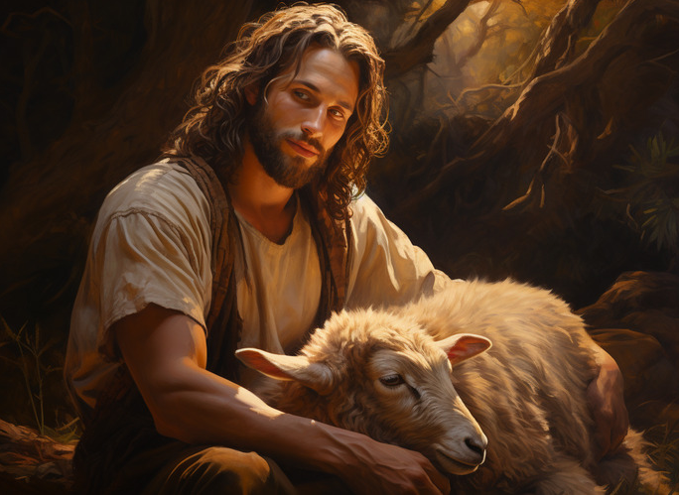
In Sunday’s Gospel Reading …
Fourth Sunday of Easter
21st April 2024
In the Gospel of John, Jesus tells us : “I AM the Good Shepherd.”
BDES

Slide 4
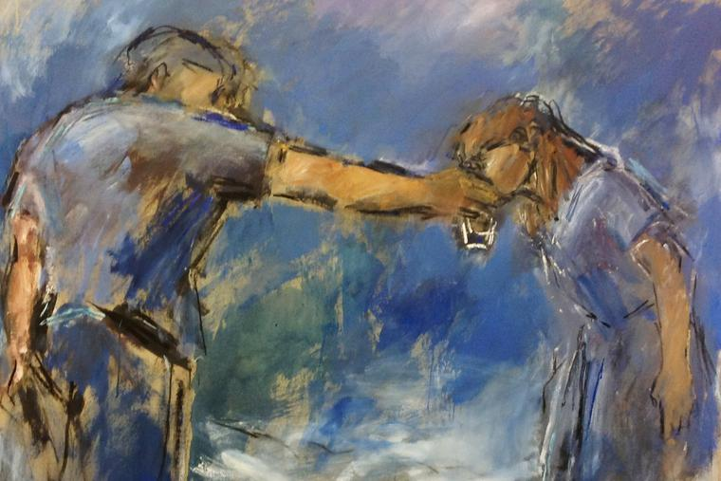
Reflection
Give the Thirsty to Drink
“For truly, I say to you, whoever gives you a cup of water to drink because you belong to Christ will by no means lose his reward.” (Mark 9 : 41)
BDES

Slide 5
Preparing for World Youth Day 2027
“Easter is the passage from
death to life.”
- Pope Francis,
Easter, 2023
BDES

Slide 6
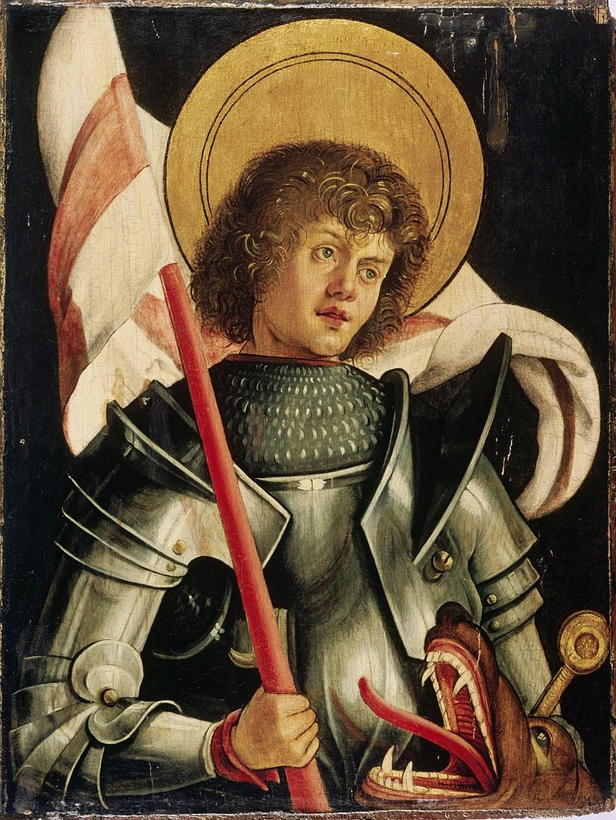
National Solemnity of St George
~ 23rd April ~
According to legend, Saint George of Lydda was a Christian soldier in the Roman army who was martyred by the emperor Diocletian in the 3rd century for refusing to renounce his faith. He is one of the Fourteen Holy Helpers, a group of saints whose intercession is believed to be effective in times of illness, and has been venerated as a military saint since the Crusades. The legend of St George and the Dragon is widely known and very popular in art.
As well as being the patron saint of England, whose flag bears his cross, St George is the patron saint of Ethiopia, Georgia, Moscow, Catalonia and Aragon in Spain, and numerous regions, cities, universities, professions and organisations.
His bones are believed to be buried in the Church of St George xxxxxx in Lod in Israel.
BDES

Slide 7
Our Father
Our Father,
Who art in Heaven,
Hallowed be Thy name.
Thy Kingdom come,
Thy Will be done on earth as it is in Heaven.
Give us this day our daily bread,
and forgive us our trespasses,
as we forgive those who trespass against us, and lead us not into temptation,
but deliver us from evil.
Amen
BDES

Slide 8
Walking the Path
~ Walking the Path of Joy~
Monday 22nd April 2024
Brentwood Diocese Education Service

