Slide 1
Walking the Path
~ Walking the Path of Joy~
Monday 29th April 2024
Brentwood Diocese Education Service

Slide 2
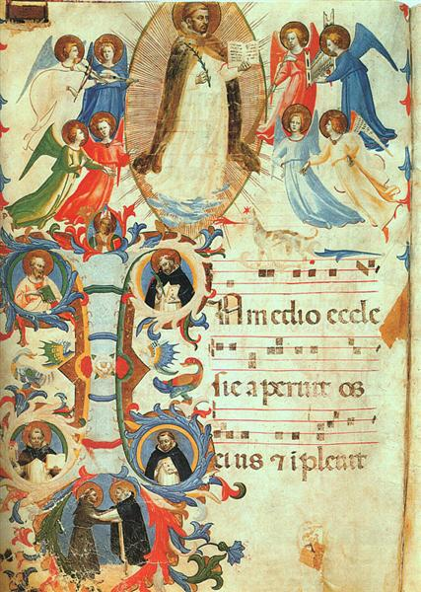
Walking the path of joy
The fifth Sunday of Easter is also known as
Cantate Sunday from the opening words of the liturgical celebration.
Sing to the Lord a new song,
for the Lord has done wonderful things,
He has revealed his righteousness
before the eyes of the nations,
alleluia, alleluia, alleluia.
____________________________
J.O.Y. ~ Loving Jesus, Loving Others, Loving Yourself.
BDES

Slide 3
In Sunday’s Gospel Reading …
Fifth Sunday of Easter
28th April 2024
In the Gospel of John, Jesus tells us : “I AM the true vine.”
BDES

Slide 4
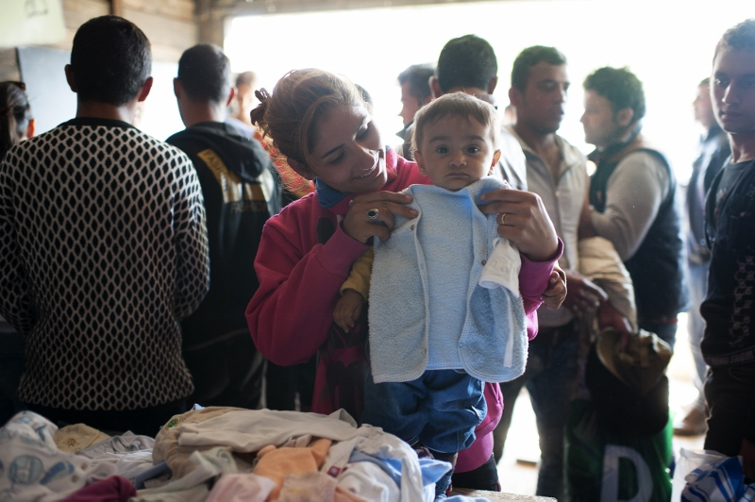
Reflection
Clothe the Naked
We can help in many ways.
Think about those who are vulnerable.
Who needs to be cloaked in dignity and reminded they are loved?
BDES

Slide 5
Preparing for World Youth Day 2027
“Easter is the passage from
sin to grace.”
- Pope Francis,
Easter, 2023
BDES

Slide 6
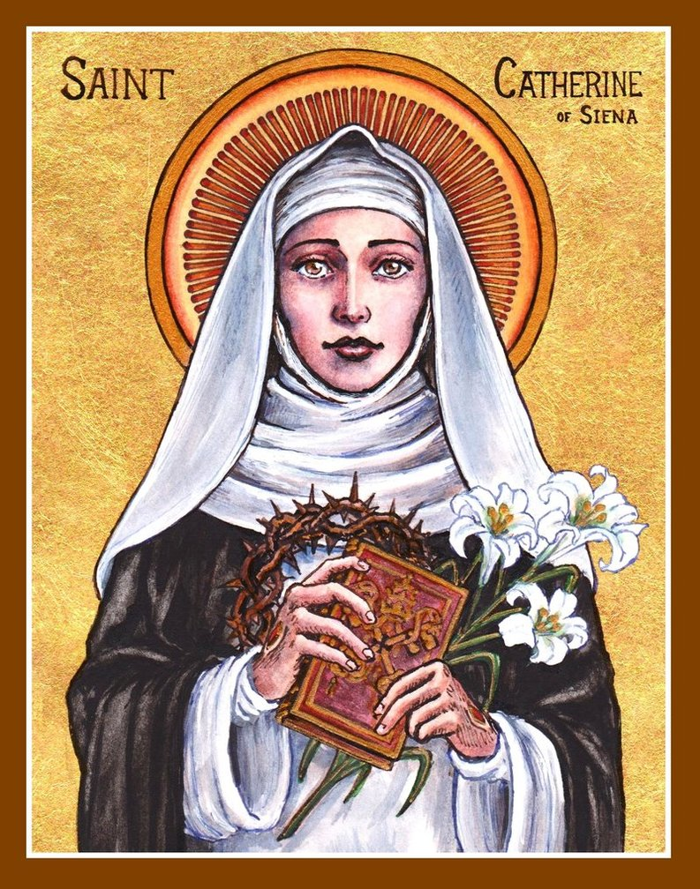
Saint Catherine of Siena
Feast day : 29th April
Catherine was a lay member of the Dominican order. She was famous as a mystic, an activist and an author. She might be described as the original “influencer”! She influenced popes and princes and cardinals with her letters, of which she wrote hundreds. She wrote numerous prayers, and a set of spiritual treatises collected together as a book under the title The Dialogue of Divine Providence. She was even sent on missions by the Pope, something extraordinarily rare for a woman in the 14th century!
BDES

Slide 7
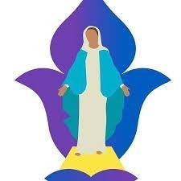
Hail Mary
Hail Mary, full of grace, the Lord is with thee;
blessed art thou among women and blessed is the fruit of thy womb, Jesus.
Holy Mary, Mother of God, pray for us sinners, now and at the hour of our death. Amen
BDES

Slide 8
Walking the Path
~ Walking the Path of Joy~
Monday 29th April 2024
Brentwood Diocese Education Service

