Slide 1



Walking the Path
~ Walking the Path of Joy~
Monday 6th May 2024
Brentwood Diocese Education Service

Slide 2
Walking the path of joy
“The joy of the gospel fills the hearts and lives
of all who encounter Jesus.
Those who accept his offer of salvation are set free
from sin, sorrow, inner emptiness and loneliness.
With Christ joy is constantly born anew.”
- Pope Francis, Evangelii Gaudium
____________________________
J.O.Y. ~ Loving Jesus, Loving Others, Loving Yourself.
BDES

Slide 3
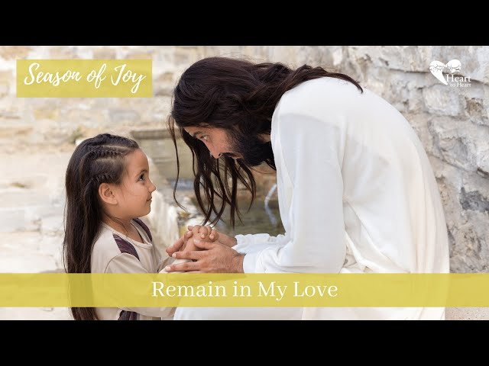
In Sunday’s Gospel Reading …
Sixth Sunday of Easter
5th May 2024
In the Gospel of John, Jesus tells his friends :
“Remain in my love.”
BDES

Slide 4
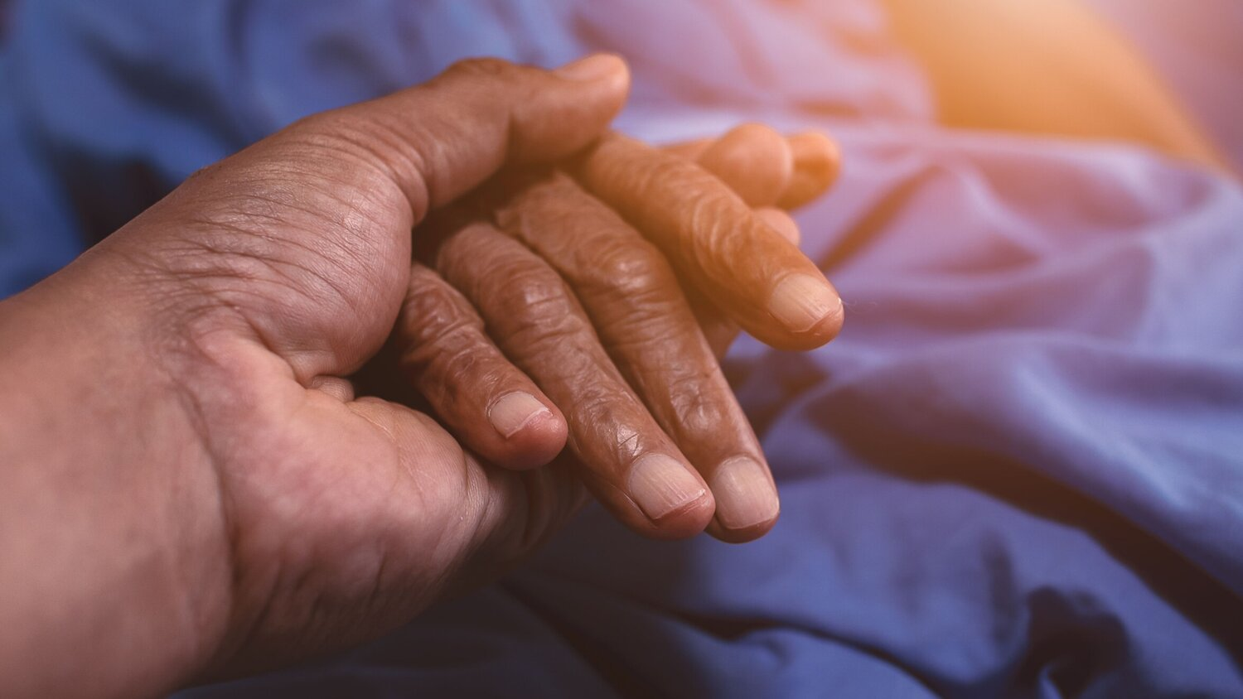
Reflection
Care for the Sick
“Lord my God, I called to you for help and you healed me.”
(Psalm 30 : 2)
BDES

Slide 5

Preparing for World Youth Day 2027
“Easter is the passage from
fear to confidence.”
- Pope Francis,
Easter, 2023
BDES

Slide 6
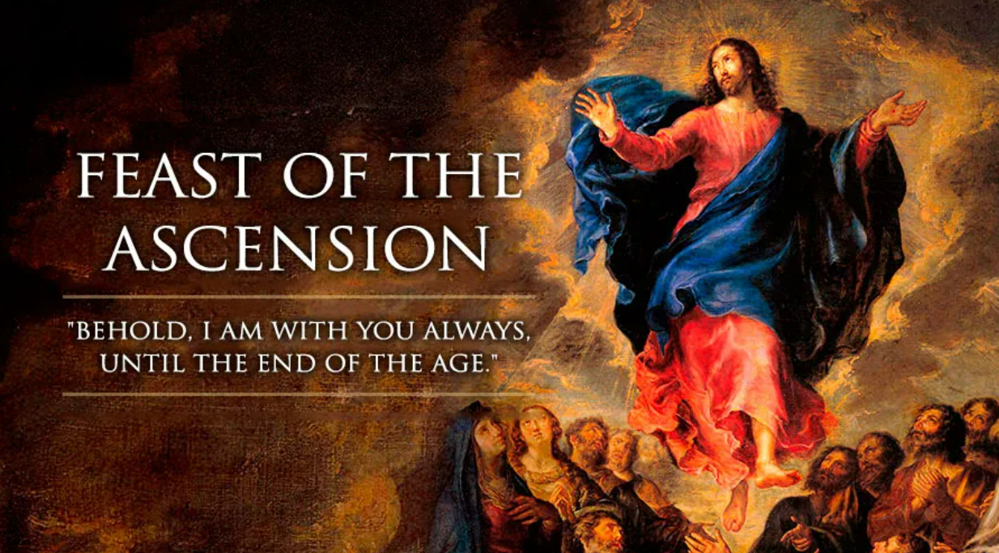
BDES

Slide 7
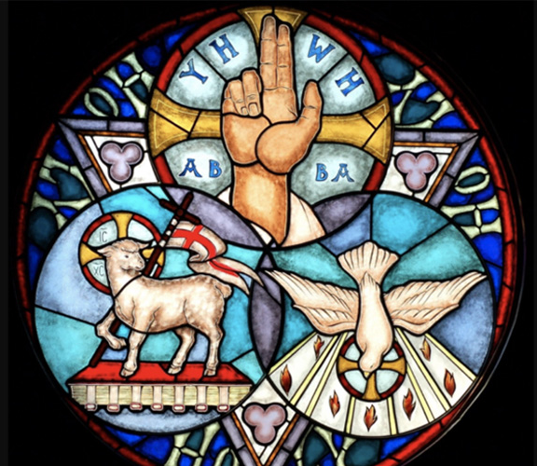
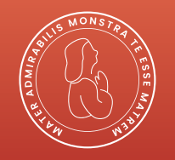
Glory be to the Father
Glory be to the Father,
and to the Son
and to the Holy Spirit,
as it was in the beginning,
is now, and ever shall be,
world without end.
Amen
BDES

Slide 8
Walking the Path
~ Walking the Path of Joy~
Monday 6th May 2024
Brentwood Diocese Education Service

