Slide 1
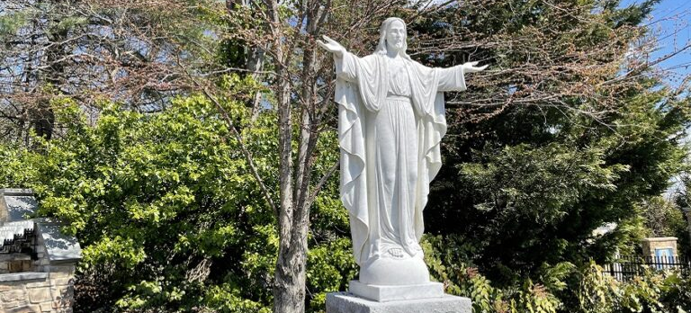
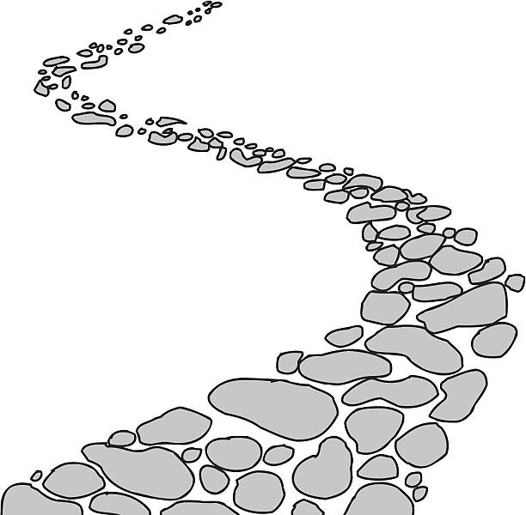

Walking the Path
~ Walking the Path of Joy~
Monday 13th May 2024
Brentwood Diocese Education Service

Slide 2
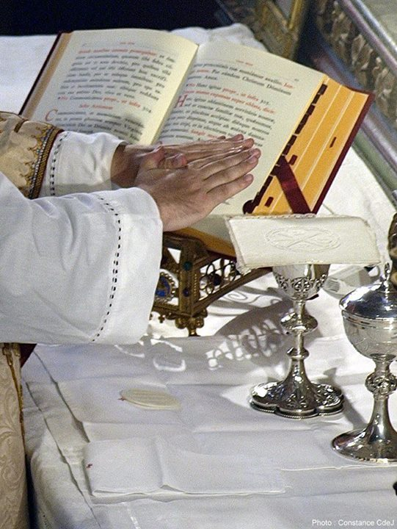
Walking the path of joy
The Seventh Sunday of Easter
Pope Francis says that
Easter is the passage from desolation to the joy of communion with Jesus.
We are walking the path of joy.
____________________________
J.O.Y. ~ Loving Jesus, Loving Others, Loving Yourself..
BDES

Slide 3
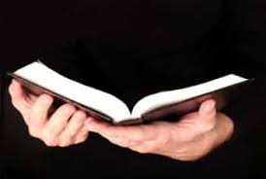
In Sunday’s Gospel Reading …
Seventh Sunday of Easter:
12th May 2024 :
In the Gospel of John,
Jesus prays to the Father :
“Your word is truth.”
BDES

Slide 4
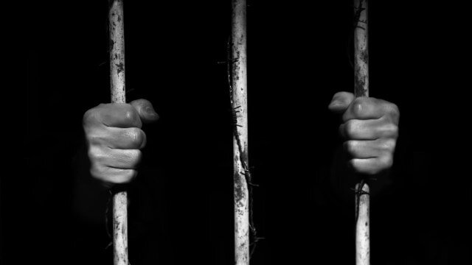
Reflection
Visit those in prison
Think about those who are in prison because of their beliefs.
We may not be able to
visit them in person,
but people of good will write to them to raise their spirits …
BDES

Slide 5
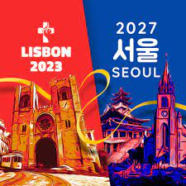
Preparing for World Youth Day 2027
“Easter is the passage from desolation to the joy of communion with Jesus.”
- Pope Francis,
Easter, 2023
BDES

Slide 6
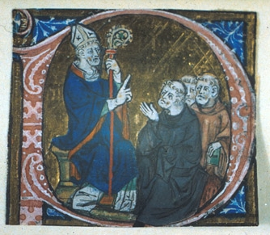
Feast Day of St Erconwald
~ 13th May ~
St Erconwald was born in Lincolnshire and as a member of the royal house established two Benedictine Abbeys, one for men at Chertsey in Surrey, where he became abbot, and one for women at Barking, where his sister Ethelburga was made abbess. In 675 AD he became the Bishop of London.
He is credited with being an influential adviser on law-making and charters, especially for the King of Wessex. He died in 693 and was buried in the churchyard of St Paul’s Cathedral.
St Erconwald is the patron saint of London and the secondary co-patron of our Diocese of Brentwood. He is often depicted in art as a bishop in a small chariot, which he used for travelling around his diocese.
BDES

Slide 7

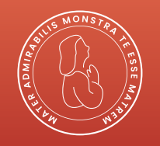
Grace Before Our Meal
Bless us, O Lord, and these your gifts
which we are about to receive from your bounty. Through Christ our Lord. Amen
BDES

Slide 8
Walking the Path
~ Walking the Path of Joy~
Monday 13th May 2024
Brentwood Diocese Education Service

