Slide 1
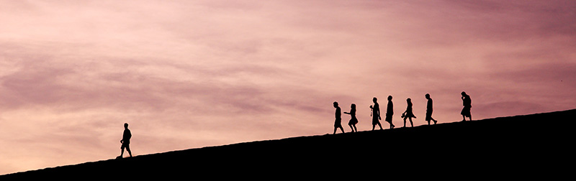
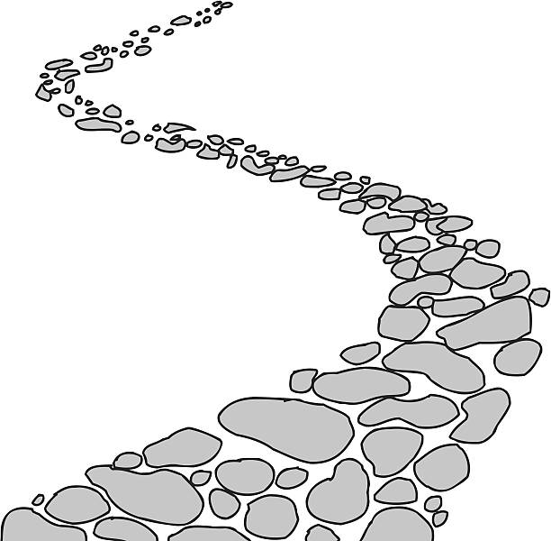
Walking the Path
~ Walking the Path of the Spirit ~
Monday 10th June 2024
Brentwood Diocese Education Service

Slide 2
Walking the Path of the Spirit
“Spirit of right judgment and courage,
guide us and
make us firm in our decision
to follow
Jesus’ way of love.”
BDES

Slide 3
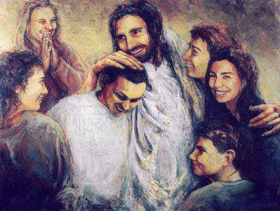
In Sunday’s Gospel Reading …
9th June 2024
In the Gospel of Mark, Jesus tells his friends :
“Whoever does the will of God is my brother and sister.”
BDES

Slide 4
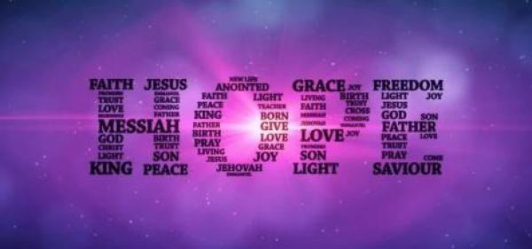
Virtues for Catholic Schools
HOPE
“But those who hope in the Lord will renew their strength. They will soar on wings like eagles; they will run and not grow weary, they will walk and not be faint.”
(Isaiah 40 : 31)
BDES

Slide 5
Preparing for World Youth Day 2027
“The Holy Spirit
draws us into the mystery
of the living God.”
- Pope Francis,
Homily, 13th May 2013
BDES

Slide 6
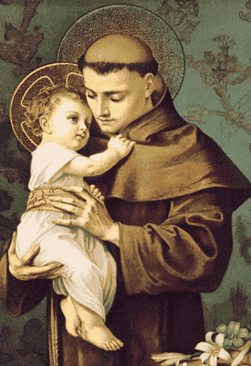
Saint Anthony of Padua
Feast day : 13th June
Saint Anthony was born into a wealthy family in Portugal but gave up worldly wealth to become a poor Franciscan. He preached in Morocco and his skill led St Francis, the founder of the Order, to entrust the friars’ studies to him. He taught at the universities of Montpellier and Toulouse and continued to preach with great success. He died at the age of only 35, and is depicted as holding the Christ Child, referencing a vision he once had. He is the patron of those who have lost things and numerous churches contain a box poor box for offerings from those grateful for his xxxxx intercession.
BDES

Slide 7
Act of Contrition
O my God,
because you are so good,
I am very sorry that I have sinned against you,
and with the help of your grace I will not sin again.
BDES

Slide 8
Walking the Path
~ Walking the Path of the Spirit ~
Monday 10th June 2024
Brentwood Diocese Education Service

