Slide 1
Walking the Path
~ Walking the Path of the Spirit ~
Monday 8th July 2024
Brentwood Diocese Education Service

Slide 2
Walking the Path of the Spirit
“But the fruit of the Spirit is love, joy, peace, patience, kindness, goodness, faithfulness, gentleness, and self-control.”
(Galatians 5 : 22-23)
BDES

Slide 3
In Sunday’s Gospel Reading …
7th July 2024
In the Gospel of Mark, we hear that :
“Jesus went around teaching from village to village.”
BDES

Slide 4
Virtues for Catholic Schools
TEMPERANCE
“Temperance increases the joy that flourishes in the heart of those who recognize and value what counts most in life.”
(Pope Francis)
BDES

Slide 5
Preparing for World Youth Day 2027
“The Holy Spirit
will teach you
everything.”
- Pope Francis,
5th June 2022
BDES

Slide 6
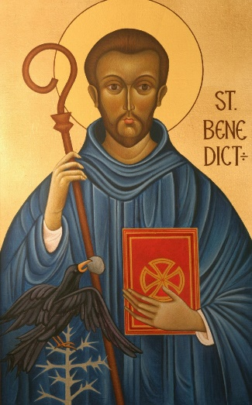
Feast of St Benedict : 11th July
St Benedict (480-548) founded 12 monasteries at Subiaco before moving on to found the great monastery of Monte Cassino. His Rule for his followers and communities is based on a spirit of balance, moderation and common sense. His feast day is this week, on 11th July. In 1980 Pope John Paul II declared St Benedict to be one of the patron saints of Europe.
BDES

Slide 7
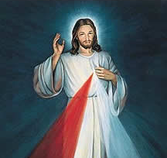
Morning Offering
O Jesus,
through the most pure heart of Mary,
I offer you all my prayers, thoughts,
works and sufferings of this day
for all the intentions
of your most Sacred Heart.
BDES

Slide 8
Walking the Path
~ Walking the Path of the Spirit ~
Monday 8th July 2024
Brentwood Diocese Education Service

