Slide 1



Walking the Path
~ Walking the Path of the Spirit~
Monday 15th July 2024
Brentwood Diocese Education Service

Slide 2
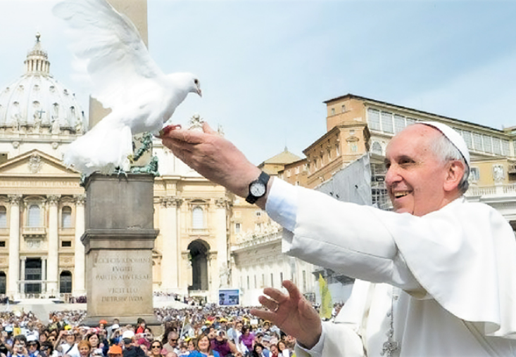
Walking the path of the Spirit
“The Holy Spirit gives us the courage to live the Christian life,
and for this reason,
with this courage,
it changes our lives.”
- Pope Francis, Verona, May 2024
J.O.Y. ~ Loving Jesus, Loving Others, Loving Yourself..
BDES

Slide 3
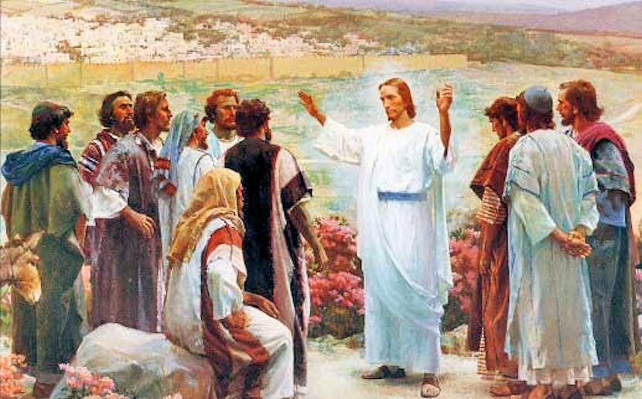
In Sunday’s Gospel Reading …
14th July 2024 :
In the Gospel of Mark, we hear that :
“He gave them
authority.”
BDES

Slide 4

Virtues for Catholic Schools
COURAGE
Listen to the Spirit, pray to the Spirit, and if it’s Him changing your life, trust the Spirit.
- Pope Francis
BDES

Slide 5

Preparing for World Youth Day 2027
“The gifts of the Holy Spirit are for everyone.”
- Pope Francis,
(Homily, 28th May 2023)
BDES

Slide 6
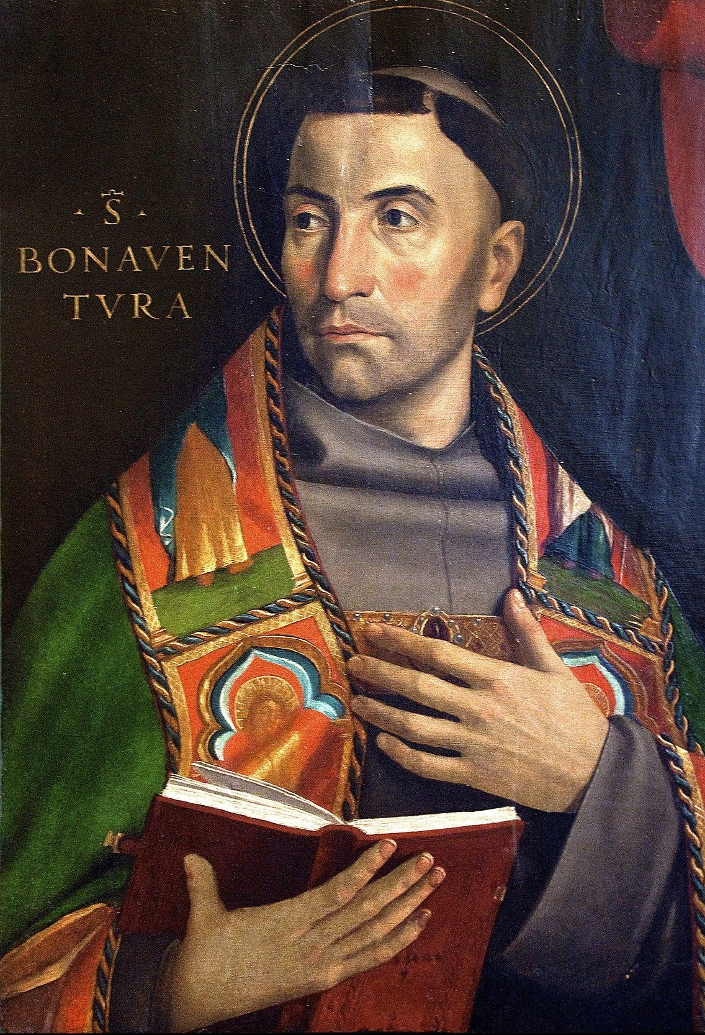
Saint Bonaventure
Feast Day : 15th July
St. Bonaventure (1221-1274) was actually born as Giovanni di Fidanza and became the seventh Minister General of the Franciscans, who gave him the name Bonaventura, meaning “good fortune.” He was a scholar of the University of Paris, and is regarded as one of the greatest philosophers of the Middle Ages. Canonised in 1484, he was declared to be one of the Doctors of the Church in 1587 by the Franciscan pope Sixtus V. St Bonaventure’s School in Forest Gate was founded in 1877 and named in his honour.
BDES

Slide 7
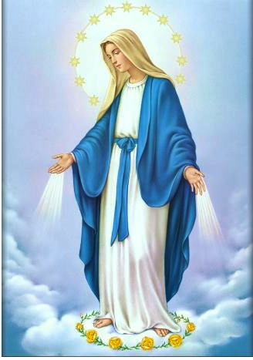
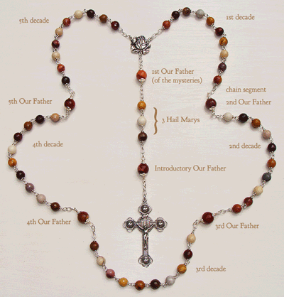
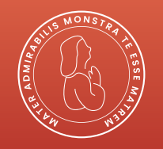
The Rosary
BDES

Slide 8
Walking the Path
~ Walking the Path of the Spirit~
Monday 15th July 2024
Brentwood Diocese Education Service

