Slide 1
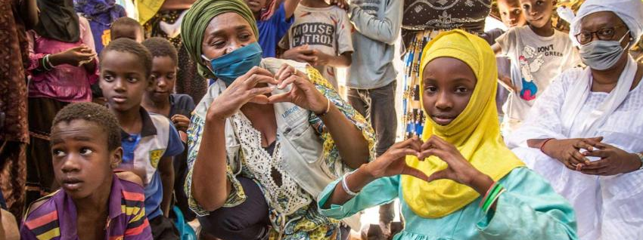
Walking the Path
~ Walking the Path of Solidarity ~
Monday 2nd September 2024
Brentwood Diocese Education Service

Slide 2
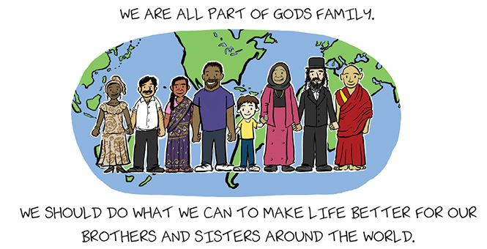
Walking the Path of Solidarity
BDES

Slide 3
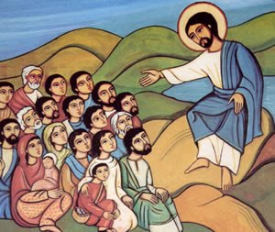
In Sunday’s Gospel Reading …
1st September 2024
In the Gospel of Mark, Jesus says:
“Hear me, all of you, and understand.”
BDES

Slide 4
WORLD DAY OF PRAYER
“Let justice
and peace flow.”
Season of Creation
BDES

Slide 5
From St Paul’s Letters # 1
1st Letter to the Corinthians
“Love is patient, love is kind.
It does not envy, it does not boast, it is not proud. It is not rude, it is not self-seeking,
it is not easily angered, it keeps no record of wrongs. Love does not delight in evil but rejoices with the truth.
It always protects, always trusts,
always hopes, always perseveres. Love never fails.”
BDES

Slide 6
Preparing for World Youth Day 2027
“Solidarity is sharing the little we have with those who have nothing, so that no one will go without.”
- Pope Francis,
World Day of the Poor, 2022
BDES

Slide 7
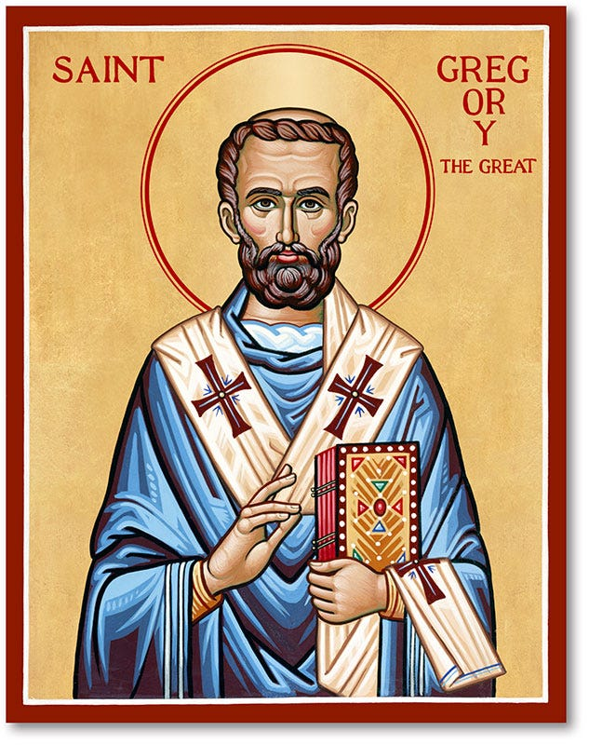
Feast of St Gregory the Great : 3rd Sept.
Pope Gregory I (540-604) was responsible for the first recorded large-scale mission from Rome, to convert the pagan Anglo-Saxons to Christianity. He wrote more than any previous pope and is famous for his Dialogues. He is the patron saint of teachers and musicians, as the song form plainchant is named after him as the “Gregorian chant”.
BDES

Slide 8
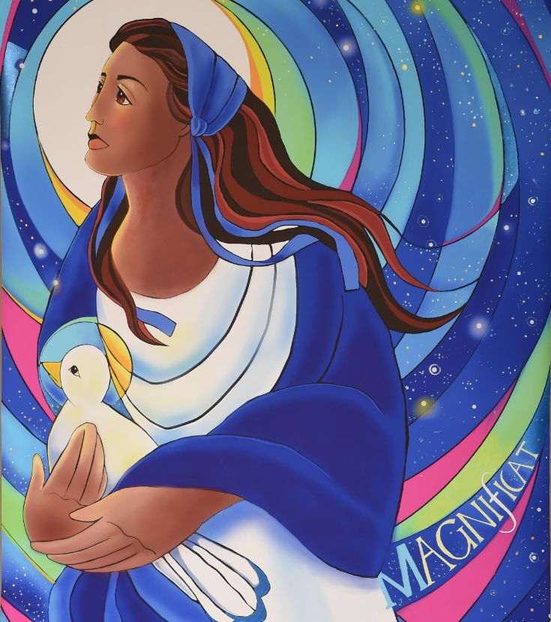
The Magnificat
My soul proclaims the greatness of the Lord, my spirit rejoices in God my Saviour, for he has looked with favour on his lowly servant. From this day all generations will call me blessed: the Almighty has done great things for me, and holy is his Name. He has mercy on those who fear him in every generation. He has shown the strength of his arm, he has scattered the proud in their conceit. He has cast down the mighty from their thrones, and has lifted up the lowly. He has filled the hungry with good things, and the rich he has sent away empty.
BDES

Slide 9
Walking the Path
~ Walking the Path of Solidarity ~
Monday 2nd September 2024
Brentwood Diocese Education Service

