Slide 1
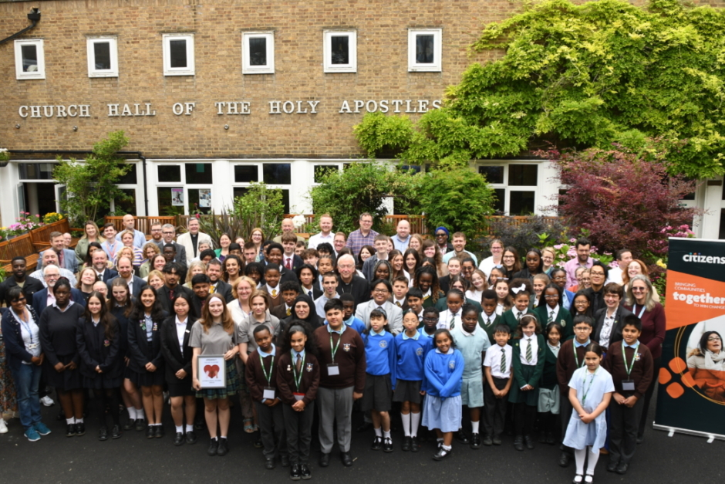
Walking the Path
~ Walking the Path of Solidarity ~
Monday 9th September 2024
Brentwood Diocese Education Service

Slide 2
Walking the Path of Solidarity
May your love
strengthen and nurture
all pupils and students
through the influence and example of those who care for them.
We pray that through their time at school and university
they will flourish and grow
to discover who
you have called them to be.
Amen
BDES

Slide 3
In Sunday’s Gospel Reading …
23rd Sunday of Ordinary Time:
8th September 2024
In the Gospel of Mark,
people say of Jesus :
“ He has done
all things well.”
BDES

Slide 4
From St Paul’s Letters # 2
2nd Letter to the Corinthians
“We know that the one who raised the Lord Jesus
will raise us also with Jesus
and place us with you in his presence.
Everything indeed is for you,
so that the grace bestowed in abundance
on more and more people
may cause the thanksgiving to overflow
for the glory of God.”
BDES

Slide 5
Preparing for World Youth Day 2027
“Through prayer, we become a single heart and soul with both Jesus and others.”
- Pope Francis,
(To the Papal Foundation, April 2024)
BDES

Slide 6
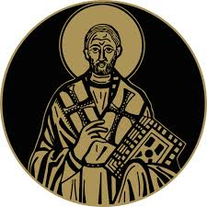
St John Chrysostom
13th September
St John, who lived 347-407 AD in Antioch, was known as Chrysostomos (“Golden Mouth”) on account of his gift of eloquence. He was a gifted public speaker at the Golden Church of Antioch, interpreting Scripture and preaching compassion for the poor. He became Archbishop of Constantinople
in 397, reformed the clergy and founded several hospitals. He lived a simple life but made political enemies on account of his preaching and was banished. One of his celebrated teachings is that “prayer without almsgiving is unfruitful.”
BDES

Slide 7
Act of Faith
My God,
I believe in you
and all that
your Church teaches,
because you have said it,
and your Word is true.
BDES

Slide 8
Walking the Path
~ Walking the Path of Solidarity ~
Monday 9th September 2024
Brentwood Diocese Education Service

