Slide 1
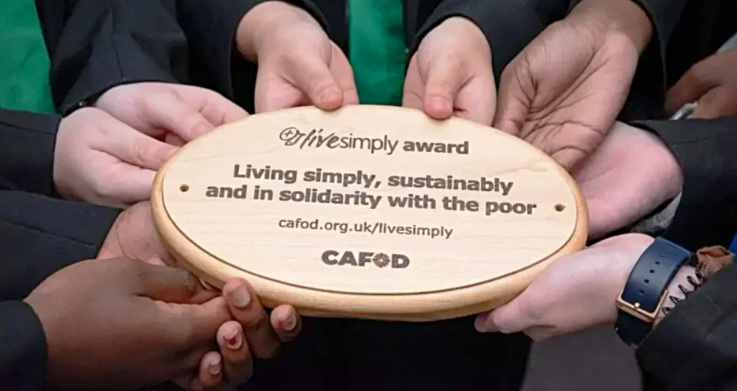


Walking the Path
~ Walking the Path of Solidarity ~
Monday 30th September 2024
Brentwood Diocese Education Service

Slide 2
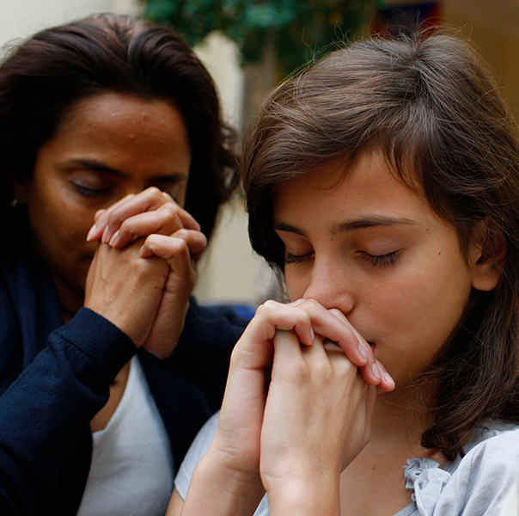
Walking the Path of Solidarity
A Prayer for Global Solidarity
Give us the wisdom of mind
and generosity of heart
to seek your will in the world today.
Inspire us to respond to the call to live in solidarity
with impoverished countries of the world,
so that all children of God might live
in dignity and peace.
- Catholic Relief Services
BDES

Slide 3
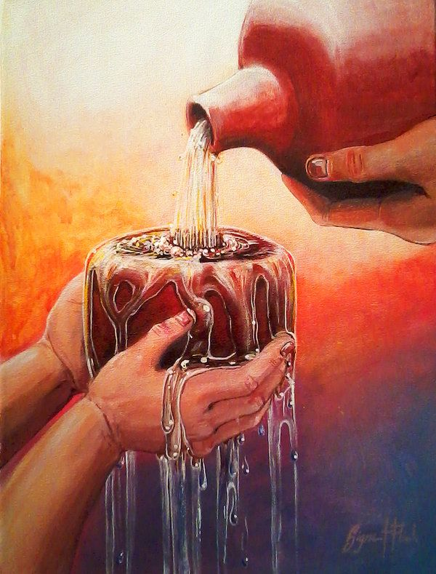
In Sunday’s Gospel Reading …
15th September 2024
In the Gospel of Mark, Jesus tells his friends :
“Anyone who gives you a cup of water to drink because
you belong to Christ
will surely not lose his reward.”
BDES

Slide 4
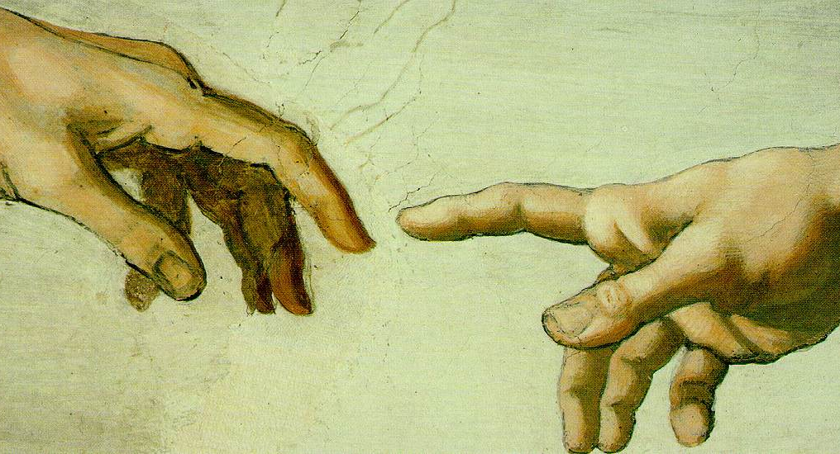
From St Paul’s Letters # 5
Letter to the Philippians
“God is the one who began this good work in you.”
BDES

Slide 5

Preparing for World Youth Day 2027
“Where the poor are concerned, it is not talk that matters. What matters is rolling up our sleeves and putting our faith into practice through direct involvement.”
- Pope Francis,
World Day of the Poor, 2022
BDES

Slide 6
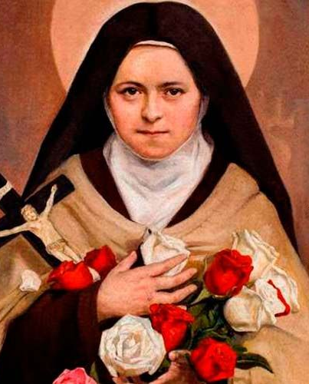
~ St Theresa of the Child Jesus ~
St Theresa of Lisieux (1873-1897), sometimes known as St Theresa the Little Flower, sometimes known as St Theresa of the Child Jesus, was a young saint known for the quality of her wisdom. Here are two examples :
“You know well enough that Our Lord does not look so much at the greatness of our actions, nor even at their difficulty, but at the love with which we do them.”
“Miss no single opportunity of making some small sacrifice, here by a smiling look, there by a kindly word; always doing the smallest right and doing it all for love.”
1st October
BDES

Slide 7
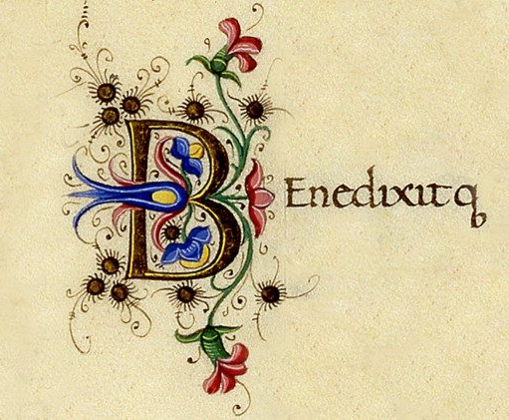
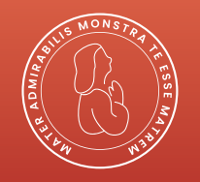
The Benedictus
Blessed be the Lord, the God of Israel;
he has come to his people and set them free.
He has raised up for us a mighty savior,
born of the house of his servant David.
Through his holy prophets
he promised of old
that he would save us from our enemies,
from the hands of all who hate us ….
BDES

Slide 8
Walking the Path
~ Walking the Path of Solidarity ~
Monday 30th September 2024
Brentwood Diocese Education Service

