Slide 1
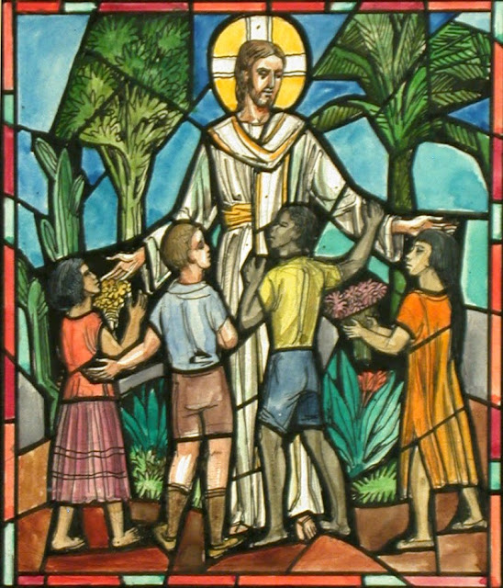
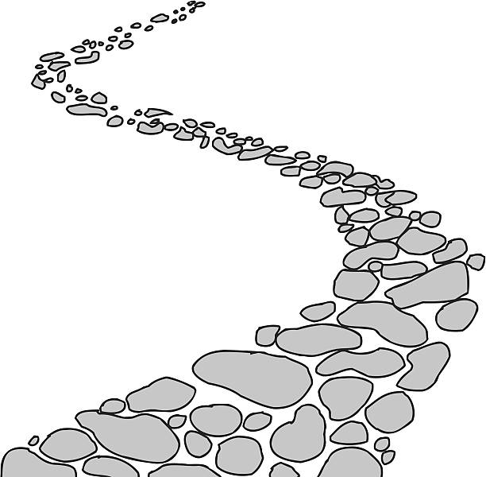
Walking the Path
~ Walking the Path of Solidarity ~
Monday 7th October 2024
Brentwood Diocese Education Service

Slide 2
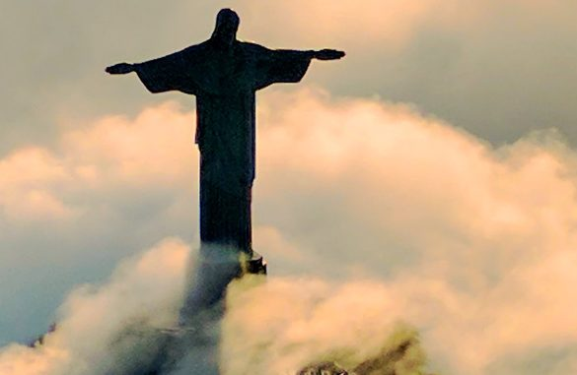
Walking the Path of Solidarity
In Christ there is no east or west, In him no south or north, But one great fellowship of love Throughout the whole wide earth.
BDES

Slide 3
In Sunday’s Gospel Reading …
27th Sunday of Ordinary Time
6th October 2024
In the Gospel of Mark, Jesus tells his friends :
“Let the children come to me; do not prevent them, for the kingdom of God belongs to such as these.”
BDES

Slide 4
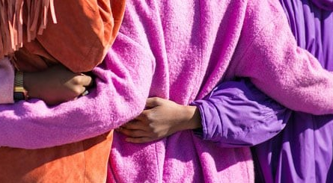
From St Paul’s Letters # 6
Letter to the Colossians
“You should be clothed in sincere compassion,
in kindness and humility, gentleness and patience.
Bear with one another; forgive each other.”
BDES

Slide 5
Preparing for World Youth Day 2027
“Christ’s own poverty sets us free and brings grace.”
- Pope Francis,
(World day of the Poor, 2022)
BDES

Slide 6
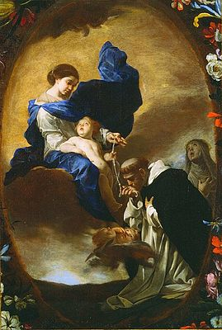
Our Lady of the Rosary
~ 7th October ~
In Catholic tradition, the entire month of October is dedicated to the Holy Rosary. This month-long observance is largely due to the liturgical feast of Our Lady of the Rosary, celebrated on 7th October.
According to legend, Mary entrusted the Rosary to St. Dominic in the 13th century.
Saint Dominic (1170–1221) was a Castilian Catholic priest and the founder of the Dominican Order. He is the patron saint of astronomers and natural scientists, and he and his order are traditionally credited with spreading and popularizing the rosary.
BDES

Slide 7
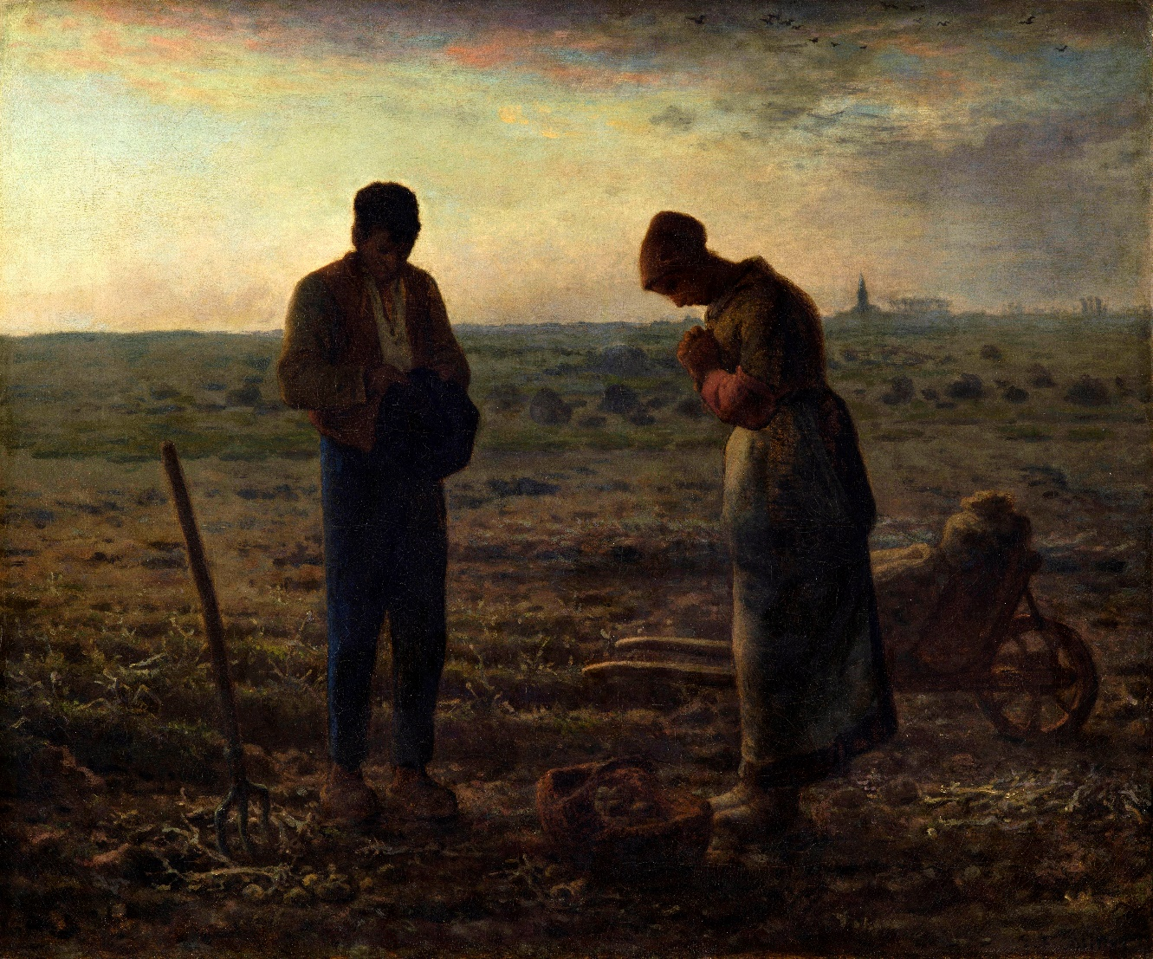
The Angelus
℣. The Angel of the Lord declared unto Mary, ℟. And she conceived of the Holy Spirit.
Hail Mary, full of grace; the LORD is with thee …
℣. Behold the handmaid of the LORD. ℟. Be it done unto me according to thy word.
Hail Mary, full of grace; the LORD is with thee ….:
℣. And the Word was made flesh. ℟. And dwelt among us …
BDES

Slide 8
Walking the Path
~ Walking the Path of Solidarity ~
Monday 7th October 2024
Brentwood Diocese Education Service

