Slide 1
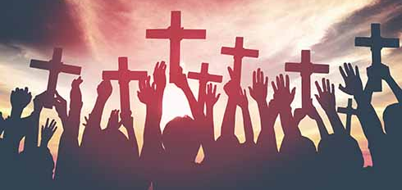
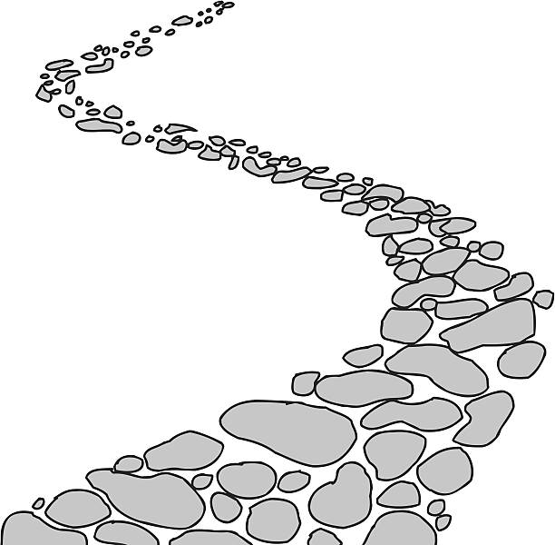
Walking the Path
~ Walking the Path of Solidarity ~
Monday 14th October 2024
Brentwood Diocese Education Service

Slide 2
Walking the Path of Solidarity
Good and gracious God, you invite us to love one another as brothers and sisters. Give us the courage to clearly see and challenge all that would divide us. Let us stand in solidarity with those who are persecuted, those who live in fear, and those who are marginalised by the structures of society. In the face of violence and hatred, we look to the words of the prophet Micah to guide our actions: “To do justice and to love goodness, and to walk humbly with your God”. Strengthen our hearts to love our neighbor as you love us. We ask all things through Christ our Lord. Amen.
BDES

Slide 3
In Sunday’s Gospel Reading …
13th October 2024
In the Gospel of Mark, Jesus tells his friends :
“All things are possible for God.”
BDES

Slide 4
Prisoners Sunday 13th October 2024
Lord, you offer freedom to all people.
We pray for those in prison.
Break the bonds of fear and isolation that exist.
Support with your love prisoners
and their families and friends,
prison staff and all who care.
Heal those who have been wounded
by the actions of others,
especially the victims of crime.
Help us to forgive one another,
to act justly, love mercy
and walk humbly together with Christ,
in his strength and in his Spirit,
now and every day.
Amen
BDES

Slide 5
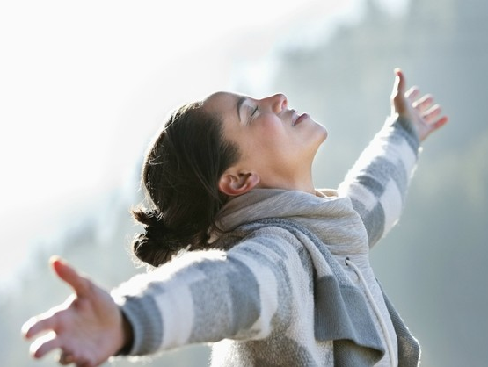
From St Paul’s Letters # 5
Letter to the Thessalonians
“Rejoice always,
pray without ceasing,
give thanks in all circumstances;
for this is the will of God in Christ Jesus for you.”
BDES

Slide 6
Preparing for World Youth Day 2027
“The treasure that no one can steal from us : true and giving love.”
- Pope Francis,
World Day of the Poor,
2022
BDES

Slide 7
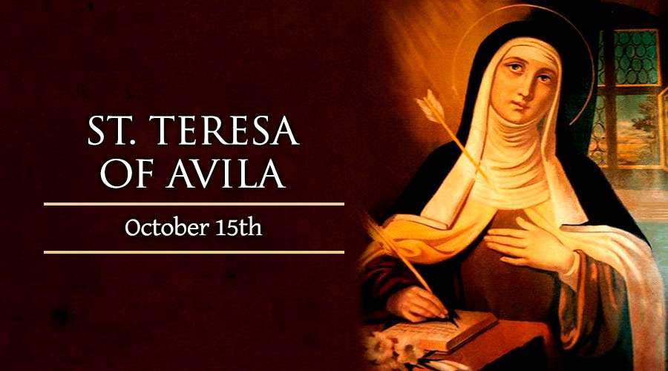
BDES

Slide 8
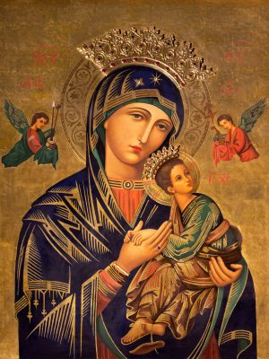
Hail Holy Queen
Hail, holy Queen, Mother of Mercy, Hail our life, our sweetness and our hope. To thee do we cry, Poor banished children of Eve; To thee do we send up our sighs, Mourning and weeping in this valley of tears. Turn then, most gracious advocate, Thine eyes of mercy toward us; And after this our exile, Show unto us the blessed fruit of thy womb, Jesus. O clement, O loving, O sweet Virgin Mary …
BDES

Slide 9
Walking the Path
~ Walking the Path of Solidarity ~
Monday 14th October 2024
Brentwood Diocese Education Service

