Slide 1
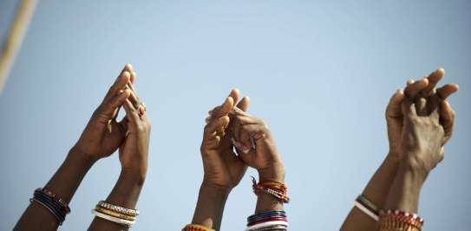
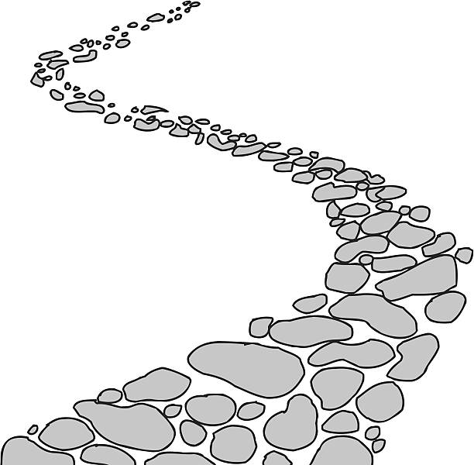
Walking the Path
~ Walking the Path of Solidarity ~
Monday 21st October 2024
Brentwood Diocese Education Service

Slide 2
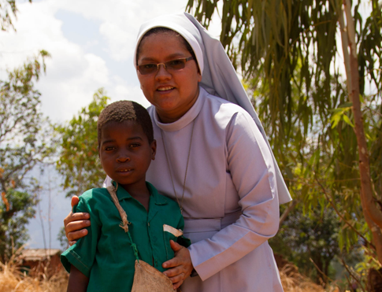
Walking the Path of Solidarity
~ Sunday 20th October is World Mission Sunday ~
World Mission Sunday is our chance to show love and solidarity to our brothers and sisters overseas who share our faith.
In offering our prayers, we join with missionaries everywhere in communion and compassion to support them
in spreading the Good News,
and by giving a donation we respond to
Christ’s call to feed the hungry and clothe the naked.
Pope Francis said
“Dear young people…
Be always ready to offer solidarity, to be steadfast in your closeness to others, determined in awakening joy and genuine in giving comfort.
The world stands in need of concrete signs of solidarity.
(The Works of Mercy, 2016)
BDES

Slide 3
In Sunday’s Gospel Reading …
25th Sunday of Ordinary Time
20th October 2024 :
In the Gospel of Mark, Jesus tells us :
“The Son of Man did not come to be served but to serve.”
BDES

Slide 4
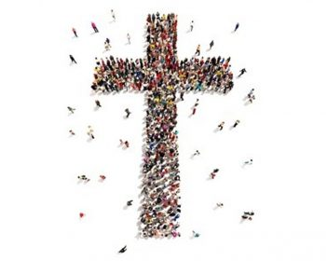
From St Paul’s Letters # 8
Letter to the Romans
“So we, though many, are one body in Christ .”
BDES

Slide 5
Preparing for World Youth Day 2027
“Create equality :
free the poor from their misery and the rich from their vanity.”
- Pope Francis,
(World Day of the Poor, 2022)
BDES

Slide 6
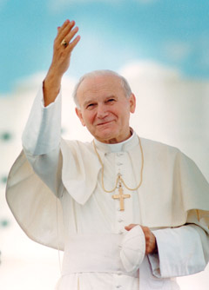
Saint John Paul II: 22nd October
Pope John Paul II was born in Poland as Karol Wojtyla before World War II.
He was a good sportsman, often playing in goal in football and was also involved in the theatre in his younger days.
He was an impressive linguist, using nine of the languages he had learnt when he became Pope.
His decision to become a priest came during the war; he survived having hidden from the German forces who rounded up many of the young men in Krakow.
He was made a Bishop in 1958 and was involved in the Second Vatican Council and in 1964 was made Archbishop of Krakow. In 1978 (the year of the three Popes) he was elected by the College of Cardinals and took the name John Paul II.
He pioneered World Youth Day and was very active in all areas of the Papacy.
He died in 2005 following a period of ill health.
He was beatified by his successor Pope Benedict in 2011 and canonised by
Pope Francis with Emeritus Pope Benedict concelebrating in 2014.
BDES

Slide 7
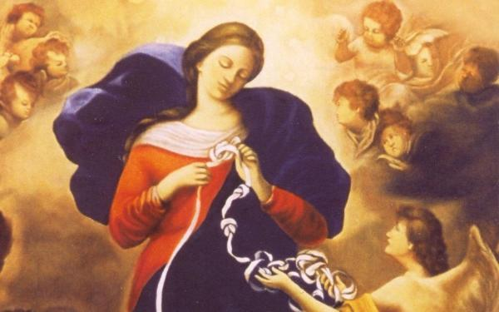
The Memorare
Remember, O most gracious Virgin Mary, that never was it known that anyone who fled to thy protection, implored thy help, or sought thy intercession, was left unaided. Inspired by this confidence I fly unto thee, O Virgin of virgins, my Mother. To thee do I come, before thee I stand, sinful and sorrowful. O Mother of the Word Incarnate, despise not my petitions, but in thy mercy hear and answer me. Amen.
BDES

Slide 8
Walking the Path
~ Walking the Path of Solidarity ~
Monday 21st October 2024
Brentwood Diocese Education Service

