Slide 1
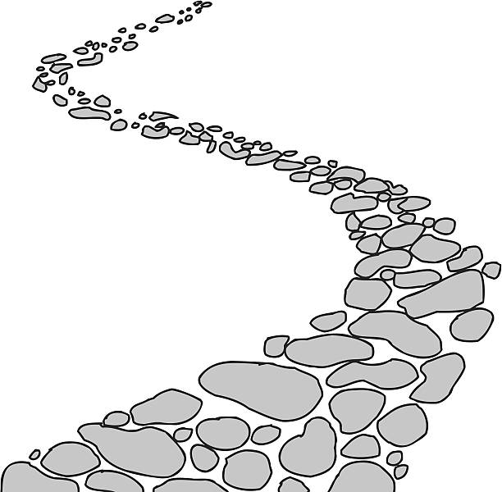
Walking the Path
~ Walking the Path of Courage ~
Monday 4th November 2024
Brentwood Diocese Education Service

Slide 2
Walking the Path of Courage
I hear you calling me my Lord. How can I respond to your invitation? Help me do the right thing.
You have given me a conscience So that I can know what is right and wrong. Please give me the strength to follow it.
You have given me words. Let them be words of truth. Words which harm do not reflect your love.
You have given me friends who do what is right. They help me stay faithful to you. I am grateful for them.
You have given me so many blessings. Help me be generous with my gifts And use them for the common good.
You give me courage. Knowing you are close by Helps me do the right thing.
Amen.
BDES

Slide 3
In Sunday’s Gospel Reading …
3rd November 2024
In the Gospel of Mark, Jesus tells us:
“You shall love
the Lord your God
with all your heart.”
BDES

Slide 4
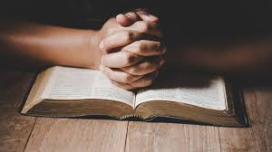
Letters of the New Testament # 1
From the Letter of St James :
“Come near to God and He will come near to you.”
BDES

Slide 5
Preparing for World Youth Day 2027
“A Christian without courage is a useless Christian.”
- Pope Francis (2024)
BDES

Slide 6
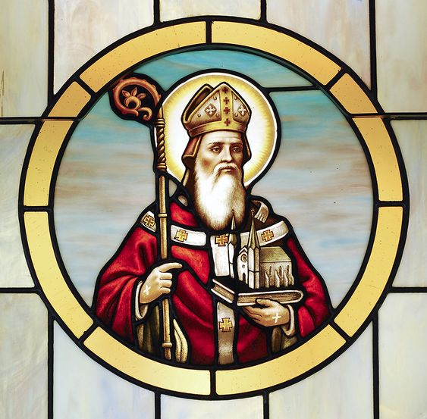
Feast of St Willibrord : 7th November
Willibrord (658-739) was born in Northumberland and went to Ireland at the age of 20 to study. He travelled to Rome twice, and was consecrated by Pope Sergius as a missionary bishop to the Frisians. He built an abbey at Echternach and a monastery and a cathedral at Utrecht. His mission to the Frisians took a setback after a violent pagan revolt caused him to flee, but he returned and rebuilt the Christian communities there. He worked tirelessly for over 50 years spreading the faith and was the patron of fellow Anglo-Saxon St Boniface, Apostle to the Germans.
BDES

Slide 7
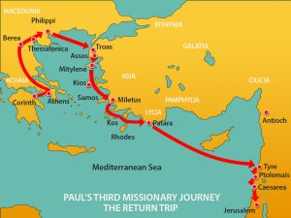
St Paul’s Missionary Journeys
St Paul made a number of visits to Jerusalem during his busy life. On his final visit, at the end of his third missionary journey, Paul arrived with a donation of money for the Christian community but was arrested after bringing a non-Jew into the Temple.
# 1 : Jerusalem
BDES

Slide 8
Walking the Path
~ Walking the Path of Courage ~
Monday 4th November 2024
Brentwood Diocese Education Service

