Slide 1
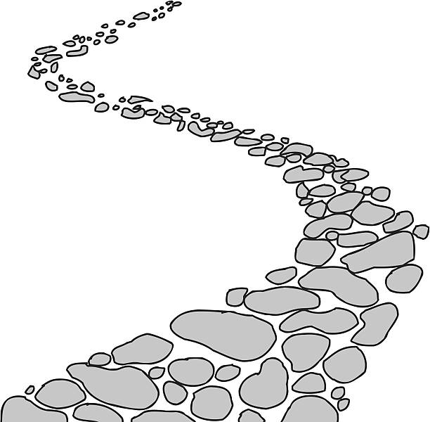
Walking the Path
~ Walking the Path of Courage ~
Monday 11th November 2024
Brentwood Diocese Education Service

Slide 2
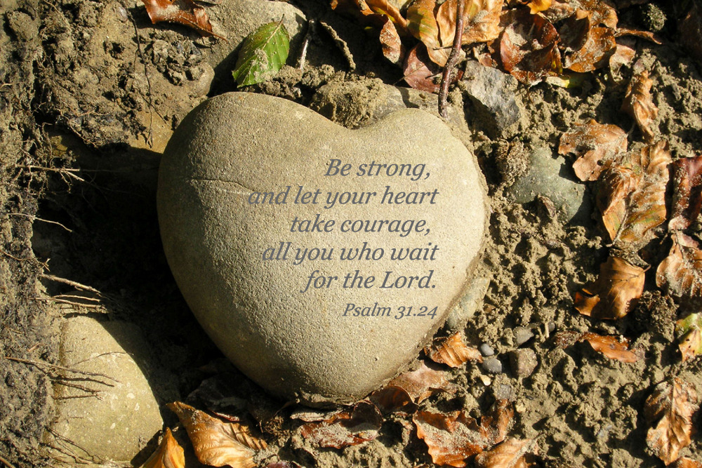
Walking the Path of Courage
Many philosophers have identified courage as the greatest of all virtues since it takes courage to sustain all others.
For example, in order to be a peace-maker it takes courage.
In order to uphold justice it takes courage.
And many times to really truly love someone it takes courage.
So what is courage? Some people think that in order to be courageous you need to be fearless.
But this isn’t totally right....because courage isn’t really the absence of fear, but it’s the ability to act in spite of fear.
BDES

Slide 3
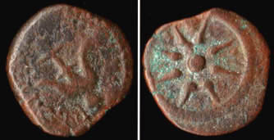
In Sunday’s Gospel Reading …
32nd Sunday of Ordinary Time
10th November 2024 :
The Gospel of Mark :
“For she gave all she had.”
BDES

Slide 4
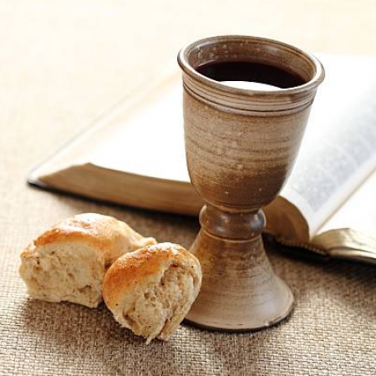
From Letters of the New Testament
1st Letter of St Peter
“Although you have not seen him you love him; even though you do not see him now yet believe in him, you rejoice with an indescribable and glorious joy.”
BDES

Slide 5
Preparing for World Youth Day 2027
“Christians must be able to hope with courage, and freely welcome God’s grace.”
- Pope Francis,
(2022).
BDES

Slide 6
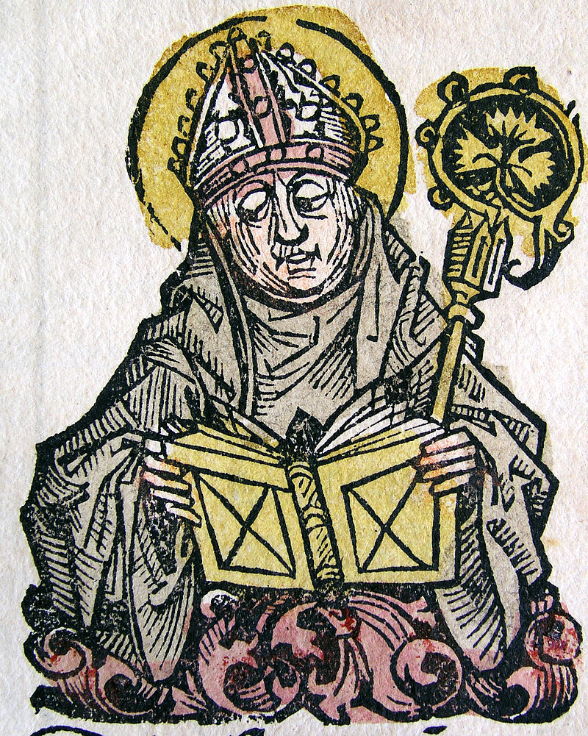
St. Edmund of Canterbury
Feast day :
16th November
St Edmund, along with Our Lady of Lourdes, St Erconwald and St Cedd, is one of the patrons of the Diocese of Brentwood. He was a renowned scholar of the universities of Paris and Oxford and was appointed as Archbishop of Canterbury in 1233. St Edmund’s Hall, one
of the colleges of the University of Oxford, is named after him.
BDES

Slide 7
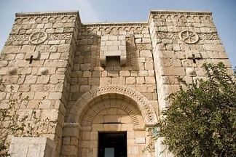
The Missionary journeys of St Paul
Damascus:
The Chapel of St. Paul is a modern stone chapel in Damascus that incorporates materials from the Bab Kisan, the ancient city gate through which Paul was lowered out of a window in Acts 9:25.
Straight Street is the Roman street that runs from east to west in the old city of Damascus. It was visited by St. Paul and is mentioned in the story of Paul's conversion to Christianity in Acts 9. God speaks to Ananias in a vision, and tells him to go to the Damascus Straight Street. At the house of Judas, he was to look for a man of Tarsus named Saul, as Paul was then known. Ananias is hesitant but goes anyway. After Ananias lays hands on Saul, his eyesight is restored
and he is baptized.
BDES

Slide 8
Walking the Path
~ Walking the Path of Courage ~
Monday 11th November 2024
Brentwood Diocese Education Service

