Slide 1
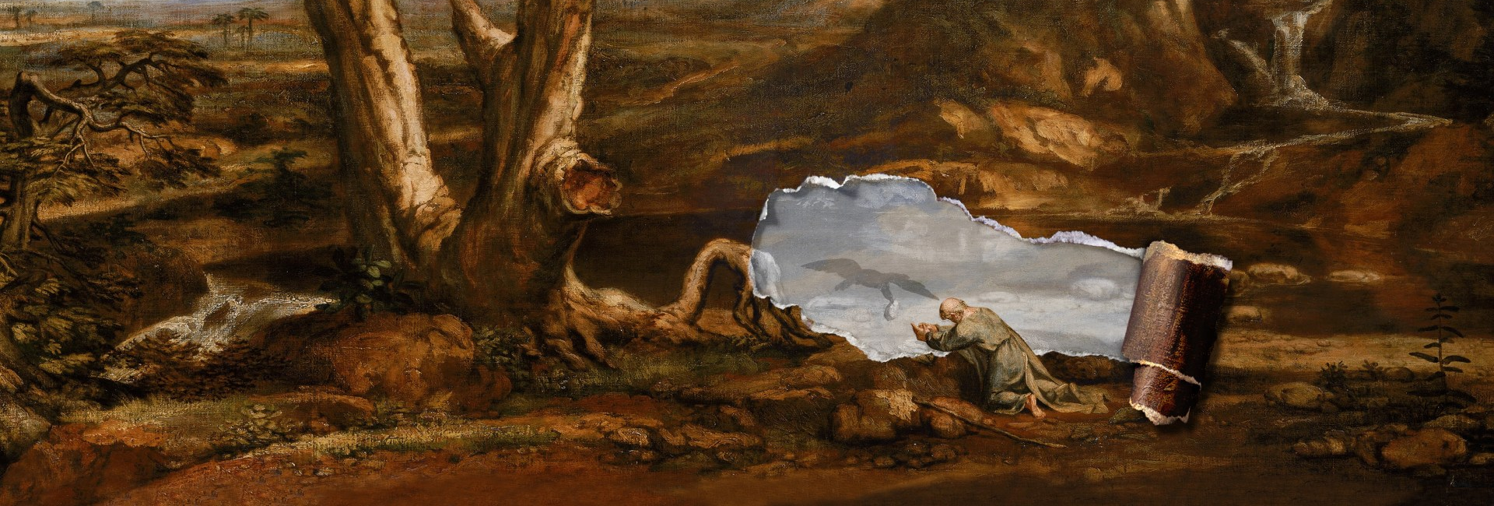


Walking the Path
~ Walking the Path of Courage ~
Monday 18th November 2024
Brentwood Diocese Education Service

Slide 2
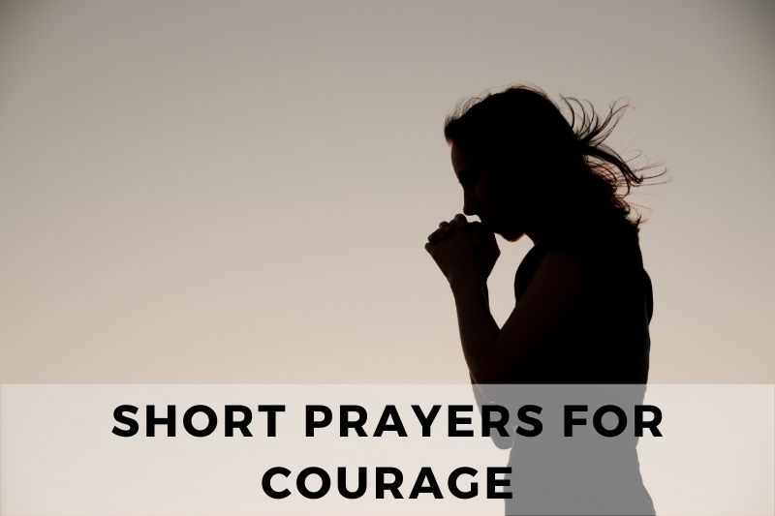
Walking the Path of Courage
“Be strong and courageous and do your work.
Do not be afraid or discouraged for the Lord God is with you.
He will not leave you or forsake you.”
(1 Chronicles 28 : 20)
BDES

Slide 3

In Sunday’s Gospel Reading …
17th November 2024
In the Gospel of Mark, Jesus reveals :
“Then they will see the Son of Man coming in the clouds with great power and glory.”
BDES

Slide 4
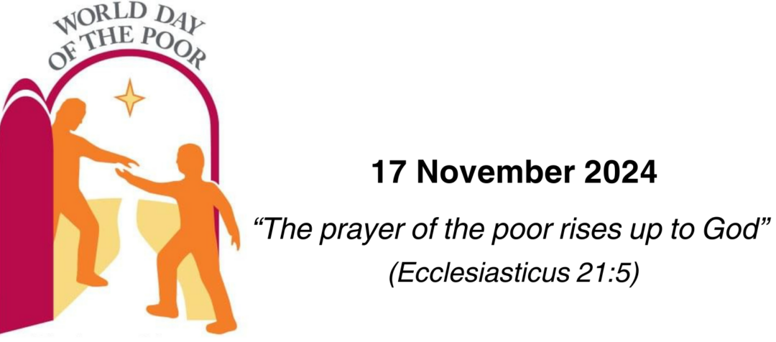
World Day of the Poor 2024
17th November 2024
“The prayer of the poor rises up to God.”
(Ecclesiasticus 21 : 5)
BDES

Slide 5
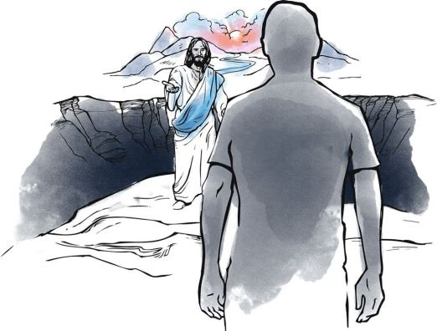
Letters of the New Testament # 3
From the 2nd Letter of St Peter :
“May you know more and more of grace and peace as your knowledge of God and Jesus our Lord grows deeper.”
BDES

Slide 6

Preparing for World Youth Day 2027
“Just as we need the courage to be happy, we also need the courage to live simply.”
- Pope Francis
BDES

Slide 7
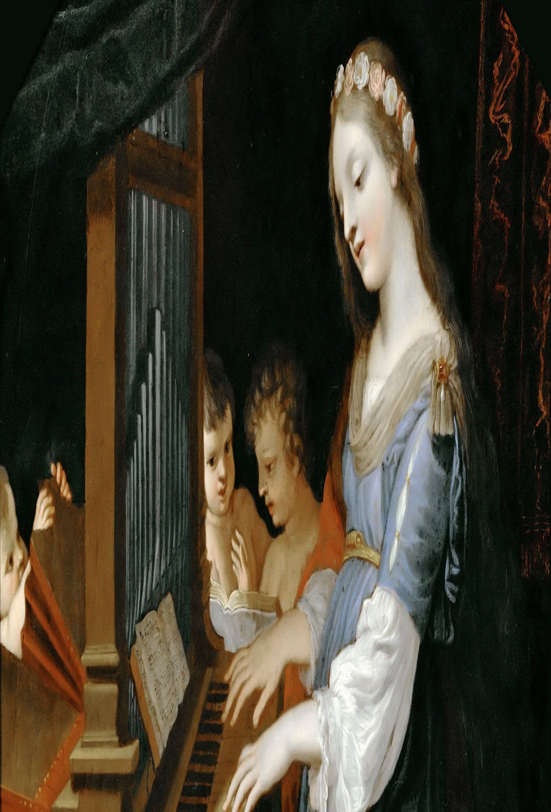
St. Cecilia
Feast day :
22nd November
St Cecilia is the patron saint of musicians with her feast day often being celebrated with concerts and musical events. She symbolizes the central role of music in the Liturgy of the Church.
She lived in Roman times and was executed for her beliefs. At her wedding, she was reputed to have sung her heart to God and was responsible for the conversion of her husband, who was baptized by Pope Urban I. She did good works and distributed her goods to the poor.
Her death followed that of her husband and brother-in -law, and she requested that after her death her home be converted into a church.
BDES

Slide 8
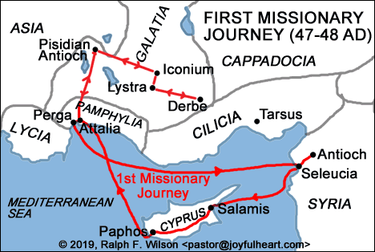
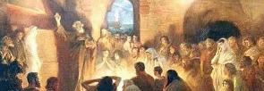
St Paul’s Missionary Journeys
St Paul visited Antioch in Pisidia, a major Christian centre, at least three times during his missionary journeys. It was at the synagogue in Antioch that Paul gave a famous speech demonstrating that Jesus is the Messiah.
# 3 : Antioch
BDES

Slide 9
Walking the Path
~ Walking the Path of Courage ~
Monday 18th November 2024
Brentwood Diocese Education Service

