Slide 1
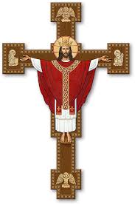
Walking the Path
~ Walking the Path of Courage ~
Monday 25th November 2024
Brentwood Diocese Education Service

Slide 2
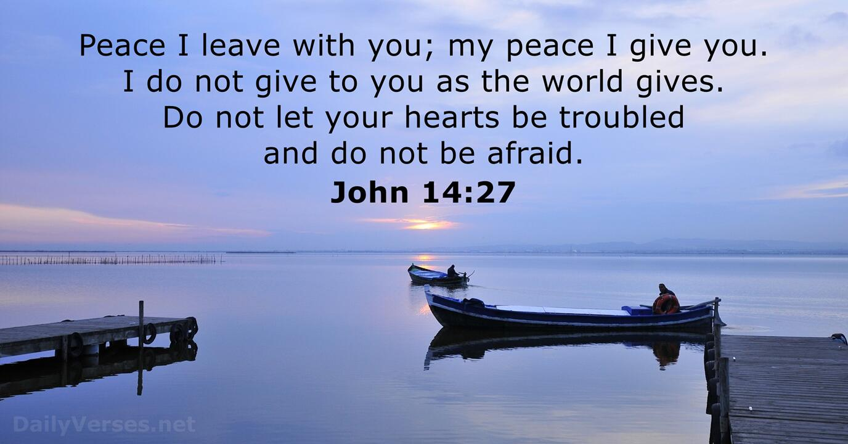
Walking the Path of Courage
BDES

Slide 3
In Sunday’s Gospel Reading …
Christ the King
24th November 2024 :
In the Gospel of John, Jesus says :
“My kingdom does not belong to this world.”
BDES

Slide 4
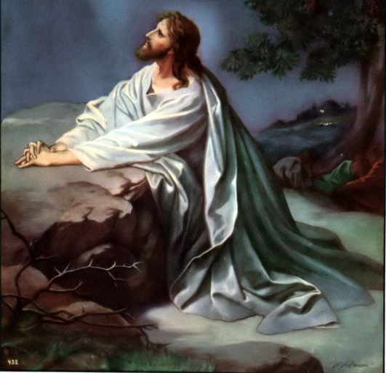
Letters of the New Testament # 4
From the 1st Letter of St John :
“We proclaim now to you,
so that you too may have fellowship with us; for our fellowship is with the Father and with his Son, Jesus Christ.”
BDES

Slide 5
Preparing for World Youth Day 2027
“The Kingdom of Heaven is for those who have the courage to go forward.”
- Pope Francis (2022)
BDES

Slide 6
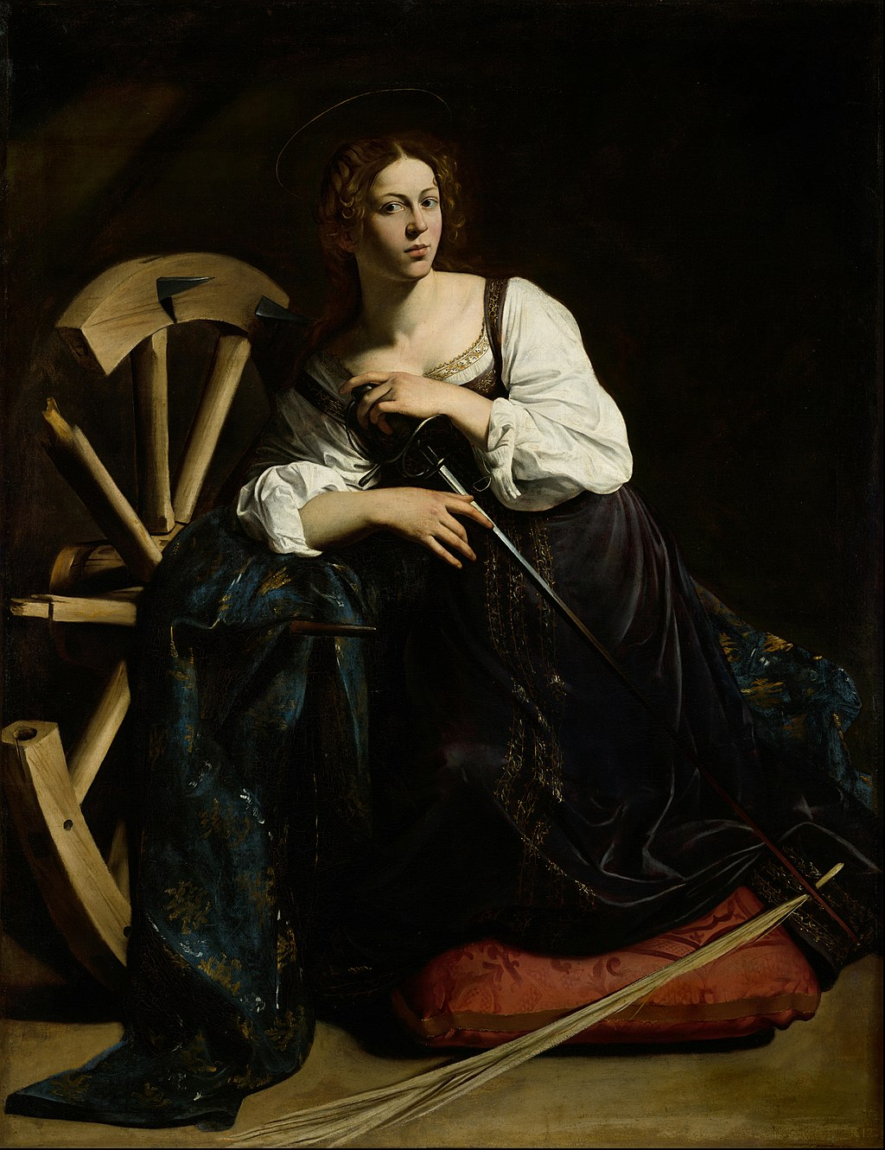
St. Catherine of Alexandria
Feast day :
25th November
Catherine of Alexandria was according to tradition, a Christian saint and virgin, who was martyred in the early 4th century at the hands of the emperor Maxentius. According to the story of her life she was both a princess and a noted scholar who became a Christian at about the age of 14, converted hundreds of people to Christianity, and was martyred at the age of 18.
BDES

Slide 7
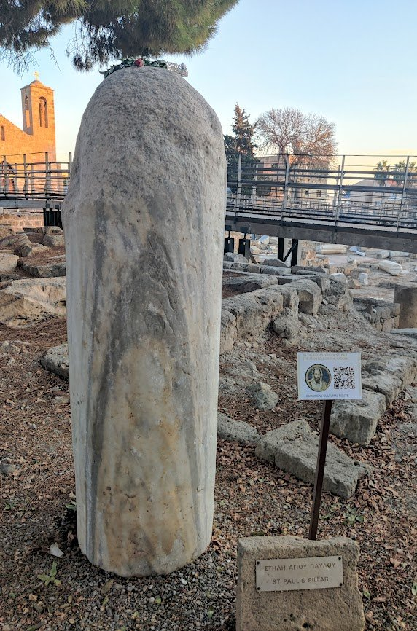
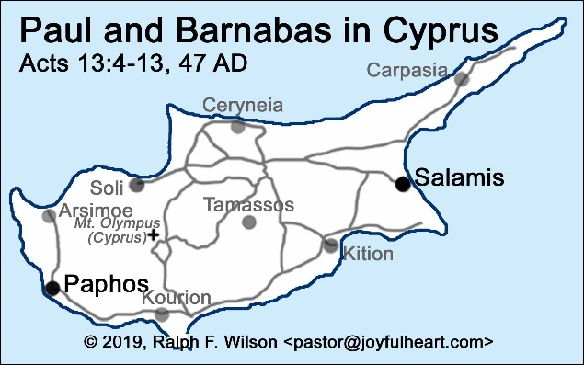
St Paul’s Missionary Journeys
Arriving in the town of Paphos on the island of Cyprus, St Paul and his companion St Barnabas converted the Roman Governor Sergius Paulus to Christianity; so Cyprus became the first country to be governed by a Christian ruler! One local Cypriot tradition tells us that the Paul was tied to one of the many pillars that now lie adjacent to the church of St Cyriacus and beaten.
# 4 : Cyprus
BDES

Slide 8
Walking the Path
~ Walking the Path of Courage ~
Monday 25th November 2024
Brentwood Diocese Education Service

