Slide 1
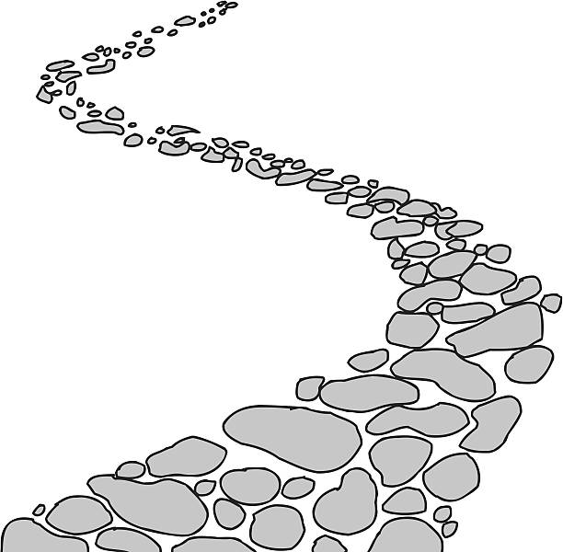
Walking the Path
~ Walking the Path of Courage ~
Monday 2nd December 2024
Brentwood Diocese Education Service

Slide 2
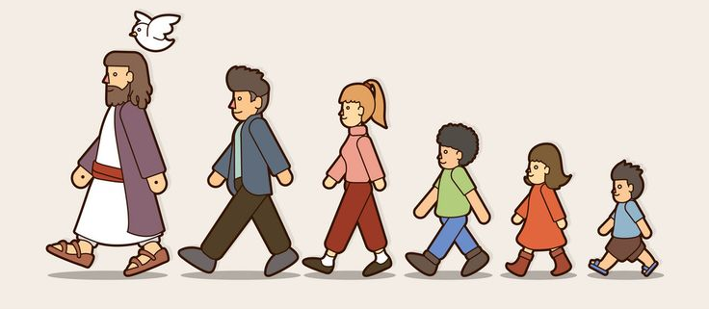
Walking the Path of Courage
“Be not afraid. I go before you always. Come, follow me and I will give you rest.”
BDES

Slide 3
In Sunday’s Gospel Reading …
1st December 2024
In the Gospel of Luke, Jesus tells us :
“Your redemption
is at hand.”
BDES

Slide 4
FIRST SUNDAY OF ADVENT
BDES

Slide 5
Letters of the New Testament # 5
From the 2nd Letter of St John :
“Grace, mercy, and peace will be with us from God the Father and from Jesus Christ the Father’s Son in truth and love.”
BDES

Slide 6
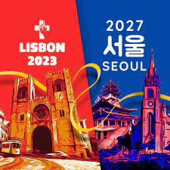
Preparing for World Youth Day 2027
“Courage is generated by hope.”
- Pope Francis (2022)
BDES

Slide 7
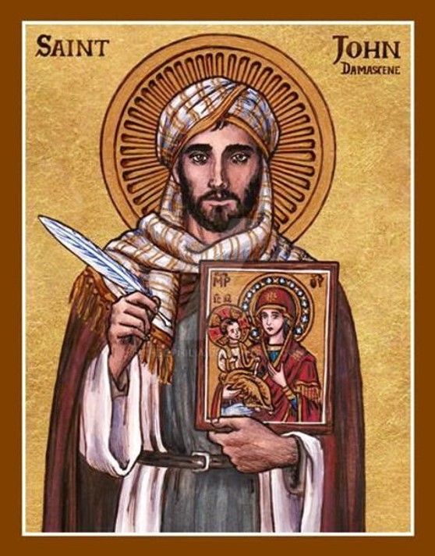
St. John Damascene :
4th December
John Damascene was an Arab Christian monk, priest and hymn-writer. He was born in Damascus – in today’s Syria – in around 675 AD and may have died around 749 AD near Jerusalem. He was a highly educated man, interested and gifted in law, theology, philosophy and music. He was nicknamed Chrysorroas, “the golden speaker,” and his hymns are still used today by Eastern Christians.
BDES

Slide 8
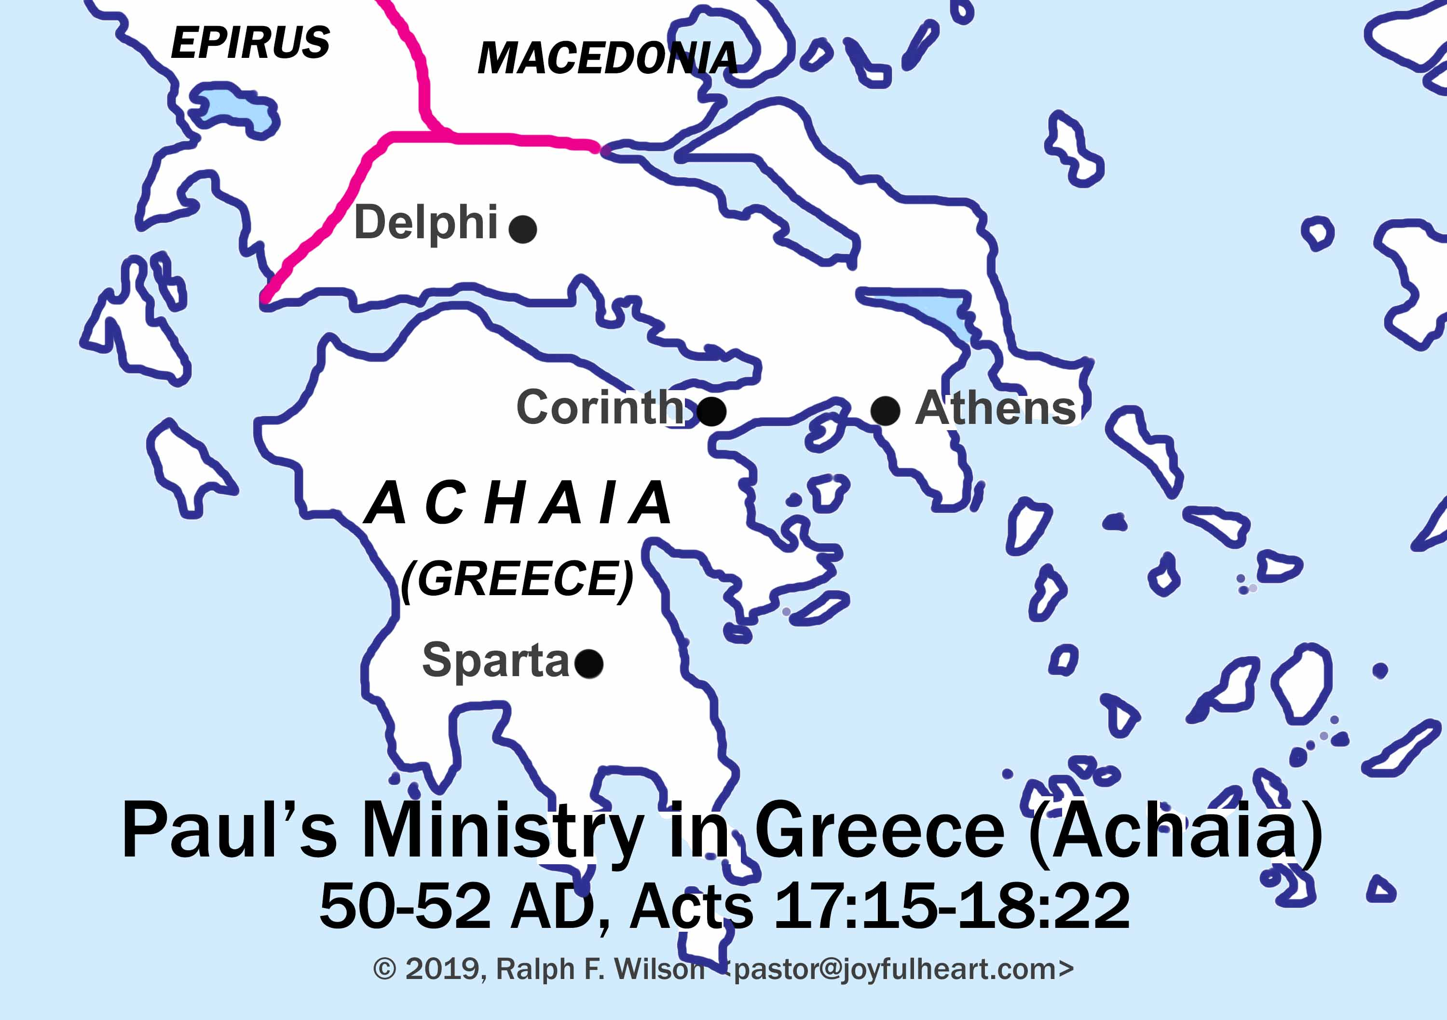
St Paul’s Missionary Journeys
St Paul visited Athens during his second missionary journey, and preached in the synagogue, in the Agora (marketplace) and on the Areopagus, the Hill of Mars, an important civic building on a hill opposite the Acropolis.
# 5 : Athens
BDES

Slide 9
Walking the Path
~ Walking the Path of Courage ~
Monday 2nd December 2024
Brentwood Diocese Education Service

