Slide 1

How to use this Powerpoint
The Powerpoint is a compilation of 100 examples of the words of wisdom of His Holiness Pope Francis, collected during three years compiling the resource “Looking Forward”. Schools are welcome to use it in any way they find useful, in lessons, in assemblies, in corridors, in foyers … It can be set up as a slide show if desired; slides can be printed out to decorate classrooms and corridors. It can be excerpted to use a slide per week or per day. Photographs and texts can be re-arranged to suit any purpose. It can be added to; it can be edited. It can be used for staff training or reflection. And just in case anyone is wondering … the young priest in the last slide is one Father Jorge Maria Bergoglio … ☺
BDES

Slide 2
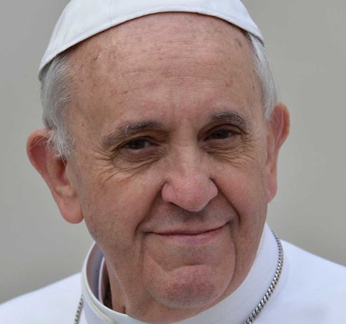
“Cultivate and bear witness to the hope, generosity, and solidarity that we all need in this difficult time.”
- Pope Francis to the young people of the world
BDES

Slide 3
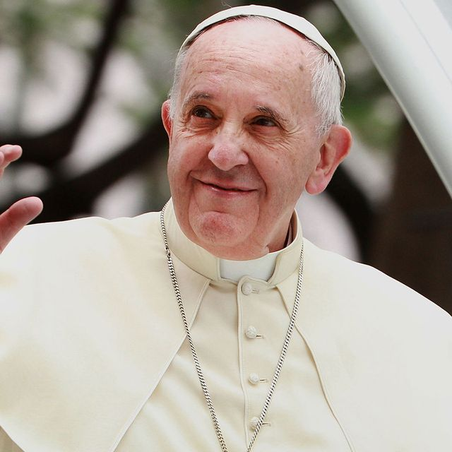
“The Gospel is for everyone,
not just for some. It is not only for those who seem closer to us,
more receptive,
more welcoming.
It is for everyone.”
- Pope Francis to the
young people of the world
BDES

Slide 4
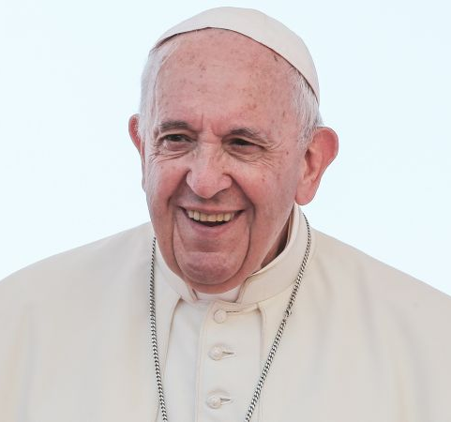
“Dream big
and don’t be scared
to live in hope,
for you are
the “now”
of Christ.”
- Pope Francis to the
young people of the world
BDES

Slide 5
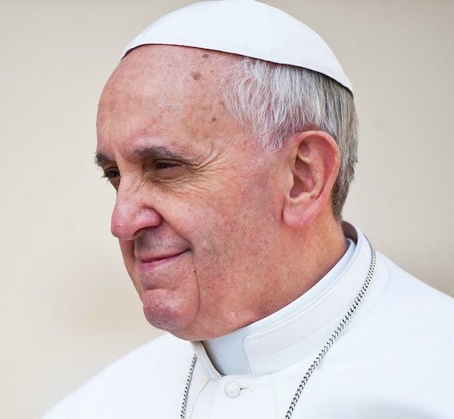
“Christ is alive!
He is our hope,
and in a wonderful way
he brings youth to our world.
The very first words, then,
that I would like to say
to every young Christian
are these: Christ is alive and he wants you to be alive!
- Pope Francis to the young people of the world
BDES

Slide 6
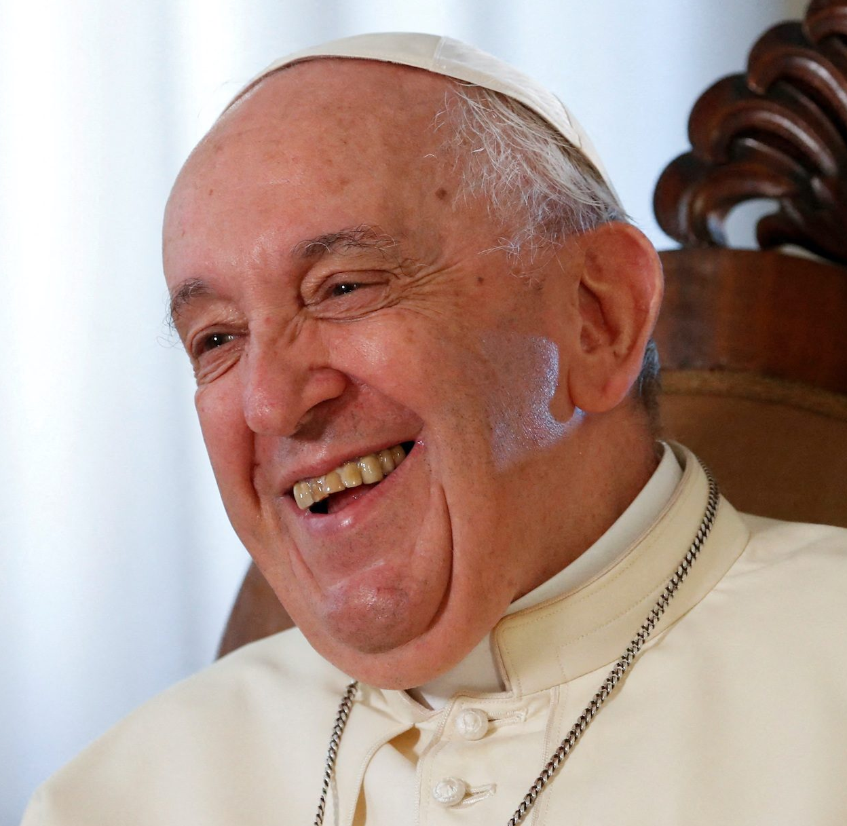
“The very first truth
I would tell each of you is this :
“God loves you”.
It makes no difference
whether you have already heard it or not.
I want to remind you of it.
God loves you.
Never doubt this,
whatever may happen to you in life.
At every moment,
you are infinitely loved.”
- Pope Francis to the young people of the world
BDES

Slide 7
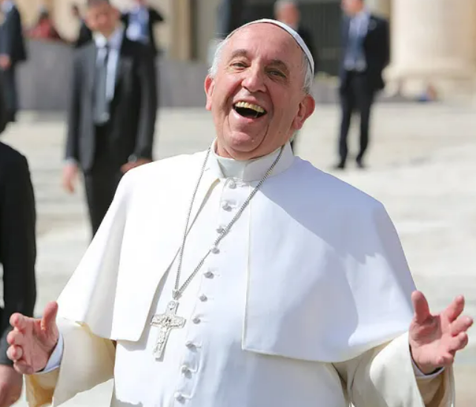
“We are asked
to open our eyes
and take a moment
to experience fully
and with gratitude
every one
of life’s little gifts.”
- Pope Francis to the
young people of the world
BDES

Slide 8
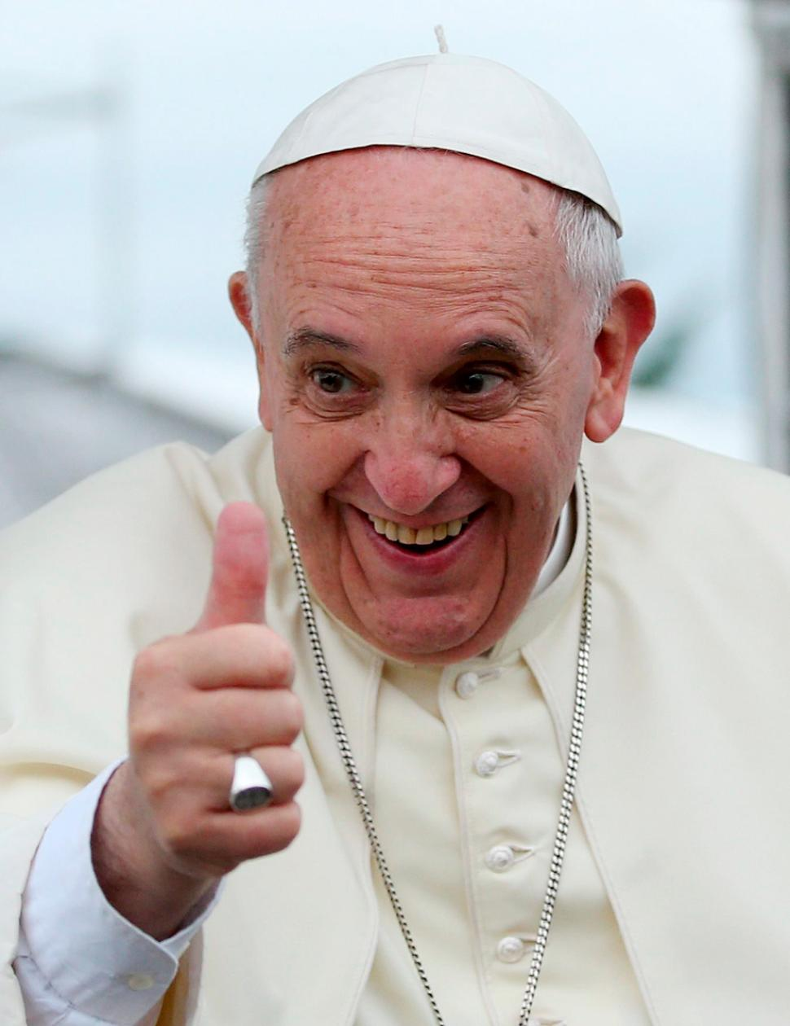
“Give yourselves over
to the best of life! Open the door of the cage, go out and fly!”
- Pope Francis to the
young people of the world
BDES

Slide 9
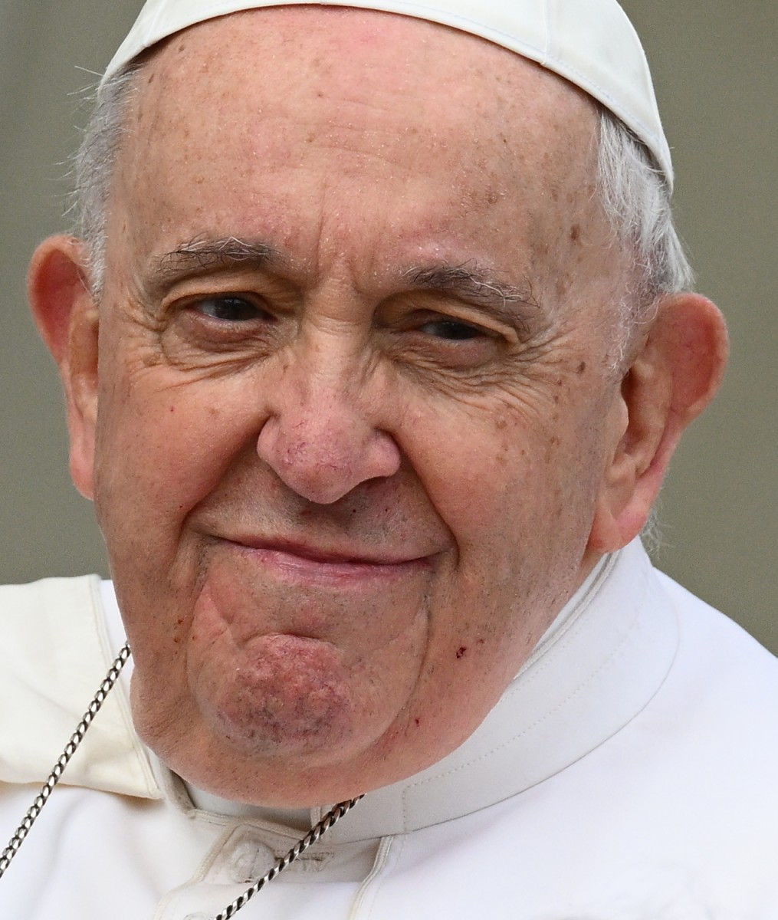
“Our best dreams
are only attained
through hope, patience and commitment …”
- Pope Francis to the
young people of the world
BDES

Slide 10
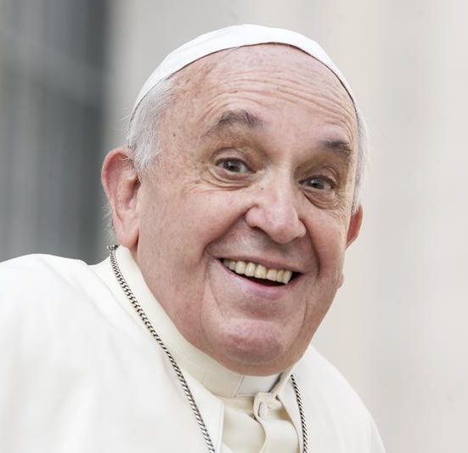
“Everyone is born as an original,
but many people end up dying
as photocopies.
Don’t let that happen to you!”
- Pope Francis to the
young people of the world
BDES

Slide 11
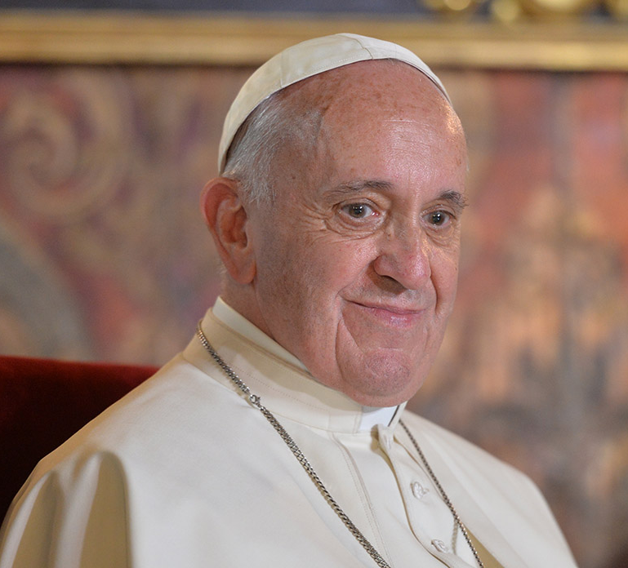
“However far you
may wander,
he is always there,
the Risen One.
He calls you
and he waits for you
to return to him
and start over again.”
- Pope Francis to the young people of the world
BDES

Slide 12
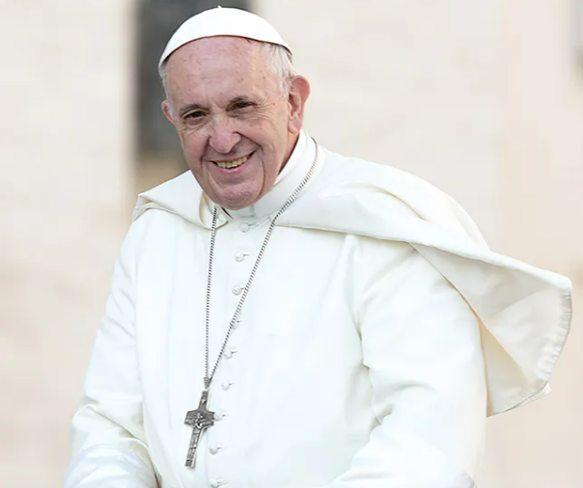
“Samuel was still a young boy,
yet the Lord spoke to him.
Thanks to the advice of an adult,
he opened his heart to hear God’s call: ‘Speak, Lord,
for your servant is listening.’”
- Pope Francis to the young people of the world
BDES

Slide 13
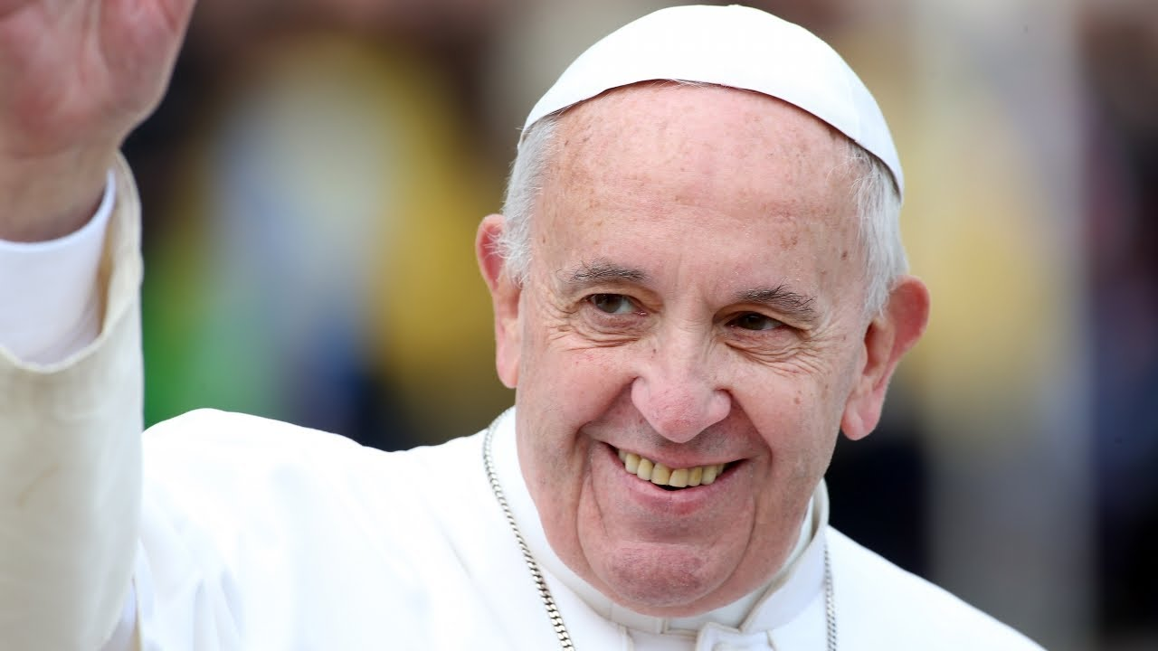
“Young hearts
are naturally
ready to change,
to turn back,
get up
and learn from life.”
- Pope Francis to the
young people of the world
BDES

Slide 14
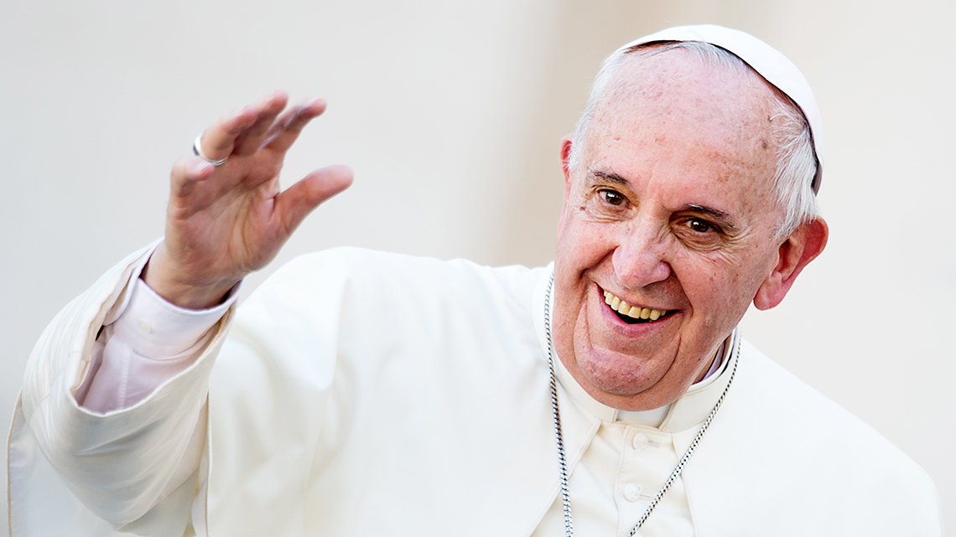
“Jesus,
himself
eternally young,
wants to give us
hearts
that are
ever young.”
- Pope Francis to the
young people of the world
BDES

Slide 15
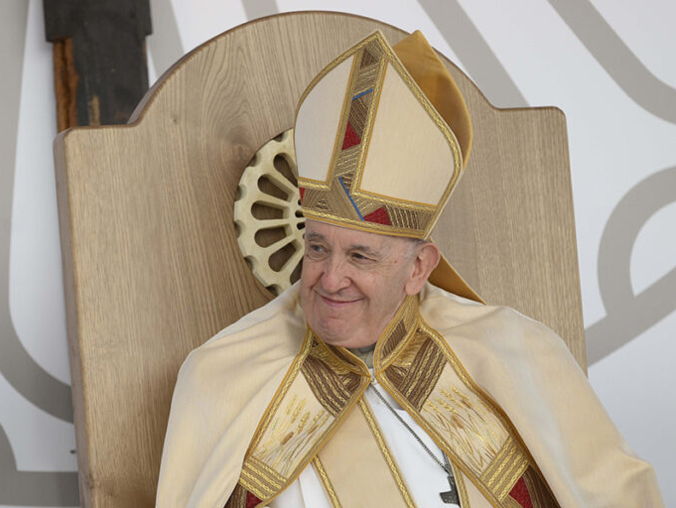
“He is in you,
He is with you
and He never abandons you.”
- Pope Francis to the
young people of the world
BDES

Slide 16
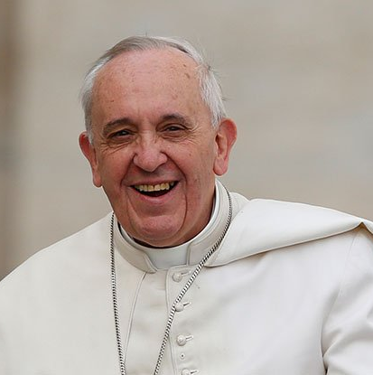
“What we have been promised
is greater than
we can imagine.”
- Pope Francis on the
Year of the Family
BDES

Slide 17
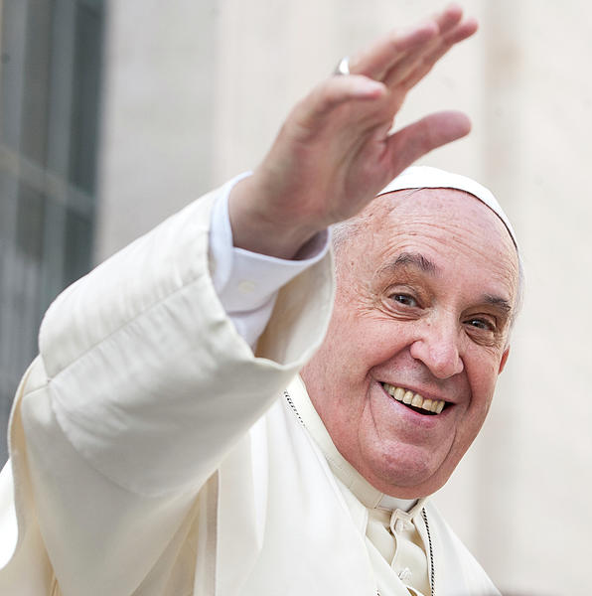
“Please. Thank you. Sorry.
If in a family environment
there are
these three words,
the family is fine.”
- Pope Francis on the Year of the Family
BDES

Slide 18
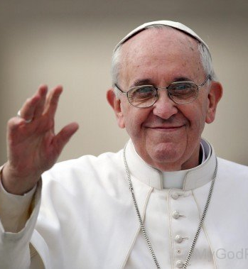
Jesus, Mary and Joseph,
in you we contemplate
the splendour of true love;
to you we turn with trust.
– Pope Francis, Prayer to the Holy Family
(from Amoris Laetitia)
BDES

Slide 19
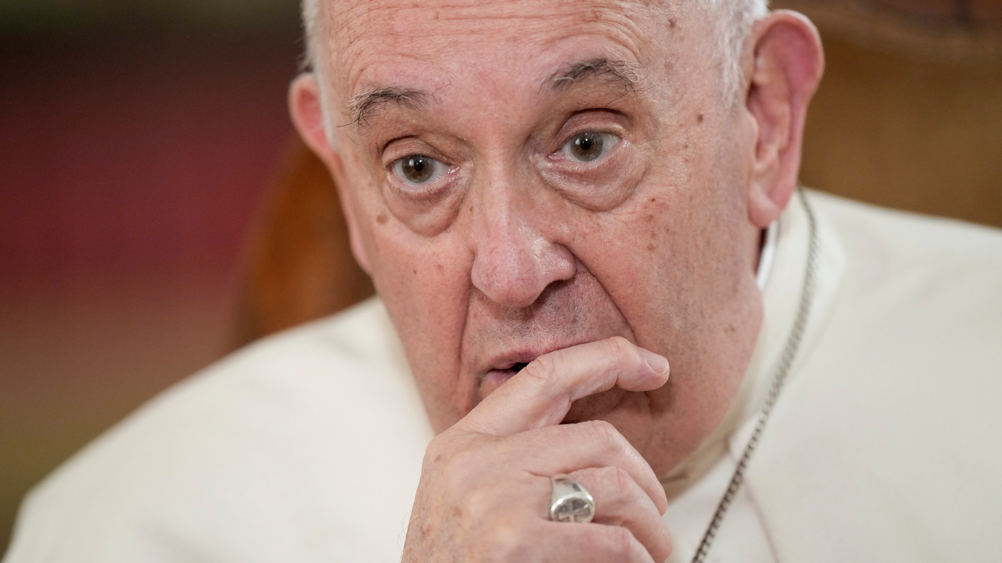
“Love needs time and space; everything else is secondary.”
- Pope Francis, Amoris Laetitia 224
BDES

Slide 20
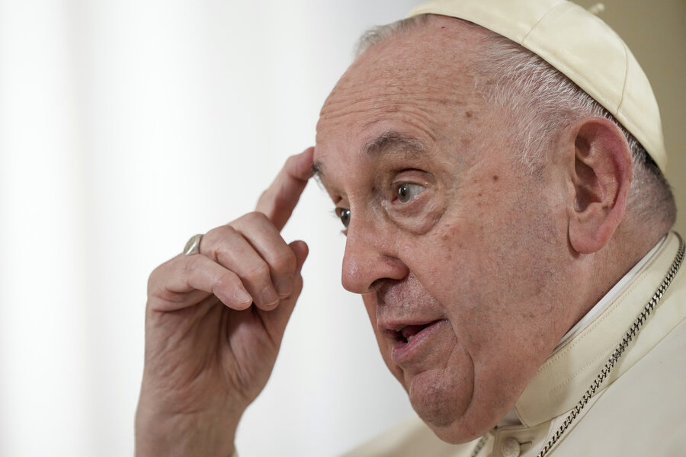
As a community,
we have an obligation
to ensure that
every person lives
with dignity.
- Pope Francis, Fratelli Tutti, 118
BDES

Slide 21
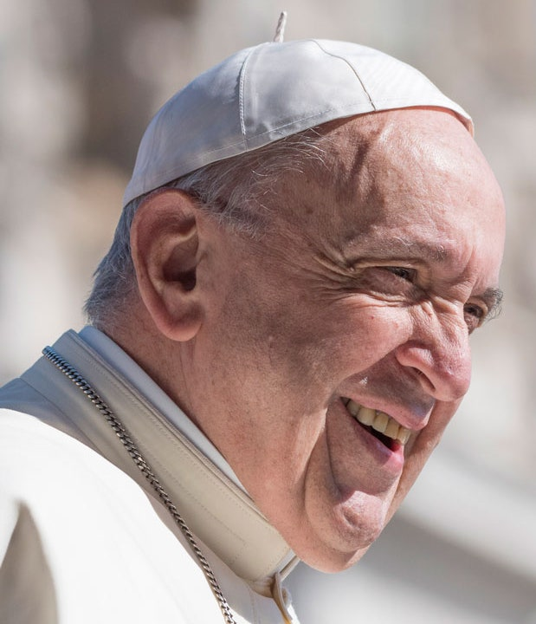
“The world exists
for everyone,
because all of us
were born with the same dignity.”
- Pope Francis, Fratelli Tutti 118
BDES

Slide 22
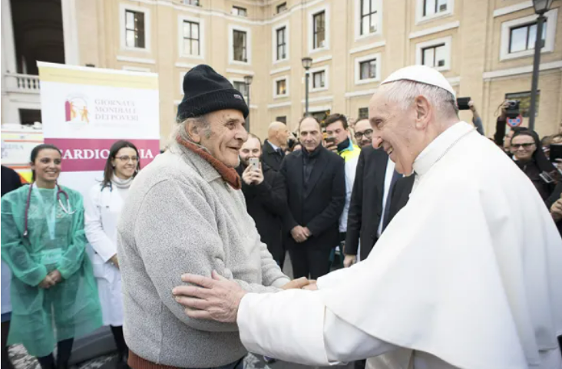
“Each of us can learn something from others.”
- Pope Francis, Fratelli Tutti (215)
BDES

Slide 23
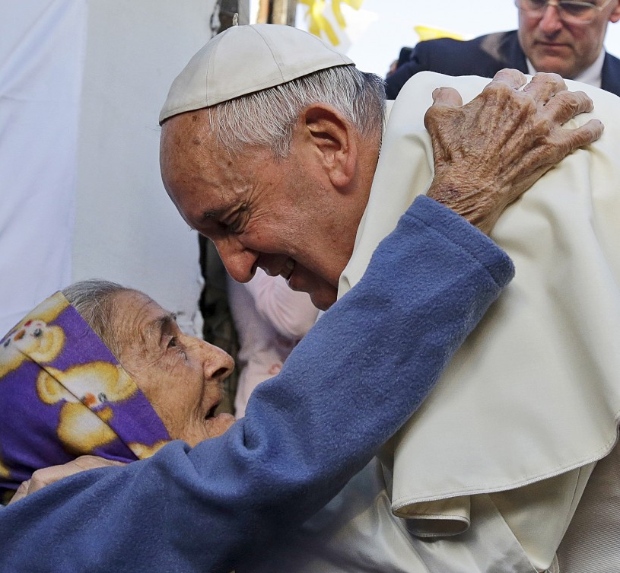
“No one is
useless
and
no one is
expendable.”
- Pope Francis, Fratelli Tutti 215
BDES

Slide 24
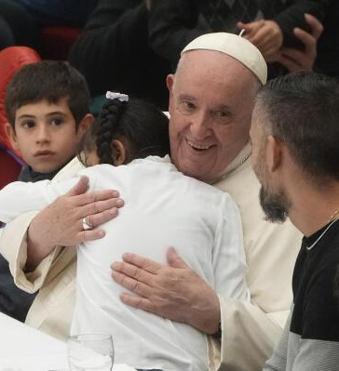
“It is an act of charity
to assist someone suffering,
but it is also an act of charity to work to change
the social conditions
that caused
his or her suffering.”
- Pope Francis, Fratelli Tutti 186
BDES

Slide 25
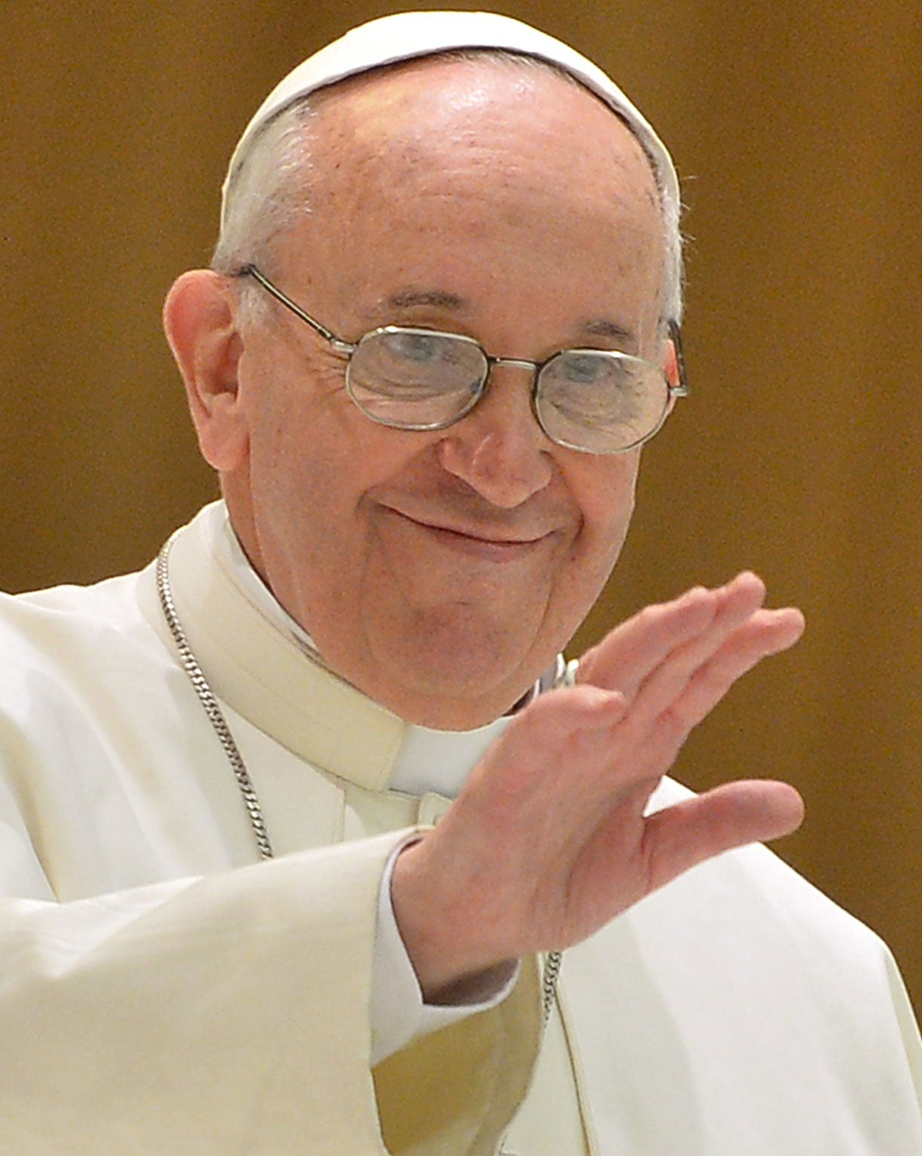
“I will give everyone
the possibility of
sharing this planet
with me,
despite all our
differences.”
- Pope Francis, Fratelli Tutti 269
BDES

Slide 26
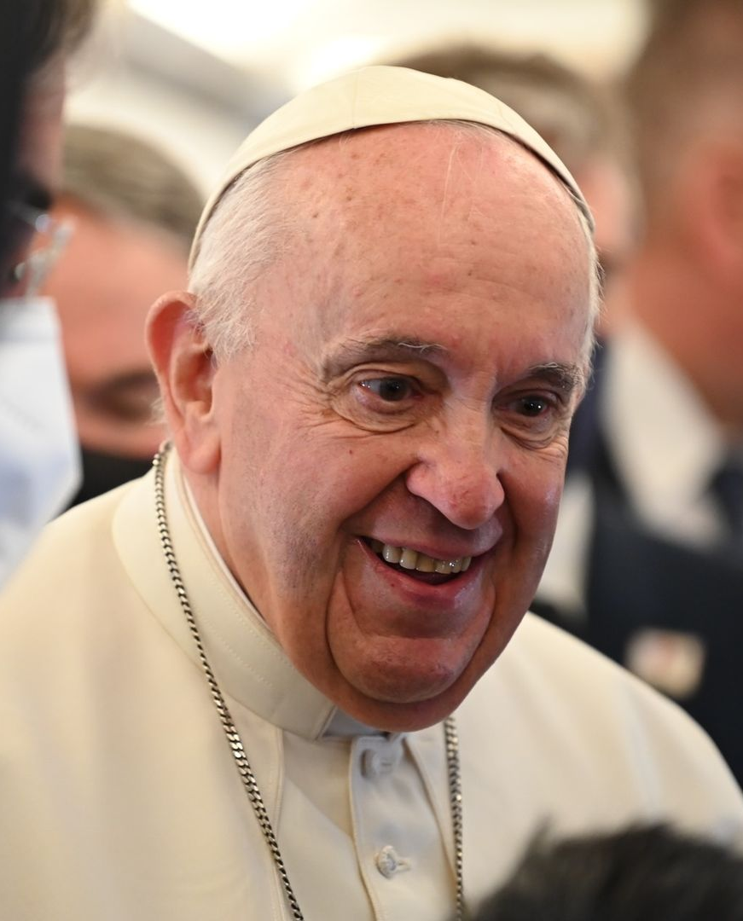
“We can choose
to cultivate
kindness.”
- Pope Francis,
Fratelli Tutti 222
BDES

Slide 27
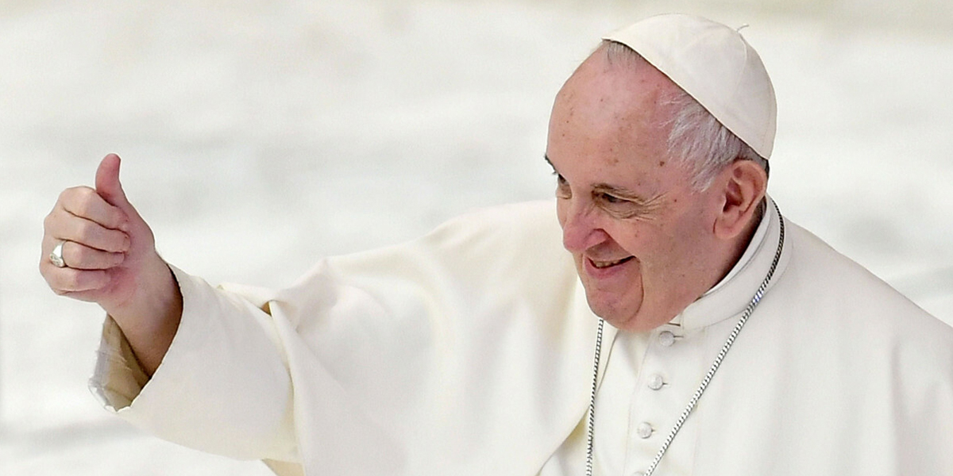
“You are priceless.”
- Pope Francis, Christus Vivit
BDES

Slide 28
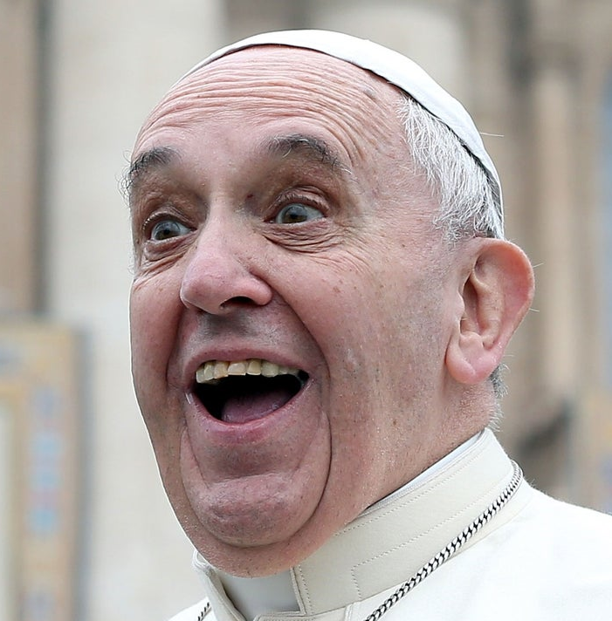
“Imitating the Saints does not mean
copying their lifestyle
and their way of living holiness.
You have to discover who you are and develop your own way of being holy, whatever others may say or think.”
- Pope Francis, Christus Vivit
BDES

Slide 29
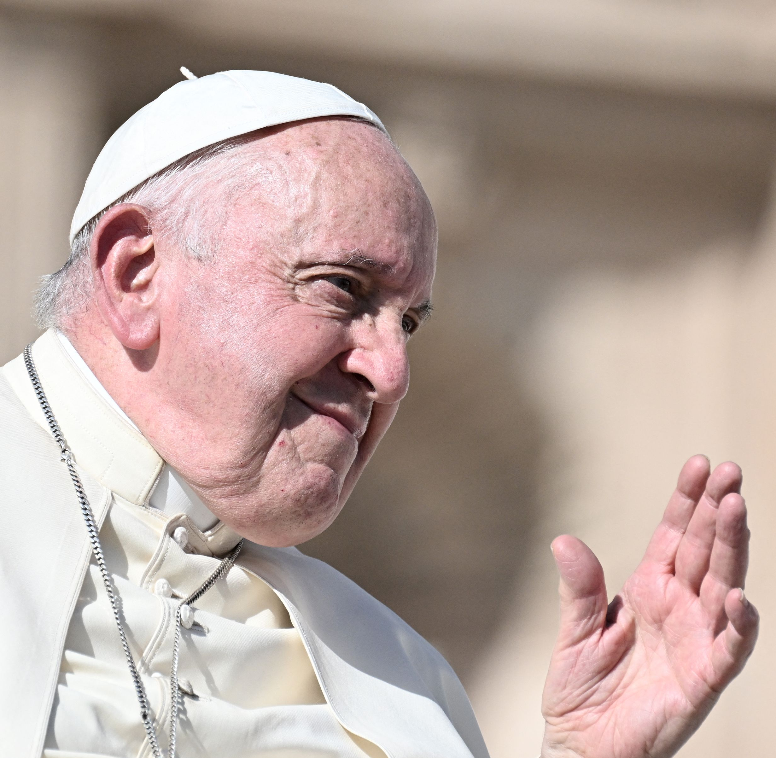
“Make the most of these
years of your youth.
Don’t observe life
from a balcony.”
- Pope Francis, Christus Vivit
BDES

Slide 30
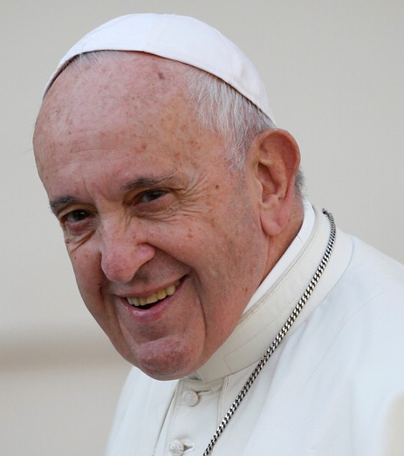
“Just as you try not to lose your connection to the internet, make sure that you stay connected with the Lord.”
- Pope Francis, Christus Vivit
BDES

Slide 31
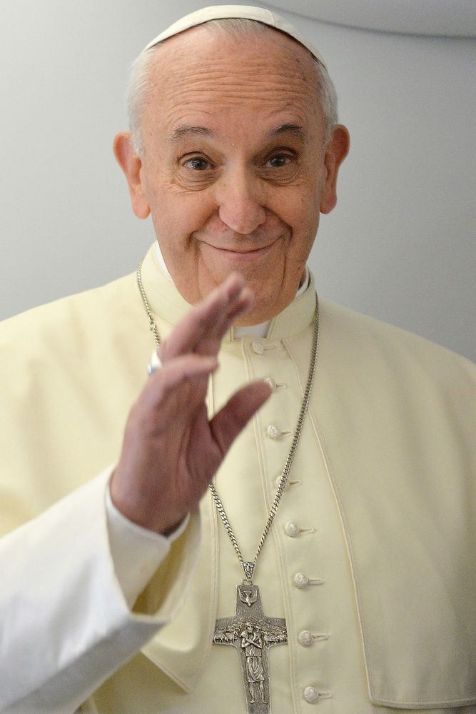
“Dream freely and make good decisions.”
- Pope Francis, Christus Vivit
BDES

Slide 32
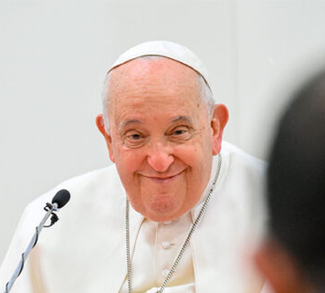
“Even if you make mistakes, you can always get up and start over, for no one has the right to rob you of hope.”
- Pope Francis, Christus Vivit
BDES

Slide 33
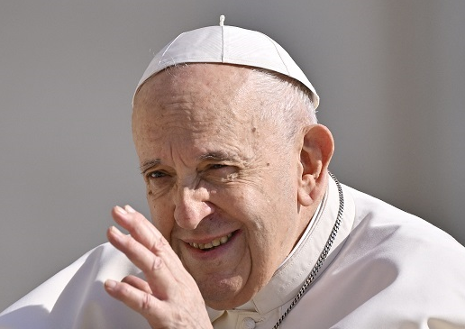
“Don’t go through life anaesthetized or approach the world like tourists.”
- Pope Francis, Christus Vivit
BDES

Slide 34
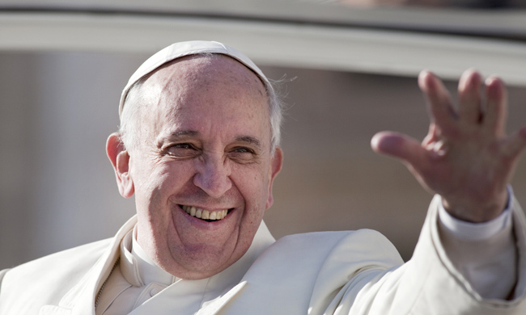

“The Saints next door : in their daily perseverance I see the holiness of the Church … it is a holiness found in our next-door neighbours, those who, living in our midst, reflect God’s presence.”
- Pope Francis, Gaudete et Exsultate
BDES

Slide 35
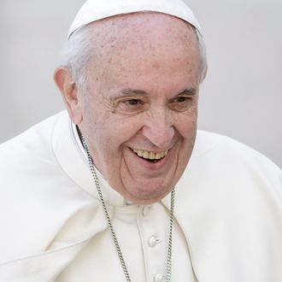
“I thank God
that many families, which are far from considering
themselves perfect, live in love, fulfil their calling and keep moving forward.”
- Pope Francis, Amoris Laetitia
BDES

Slide 36
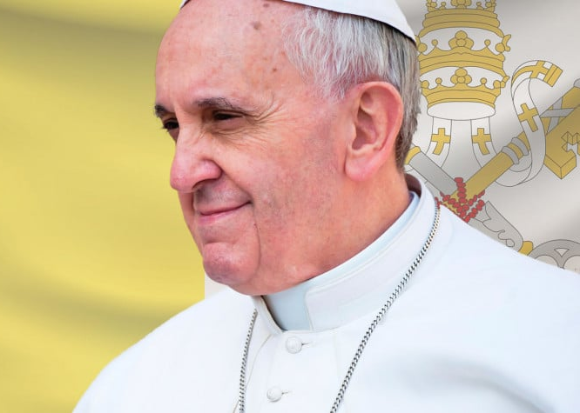
“Join in
daily prayer,
read the
word of God
and
grow in love.”
- Pope Francis, Amoris Laetitia
BDES

Slide 37
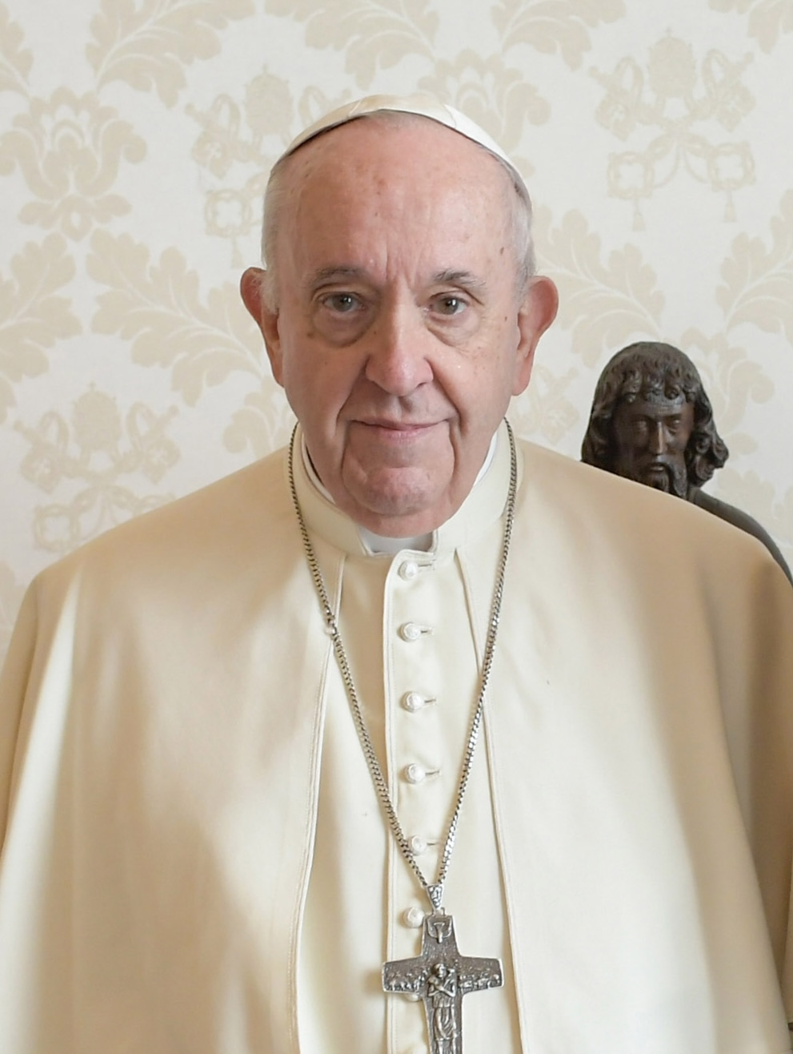
“Unless we cultivate patience, we will always find excuses for responding angrily.”
- Pope Francis, Amoris Laetitia
BDES

Slide 38
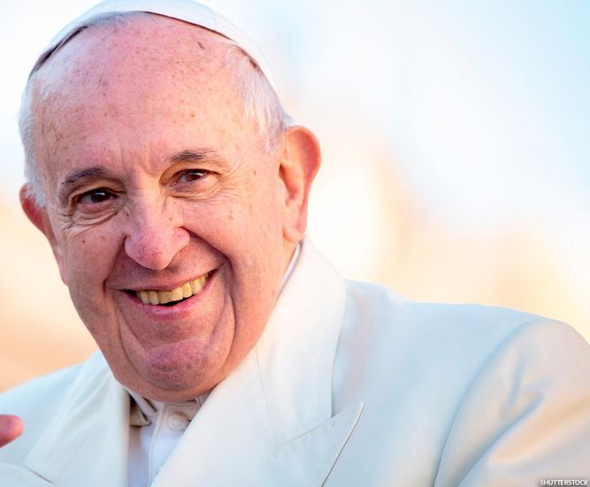
“True love frees us from the sour taste of envy.”
- Pope Francis, Amoris Laetitia
BDES

Slide 39
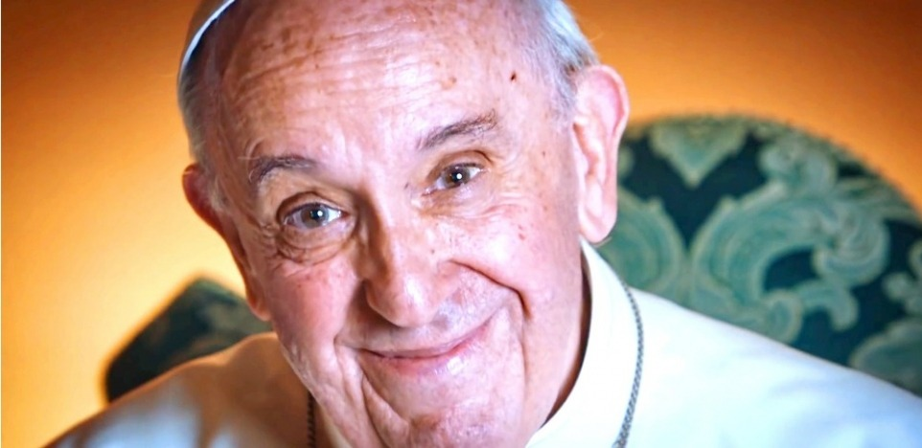
“True love values the other person’s achievements.”
- Pope Francis, Amoris Laetitia
BDES

Slide 40
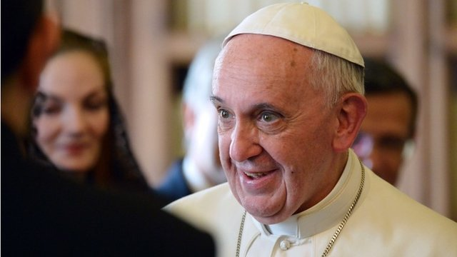
“True love recognises that everyone has different gifts and a unique path in life.”
- Pope Francis, Amoris Laetitia
BDES

Slide 41
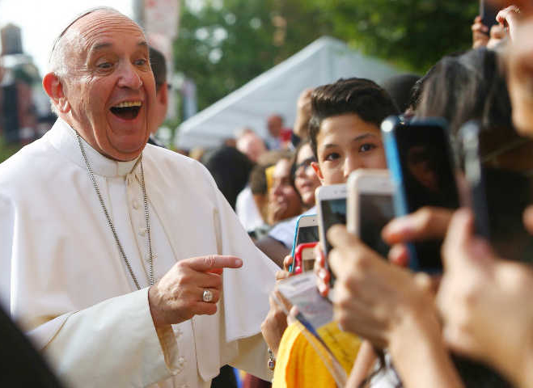
“True love strives to discover its own road to happiness,
while allowing others
to find theirs.”
- Pope Francis, Amoris Laetitia
BDES

Slide 42
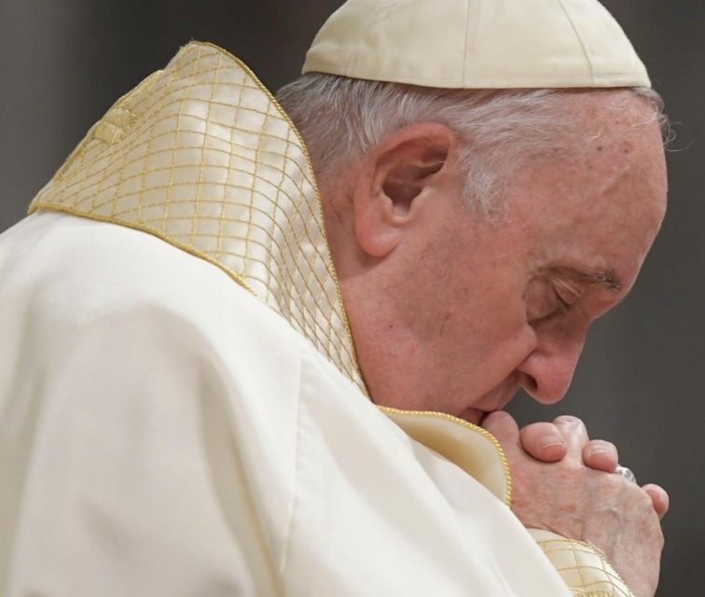
“The final word on our life will belong to Jesus.”
- Pope Francis, Youth Sunday Mass 2021
BDES

Slide 43
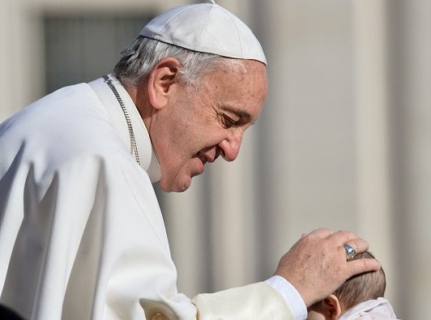
“Jesus reassures us :
‘I will not leave you alone when storms gather over your life’.”
- Pope Francis, Youth Sunday Mass 2021
BDES

Slide 44
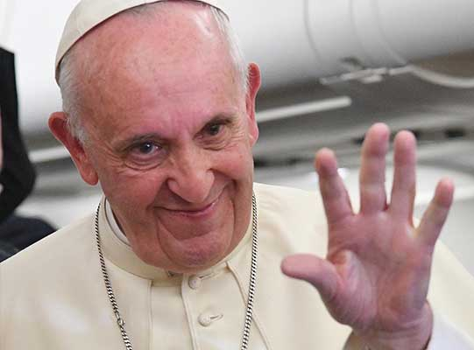
“Jesus reassures us :
I am always with you.”
- Pope Francis, Youth Sunday Mass 2021
BDES

Slide 45
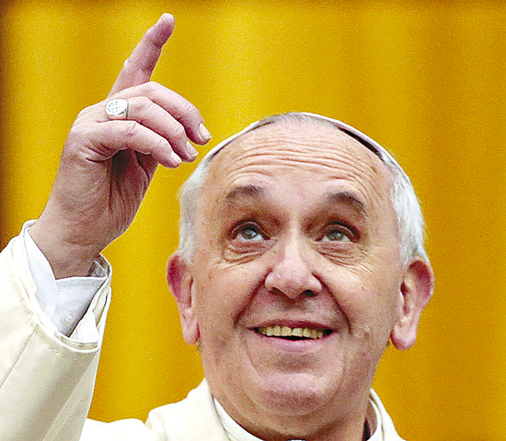
“Jesus
reassures us :
I come to bring back the bright sky.”
- Pope Francis,
Youth Sunday Mass 2021
BDES

Slide 46
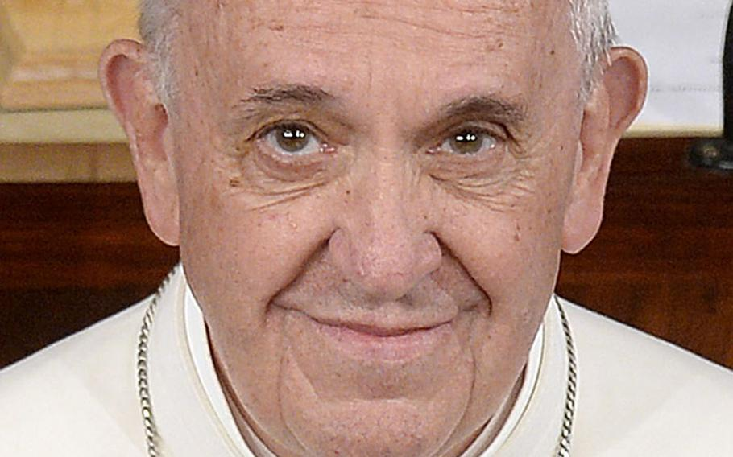
“Let your eyes remain bright even amid the darkness.”
- Pope Francis,
Youth Sunday Mass 2021
BDES

Slide 47
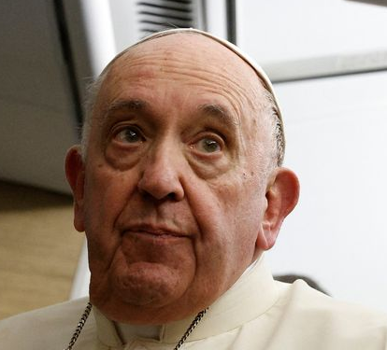
“Never stop seeking the light amid whatever darkness we may bear in our hearts or see all around us.”
- Pope Francis,
Youth Sunday Mass 2021
BDES

Slide 48
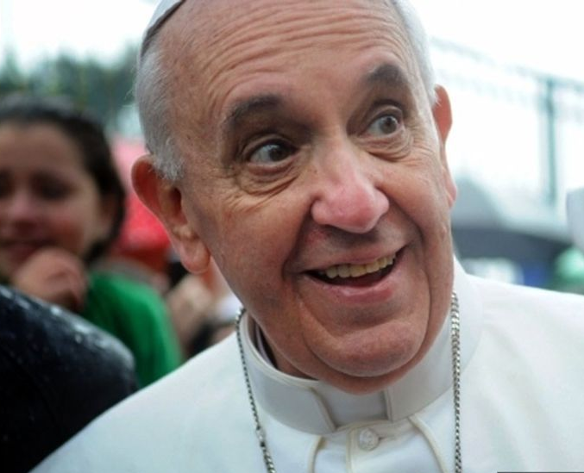
“You have been entrusted with an exciting but also a challenging task :
to be sentinels prepared to see the light in night visions.”
- Pope Francis, Youth Sunday Mass 2021
BDES

Slide 49
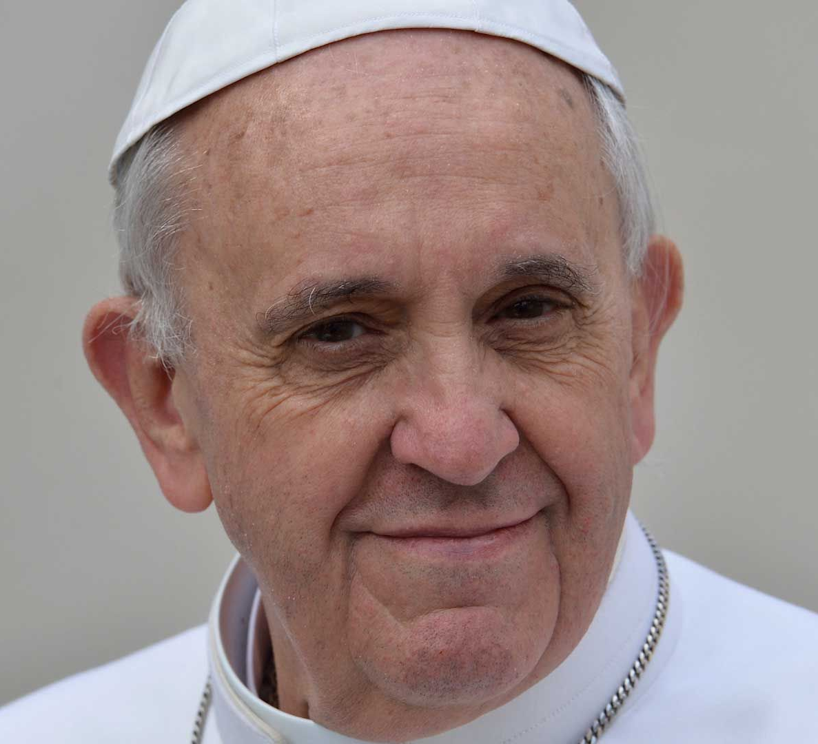
“You have been entrusted with an exciting but also a challenging task :
to stand tall while everything around us seems to be collapsing.”
- Pope Francis, Youth Sunday Mass 2021
BDES

Slide 50
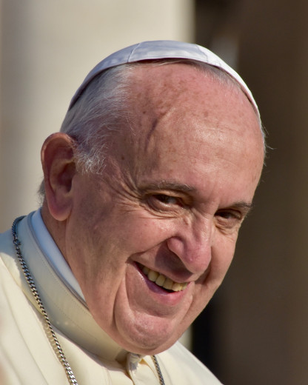
“You have been entrusted with an exciting but also a challenging task : to be builders amid the ruins; to be capable of dreaming.”
- Pope Francis, Youth Sunday Mass 2021
BDES

Slide 51
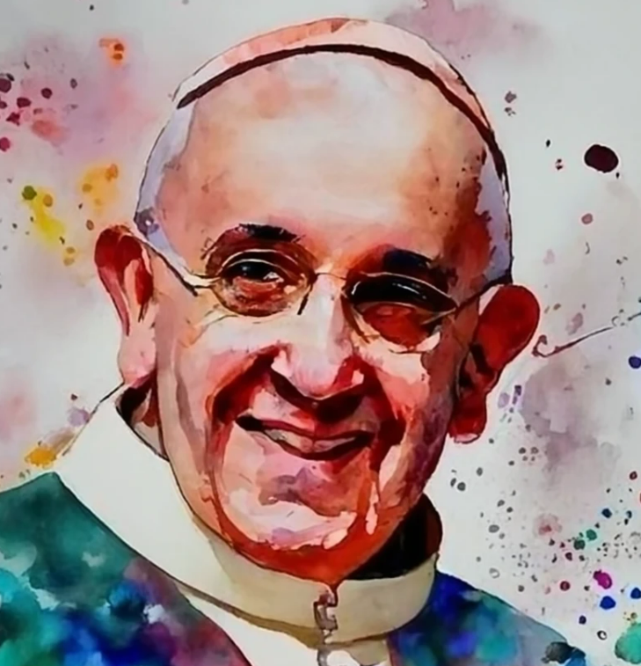
“A better world can be built as a result of your efforts,
your desire to change and your generosity.”
- Pope Francis,
Letter to Young People, 2018
BDES

Slide 52

“Everyone is grateful to you when you dream.”
- Pope Francis, Youth Sunday Mass 2021
BDES

Slide 53

“When you make Jesus your life’s dream, and you embrace him with joy and a contagious enthusiasm, this does us all good.”
- Pope Francis, Youth Sunday Mass 2021
BDES

Slide 54

“In a world that thinks only of present gain, that tends to stifle grand ideals,
you have not lost the ability to dream.
This helps us adults, and the Church as well.”
- Pope Francis, Youth Sunday Mass 2021
BDES

Slide 55

“By following Jesus,
we see life as it really is.”
- Pope Francis,
Youth Sunday Mass 2021
BDES

Slide 56

“By following Jesus, we are not deceived by the fashions of the moment and the displays of consumerism that dazzle but also deaden.”
- Pope Francis, Youth Sunday Mass 2021
BDES

Slide 57

“Friends, we are not here to be enchanted by the lures of the world, but to take our lives in hand.”
- Pope Francis, Youth Sunday Mass 2021
BDES

Slide 58

“Friends, we are here … to take a bite out of life, in order to live it to the full.”
- Pope Francis,
Youth Sunday Mass 2021
BDES

Slide 59

“With the freedom of Jesus, we find the courage we need to swim against the current.”
- Pope Francis, Youth Sunday Mass 2021
BDES

Slide 60

“Continue to dream even when you get older.”
- Pope Francis, Youth Sunday Mass 2021
BDES

Slide 61

“Be free and authentic.”
- Pope Francis, Youth Sunday Mass 2021
BDES

Slide 62

“Be the critical conscience of society.”
- Pope Francis,
Youth Sunday Mass 2021
BDES

Slide 63

“Be passionate about truth.”
- Pope Francis, Youth Sunday Mass 2021
BDES

Slide 64

“In your dreams, you can say :
my life is not captive to the mindset of the world.”
- Pope Francis, Youth Sunday Mass 2021
BDES

Slide 65

“Always know in your heart
that God is
by your side.”
- Pope Francis, World Youth Day 2013
BDES

Slide 66

“God never abandons you.”
- Pope Francis,
World Youth Day 2013
BDES

Slide 67

“Let us never lose hope!”
- Pope Francis, World Youth Day 2013
BDES

Slide 68

“Let us never allow hope to die in our hearts!”
- Pope Francis,
World Youth Day 2013
BDES

Slide 69

“Let us be lights of hope!”
- Pope Francis, World Youth Day 2013
BDES

Slide 70

“Let us maintain a positive outlook on reality.”
- Pope Francis,
World Youth Day 2013
BDES

Slide 71

“Let us encourage the generosity which is typical of the young and help them to work actively in building a better world!”
- Pope Francis, World Youth Day 2013
BDES

Slide 72

“Young people are
a powerful engine for
the Church and for society. ”
- Pope Francis, World Youth Day 2013
BDES

Slide 73

“What is the Lord saying to us? Three simple ideas:
Go, do not be afraid, and serve.”
- Pope Francis, World Youth Day 2013
BDES

Slide 74

“Faith is a flame that grows stronger the more it is shared and passed on.”
- Pope Francis,
World Youth Day 2013
BDES

Slide 75

“Jesus not only sends us, he accompanies us, he is always beside us in our mission of love.”
- Pope Francis, World Youth Day 2013
BDES

Slide 76

“Do not be afraid to listen
to the Spirit
who proposes bold choices.”
- Pope Francis,
Letter to Young People, 2018
BDES

Slide 77

“Young people must say to the world : to follow Christ is good!”
- Pope Francis, Palm Sunday 2013
BDES

Slide 78

“Young people must say to the world : the message of
Christ
is good!”
- Pope Francis, Palm Sunday 2013
BDES

Slide 79

“Jesus is in you, He is with you and He never abandons you.”
- Pope Francis, Christus vivit, 2019
BDES

Slide 80

“In your dreams,
you can say :
I am free,
because I reign
with Jesus
for justice,
love and peace.”
- Pope Francis, Youth Sunday 2021
BDES

Slide 81

“However far you wander, Jesus is always there.”
- Pope Francis,
Christus vivit, 2019
BDES

Slide 82

“Jesus calls you and He waits for you to return to Him and start over again.”
- Pope Francis, Christus vivit, 2019
BDES

Slide 83

“Jesus will always be there to restore your strength and your hope.”
- Pope Francis, Christus vivit, 2019
BDES

Slide 84

“Youth
is for taking risks,
good risks,
risks full of hope.”
- Pope Francis,
Convocation of the
Renewal in the Holy Spirit,
2014
BDES

Slide 85

“Youth is meant to help others know the Lord.”
- Pope Francis, Convocation of the Renewal in the Holy Spirit, 2014
BDES

Slide 86

“Don’t keep your youth
to yourselves : get out there!”
Pope Francis,
Convocation of the
Renewal in the Holy Spirit,
2014
BDES

Slide 87

“Ask the Lord to give us
the grace to be merciful
to those
who do us wrong.”
- Pope Francis, World Youth Day, 2016
BDES

Slide 88

“Always be living stones in the Church, to build up the Church, by being united to Jesus.” - To the young people of Italian xxxxxxxxxxxxxxxxxxxxxxxxxxxxxxxxxxxxxxxxxxxxxxxxxCatholic Action, 2013
BDES

Slide 89

“Enthusiasm, when it is healthy, demonstrates this: that one has something of God inside and expresses Him joyously.”
- Papal address, July 2014
BDES

Slide 90

“Catholic Action without Jesus is pointless.”
- Pope Francis, To young people of Italian Catholic Action, 2013
BDES

Slide 91

“Be open to hope and to yearn for fullness.”
- Pope Francis, Papal Address, July 2014
BDES

Slide 92

“Be open
to yearn
to give meaning
to your future.”
- Pope Francis, papal address, July 2014
BDES

Slide 93

“Imagine
the appropriate journey
for each of you.”
- Pope Francis, Papal Address 2014
BDES

Slide 94

“Choose the path that brings you peace and human fulfilment.”
- Pope Francis, papal address, July 2014
BDES

Slide 95

“Do not stand still; a young person cannot stand still.”
- Pope Francis, Papal Address 2014
BDES

Slide 96

“Youth cannot remain on hold.”
- Pope Francis : Young People, Faith and Discernment, 2018)
BDES

Slide 97

“Youth is the age of choices and here lies its fascination and its greatest responsibility.”
- Pope Francis,
Young People, Faith and Discernment, 2018
BDES

Slide 98

“Hear God’s voice resounding in your heart through the breath of the Holy Spirit.” - Pope Francis, Letter to Young People, 2018
BDES

Slide 99

“Jesus looks at you
and invites you
to go with Him.”
- Pope Francis,
Letter to Young People, 2018
BDES

Slide 100

“Even when the journey is uncertain and you fall, God, rich in mercy, will extend his hand to pick you up.”
- Pope Francis, Letter to Young People, 2018
BDES

Slide 101


“Life is not made for roaming aimlessly through, it is made to journey through, and this is your challenge!”
- Pope Francis, papal address, July 2014
BDES

