Slide 1
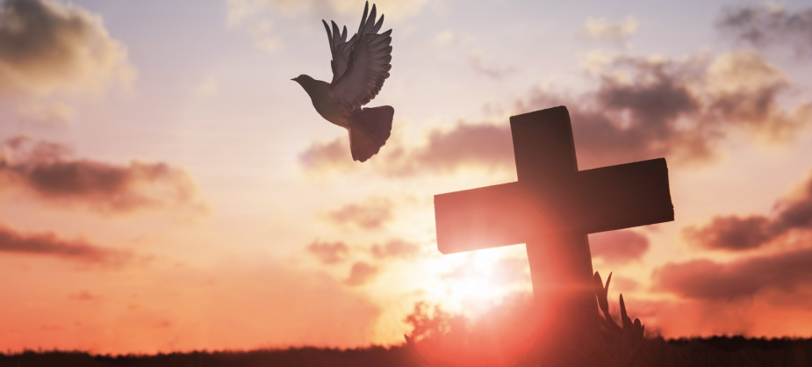


Walking the Path
~ Walking the Path of Courage ~
Monday 16th December 2024
Brentwood Diocese Education Service

Slide 2
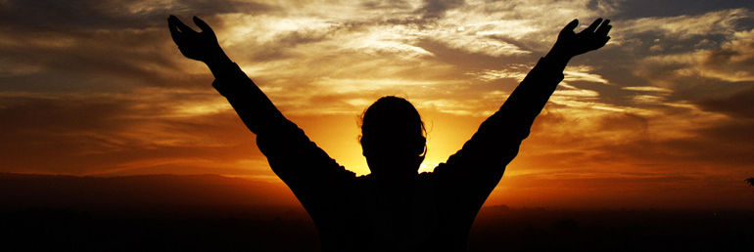
Walking the Path of Courage
“Do not be afraid,” he said.
“Peace! Be strong now; be strong.”
When he spoke to me, I was strengthened and said,
“Speak, my lord, since you have given me strength.”
(Daniel 10 : 19)
BDES

Slide 3
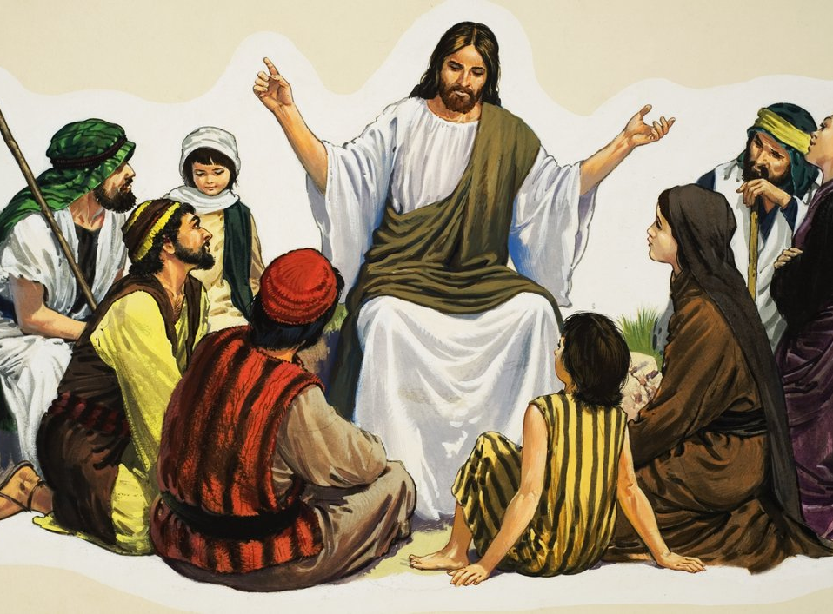
In Sunday’s Gospel Reading …
15th December 2024
In the Gospel of Luke, we hear that :
“He preached good news to the people.”
BDES

Slide 4

THIRD SUNDAY OF ADVENT
GAUDETE SUNDAY
BDES

Slide 5

Letters of the New Testament # 7
From the Letter of St Jude :
“Mercy, peace and love be yours in abundance.”
BDES

Slide 6

Preparing for World Youth Day 2027
“Have the courage to swim against the tide.”
- Pope Francis
BDES

Slide 7
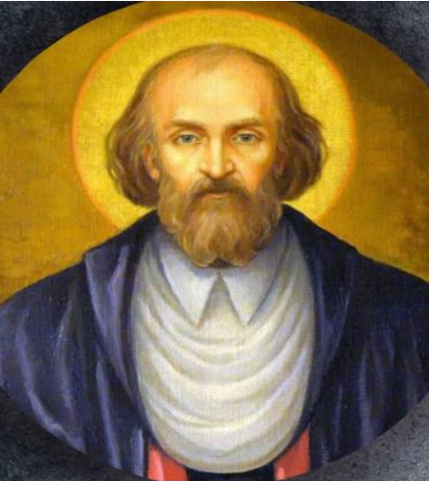
St. John of Kanty
23rd December
John was from a simple country background but after brilliant studies he became a professor of theology at the university of Kraków, Poland and was ordained a priest. He was a serious, humble man, but known to all the poor of Kraków for his kindness. His famous advice : “Fight all error but do it with good humour, patience, kindness and love.”
BDES

Slide 8
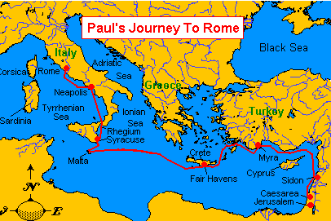
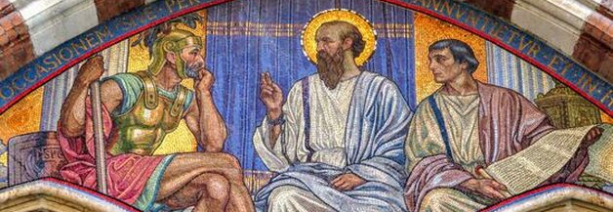
St Paul’s Missionary Journeys
St Paul’s final known journey was as a prisoner aboard ship to Rome where he spent two years under house arrest. During all this journeying and during the time of his imprisonment, he continued to spread the Good News.
# 7 : Rome
BDES

Slide 9
Walking the Path
~ Walking the Path of Courage ~
Monday 16th December 2024
Brentwood Diocese Education Service

