Slide 1
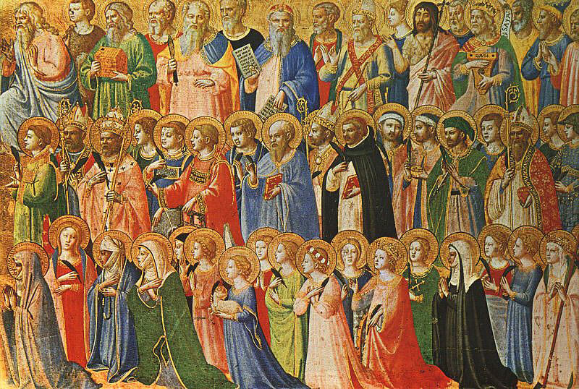
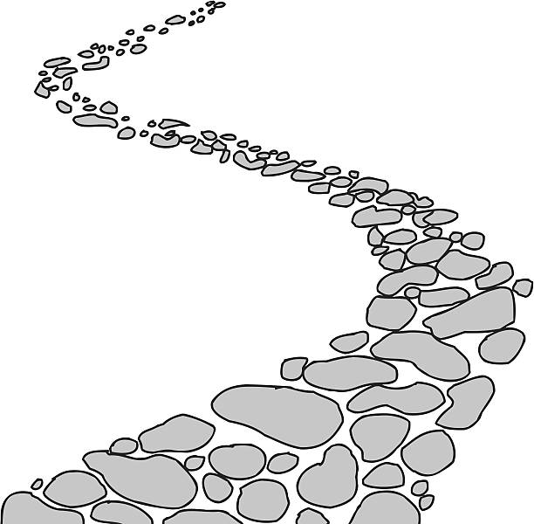
Walking the Path
~ Walking the Path of Saintliness ~
Monday 6th January 2025
Brentwood Diocese Education Service

Slide 2
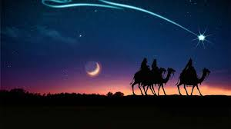
Walking the Path of Saintliness
Epiphany
A special blessing for your home
The Church has a custom of blessing homes on the Solemnity of the Epiphany and the weeks following. Family and friends gather to ask God’s blessing on their homes and those who live in or visit. It is an invitation for Jesus to be a daily guest in our home, our comings and goings, our conversations, our work and play, our joys and sorrows.
A traditional way of doing this is to use chalk blessed during the Solemnity of the Epiphany and write above the home’s entryway, 20 + C + M + B + 25. The letters C, M, B have two meanings. They are the initials of the traditional names of the three magi: Caspar, Melchior, and Balthazar. They also abbreviate the Latin words Christus mansionem benedicat, “May Christ bless the house.” The “+” signs represent the Cross, and 2025 is the year.
BDES

Slide 3
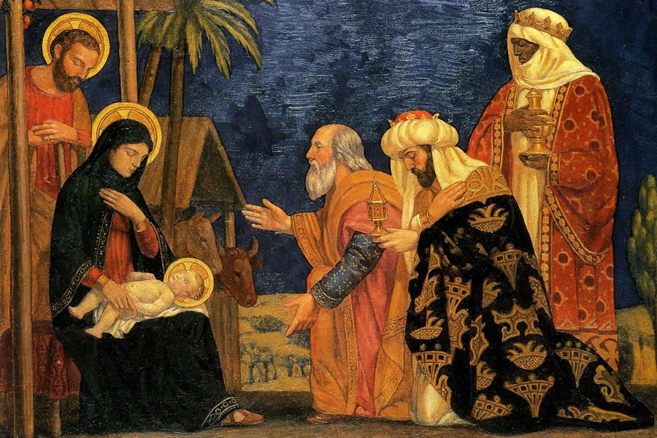
In Sunday’s Gospel Reading …
Epiphany
Sunday 5th January 2025
In the Gospel of Luke, we hear that
“They rejoiced exceedingly with great joy.”
BDES

Slide 4
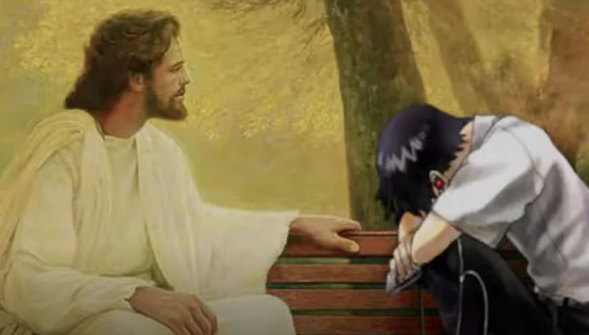
Reflection
CHRIST
BE
BESIDE
ME.
From the prayer known as
St Patrick’s Breastplate,
5th Century
BDES

Slide 5
Preparing for World Youth Day 2027
“Saints are precious pearls.”
- Pope Francis.
BDES

Slide 6
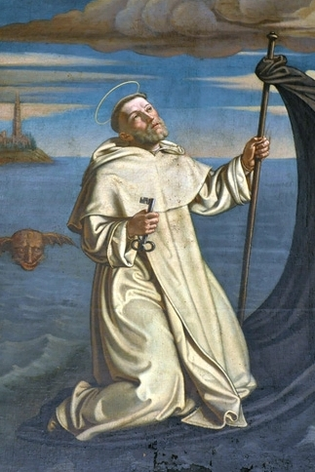
St. Raymond of Penyafort
Feast day : 10th January
St Raymond of Penyafort was a Dominican friar from Catalonia who lived from 1176 to 1275.
He was seen to perform a miracle by using his cloak and staff to create a boat in which he sailed from Majorca to Barcelona in six hours.
He collected canon laws which were in use until 1917 when they were revised. He is the patron saint of lawyers, especially canon lawyers.
BDES

Slide 7
Rites of the Catholic Church # 1
THE COPTIC CATHOLIC CHURCH
The Alexandrian Rite, which includes the Egyptian Coptic Catholic Church, is historically linked with the missionary John Mark of the Acts of the Apostles, who travelled to Alexandria, the Greek-speaking capital of the diocese of Egypt.
The liturgy of the modern Coptic Catholic Church developed from that of St. John Chrysostom. Their service book is written in the ancient Coptic language, with Arabic in parallel columns. Readings from the Apostles and the Gospels are in Arabic.
The Alexandrian Rite
BDES

Slide 8
Walking the Path
~ Walking the Path of Saintliness ~
Monday 6th January 2025
Brentwood Diocese Education Service

