Slide 1
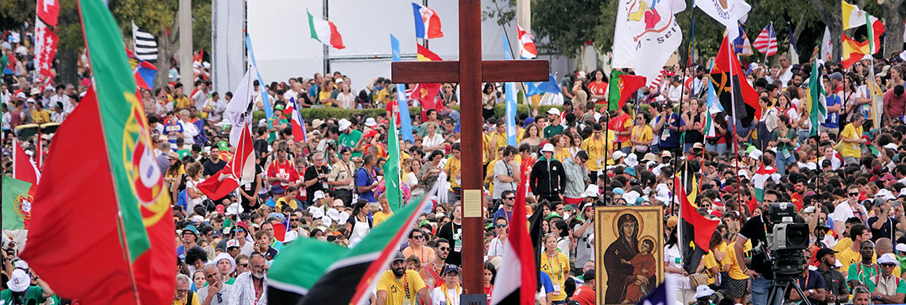
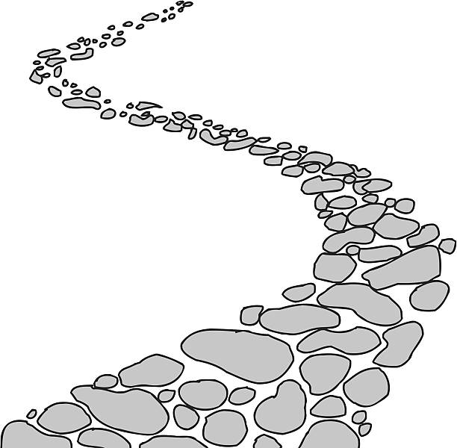
Walking the Path
~ Walking the Path of Saintliness ~
Monday 13th January 2025
Brentwood Diocese Education Service

Slide 2
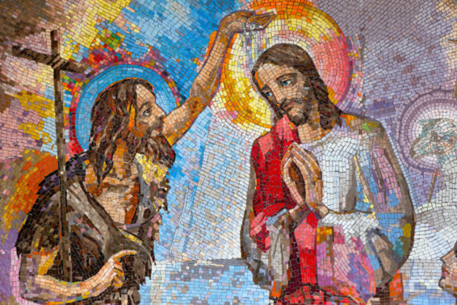
Walking the Path of Saintliness
FEAST OF THE BAPTISM OF THE LORD
Sunday 12th January
BDES

Slide 3
Walking the Path of Saintliness
Open the heavens, Almighty Father, and pour out your Spirit upon your people. Renew in us the grace of our Baptism so that we may reflect ever more faithfully the image of your Beloved Son, Jesus Christ who is Lord for ever and ever.
BDES

Slide 4
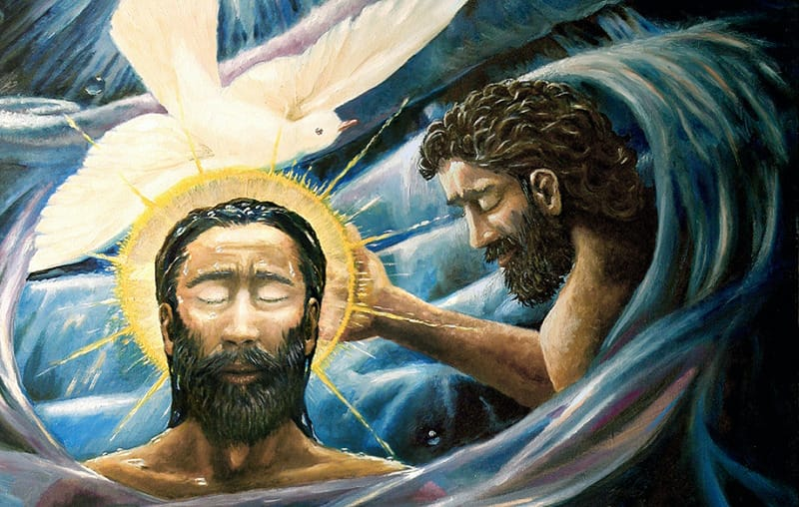
In Sunday’s Gospel Reading …
The Baptism of the Lord
Sunday 12th January 2025
In the Gospel of Luke,
the Father says to Jesus :
“You are my beloved Son;
with you I am
well pleased.”
BDES

Slide 5
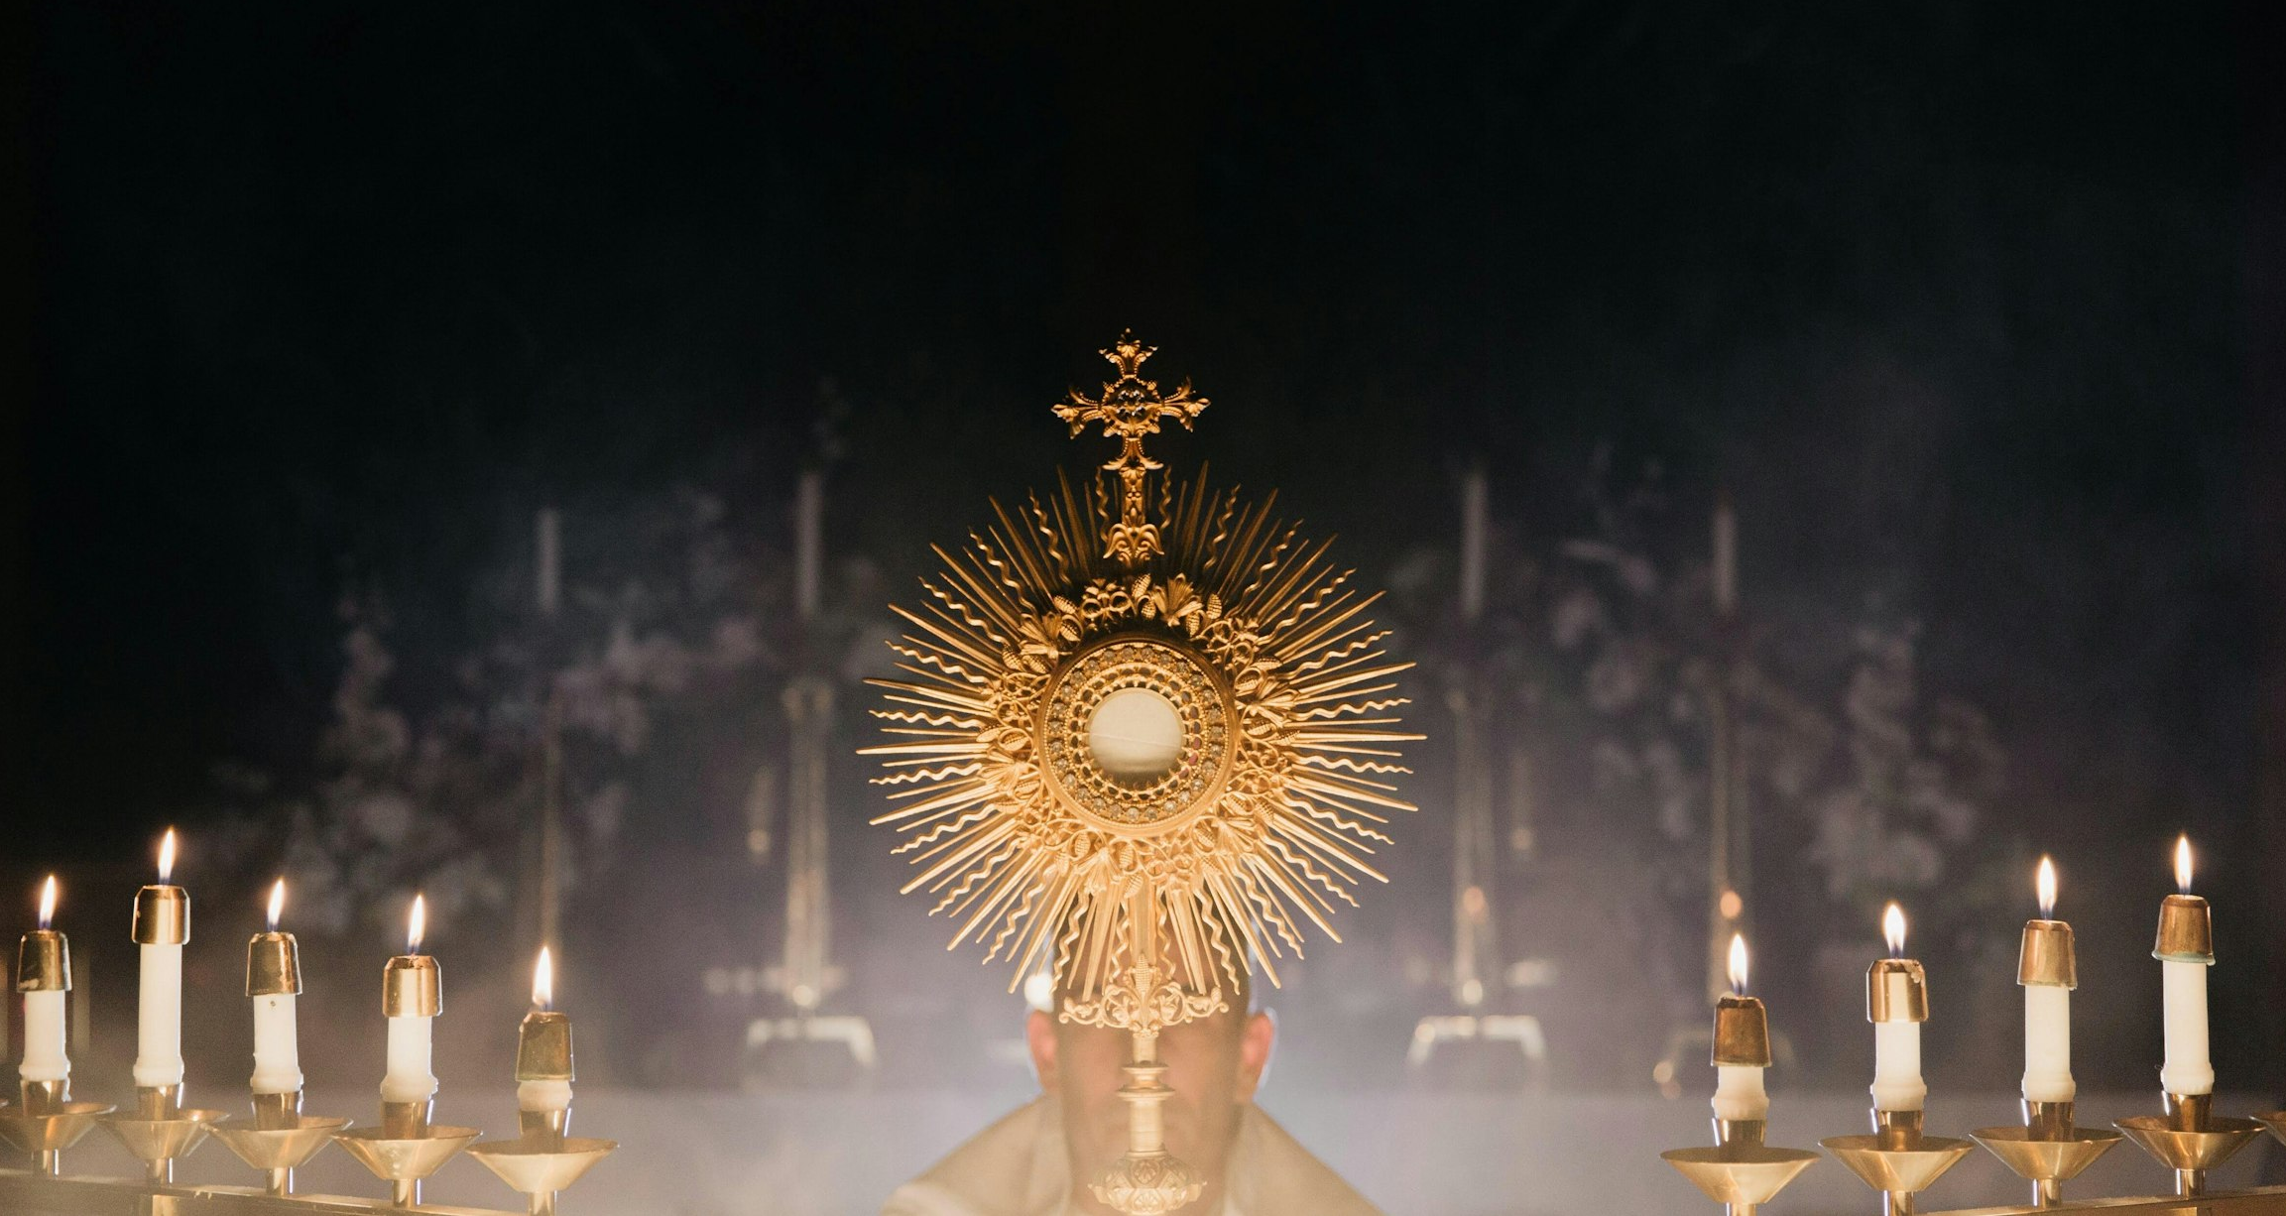
Reflection
CHRIST
BE
BEFORE
ME.
From the prayer known as
St Patrick’s Breastplate,
5th Century
BDES

Slide 6
Preparing for World Youth Day 2027
“Saints are our elder
brothers and sisters.”
- Pope Francis.
BDES

Slide 7
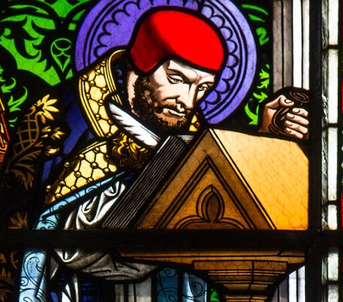
~ St. Hilary ~ 13th January ~
Hilary was born into a noble family in Poitiers, France. Although he was raised as a pagan his philosophical inquiries and study of Sacred Scripture led him to the Christian Faith.
He was appointed bishop of Poitiers in 353 AD. A very mild-mannered man, he did not hesitate to use robust language in telling off Emperor Constantius for his support of Arianism.
The outraged emperor exiled Hilary as punishment for his criticism. During the time in exile he gained fame writing in defence of the Faith. He was an “influencer” of his day!
St Hilary eventually returned to Poitiers and died there in 368. He has traditionally been invoked for protection against snakebites and was named a Doctor of the Church in 1851.
BDES

Slide 8
Rites of the Catholic Church # 1
THE ERITREAN CATHOLIC CHURCH
The Eritrean Catholic Church is an Eastern Catholic church in full communion with the Bishop of Rome, Pope Francis. Christianity emerged in Eritrea in the 1st century AD, when St Mark the Evangelist, St Matthias the Apostle and St Philip the Evangelist were preaching the Gospels in the region. Its language is Ge’ez (an otherwise extinct language) and its 160,000 members have been led by the Metropolitan Archbishop of Asmara, Menghesteab Tesfamariam, since 2015.
The Alexandrian Rite
BDES

Slide 9
Walking the Path
~ Walking the Path of Saintliness ~
Monday 13th January 2025
Brentwood Diocese Education Service

