Slide 1
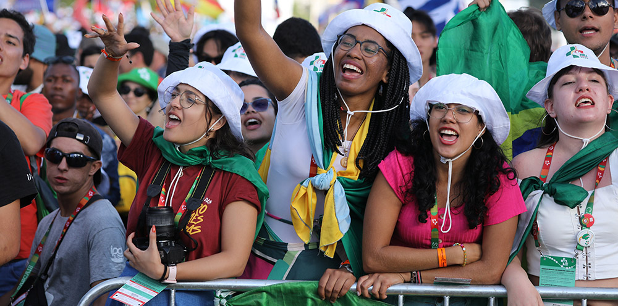
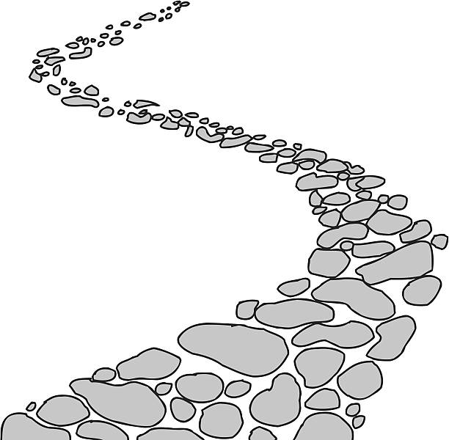
Walking the Path
~ Walking the Path of Saintliness ~
Monday 27th January 2025
Brentwood Diocese Education Service

Slide 2
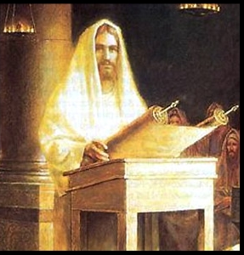
Hymn based on Sunday’s Gospel
God’s Spirit is in my heart
He has called me and set me apart.
This is what I have to do, what I have to do
He sent me to give the Good News to the poor
Tell prisoners that they are prisoners no more
Tell blind people that they can see
And set the downtrodden free
And go tell everyone the news that the
Kingdom of God has come
And go tell everyone
The news that God’s Kingdom has come.

Slide 3
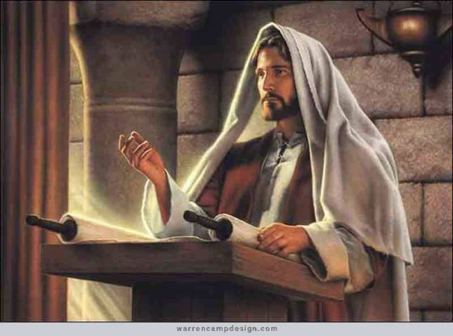
In Sunday’s Gospel Reading …
Sunday 26th January 2025
In the Gospel of Luke,
Jesus teaches :
“Today this Scripture
has been fulfilled in
your hearing.”
BDES

Slide 4
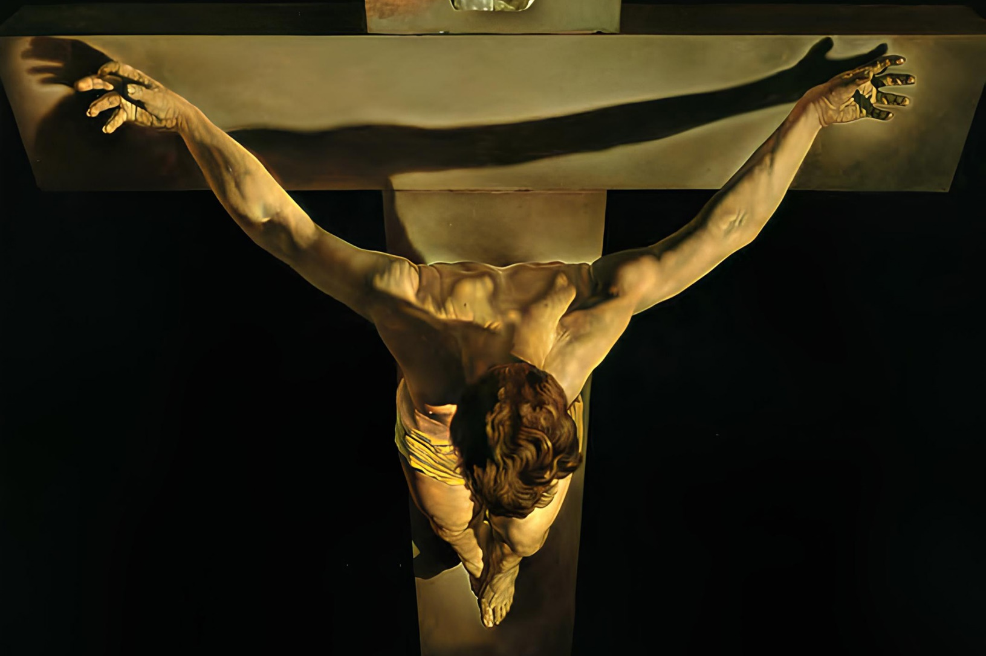
Reflection
CHRIST
BE
ABOVE
ME.
From the prayer known as
St Patrick’s Breastplate,
5th Century
BDES

Slide 5
Preparing for World Youth Day 2027
“The lives of the saints
provide us with
inspiration.”
- Pope Francis.
BDES

Slide 6
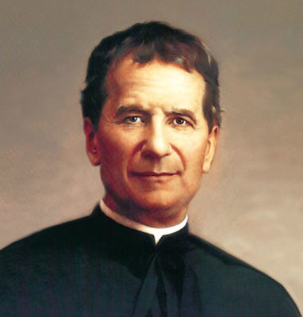
~ St. John Bosco ~ 31st January ~
Born in, 1815, John was educated in the faith and in living according to the Gospel message by his mother. He was just nine years old when he had a dream, which called him to dedicate himself to the education of young people. While still a boy, he began to entertain his peers with games alternated with work, prayer and religious education.
On becoming a priest, he began his work among poor young people with the founding of the Oratory, which he placed under the patronage of St. Francis de Sales.
He led young people to meet Christ by means of his educational style and pastoral practice, based on reason, religion and loving kindness. He led young people to reflect and to meet Christ and their brothers and sisters.
BDES

Slide 7
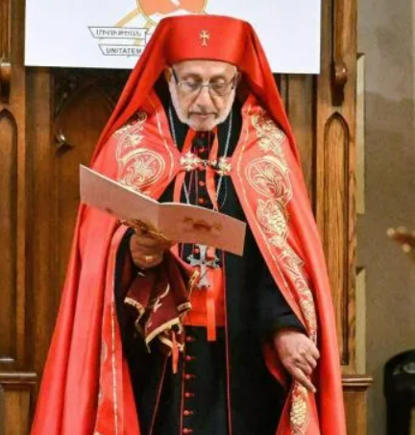
Rites of the Catholic Church # 2
THE ARMENIAN CATHOLIC CHURCH
Members of the Armenian Catholic Church are dispersed throughout the world. Their most numerous, and at the same time probably least known, group lives in Armenia and Georgia, especially in the provinces of Shirak and Lori and Samtskhe-Javakheti (Georgia). After the fall of the Soviet Union, the Armenian Catholic Church embarked on a process of reconstructing and reorganising its religious life. Priests from Europe and the Middle East have been delegated to work in Armenia and Georgia along with local clergy.
The Armenian Rite
BDES

Slide 8
Walking the Path
~ Walking the Path of Saintliness ~
Monday 27th January 2025
Brentwood Diocese Education Service

