Slide 1
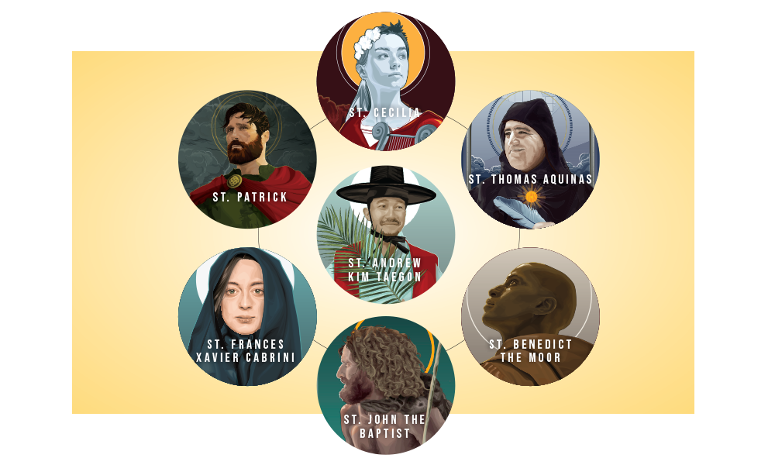


Walking the Path
~ Walking the Path of Saintliness ~
Monday 3rd February 2025
Brentwood Diocese Education Service

Slide 2

Walking the Path of Saintliness
Lord Jesus Christ,
You are the true Light
enlightening every soul born into this world.
Help us to realise, this day and every day,
that our own humdrum daily work,
if it is done for love of You,
and will shine brightly before You for all eternity.
You are the Light shining in the darkness of this world.
Help us to live in that Light, to make it our own,
and to kindle it in the souls of others.
Then we, too, working for You,
shall be light-bearers who will help to spread Your kingdom on earth,
and increase the number of those who dwell in heaven,
the city of eternal light.
Amen.
BDES

Slide 3
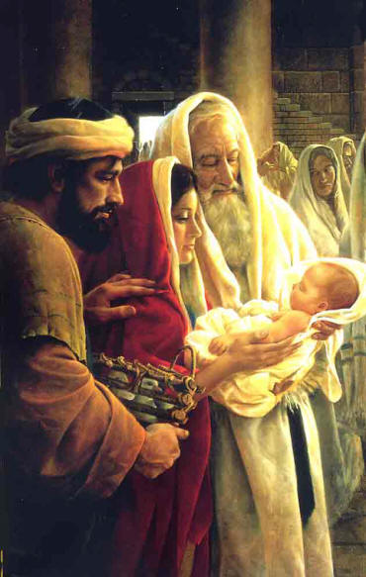
In Sunday’s Gospel Reading …
Presentation of Our Lord
Sunday 2nd February 2025
In the Gospel of Luke, Wise Simeon proclaims :
“For my eyes have seen your salvation.”
BDES

Slide 4
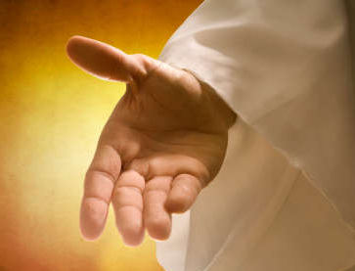
Reflection
CHRIST
BE ON MY RIGHT.
CHRIST
BE ON MY LEFT.
From the prayer known as
St Patrick’s Breastplate,
5th Century
BDES

Slide 5

Preparing for World Youth Day 2027
“We are called to be saints.”
- Pope Francis
BDES

Slide 6
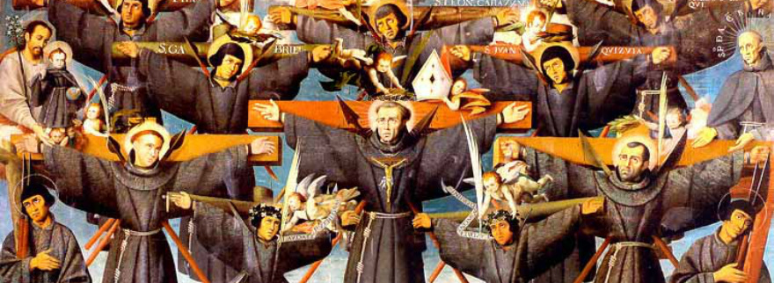
St Paul Miki & Companions
~ 6th February ~
Paul Miki was born into a wealthy Japanese family. He was educated by the Jesuits and joined their order, becoming a successful preacher and gaining numerous converts to Catholicism. The ruler of Japan began persecuting Catholics for fear of the Jesuits' influence and intentions.
Miki was arrested and jailed with his fellow Catholics, who were forced to march 600 miles from Kyoto to Nagasaki; all the while they sang the Te Deum. He was crucified, preaching his last sermon from the cross, and forgave his executioners. Twenty-five clergy and laity were crucified alongside him, all of whom were canonised by Pope Pius IX in 1862.
BDES

Slide 7
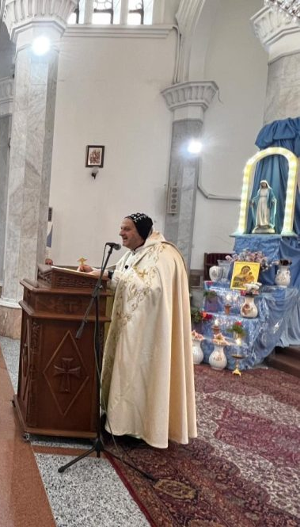
Rites of the Catholic Church # 3
THE SYRIAC CATHOLIC CHURCH
The Syriac Catholic Church traces its history and traditions to the early centuries of Christianity. It came into full communion with the Holy See and the modern Syriac Orthodox Church is the result of those that did not want to join the Catholic Church. The Syriac Catholic Church is therefore considered to be a direct descendant of the ancient and original Church of Antioch.
The church is headed by Mor (“Lord”) Ignatius Joseph III Younan, who has been the patriarch since 2009, with the title Patriarch of Antioch and all the East of the Syriacs. He resides in Beirut in Lebanon.
The Antiochian (West Syrian) Rite
BDES

Slide 8
Walking the Path
~ Walking the Path of Saintliness ~
Monday 3rd February 2025
Brentwood Diocese Education Service

