Slide 1
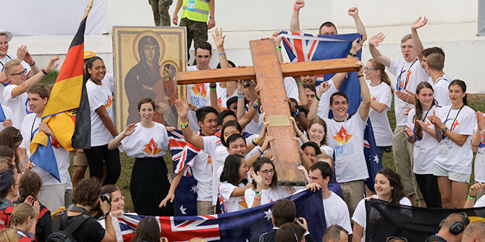
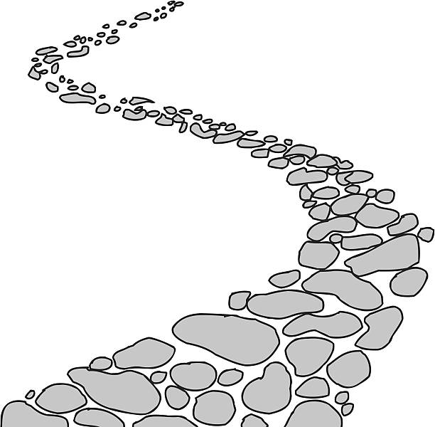
Walking the Path
~ Walking the Path of Saintliness ~
Monday 10th February 2025
Brentwood Diocese Education Service

Slide 2
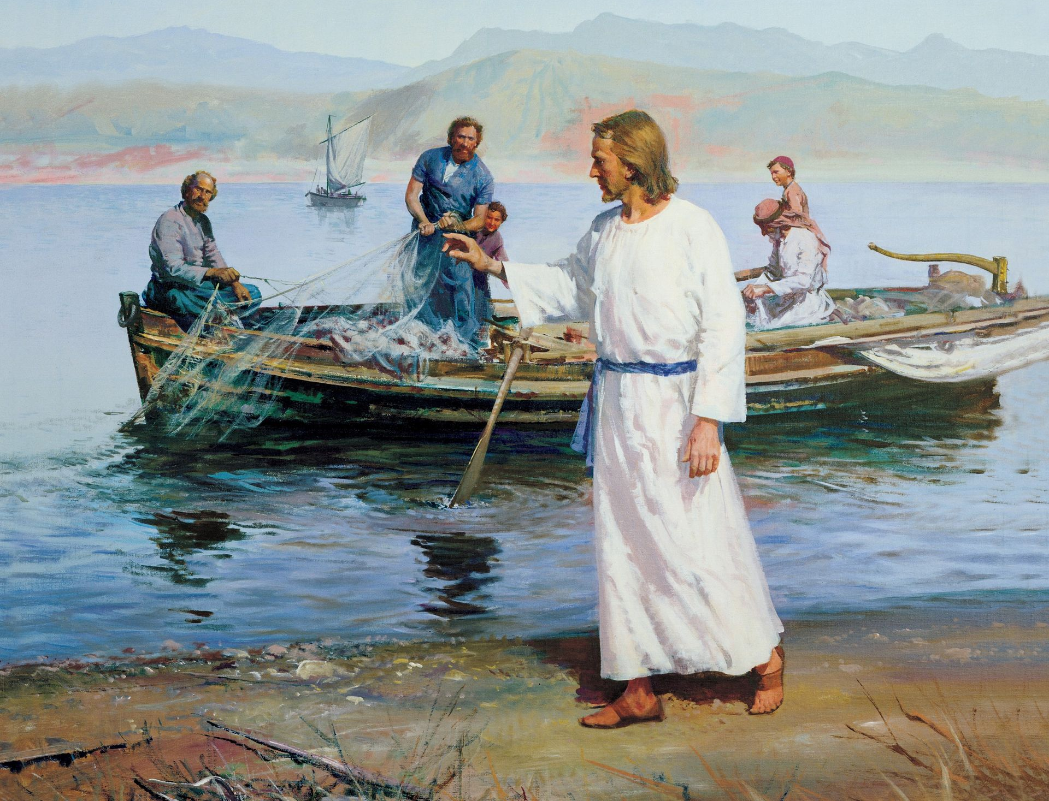
In Sunday’s Gospel Reading …
9th February 2025
In the Gospel of Luke,
Jesus says :
“Do not be afraid.”
BDES

Slide 3
DO NOT BE AFRAID
Do not be afraid, for I have redeemed you. I have called you by your name; you are mine.
When the fear of loneliness is looming, then remember I am at your side.
You are mine, O my child, I am your Father, and I love you with a perfect love.
- excerpt from hymn lyrics by Gerard Markland, based on Isaiah, Chapter 43

Slide 4
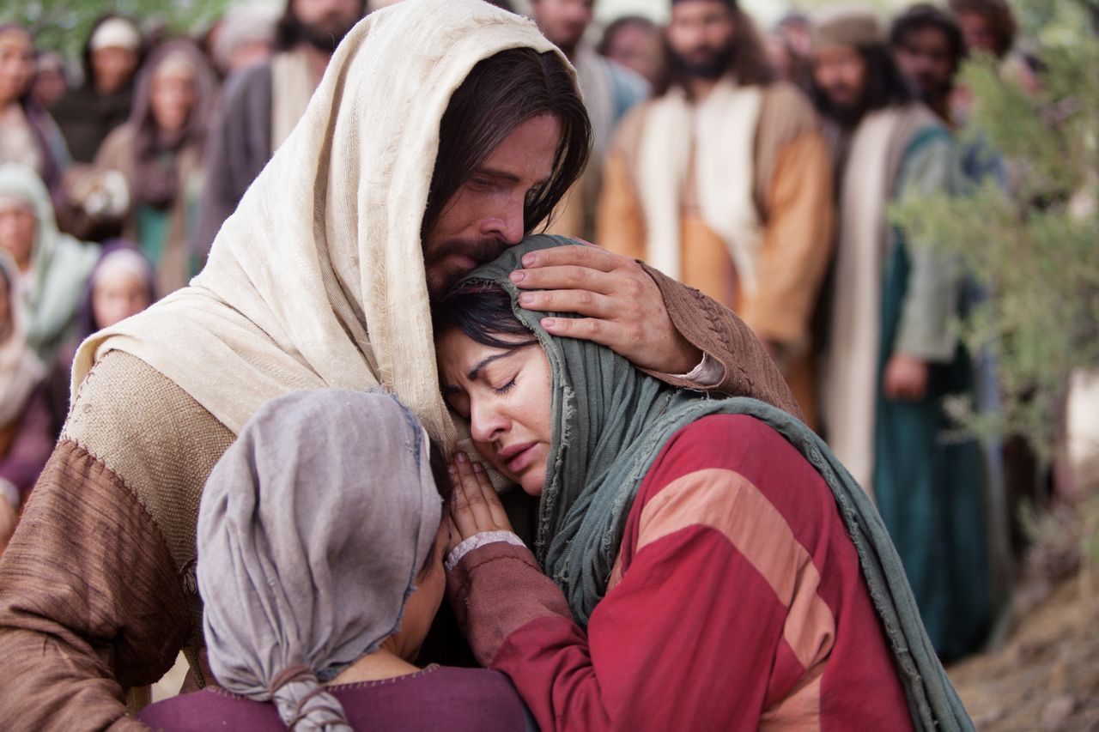
Reflection
CHRIST
BE ALL
AROUND
ME.
From the prayer known as
St Patrick’s Breastplate,
5th Century
BDES

Slide 5
Preparing for World Youth Day 2027
“There are saints next door who live out their faith quietly.”
- Pope Francis.
BDES

Slide 6
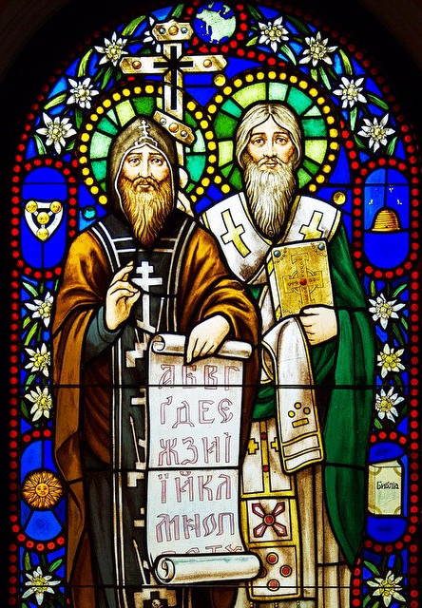
~ Saints Cyril and Methodius ~ ~ 14th February ~
Cyril and Methodius were two brothers remembered today as “Apostles of the Slavs” for their tireless work in spreading the Gospel throughout Eastern Europe in the ninth century. Such was their influence, that St. Pope John Paul II named them the patron saints of Europe along with St. Benedict.
They renounced family wealth to become monks and missionaries, first to the Khazars, then to the Moravians, then in modern-day Poland. They were enthusiastic learners of foreign languages and invented the “Cyrillic” alphabet, adapted from Greek, to translate the Bible xxx and liturgical books into Slavonic languages.
BDES

Slide 7
Rites of the Catholic Church # 2
THE MARONITE CATHOLIC CHURCH
The Maronite Catholic Church was founded in the 4th century by St Maron; after his death, over 800 monks adopted his way of life and became known as Maronites. The Maronite Patriarch has his seat in Bkerke, north of Beirut in Lebanon. In the liturgy of the Maronites there are a number of prayers said in Aramaic, the language of Jesus.
Maronites began to emigrate to the United States in the 19th century and there are currently 86 Maronite parishes and missions there, as well as a Maronite seminary established in 1961.
The Antiochian Rite
BDES

Slide 8
Walking the Path
~ Walking the Path of Saintliness ~
Monday 10th February 2025
Brentwood Diocese Education Service

