Slide 1
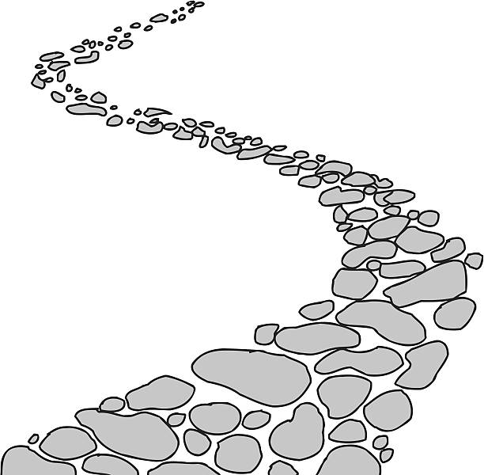
Walking the Path
~ Walking the Path of Forgiveness ~
Monday 3rd March 2025
Brentwood Diocese Education Service

Slide 2
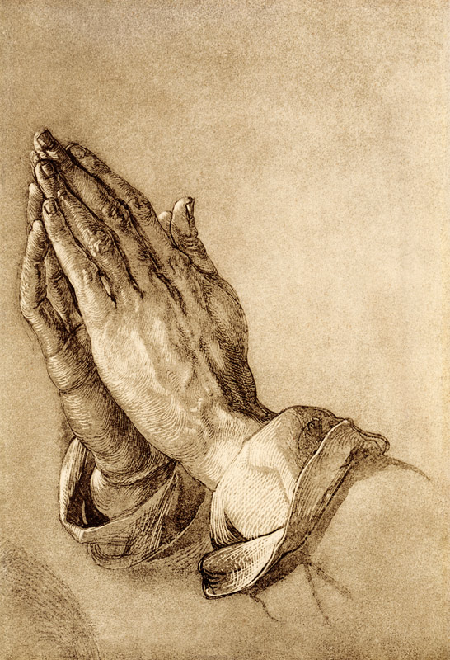
Reflection on Forgiveness
One of the most important skills we each need is that of knowing how to forgive.
There is an African proverb which states:
‘He who forgives ends the quarrel.’
Forgiveness builds us up and helps us move on; whereas revenge destroys and creates bitterness. Forgiving helps us to heal our own wounds.
- CAFOD
BDES

Slide 3
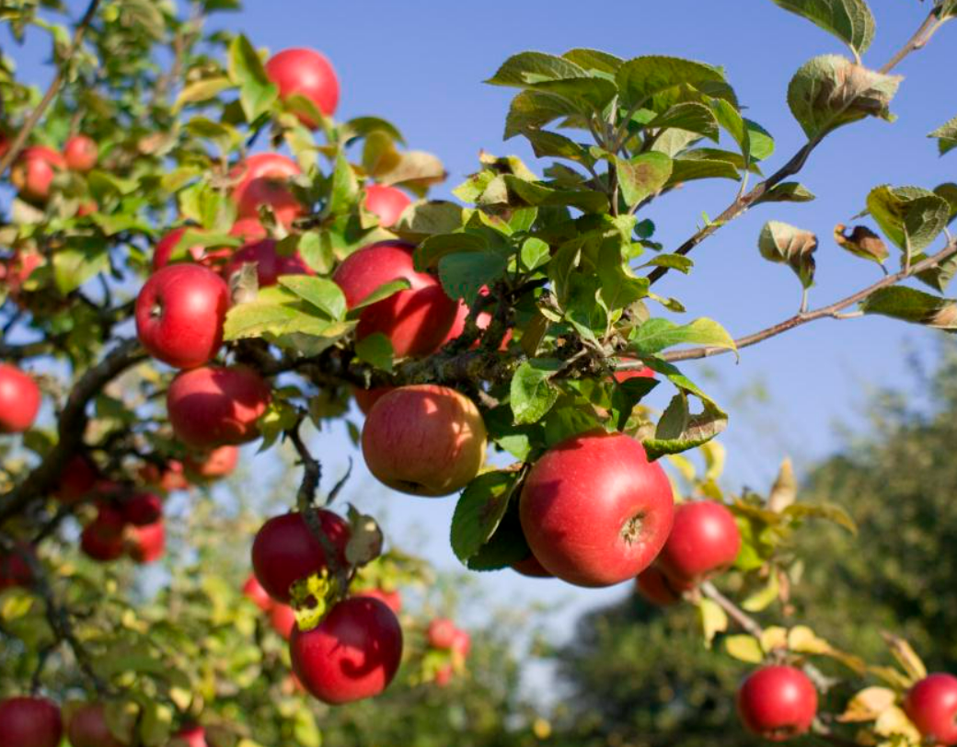
In Sunday’s Gospel Reading …
2nd March 2025
In the Gospel of Luke,
Jesus says :
“Each tree is known by its own fruit.”
BDES

Slide 4
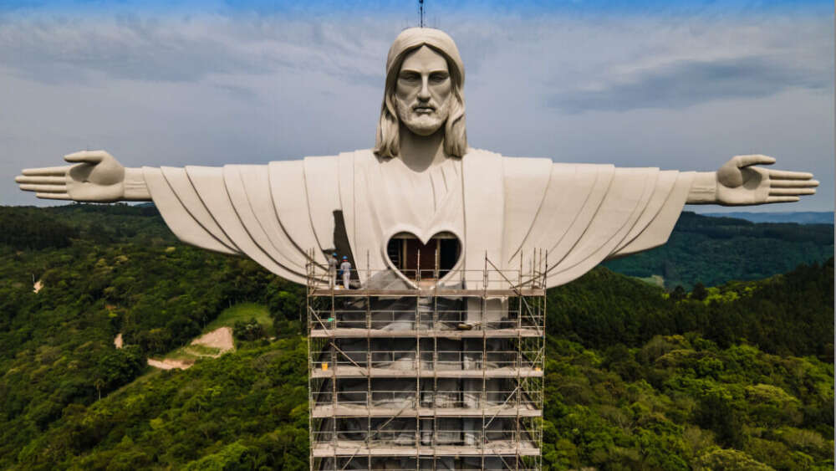
Reflection
CHRIST
BE
MY
SHIELD.
From the prayer known as
St Patrick’s Breastplate,
5th Century
BDES
“Christ the Protector” : giant statue currently being completed in Brazil

Slide 5
Preparing for World Youth Day 2027
“Forgiveness
heals the poisons of resentment.”
- Pope Francis.
BDES

Slide 6
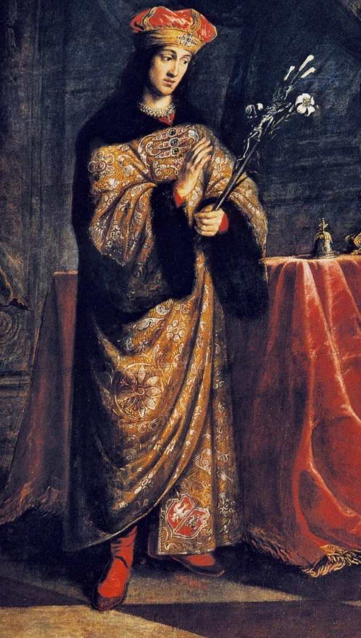
~ Saint Casimir ~ 4th March ~
Casimir Jagiellon (1458-1484) was a prince of the Kingdom of Poland and the Grand Duchy of Lithuania. After his elder brother Vladislaus was elected as King of Bohemia in 1471, Casimir became the heir to the Polish throne. He became known for his piety, devotion to God, and generosity towards the sick and poor. He became ill (most likely with tuberculosis) and died at the age of 25. He was buried in Vilnius Cathedral in Lithuania.
St Casimir is credited as the author of the hymn Omni die dic Mariae (“Daily, Daily Sing to Mary”), sometimes known as “Hymn of St. Casimir”.
BDES

Slide 7
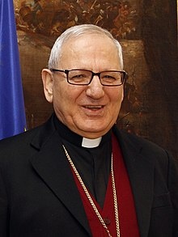
Rites of the Catholic Church # 4
THE CHALDEAN CATHOLIC CHURCH
The Chaldean Catholic Church uses in its liturgy the Syriac dialect of Aramaic, the language spoken by Jesus. Its headquarters has been at the Cathedral of Our Lady of Sorrows in Baghdad in Iraq since 1951.
Because of the recent troubled history of Iraq, Chaldean Catholics have fled in large numbers, particularly to the United States, Canada and Australia.
The Patriarch of Baghdad, Louis Raphaël I Sako was made a cardinal by Pope Francis in 2018 (see photograph, left).
The Chaldean Rite
BDES

Slide 8
Walking the Path
~ Walking the Path of Forgiveness ~
Monday 3rd March 2025
Brentwood Diocese Education Service

