Slide 1
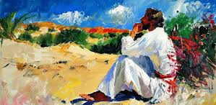


Walking the Path
~ Walking the Path of Forgiveness ~
Monday 10th March 2025
Brentwood Diocese Education Service

Slide 2

Walking the Path of Forgiveness
Fast from apparent darkness; feast on God’s light.
Fast from words that cut down; feast on speech that uplifts.
Fast from gossip; feast on affirmations.
Fast from discontent; feast on gratitude.
Fast from pessimism; feast on hope.
Fast from anger; feast on patience.
Fast from self-centeredness; feast on compassion.
Fast from giving up; feast on enthusiasm.
Fast from the shadows of sorrow; feast on trust in God.
Fast from focusing on problems; feast on unceasing prayer.
Fast from anxiety; feast on faith.
BDES

Slide 3
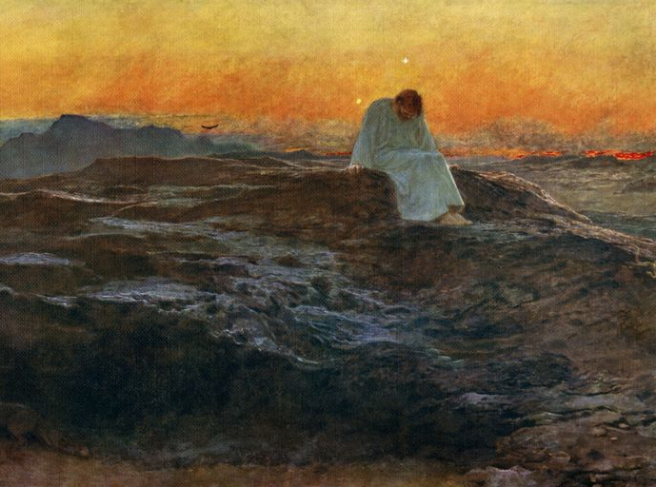
In Sunday’s Gospel Reading …
1st Sunday of Lent
Sunday 9th March 2025
In the Gospel of Luke, Jesus says :
“You shall worship
the Lord your God.”
BDES

Slide 4

Reflection
CHRIST
BE IN ALL HEARTS THINKING ABOUT ME.
From the prayer known as
St Patrick’s Breastplate,
5th Century
BDES

Slide 5

Preparing for World Youth Day 2027
“Forgiveness
restores peace
in our hearts.”
- Pope Francis
BDES

Slide 6
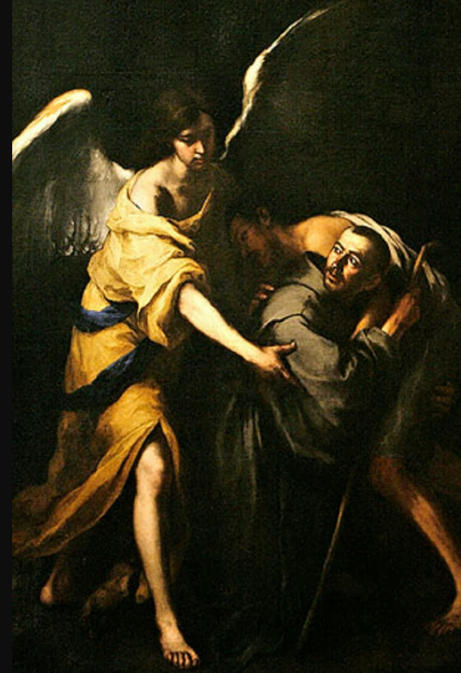
St John of God
Feast day :8th March
St John of God was born on 8th March 1495 at Montemor-o-Novo in Portugal. He enlisted twice to fight in the Spanish army, once against the French and later against the Turks.
After years of living a highly religious way of life in Spain, resulting from a conversion experience, in 1535 he founded his first hospital at Granada, where he served the sick and afflicted. After ten years spent in the exercise of charity, he died on 8th March 1550, of pneumonia, after he had plunged into a river to save a young man from drowning. He was made a saint by Pope Alexander VIII in 1690 and was declared the patron saint of the dying and of all hospitals by Pope Leo XIII in 1898.
BDES

Slide 7
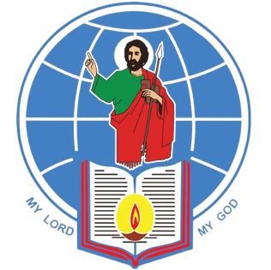
Rites of the Catholic Church # 4
THE SYRO-MALABAR CATHOLIC CHURCH C HURCH cccccccccccccccccccccccccccccccccccccccccccccccccccccccccccccccccccccccccccccccccccccccccccccccccccccccccccccccccccccccccccccccccccccccccccccccccccccccccccccccccccccccccccc "This is one of the major archiepiscopal churches of the Catholic Church which means that a major archbishop presides over the entire church. Since January 2024 this has been Major Archbishop is Raphael Thattil. The Syro-Malabar Church is the largest Syriac Christian church and the largest Eastern Catholic church. It is called “Syro-Malabar” to reflect the church’s use of the East Syriac liturgy and its origins in Malabar (modern-day Kerala, in India).
The Chaldean Rite
BDES

Slide 8
Walking the Path
~ Walking the Path of Forgiveness ~
Monday 10th March 2025
Brentwood Diocese Education Service

