Slide 1
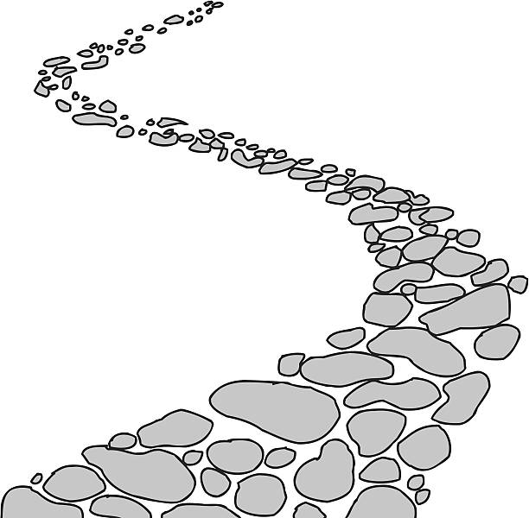
Walking the Path
~ Walking the Path of Forgiveness ~
Monday 17th March 2025
Brentwood Diocese Education Service

Slide 2
Prayer and Forgiveness
“Forgive us our trespasses,
as we forgive those
who have trespassed
against us.”
BDES

Slide 3
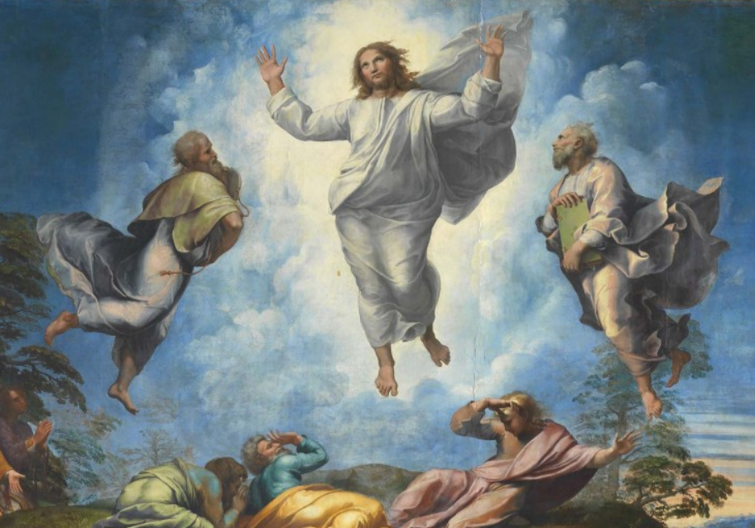
In Sunday’s Gospel Reading …
16th March 2025
In the Gospel of Luke,
God tells us :
“This is my Son, my Chosen One,
listen to Him.”
BDES

Slide 4
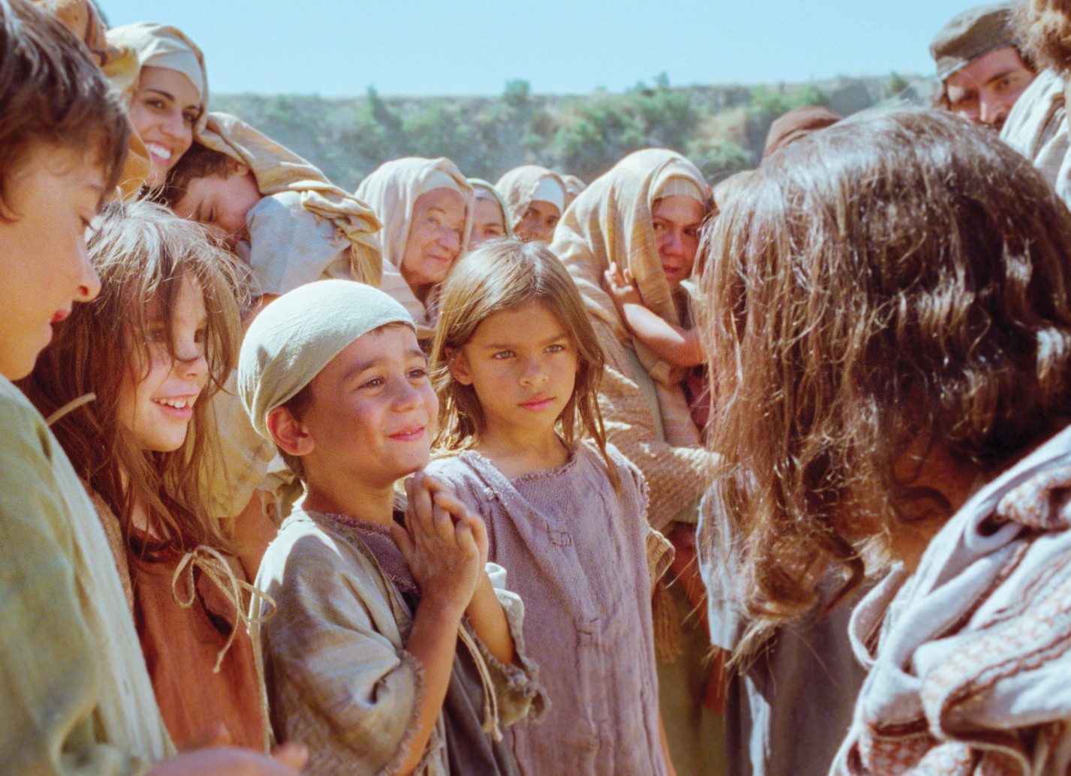
Reflection
CHRIST BE ON ALL TONGUES THAT SPEAK OF ME.
From the prayer known as
St Patrick’s Breastplate,
5th Century
BDES

Slide 5
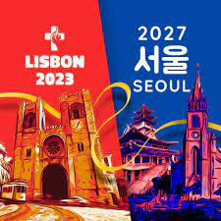
Preparing for World Youth Day 2027
“Forgiveness is the oxygen which purifies the air of hatred.”
- Pope Francis
BDES

Slide 6
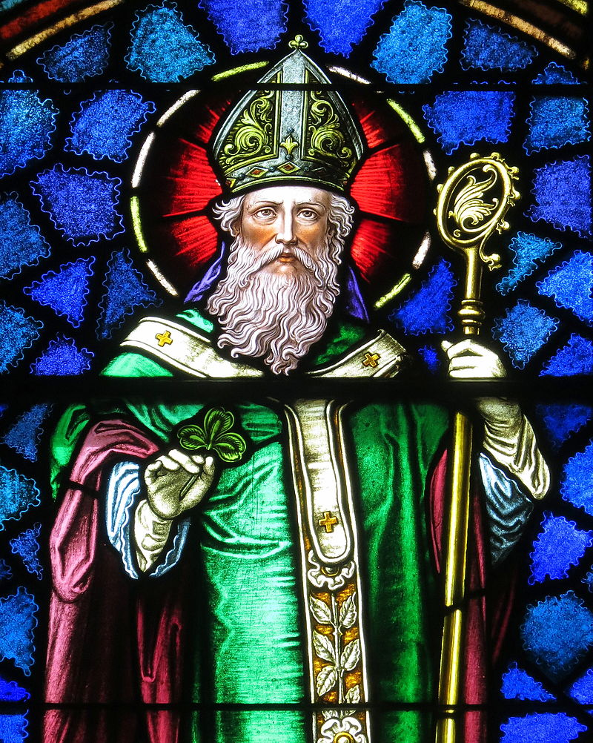
~ St Patrick’s Day : 17th March ~
Christ beside me, Christ before me, Christ behind me, King of my heart; Christ within me, Christ below me, Christ above me, never to part.
Christ on my right hand, Christ on my left hand, Christ all around me, shield in the strife; Christ in my sleeping, Christ in my sitting, Christ in my rising, light of my life.
- from St Patrick’s Breastplate
BDES

Slide 7
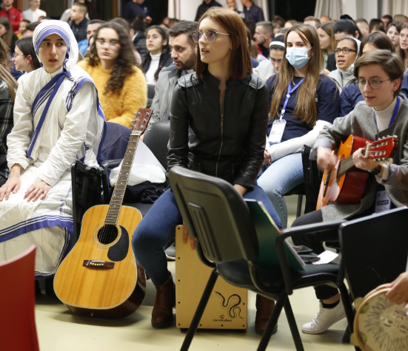
Rites of the Catholic Church # 5
THE ALBANIAN GREEK CATHOLIC CHURCH
Sometimes called the Albanian Greek Catholic Church, sometimes called the Albanian Byzantine Catholic Church, its members are largely resident in Albania. During the Communist era the Church was effectively banned and until 1998 there was not a single parish church. Even today it only has some 3,200 members in 9 parishes with 11 churches. Their current archbishop, of the Archdiocese of Shköder-Pult, is Archbishop Angelo Massafra, who retires this year.
The Byzantine Rite
BDES

Slide 8
Walking the Path
~ Walking the Path of Forgiveness ~
Monday 17th March 2025
Brentwood Diocese Education Service

