Slide 1
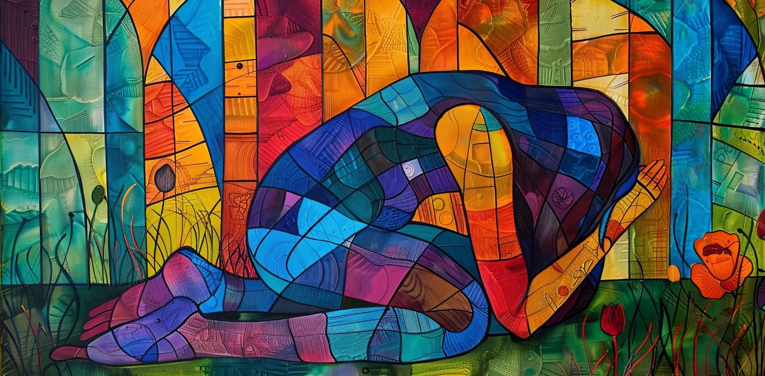
Walking the Path
~ Walking the Path of Forgiveness ~
Monday 24th March 2025
Brentwood Diocese Education Service

Slide 2
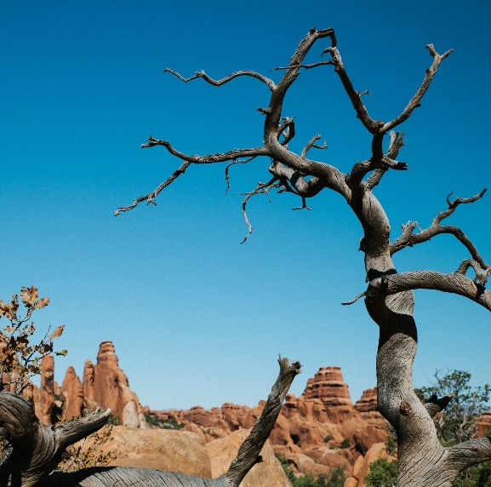
Walking the Path of Forgiveness
We are called to reflect on God’s call to free us, the importance of staying faithful, and the need to bear fruit in our lives.
We are reminded us that He is always aware of our difficulties. He sees our hardships and is ready to help us.
St Paul calls us to examine our lives. We need to identify and remove anything that distracts us from God.
Staying faithful means putting God first in everything we do.
BDES

Slide 3
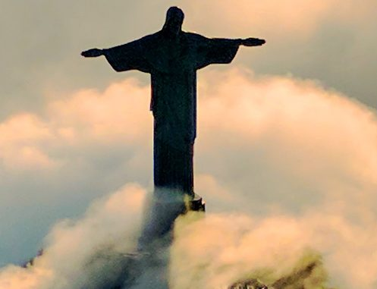
In Sunday’s Gospel Reading …
3rd Sunday of Lent
Sunday 23rd March 2025
In the Gospel of Luke, we hear that
“This is indeed the Saviour of the world.”
BDES

Slide 4
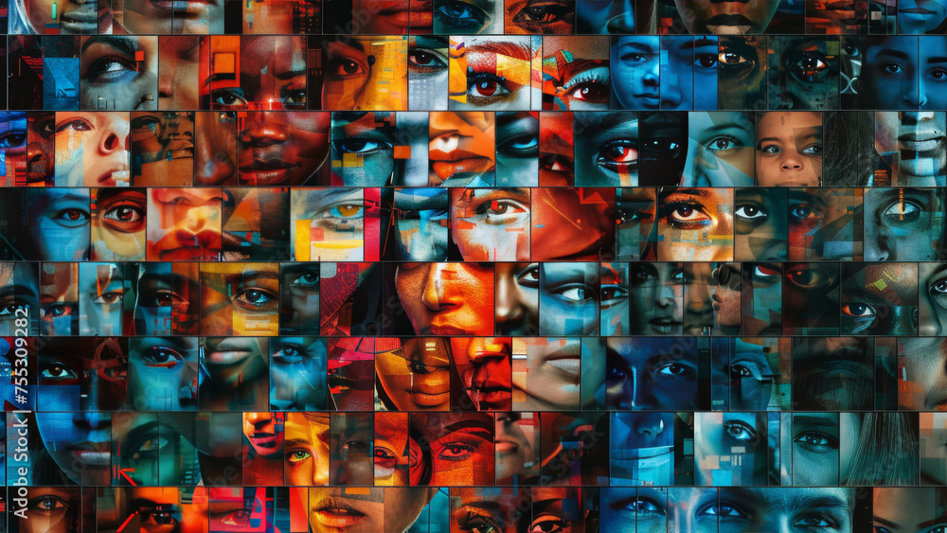
Reflection
CHRIST
BE IN ALL
THE EYES
THAT SEE ME.
From the prayer known as
St Patrick’s Breastplate,
5th Century
BDES

Slide 5
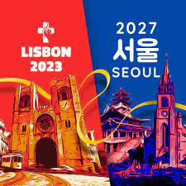
Preparing for World Youth Day 2027
“Never tire of asking God’s forgiveness.”
- Pope Francis
BDES

Slide 6
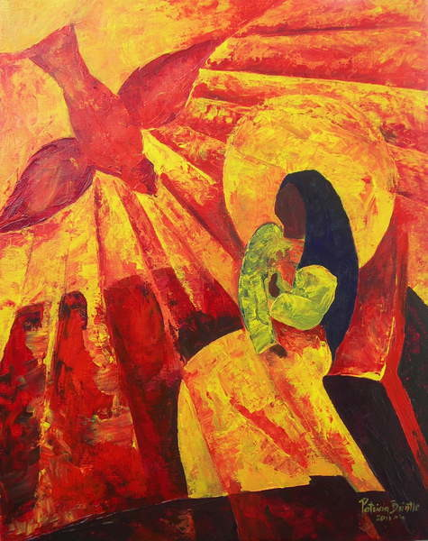
The Annunciation: 25th March
The Annunciation is the beginning of Jesus in His human nature. It was with the consent of Mary, which was foreseen through eternity that the will of God was done. It is through Mary that Jesus is a member of the human race.
We ask Mary to intercede for us and for the world.
Holy Mary, mother fair, Filled with love for God, Pray for us in all our needs. Pray for us today.
Amen
BDES

Slide 7
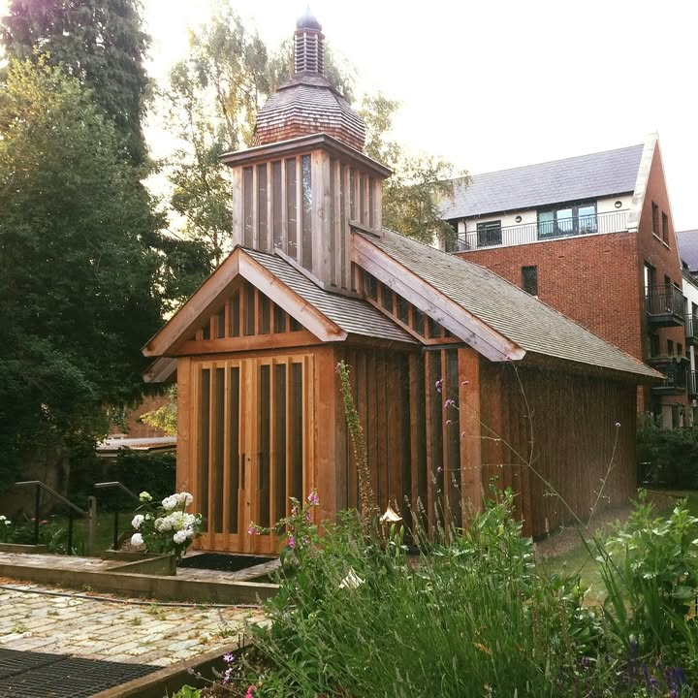
Rites of the Catholic Church # 5
THE BELARUSIAN GREEK CATHOLIC CHURCH
At the beginning of 2015, the Belarusian Greek Catholic Church had 10,000 members within Belarus, 3,000 of whom live in the Church’s 20 parishes. The parishes are organized into two deaneries, each headed by a protopresbyter or archpriest. In March 2023, Pope Francis appointed Jan Sergiusz Gajek, M.I.C. to head the Church as its Mitred Archimandrite. Belarusian Greek Catholics abroad number a further 2,000, with the chief centres being the Church of St Cyril of Turau and All the Patron Saints of the Belarusian People (in London) and a parish in Antwerp.
The Byzantine Rite
BDES

Slide 8
Walking the Path
~ Walking the Path of Forgiveness ~
Monday 24th March 2025
Brentwood Diocese Education Service

