Slide 1

Diocese of Brentwood Chancery Training Day
Tuesday 26th November 2024
11am

Slide 2
Agenda
1030: Coffee and Arrivals
1100: Welcome and Notices
1110: Preparing for Marriages I
1150: BREAK
1200: Preparing for Marriages II
1230: Parochial Registers and Archives
1300: Questions
1315: LUNCH
1400: Preparing for RCIA
1430: END

Slide 3
Notes
All materials, including my notes, will be available on the Chancery Resources page of the diocesan website by next week.
Please complete the feedback form (on the rear of the agenda).
Don't hesitate to e-mail any questions directly to:
desconnors@brcdt.org or chancery@brcdt.org

Slide 4
Preparing for Marriage
Paperwork basics; marriages in E&W; Marriages in Ireland; Marriages abroad; Permissions and dispensations; previous marriages.

Slide 5
Preparing for Marriages
Paperwork Basics
WHO? The paperwork for marriage is (ordinarily) to be started in any parish in which a party resides.
WHEN? The Chancery Office cannot process paperwork sent more than six months before the date of the wedding, and such papers will be returned to the parish of origin. Marriage papers received with fewer than eight weeks from the date of the wedding, CANNOT be guaranteed to be processed in time.
WHAT? The paperwork for marriage may be dealt with separately from the spiritual preparation for the sacrament. If this is the case the priest preparing the paperwork should ensure that adequate spiritual preparation will be given and should include evidence of this with the papers.
Note: If marriage preparation has been completed by the parish, then this should be acknowledged by a separate letter on headed notepaper and included in the marriage papers.

Slide 6

DO NOT SET A WEDDING DATE
IF THERE IS A PREVIOUS MARRIAGE!

Slide 7
Preparing for Marriages;
Marriages in England and Wales
Where a wedding is taking place in England and Wales and no dispensations or permissions are required, the marriage paperwork may be sent parish to parish.
In all other cases, including convalidations, the paperwork is to be sent to the Chancery between eight weeks to six months before the wedding date.
The parish will receive confirmation of receipt of marriage papers.
The paperwork will be returned to the parish of origin to be kept securely or forwarded to the Diocese of marriage.
It is the responsibility of the parish priest to notify the church(es) of baptism, and the responsibility of the parties to ensure civil requirements are met.
Please use the checklist to ensure all the necessary documents, have been included.

Slide 8
Preparing for Marriages;
Marriages in Ireland
Include a copy of the local Irish registrar’s receipt of notification to marry (The Marriage Registration Form – MRF)
After processing we will:
  forward the marriage papers to the relevant diocese;
  write to the couple;
  send you confirmation.

Slide 9
Preparing for Marriages
Marriages Abroad (excl. Ireland)
Please Include translations of documents not in English.
There may be extra requirements imposed by the Diocese of marriage, we may not be able to tell you these in advance. (eg; confirmation certificates – Couple must check with the country)
After processing we will:
  forward the marriage papers to the couple;
  post an authenticated copy of the paperwork to the relevant diocese;
  send you confirmation.

Slide 10
Preparing for Marriages
Baptism Certificates for Marriage, pg 1
When applicable:
For Catholic parties: marriage papers should include a recent Baptism Certificate (dated not more than 6 months before the date of the wedding). If the Catholic party has a Baptismal Book (usually from those from African nations), a certified copy of the booklet is acceptable, but the Catholic party should try to provide and obtain a letter from the parish of baptism confirming the details, and any annotations mentioned in the Baptism Register.
For non-Catholic parties: marriage papers should include a copy of their Baptism Record. This may be in the form of a ‘Certificate of Baptism’ booklet, or a copy of their entry in their Baptism Register. If Church of England, the parish may provide a form for just the individual, or a copy of the relevant page from their Baptism Register, which may include details of other parties.

Slide 11
Preparing for Marriages
Baptism Certificates for Marriage, pg 2
If you are approached for a Baptism Certificate for Marriage:
- if it is the Catholic party themselves - or perhaps their parents – please ask them to provide some form of ID, and details of the wedding, as you will be receiving a marriage notification in due course, which will need to be entered as an annotation against the Baptism Record. You can then provide them a Baptism Certificate for Marriage;
- if the request comes from the priest who is preparing the marriage papers, they will provide you with details of the couple and date of the wedding. The request should be in writing. You can then send the Baptism Certificate for Marriage direct to them, to be included with the marriage papers;
Baptism Certificates for Marriage must not be issued more than 6 months before the date of the wedding. It must include any annotation recorded against the Baptism Record, such as details of Confirmation; Marriage; Annulment by the Catholic Church.
The Baptism Certificate for Marriage should be on parish headed paper. A template is included in the ‘Chancery & Tribunal Procedures’ booklet, which includes the Latin translation – useful for marriage papers going abroad.

Slide 12
Break
10 mins

Slide 13

DO NOT SET A WEDDING DATE
IF THERE IS A PREVIOUS MARRIAGE!

Slide 14
Permissions and Dispensations
Permission for Mixed Marriages (c. 1125)
Marriage of a baptised Catholic and baptised non-Catholic.
Mixed religion permission may be granted by parish priests/priests in charge (not assistant priests), only if: (As per Canon Law -
  The Catholic party resides in the territorial boundaries of the parish;
  This permission alone is required;
  The marriage is to take place in the parish of the parish priest granting the permission.
Application to the Chancery must be made if:
  Permission is sought alongside an application for convalidation;
  Dispensation from canonical form is also requested;
  Marriage is taking place outside the territorial boundaries of the parish.
Permission will ordinarily be given if the priest supports it, the Catholic party makes the promise, and the non-Catholic party does not object to the promise.

Slide 15
Permissions and Dispensations
Dispensation from Disparity of Cult (c. 1125)
Marriage of a baptised Catholic and a non-baptised person.
This permission will ordinarily be given if: the priest supports it, the Catholic party makes the promise, and the non-Catholic party does not object to the promise.
Complete the supplementary application form and send it to the chancery.

Slide 16
Permissions and Dispensations
Dispensation from Canonical Form (c. 1127.2)
Marriage of a Catholic in a non-Catholic form.
Universal law requires “grave reasons” for this to be given, the Bishops’ Conference has stated such reasons include:
  The spiritual well-being of the parties;
  Tranquillity and peace of their personal and family relationships;
  A special relationship to a non-Catholic minister or non-Catholic place of worship.
It is not permitted to have two religious ceremonies “for the purposes of giving or renewing matrimonial consent” (c. 1127.2), nor to have a Catholic and non-Catholic minister ask for consent together (c. 1127.3).
Dispensation will ordinarily be given if the reasons above are fulfilled, if the applying parish priest supports the application, and (if taking place outside the Diocese) the local Ordinary does not object.
Dispensation will not ordinarily be given for a non-Christian rite, unless the situation is truly exceptional. It may be suggested to have a civil wedding followed by a convalidation.
If any concerns arise contact the Chancery.

Slide 17
Preparing for Marriages
Convalidations (cc. 1156-1159)
Customarily to regularise a marriage that took place without canonical form (c. 1108), where at least one party was Catholic and no dispensation was granted.
The wedding may have been a non-Catholic ceremony, a Tribal/Customary/Traditional ceremony, or may have taken place in a Registry Office.
Two different forms:
  Use the ‘Supplementary Application’ Form if applying alongside a permission or dispensation;
  Use the ‘Simple Convalidation’ form for the wedding of two Catholics.
A copy of the wedding certificate is to be included.

Slide 18
Preparing for Marriages
Sanatio in radice (cc. 1161-1165)
An act making a marriage valid, which was originally invalid due to a diriment impediment or lack of canonical form, without a renewal/new consent.
Generally used in situations where a convalidation is not possible because one party refuses or is unable to renew consent.
Can also be used in situations where a diriment impediment, such as disparity of cult, was not dispensed and can be dispensed by the local Ordinary.
The applying parish priest should attest that it is probable that the parties intend to persevere in conjugal life (c. 1161.1).

Slide 19
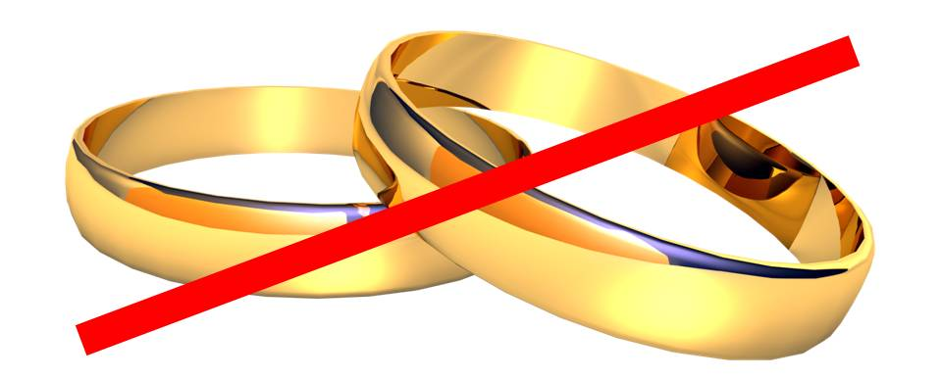
DO NOT SET A WEDDING DATE
IF THERE IS A PREVIOUS MARRIAGE!

Slide 20
Questions
?

Slide 21
Preparing for Marriages
Previous Marriages: Questions to Ask
Has either of you been married before?
01
Was the person you were previously married to married before?
03
Was either of you baptised Catholic, and did you marry without canonical form?
04
What was your baptismal status before the wedding?
05
Is the other party still alive?
02

Slide 22
Previous Marriages: Questions to Ask
01: Has either of you been married before?
Answer: Yes.
Carry on to next question.
Answer: No.
Free to marry!
Additional question: How many times have you each been married?
Please note answers and refer to Chancery/Tribunal immediately if either party has been married more than once.

Slide 23
Previous Marriages: Questions to Ask
02: Is the other party still alive?
Answer: Yes.
Carry on to next question.
Answer: No.
Free to marry! Provide death certificate with paperwork.
Additional point: if the marriage was annulled by a Catholic Tribunal the party is also free to marry.

Slide 24
Previous Marriages: Questions to Ask
03: Was the person you were previously married to married before?
Answer: Yes.
Contact Tribunal for a 'Ligamen' Application.
Time: 3 months, if all necessary documents are included.
Answer: No.
Continue to next question.

Slide 25
Previous Marriages: Questions to Ask
04: Was either of you a baptised Catholic, who married without canonical form?
Answer: Yes.
Apply to Chancery for Defect of Canonical Form.
If the correct paperwork is submitted the process will take approximately three months.
Answer: No.
Continue to next question.
If the party a member of an Eastern Orthodox Church and married outside of a 'Sacred Rite', the Catholic Church can also declare that marriage null, leaving the party free to marry.

Slide 26
Previous Marriages: Questions to Ask
05: What was your baptismal status at the time of the wedding?
Answer: Both Baptised
Contact Tribunal regarding ordinary annulment process.
Time: approx. 18 months – 2 years
Answer: One Baptised
Contact Tribunal regarding Dissolution in Favour of the Faith (Petrine Privilege).
Time: approx. 18 months (incl. 6 months processing in Rome).
Investigation is local, and the decision is made in Rome.
Answer: Neither Baptised
Contact Tribunal regarding Dissolution of marriage by the Pauline Privilege.
This process can only be used if one party has since been baptised, or is seeking baptism
Time: 3 months if all necessary documents are included.
Investigation and decision done locally.

Slide 27
Preparing for Marriages
Previous Marriages: Questions to Ask
Has either of you been married before?
01
Was the person you were previously married to married before?
03
Was either of you baptised Catholic, and did you marry without canonical form?
04
What was your baptismal status before the wedding?
05
Is the other party still alive?
02

Slide 28
Previous Marriages: Questions to Ask
This information is a guide to help you discern how long which process may be used, and how long it might take, so that you can counsel the parties appropriately.
If there has been a previous marriage please do not set a wedding date before contacting the Chancery. If a wedding has to be cancelled the priest or deacon may be personally liable if sued.
Remember that there is no guarantee that the ordinary (full) annulment process will give a constat decision.

Slide 29
Parochial Registers and Archives
Registers of Baptism and additional notes

Slide 30
Parochial Registers and Archives
Please see Fr Stewart Foster’s guidelines, it might even be helpful to have a printed copy in your parish office.
The following registers are to be kept in parishes according to canon law:
  Registers of Baptism, Confirmation, Marriage and Death (Can. 535 §1; 895)
  Register of the Reception of Converts (Briefing 85, p. 114; cf. c. 535)
  Register of Burials in Parish Cemetery (Briefing 85, p. 114; cf. c. 535)
  Registers of Foundation Masses and other obligations (Can. 1307 §2)
  Parish account books (Can. 1284 §7)
  Register of Catechumens (Can. 788 §1)
  Title deeds, insurance policies and other papers relating to temporal goods (Can. 1284 §9)
  Papers relating to Marriage Preparation (Can. 1066-1070)
I will only be looking at the requirements for the Register of Baptisms today.

Slide 31
Parochial Registers and Archives
Register of Baptisms
Canon 877.1 states the following are to be entered in the baptismal register:
    Name of the baptised;
    Minister of the sacrament;
    Parents of baptised;
    Sponsor(s);
    Witness;
    Place and date of baptism;
    Date and place of birth.

Slide 32
Parochial Registers and Archives
Register of Baptisms
  The following must be added to the baptismal record:
    Ascription to another (that is non-Latin) ritual church;
    Change of rite;
    Confirmation;
    Marriage (incl. convalidation);
    Legitimate dissolution of marriage (Petrine privilege);
    Annulments and vetita;
    Public profession of permanent vows;
    Reception of sacred orders.

Slide 33
Parochial Registers and Archives
Register of Baptisms
Adoption (c. 110, 877.3)
If the baptism occurs after the adoption, only the names of the adopted parents are to be entered into the register.
If the baptism occurred before the adoption, a new entry is to be made in the register. Each entry is to have a marginal note referring to the other entry. The entry is to include the names of the adopted parents, copies of baptismal certificates are to be made from the new entry with no mention of the natural parents or adoption.

Slide 34
Parochial Registers and Archives
Register of Baptisms
Unwed Parents (c. 877.2)
No mention is to be made of the marital status of the parents, or illegitimacy of the child.
The mother is to be recorded if:
      Publicly known;
      She requests in writing;
      She requests verbally before two witnesses.
The father is to be recorded if:
      Proved by public document (e.g. birth certificate);
      By request/declaration in front of the parish priest and two witnesses.
If these requirements are not met the entry is to be left blank; the phrase Pater ignotus (father unknown) is not to be used.

Slide 35
Parochial Registers and Archives
Register of Baptisms
Other marginal notations
When an adult is baptised their marital status is to be recorded (if married), and any annulment/dissolution granted, and their confirmation.
Conditional baptisms are to be recorded normally, but with this fact noted in the margin.
Emergency baptisms are to be recorded normally, but with this fact noted in the margin.
The CIC does not require the sex of the baptizatus to be recorded; however, should this be recorded or requested no change is to be made if the person later has his/her gender reassigned (even legally). This may be recorded in the margins, if necessary.

Slide 36

In no circumstance is an original entry to be changed by deleting, obscuring or altering original text.

Slide 37
Parochial Registers and Archives
Register of Baptisms
Who can have access?
The data subjects themselves;
Other legitimate third-parties, such as Diocesan chanceries and tribunals.

Slide 38
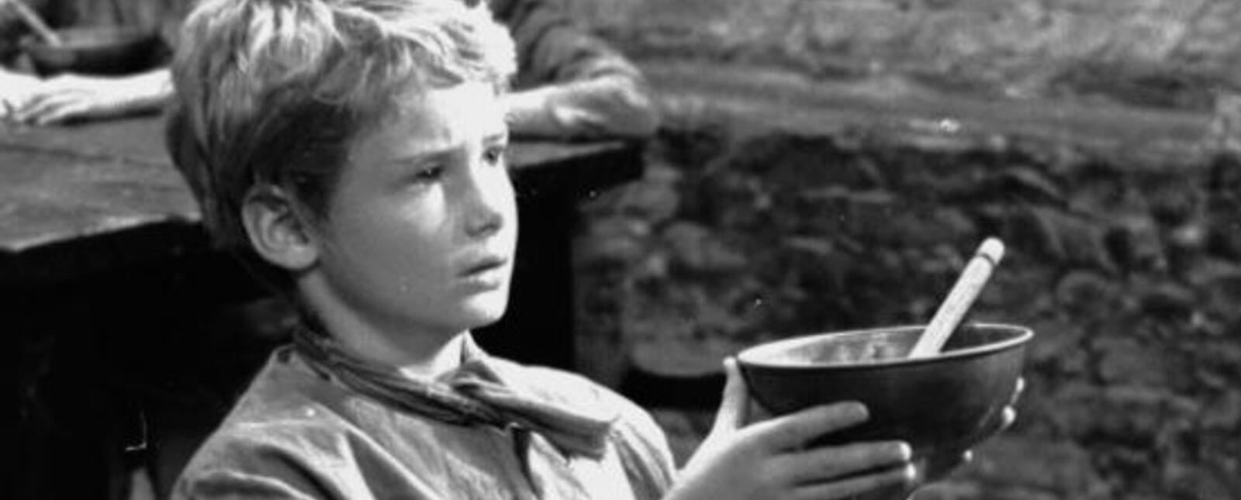
LUNCH

Slide 39
Preparing for RCIA
Baptismal status; previous marriages; obstacles to full communion; other matters

Slide 40
Preparing for RCIA
Baptismal Status
A baptismal certificate is normally required to prove baptismal status.
C. 869.1: If there is doubt as to whether a person was baptised or whether a baptism was conferred validly, and after serious enquiry this doubt persists, the person is to be baptised conditionally.
There are two types of doubt:
  Doubt of Fact;
  Doubt of Validity

Slide 41
Preparing for RCIA
Baptismal Status – Doubt of Fact
A doubt of fact occurs when it is unclear as to whether there has ever been a ceremony that purported to be a baptism.
In the absence of a baptismal certificate the following can help:
  Testimony of an (unexceptionable) witness;
  If baptised as an adult, the testimony of the one who was baptised,
  Photographs, videos, other supporting materials.
It may arise that the fact of a purported baptism can be established through a certain means, but that this also raises questions of validity.

Slide 42
Preparing for RCIA
Baptismal Status – Doubt of Validity
Doubt concerning: matter; form; intention of the minister; intention of the recipient.
Orthodox baptisms are presumed to be valid (c. 869.2).
There is no general recognition in universal law regarding the validity of baptisms in any non-Catholic ecclesial communities. There are no national agreements between the Church and non-Catholic ecclesial communities in England and Wales.
In 1949 the Holy Office declared the baptisms of the following are presumed valid: Disciples of Christ, the Presbyterians, the Congregationalists, the Baptists, the Methodists.
Presumed invalid: Jehovah’s Witnesses (invalid formula); Salvation Army (no baptism); Quakers (no baptism); Christian Scientists (no baptism).
Doubtful validity: Pentecostals.
In short: do not presume that any other baptism is valid unless there is evidence that it was given with water and the Trinitarian formula.

Slide 43
Preparing for RCIA
Baptismal Status
Conditional baptisms are to take place:
  In private, not in public;
  After the local Ordinary has determined what rites are to be included/excluded;
  After the reasons for doubting the validity is explained to the baptizandus.

Slide 44
Preparing for RCIA
Previous Marriages
People presenting themselves for instruction should be asked their marital status (and that of their partners) at the beginning of the process of instruction.
All marriages enjoy the favour of the law (c. 1060).
Simple divorce is not, in itself a bar to baptism or reception into the Church, but, it must be explained that they are not free to (re-)marry in the Catholic Church without some further process, the result of which cannot be guaranteed.
Divorce and remarried (DAR) couples must be told that they cannot be baptised or received into the Catholic Church until either there is a dissolution/annulment or the parties separate.
An unbaptised DAR may be admitted to the catechumenate, but not the Rite of Election (RCIA Appendix I).

Slide 45
Preparing for RCIA
Other Obstacles
Freemasons: It is forbidden for Catholics to be members of supporters of Masonic lodges, it also therefore not possible for Freemasons to be baptised or received into the Catholic Church until they leave that organisation. This is not something that it is within the competence of the local ordinary to dispense or derogate from.
Other political parties or movements: There is no general or universal bar to Catholics joining specific political parties/movements/groups unless they plot against the Church (c. 1374) or encourage heresy, schism or apostasy (1364.1).
It would seem prudent, however, to raise with catechumens and candidates the question of whether they belong to any parties/movements/groups who promote things contrary to natural law and the teaching of the Church.

