Slide 1



Walking the Path
~ Walking the Path of Hope ~
Monday 21st April 2025
Brentwood Diocese Education Service

Slide 2
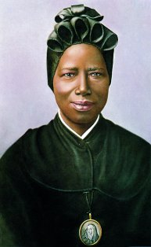
Walking the Path of Hope
“To come to know God - the true God -
means to receive hope.”
Pope Benedict XVI, reflecting on
the life of St Josephine Bakhita.
Josephine was taken to Italy and freed after many years of slavery. She journeyed around Italy in order to promote the missions. She felt she had to extend to others the liberation that she had received through her encounter with the God of Jesus Christ, that it had to be handed on to others, to the greatest possible number of people.
She could not keep to herself the hope born in her which had “redeemed” her; this hope had to reach many, to reach everybody.
BDES

Slide 3
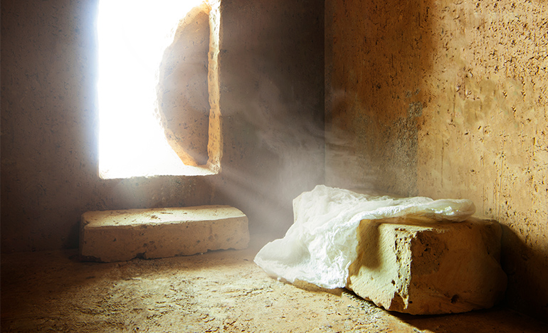
In Sunday’s Gospel Reading …
Easter Sunday
Sunday 20th April 2025
From
the Gospel of Luke :
HE HAS BEEN RAISED
BDES

Slide 4

Reflection
God, our loving Father,
remind us of our call to love creation.
Guide us on our journey as pilgrims of hope.
BDES

Slide 5

Preparing for World Youth Day 2027
“Hope is a light in the night.”
- Pope Francis
BDES

Slide 6
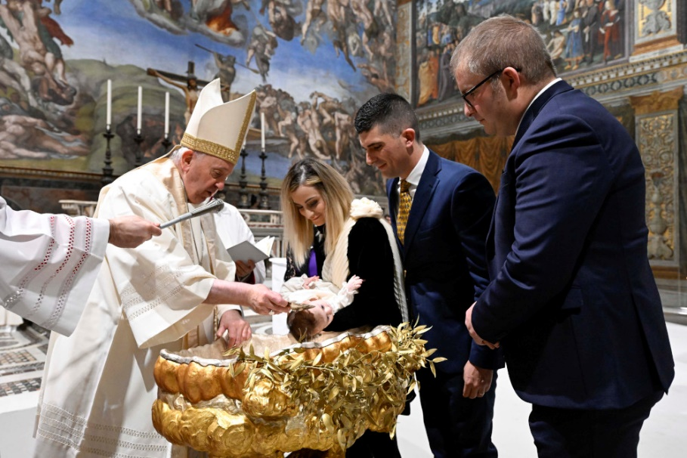
Easter Week
The joy we feel at Easter is not a passing joy, but rather a deep and radiant joy which comes from the Lord’s victory over sin and death, and we share in this joy through the very gift of baptism which is at the heart of our Easter liturgies.
BDES

Slide 7
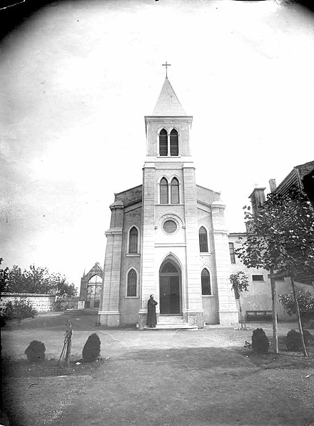
Rites of the Catholic Church # 7
THE GEORGIAN CATHOLIC CHURCH
In 1861 Fr. Peter Kharischirashvili founded the Servites of the Immaculate Conception in Istanbul, to serve and educate Catholic, Orthodox and Muslim Georgians. When Tsar Nicholas II granted religious tolerance after the Russian Revolution of 1905, Catholics in Georgia adopted the Byzantine Rite. Georgian Catholics in Istanbul can still worship in the Georgian Byzantine Rite in the church pictured, Notre-Dame de Lourdes, although it is in the hands of Italian Catholic priests. Gravestones bearing Georgian inscriptions can still be seen in its courtyard.
The Byzantine Rite
BDES

Slide 8
Walking the Path
~ Walking the Path of Hope ~
Monday 21st April 2025
Brentwood Diocese Education Service

