Slide 1



Walking the Path
~ Walking the Path of Hope ~
Monday 28th April 2025
Brentwood Diocese Education Service

Slide 2
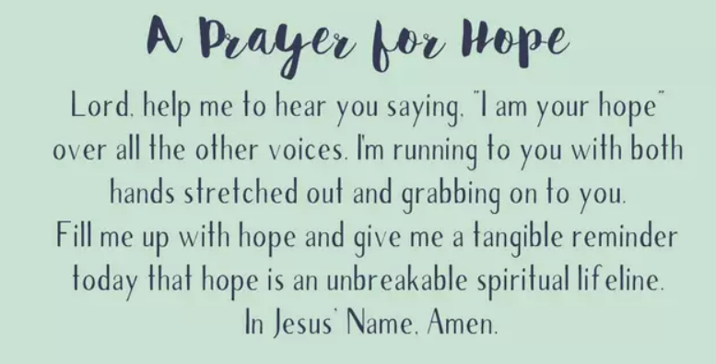
BDES

Slide 3
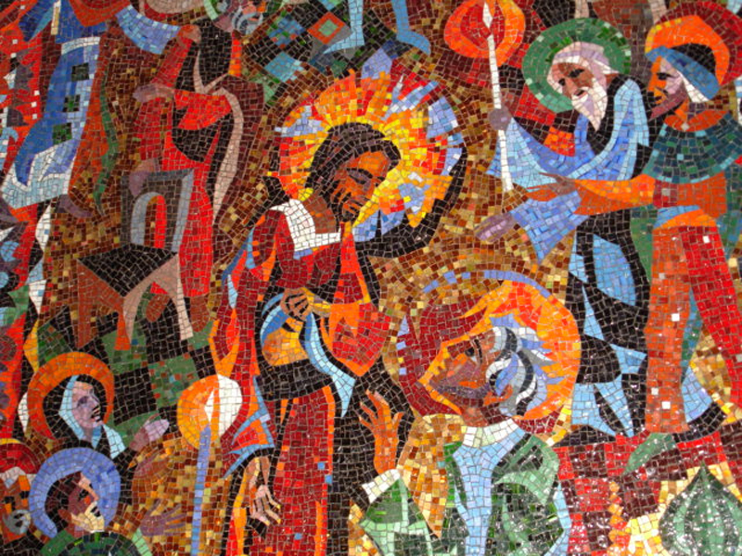
In Sunday’s Gospel Reading …
2nd SUNDAY OF EASTER
27th April 2025
In the Gospel of John,
Jesus says :
“Peace be with you.”
BDES

Slide 4

BDES

Slide 5

Reflection
God, our loving Father,
help us to work together to replant, repair, and renew.
Guide us on our journey as pilgrims of hope.
BDES

Slide 6

Preparing for World Youth Day 2027
“Hope is a gift from God.”
- Pope Francis
BDES

Slide 7
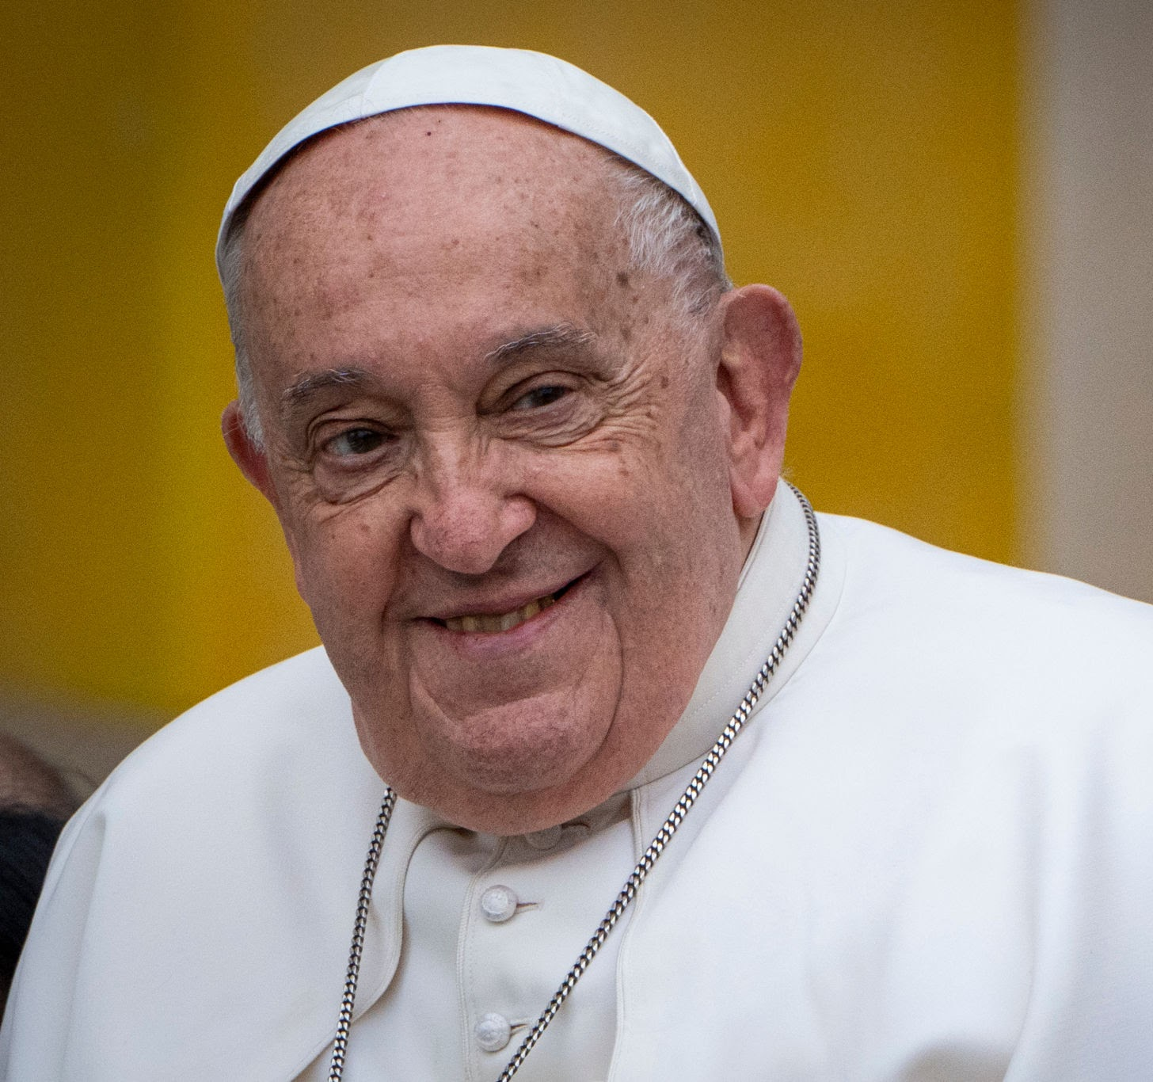
POPE FRANCIS 1936 - 2025
O God, from whom the just receive unfailing reward, grant that your servant, Francis, our Pope, whom you made vicar of Peter and shepherd of your Church, may rejoice for ever in the vision of your glory, for he was a faithful steward here on heart of the mysteries of your forgiveness and grace. We ask this through Christ our Lord. Amen
BDES

Slide 8
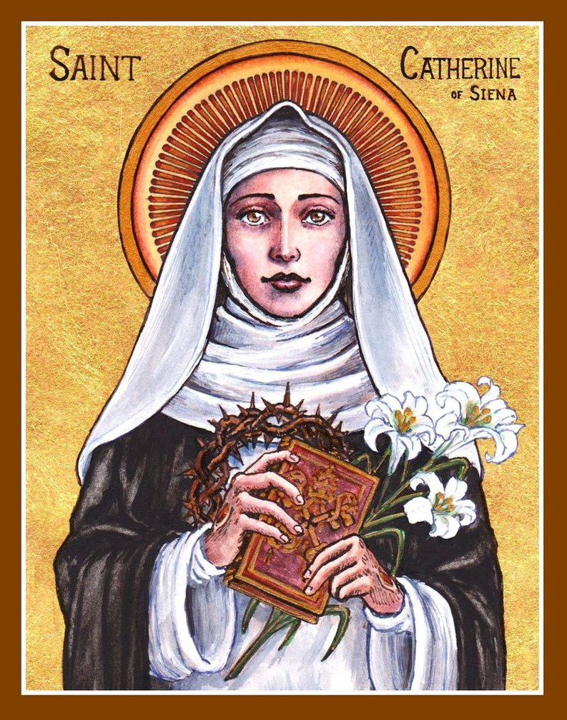
Saint Catherine of Siena
Feast day : 29th April
Catherine was a lay member of the Dominican order. She was famous as a mystic, an activist and an author. She might be described as the original “influencer”! She influenced popes and princes and cardinals with her letters, of which she wrote hundreds. She wrote numerous prayers, and a set of spiritual treatises collected together as a book under the title The Dialogue of Divine Providence. She was even sent on missions by the Pope, something extraordinarily rare for a woman in the 14th century!
BDES

Slide 9
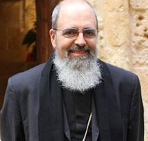
Rites of the Catholic Church # 5
THE GREEK (HELLENIC) CATHOLIC CHURCH
Vocations to the Greek Byzantine Catholic Church are largely drawn from the Greek islands of Syros and Tinos, which both have sizable Catholic populations.
Bishop Manuel Nin is the current Apostolic Exarch to the Byzantine Rite Catholics in Greece, who number some 6,000 people. In Athens, the main Greek Catholic church is the Holy Trinity Cathedral.
The Byzantine Rite
BDES

Slide 10
Walking the Path
~ Walking the Path of Hope ~
Monday 28th April 2025
Brentwood Diocese Education Service

