Slide 1
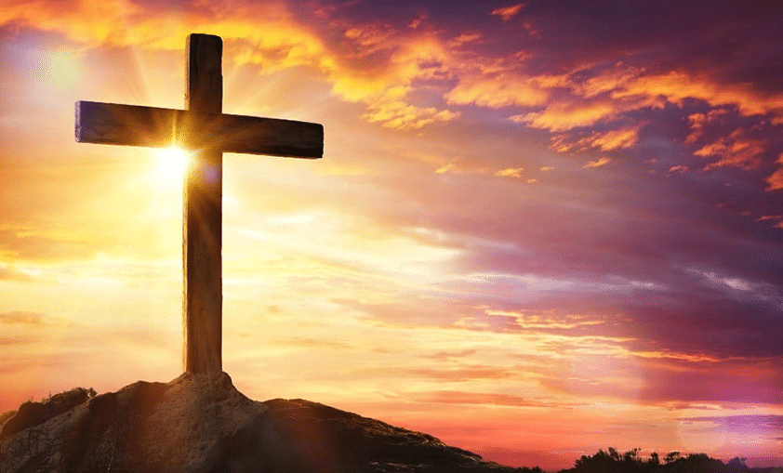
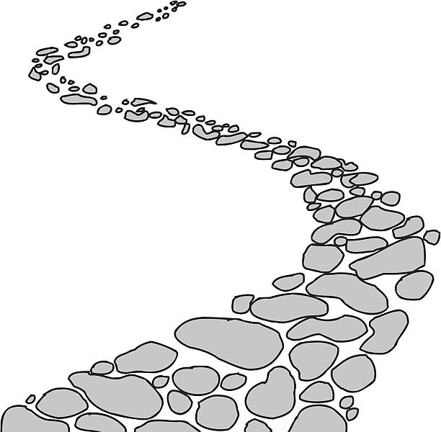

Walking the Path
~ Walking the Path of Hope ~
Monday 5th May 2025
Brentwood Diocese Education Service

Slide 2

Walking the Path of Hope
God gives us hope and so we pray :
Praise to you Father.
When I am afraid, you are with me.
You are never far from me when I call out to you.
Everyone should know this and praise you.
BDES

Slide 3
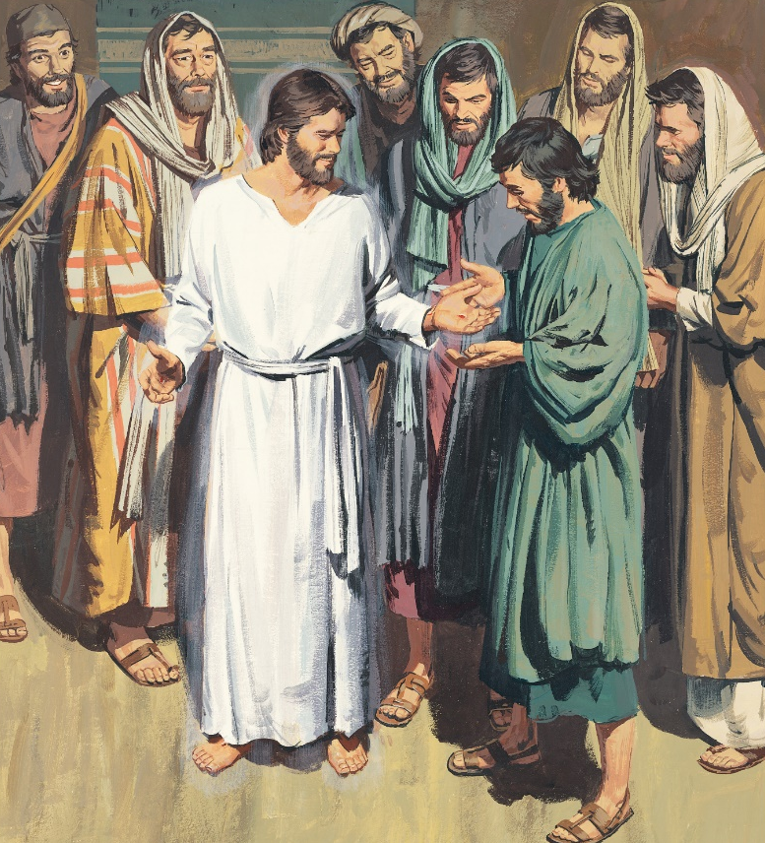
In Sunday’s Gospel Reading …
3rd Sunday of Easter
Sunday 4th May 2025
In the Gospel of John,
the beloved disciple exclaims :
“It is the Lord.”
BDES

Slide 4

Reflection
Jesus, our light,
you remind us of our call to love our neighbours and to set free those who suffer.
Guide us on our journey as pilgrims of hope.
BDES

Slide 5

Preparing for World Youth Day 2027
“Hope is a duty and a gift for every Christian.”
- Pope Francis
BDES

Slide 6
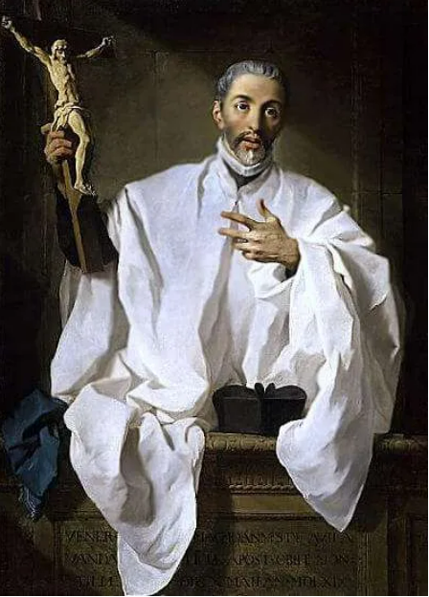
St John of Avila : 10th May
John of Avila (1499-1569) was a Spanish priest, preacher, author and religious mystic who was canonised as a saint in 1970 and a Doctor of the Catholic Church in 2012. He is called the apostle of Andalusia because of his ministry in that region.
In 1574, John’s followers published his most famous work, Audi Filia (“Listen, O Daughter”). He took his title from Psalm 45 : 11 : “Listen, o daughter, and see, incline your ear.” Through 113 chapters, John explored this passage of Scripture in order to address issues such as the value of prayer, the role of faith and good works in salvation, and the nature of sin.
BDES

Slide 7
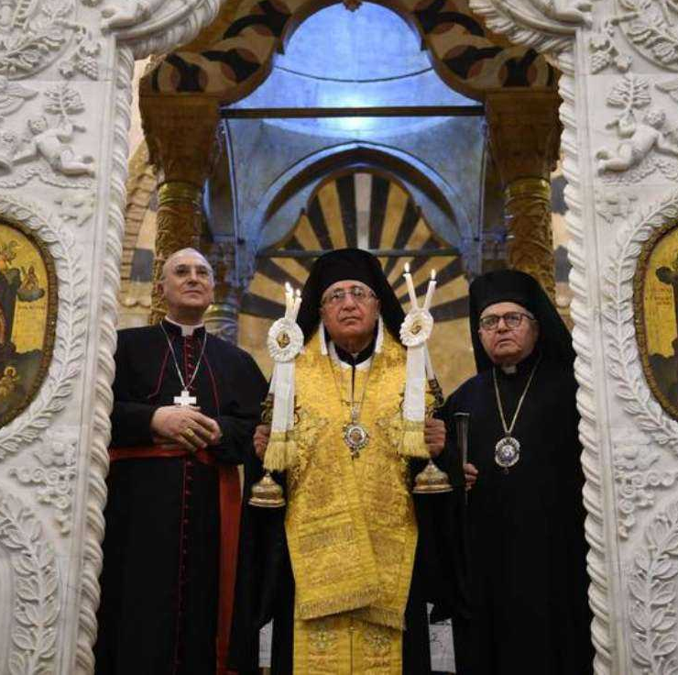
Rites of the Catholic Church # 5
THE MELKITE GREEK CATHOLIC CHURCH
This Church, based in the Cathedral of Our Lady of the Dormition in Damascus in Syria, is governed by Patriarch Youssef Absi. In November 2024 it celebrated its 300 years of full communion with the Roman Catholic Church, in time for the launch of the Year of Jubilee, “Pilgrims of Hope.”
The Melkites trace their history to the early Christians of Antioch, formerly part of Syria and now in Turkey. Christianity was introduced to the region in the 1st Century AD by Saint Peter. The foundation of the Church is based on the work of the Apostles Peter and Paul.
The Byzantine Rite
BDES

Slide 8
Walking the Path
~ Walking the Path of Hope ~
Monday 5th May 2025
Brentwood Diocese Education Service

