Slide 1

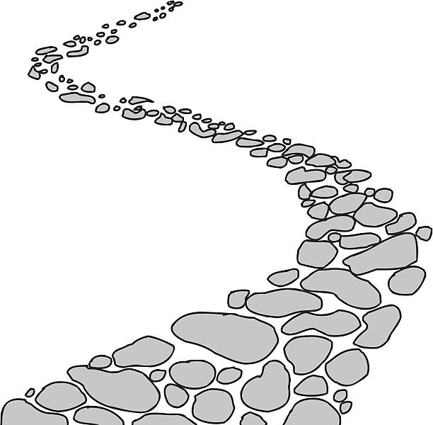

Walking the Path
~ Walking the Path of Hope ~
Monday 12th May 2025
Brentwood Diocese Education Service

Slide 2

Reflection
Jesus, our light, help us to treat everyone with dignity; to be fair, forgiving and kind.
Guide us on our journey
as pilgrims of hope.
BDES

Slide 3
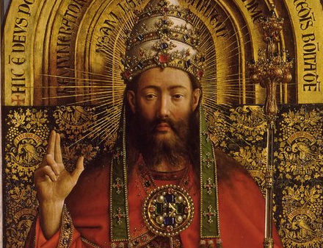
In Sunday’s Gospel Reading …
4th SUNDAY OF EASTER
11th May 2025
In the Gospel of John,
Jesus says :
“The Father and I are one.”
BDES

Slide 4

Preparing for World Youth Day 2027
“All it takes is one good person to restore hope.”
- Pope Francis
BDES

Slide 5
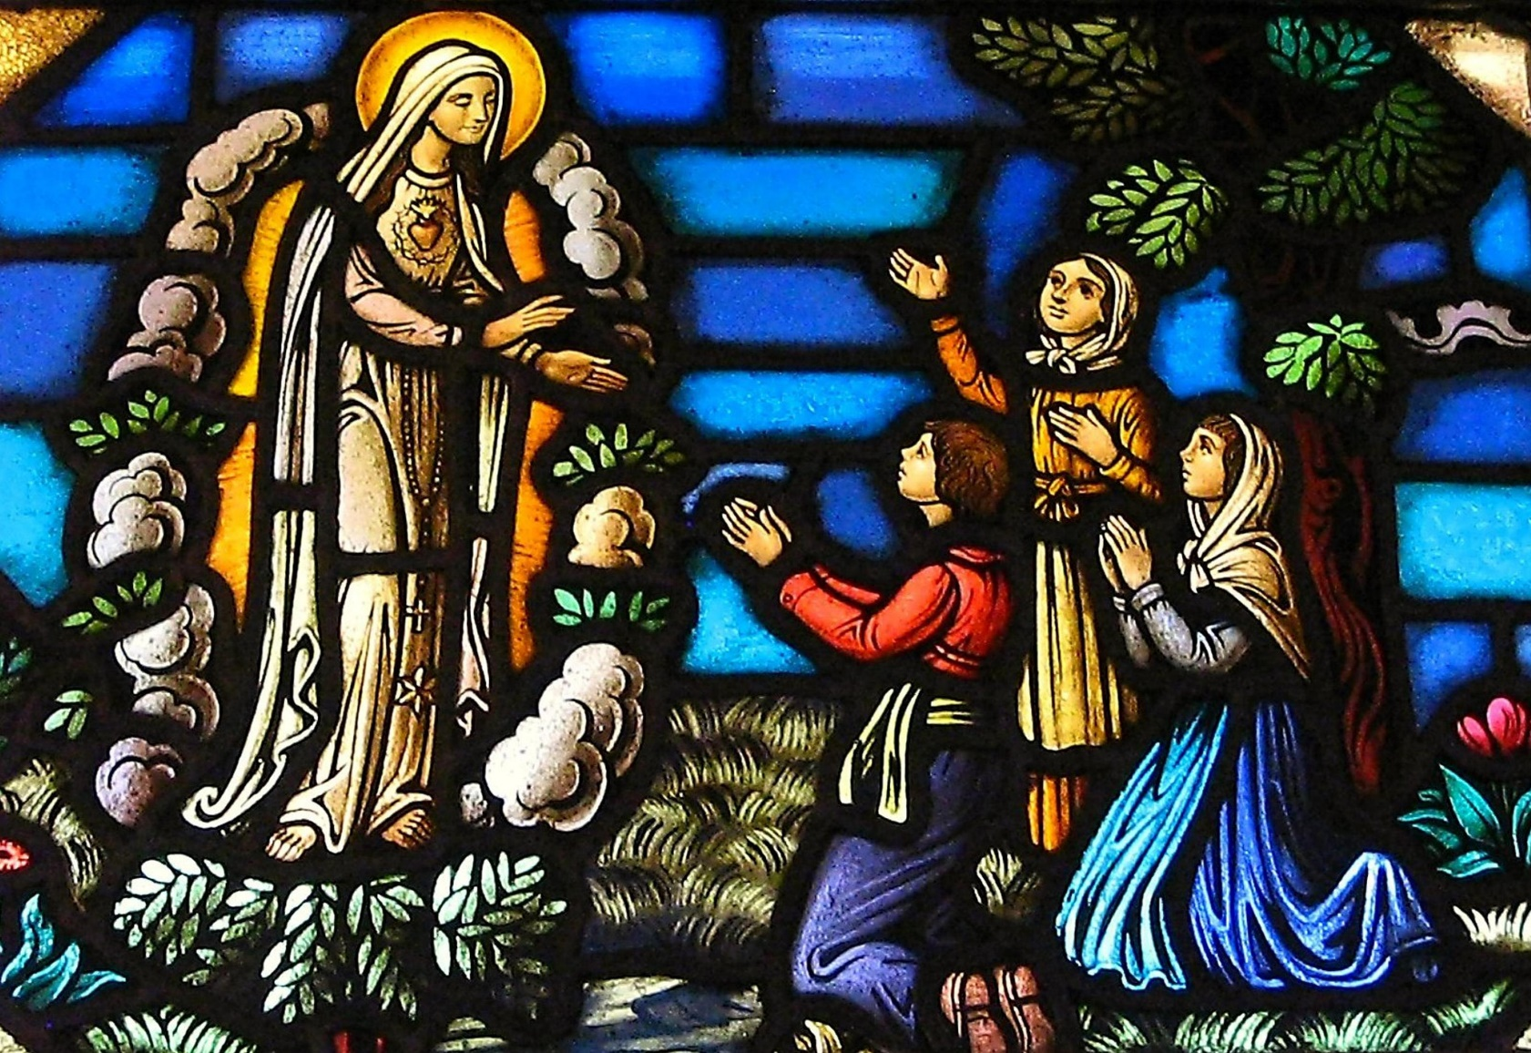
Feast Day of Our Lady of Fatima
On this feast we remember how, in 1917 during the First World War, Our Lady appeared to three children in Fatima, Portugal and asked them to join with her in praying for peace. This wonderful event reminds us how change is made through faith and prayer We encourage people everywhere to pray for peace throughout the world and peace in our own hearts.
13th May
BDES

Slide 6
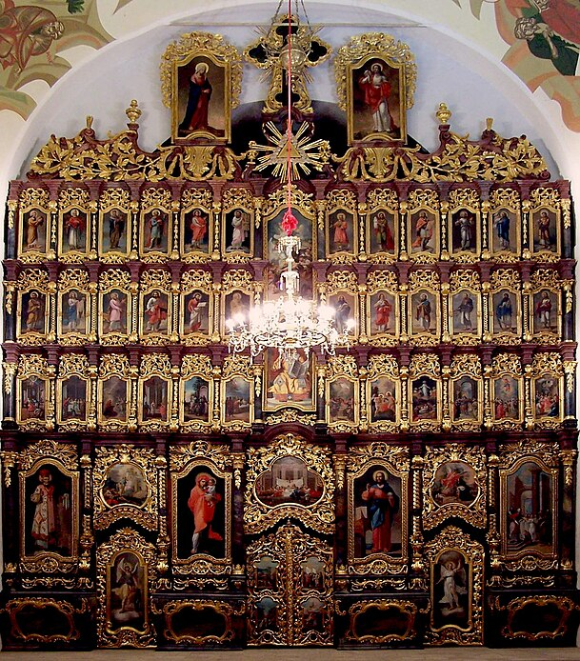
Rites of the Catholic Church # 5
THE HUNGARIAN CATHOLIC CHURCH
The Byzantine Catholic Church in Hungary uses the Hungarian language in its services. In 2015, Pope Francis named Bishop Peter Fülöp Kocsis as the new metropolitan archbishop of Debrecen and Bishop Atanáz Orosz as the new eparch of Miskolc. The Church has a gorgeous cathedral at Hajdúdorog which houses relics of St Stephen and has an impressive iconostasis; its ceiling frescos were renewed in 1989.
The Byzantine Rite
BDES

Slide 7
Walking the Path
~ Walking the Path of Hope ~
Monday 12th May 2025
Brentwood Diocese Education Service

