Slide 1
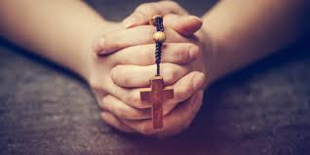
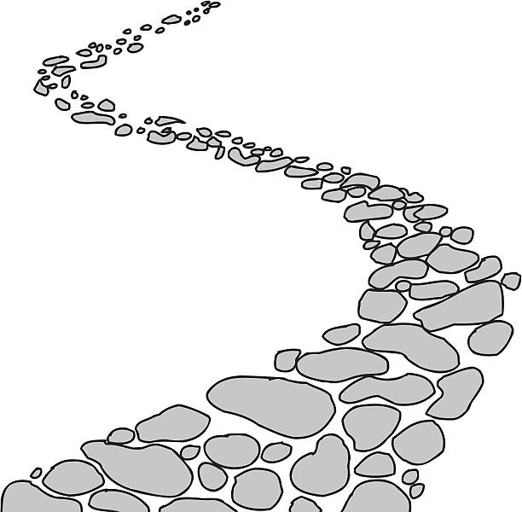

Walking the Path
~ Walking the Path of Hope ~
Monday 19th May 2025
Brentwood Diocese Education Service

Slide 2

Walking the Path of Hope
SALVATION
The saving grace won by Jesus is offered as a free gift to us, accessible through repentance, faith, and baptism.
We turn away from our sins, we are sorry for them, and we believe in Jesus Christ and the Gospel.
Repentance shows our willingness to turn from things that keep us from God, and baptism renews us, filling us with the grace necessary to have faith and to live it.
BDES

Slide 3

In Sunday’s Gospel Reading …
5th Sunday of Easter
Sunday 18th May 2025
In the Gospel of John, Jesus tells us to
“Love one another.”
BDES

Slide 4

Reflection
Holy Spirit, our inspiration, you remind us of our call to grow in faith and love. Help us to hear you in scripture,
to see Jesus in others,
and to be united as God’s global family.
Guide us on our journey as pilgrims of hope.
BDES

Slide 5

Preparing for World Youth Day 2027
“Hoping is waiting for salvation.”
- Pope Francis
BDES

Slide 6
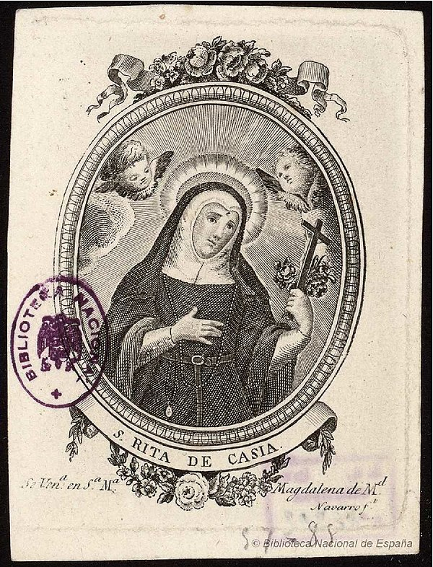
ST RITA OF CASCIA
Feast day : 22nd May
Rita was a widow who joined the Augustinian order as a nun after the death of her husband.
She was born in Italy in the 14th Century and was married to an Italian nobleman. She was married for eighteen years and after her husband was murdered Rita forgave his killers.
She then joined the order at the age of 36 and lived in prayer and piety until she died in her 70s.
She was canonised in 1900 and is the patron saint of lost and impossible causes, as well as of mothers.
BDES

Slide 7
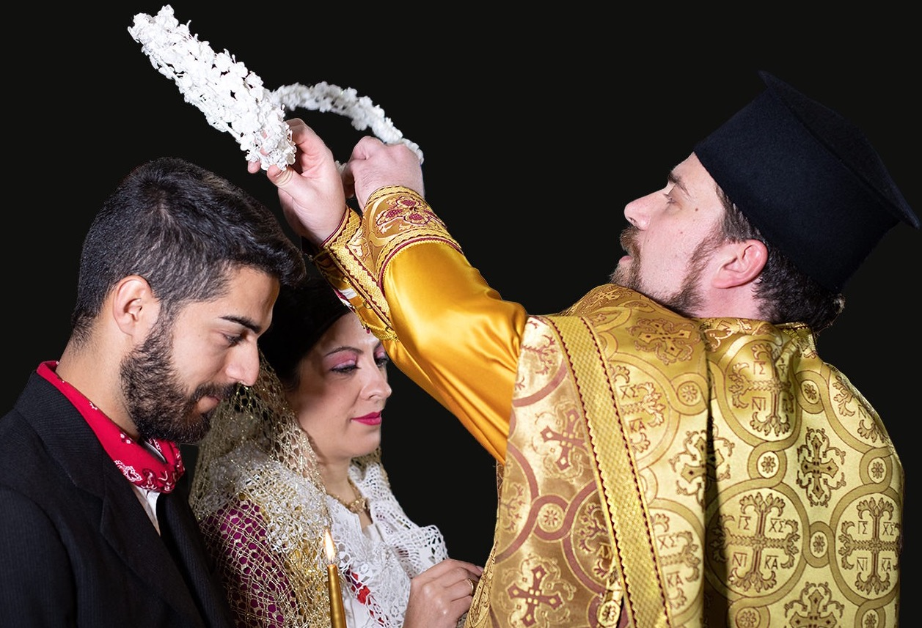
Rites of the Catholic Church # 5
ITALO-ALBANIAN CATHOLIC CHURCH
One of the 23 Eastern Catholic Churches, it uses Koine Greek and Albanian in its liturgy. Nowadays, most of the congregation live in Southern Italy and Sicily, as well as in Central Italy, where they are present only in the Monastery of Grottaferrata in the Lazio region. The Church also operates in North and South America. It has about 80,000 faithful and is led by two eparchs (bishops) and a territorial abbot.
The Byzantine Rite
BDES

Slide 8
Walking the Path
~ Walking the Path of Hope ~
Monday 19th May 2025
Brentwood Diocese Education Service

