Slide 1
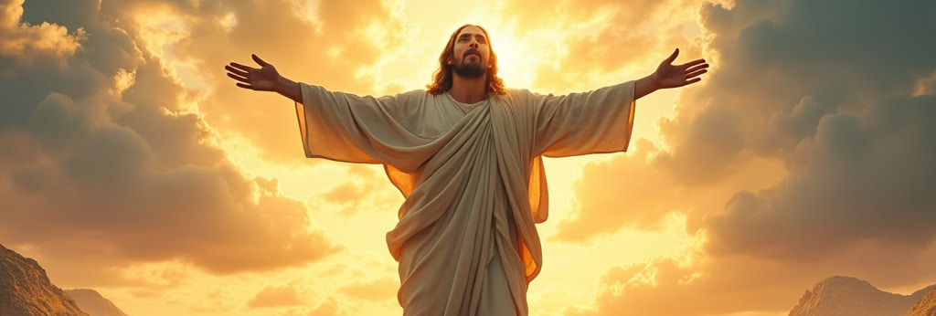


Walking the Path
~ Walking the Path of Hope ~
Monday 2nd June 2025
Brentwood Diocese Education Service

Slide 2
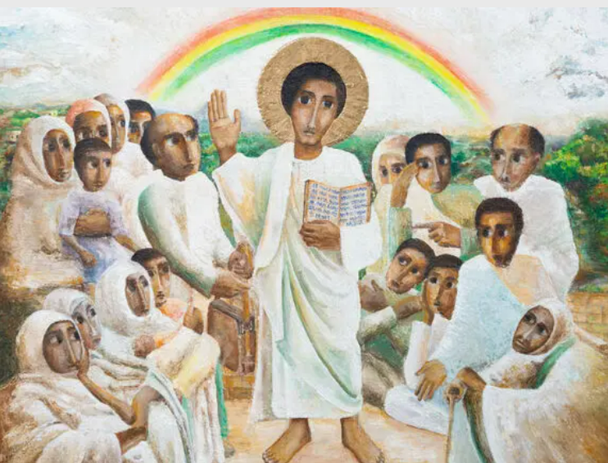
Reflection
“TRUMPETS HERALD CHANGE.”
- CAFOD Jubilee Prayer
BDES

Slide 3

In Sunday’s Gospel Reading …
7th SUNDAY OF EASTER
1st June 2025
In the Gospel of John,
Jesus says :
“May they be completely one.”
BDES

Slide 4

Preparing for World Youth Day 2027
“To hope is to welcome the gift that God gives us every day.”
- Pope Francis
BDES

Slide 5
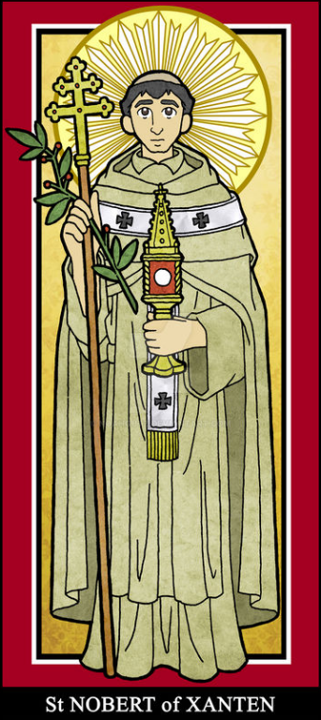
~ Saint Norbert : 6th June ~
Norbert of Xanten (1080 – 1134) was Archbishop of Magdeburg in Germany and founder of the Premonstratensian order, who until recently had a large presence in our diocese in Chelmsford.
Even after he was ordained as a deacon, Norbert was a bit of a pleasure seeker, but underwent a profound conversion after he was thrown from a horse when a bolt of lightning frightened the animal. Following this incident, he went to Xanten on the Rhine and lived a devout and penitent life.
He became an influential figure and founded his order at Prémontré in France, taking the Rule of St Augustine and the some of the customs of the Cistercians. Later, as archbishop, he supported the Pope against the German emperor. He was canonized by Pope xxxxxx Gregory XIII in 1582 and you can see his statue on the xxxxx colonnade of saints in St Peter’s Square in Rome.
BDES

Slide 6
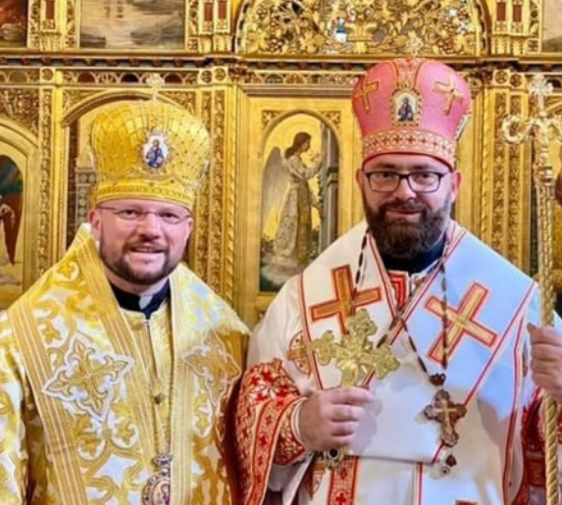
Rites of the Catholic Church # 5
THE CHURCH OF THE BYZANTINES OF THE DIOCESE OF KRIŽEVCI
The Eparchy of Križevci is a Greek Catholic Church in Croatia, Slovenia, and Bosnia and Herzegovina. Its cathedral is Holy Trinity in Križevci in Croatia and its current eparch is Bishop Milan Stipić. Its congregations are mainly Croats, but also Ukrainians and Rusyns and a small number of Serbs. Their liturgy uses the language known as Old Church Slavonic which his written in the Cyrillic alphabet.
The Byzantine Rite
BDES

Slide 7
Walking the Path
~ Walking the Path of Hope ~
Monday 2nd June 2025
Brentwood Diocese Education Service

