Slide 1
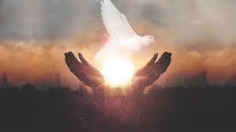
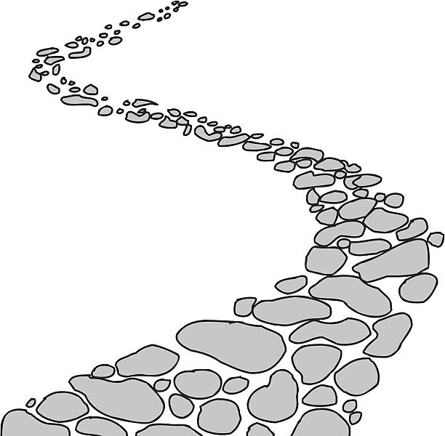

Walking the Path
~ Walking the Path of Hope ~
Monday 9th June 2025
Brentwood Diocese Education Service

Slide 2
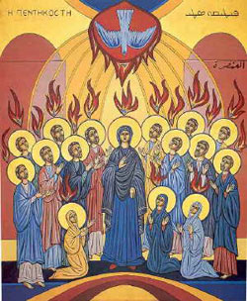
Walking the Path of Hope
Pentecost
Happy birthday to the Catholic Church!
Happy birthday to you, who are the body of the Church!
Pentecost is the Church’s birthday, and yours as well.
And like any birthday, it's a cause for celebration.
The word Pentecost is Greek and it means “50th day.”
Fifty days after Easter Sunday, we celebrate the coming of the Holy Spirit upon the Apostles and their followers, and the beginning of their earthly ministry to make disciples of all nations.
BDES

Slide 3
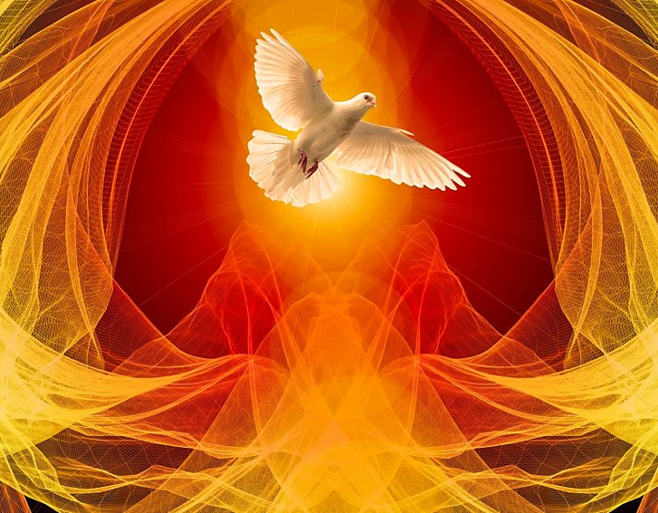
In Sunday’s Gospel Reading …
Pentecost Sunday
Sunday 8th June 2025
In the Gospel of John, Jesus says to His disciples :
“Receive the Holy Spirit.”
BDES

Slide 4

Reflection
Open our lives to the cry of the trumpet
sounding the birth of the new.
Guide us on our journey as pilgrims of hope.
BDES

Slide 5
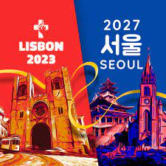
Preparing for World Youth Day 2027
“To hope is to savour the gift of being loved by God.”
- Pope Francis
BDES

Slide 6
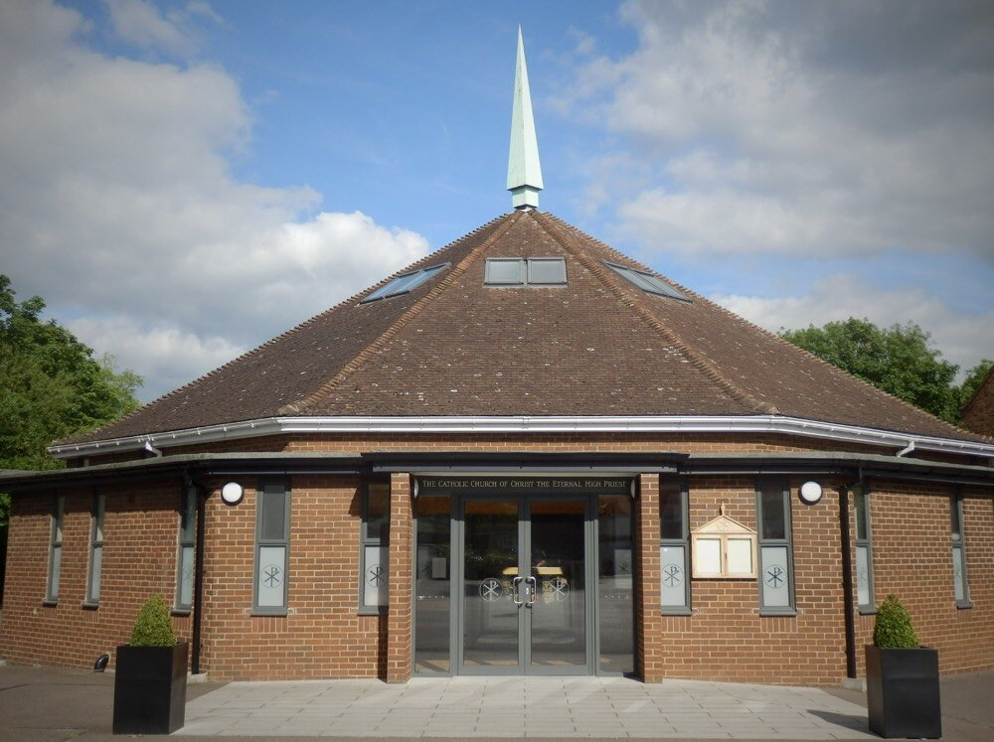
Christ the Eternal High Priest : 12th June
The Feast of Our Lord Jesus Christ, The Eternal High Priest, is a Roman Catholic moveable liturgical feast celebrated annually on the first Thursday after Pentecost. Approval for this feast was first granted by the Congregation for Divine Worship and the Discipline of the Sacraments in 1987.
There is a church with this dedication at Gidea Park in the diocese of Brentwood. It is one of a kind!
“Our church has a unique and very interesting dedication. We know of no other church with this title. The description ‘eternal high priest’ is given to Jesus in the New Testament in the Letter to the Hebrews”.
BDES

Slide 7
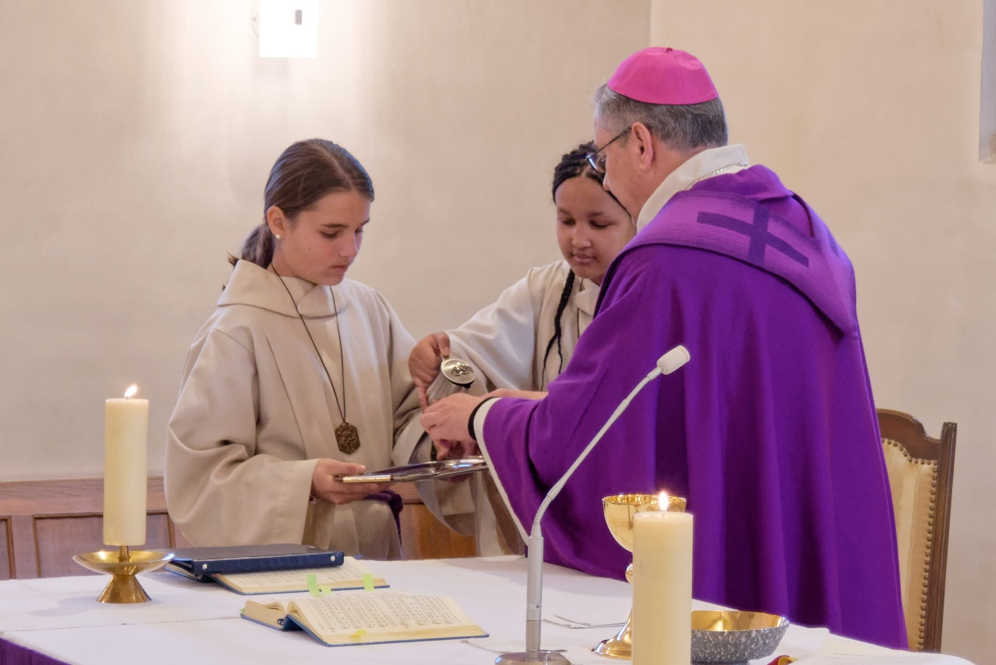
Rites of the Catholic Church # 5
THE MACEDONIAN CATHOLIC CHURCH
The Macedonian Catholic Church uses the Macedonian language in its liturgy. It has only one single eparchy (diocese), the Macedonian Catholic Eparchy of the Assumption of the Blessed Virgin Mary in Strumica-Skopje in North Macedonia. Since 2018 the Latin Church Bishop of Skopje, to give him his official title, has been the Right Reverend Dr. Kiro Stojanov (see left).
The Byzantine Rite
BDES

Slide 8
Walking the Path
~ Walking the Path of Hope ~
Monday 9th June 2025
Brentwood Diocese Education Service

