Slide 1

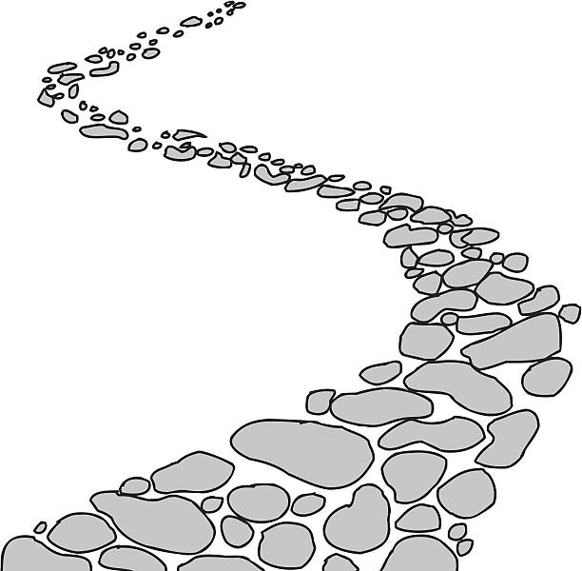

Walking the Path
~ Walking the Path of Hope ~
Monday 16th June 2025
Brentwood Diocese Education Service

Slide 2
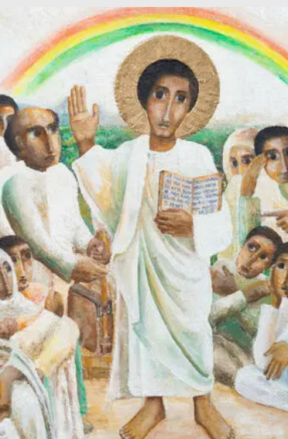
Reflection
“Open our minds to the blast of the trumpet
calling all slaves to break free.”
- CAFOD Jubilee Prayer
BDES

Slide 3
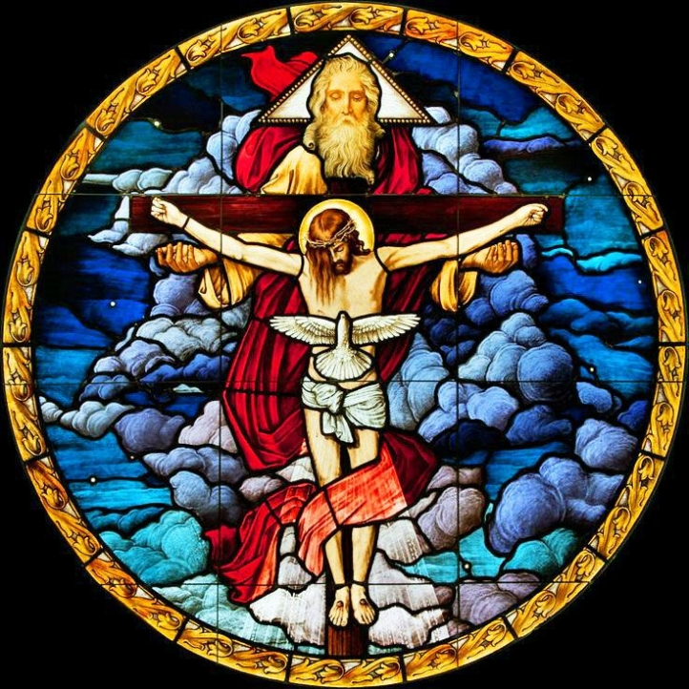
In Sunday’s Gospel Reading …
TRINITY SUNDAY
15th June 2025
In the Gospel of John,
Jesus says :
“Everything the Father has is mine.”
BDES

Slide 4

Preparing for World Youth Day 2027
“Hope is a task that Christians have a duty to cultivate.”
- Pope Francis
BDES

Slide 5
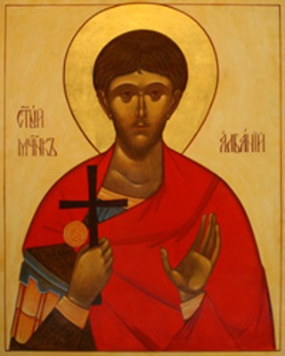
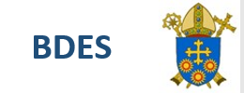
St Alban of Verulamium: Feast Day 20th June
Alban was a citizen of Verulamium – an important Roman city close to present-day St Albans. He took in a Christian priest, Amphibalus, fleeing the Roman persecution of Christians. The prayer and life of the priest so impressed Alban that he accepted the Christian faith.
When the Roman authorities discovered Amphibalus, Alban exchanged clothes with him and he escaped. Alban was brought before a judge, declared his Christian faith and though tortured, refused to sacrifice to the Roman gods. As a result he was sentenced to death, the first English martyr.
BDES
BDES

Slide 6
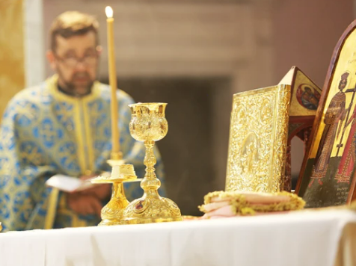
Rites of the Catholic Church # 5
THE ROMANIAN GREEK CATHOLIC CHURCH
Also known as the Romanian Church United with Rome, it uses the Byzantine liturgical rite in the Romanian language. Cardinal Lucian Mureşan, Archbishop of Făgăras and Alba Iulia, has been head of the Romanian Catholic Church since 1994; he is now 94 years old, and celebrated Mass with Pope Francis in 2019 when the Pope visited Romania to declared blessed seven martyred Romanian bishops.
The Byzantine Rite
BDES

Slide 7
Walking the Path
~ Walking the Path of Hope ~
Monday 16th June 2025
Brentwood Diocese Education Service

