Slide 1
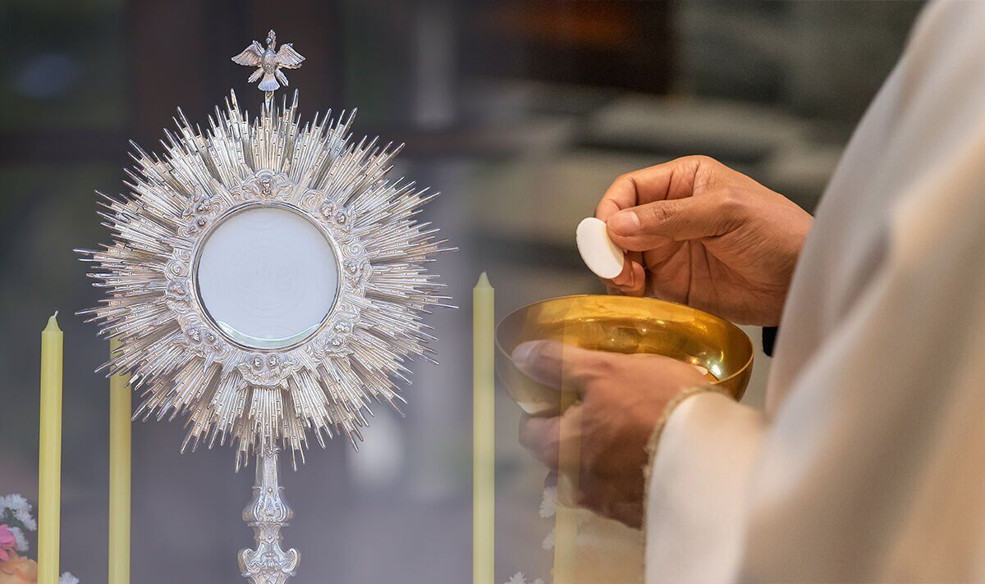


Walking the Path
~ Walking the Path of Hope ~
Monday 23rd June 2025
Brentwood Diocese Education Service

Slide 2
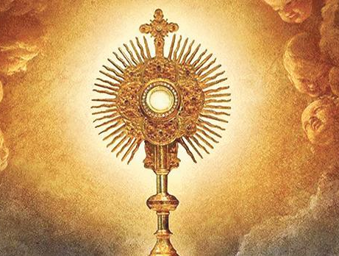
Walking the Path of Hope
The Feast of the Most Holy Body and Blood of Christ (Corpus Christi)
“Corpus Christi” is Latin for “Body of Christ”.
This feast is a celebration of the Last Supper,
where Jesus instituted the Eucharist.
It emphasizes the belief that the bread and wine
consecrated during Mass
become the actual body and blood of Christ.
One of the key features of the celebration
is the procession with the Eucharist,
where the consecrated host
is carried through the streets.
BDES

Slide 3
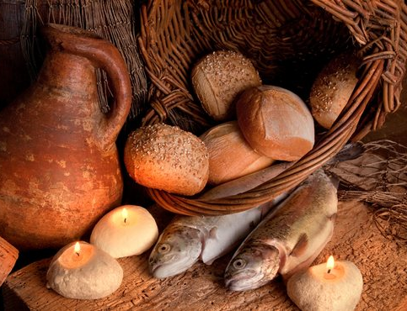
In Sunday’s Gospel Reading …
Pentecost Sunday
Sunday 22nd June 2025
In the Gospel of Luke, we hear how
“They all ate as much as they wanted.”
BDES

Slide 4

Reflection
Open our hands to take hold of the music,
breaking the shackles that bind.
Guide us on our journey as pilgrims of hope.
BDES

Slide 5

Preparing for World Youth Day 2027
“Lord, grant me to be faithful to you in hope!”
- Pope Francis
BDES

Slide 6
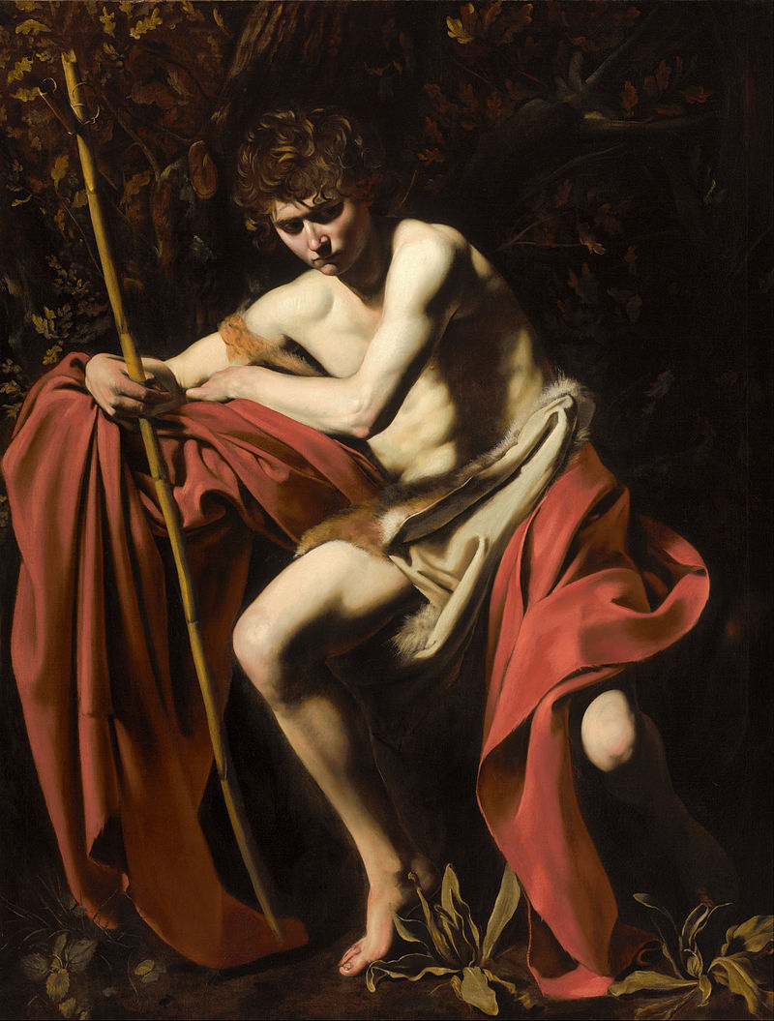
Feast of the Nativity of St John the Baptist
St John the Baptist was a preacher who fulfilled the prophecy of Isaiah. He was a voice crying in the wilderness.
The Gospel of Luke shows Mary visiting John’s mother Elizabeth and the child in her womb leapt for joy.
John spent his time preaching and baptising.
He was subsequently executed by beheading at the instruction of Herod.
23rd June
BDES

Slide 7
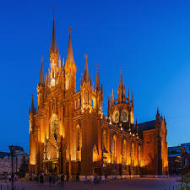
Rites of the Catholic Church # 5
THE RUSSIAN CATHOLIC CHURCH
The Russian Greek Catholic Church is also known as the Russian Byzantine Catholic Church. It is one of the Eastern Catholic Churches that are part of the worldwide Catholic Church. It follows the Byzantine Rite and maintains Russian church traditions and language. This church was established in 1905 and has its roots in a movement of Orthodox Christians who wanted to be in communion with the Pope while keeping their Byzantine traditions.
The Byzantine Rite
BDES

Slide 8
Walking the Path
~ Walking the Path of Hope ~
Monday 23rd June 2025
Brentwood Diocese Education Service

