Slide 1
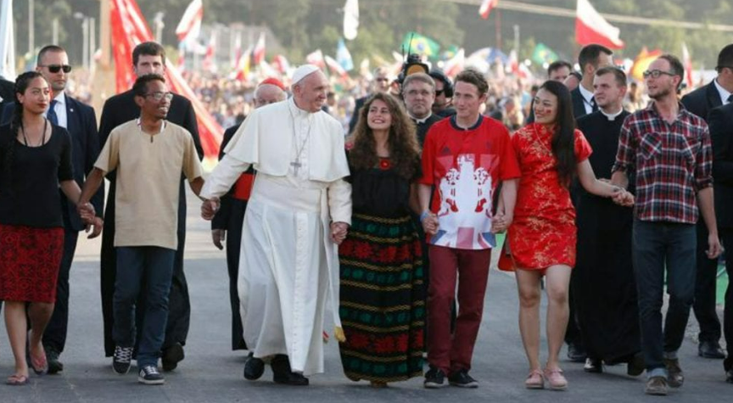


Walking the Path
~ Walking the Path of Hope ~
Monday 30th June 2025
Brentwood Diocese Education Service

Slide 2
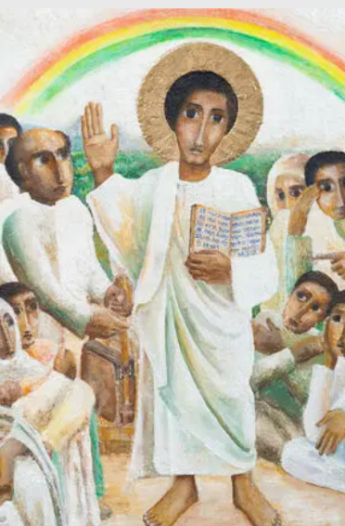
Reflection
“Open our hearts to the Jubilee promise
leading our actions and dreams.”
- CAFOD Jubilee Prayer
BDES

Slide 3
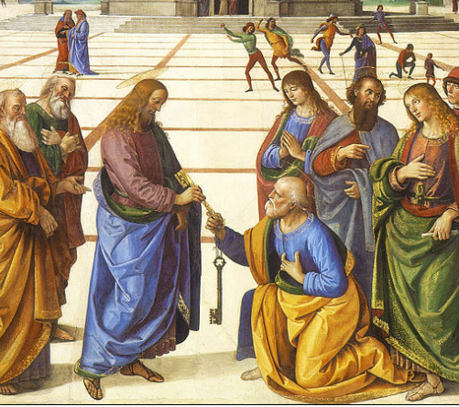
In Sunday’s Gospel Reading …
29th June 2025
In the Gospel of Matthew,
Jesus says to Peter :
“I will give you the keys of the kingdom of heaven.”
BDES

Slide 4

BDES

Slide 5

Preparing for World Youth Day 2027
“Reconciliation is an invincible sign of hope.”
- Pope Francis
BDES

Slide 6
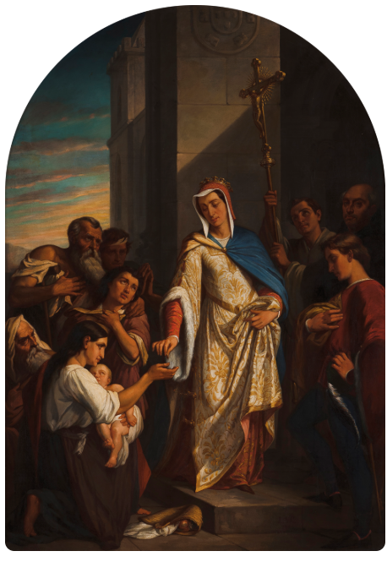
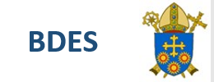
St Elizabeth of Portugal : Feast Day 4th July
Saint Elizabeth (1271 – 4th July 1336) was queen consort of Portugal and is venerated as a saint of the Catholic Church. Elizabeth showed an early enthusiasm for her faith, saying the full Divine Office daily, fasting and attending Mass twice a day.
After her marriage to King Denis of Portugal, Elizabeth showed her devotion to the poor and sick. As a widow, she retired to the monastery of the Poor Clare nuns, joining the Third Order of St. Francis and devoting the rest of her life to the poor and sick in obscurity.
BDES
BDES

Slide 7
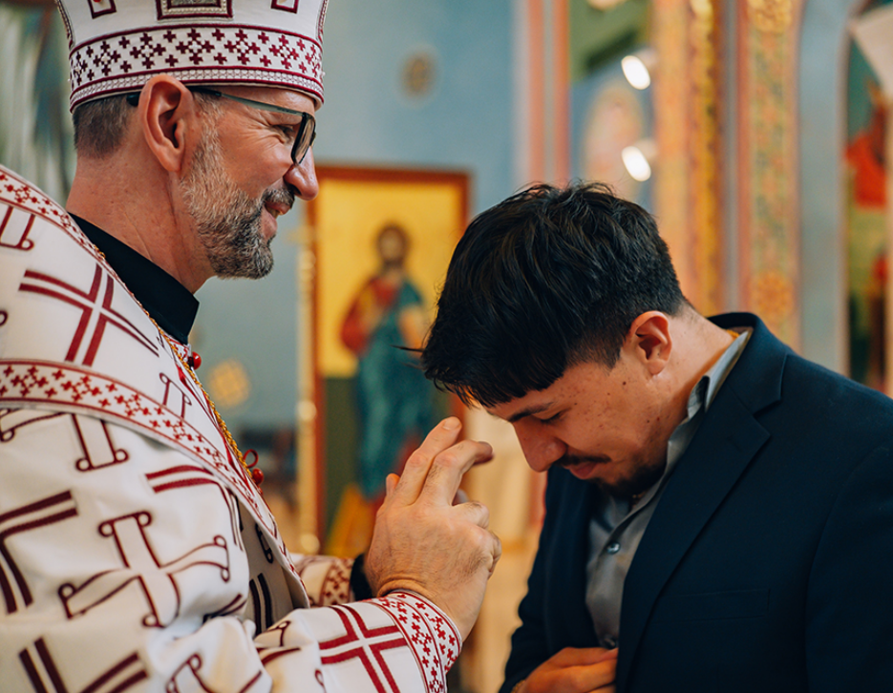
Rites of the Catholic Church # 5
THE RUTHENIAN CATHOLIC CHURCH
The picture shows the Bishop Artur Bubnevych of Holy Protection of Mary Byzantine Catholic Eparchy of Phoenix, Arizona. He was consecrated on 28th January this year; his eparchy (diocese) of the Ruthenian Greek Catholic Church has 19 parishes.
“I'm being carried by the grace of God and the prayers of the faithful,” he said; “I’m excited to start my ministry and to learn.”
The Byzantine Rite
BDES

Slide 8
Walking the Path
~ Walking the Path of Hope ~
Monday 30th June 2025
Brentwood Diocese Education Service

