Slide 1



Walking the Path
~ Walking the Path of Hope ~
Monday 7th July 2025
Brentwood Diocese Education Service

Slide 2

Walking the Path of Hope
Pope Francis told us that hope
“is an anchor that one hurls towards the future, it is what lets you pull on the line,
reach what you're aiming for and head in the right direction. Hope is also theological: God is there, too.”
We pray.
God of hope,
we cling to you,
for you renew the face of the earth.
Through the gift of your Son,
our Lord Jesus,
we follow you on the path of dawn.
Enlightened by your love and wisdom,
help us to lead each other
and all creatures
back to your open arms.
Amen.
BDES

Slide 3
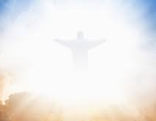
In Sunday’s Gospel Reading …
Sunday 6th July 2025
In the Gospel of Luke,
Jesus tells us :
“The Kingdom of God has come near to you.”
BDES

Slide 4

Reflection
In the holiness of the moment
be with us.
Guide us on our journey as pilgrims of hope.
BDES

Slide 5

Preparing for World Youth Day 2027
“Hope opens us to unimaginable horizons.”
- Pope Francis
BDES

Slide 6
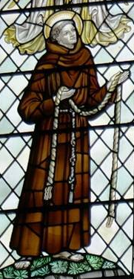
St John Jones Martyr: July 12th
John Jones O.F.M (c. 1530 - 12 July 1598)
During his lifetime he used a number of aliases including John Buckley, John Griffith, Godfrey Maurice, and Griffith Jones. He was a Franciscan priest and martyr who was born at Clynnog Fawr, Caernarfonshire (Gwynedd), Wales, and was executed on 12th July 1598 at Southwark, England.
His family had remained Catholic during the Reformation and he became a priest. In 1590 he went to France where at the age of 60 he became a Franciscan. From there he went to Rome and met Pope Clement VIII. His superiors sent him back to England, where he stayed at the house managed by St Anne Line. He was subsequently captured, imprisoned for two years, tortured and eventually executed.
He is one of the Forty Martyrs of England and Wales.
BDES

Slide 7
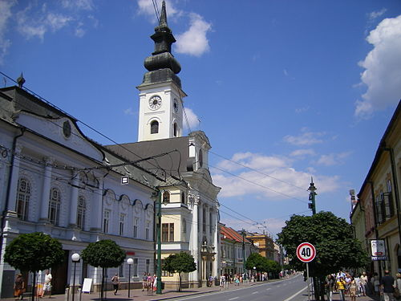
Rites of the Catholic Church # 5
THE SLOVAK CATHOLIC CHURCH
The Slovak Catholic Church includes both the Roman Catholic and Greek Catholic communities. The Slovak Greek Catholic Church is a specific Eastern Catholic Church within the larger Catholic Church.
It is also known as the Byzantine Catholic Church in Slovakia. It is in full communion with the Pope and uses the Byzantine Rite, with liturgical celebrations in Slovak and Church Slavonic.
It is organised as a single ecclesiastical province with one metropolitan see based in Prešov. The Slovak Greek Catholic Church has one archeparchy (equivalent to an archdiocese) and two eparchies (equivalent to dioceses).
The archeparchy is headed by Metropolitan Bishop Jonáš Maxim.
The Byzantine Rite
BDES

Slide 8
Walking the Path
~ Walking the Path of Hope ~
Monday 7th July 2025
Brentwood Diocese Education Service

